Slide 1


First steps with ChatGPT for Excel users

Slide 2
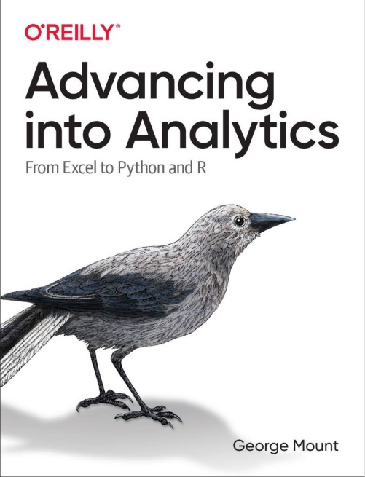
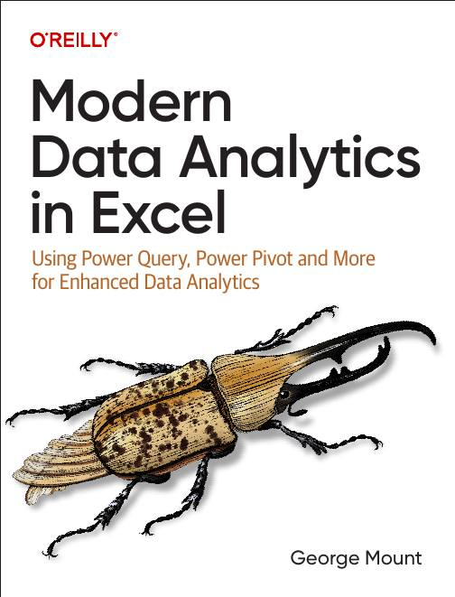



Hi, I’m George

Slide 3

Objectives for this session
Optimize data organization to enhance AI and ChatGPT performance in Excel.
Ensure data privacy and use AI responsibly.
Set clear objectives for AI solutions.
Leverage ChatGPT for debugging complex Excel formulas and improving efficiency.
Utilize AI for creating visualizations and extracting deeper data insights.
Showcase real-world examples of ChatGPT improving Excel workflows through hands-on demos.

Slide 4
Following along
Exercise workbook: intro-chatgpt-excel-start.xlsx

Slide 5
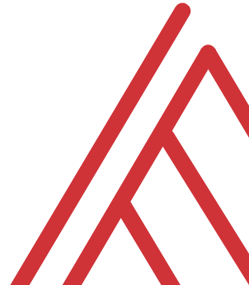
Questions?

Slide 6
Thank you

