Slide 1
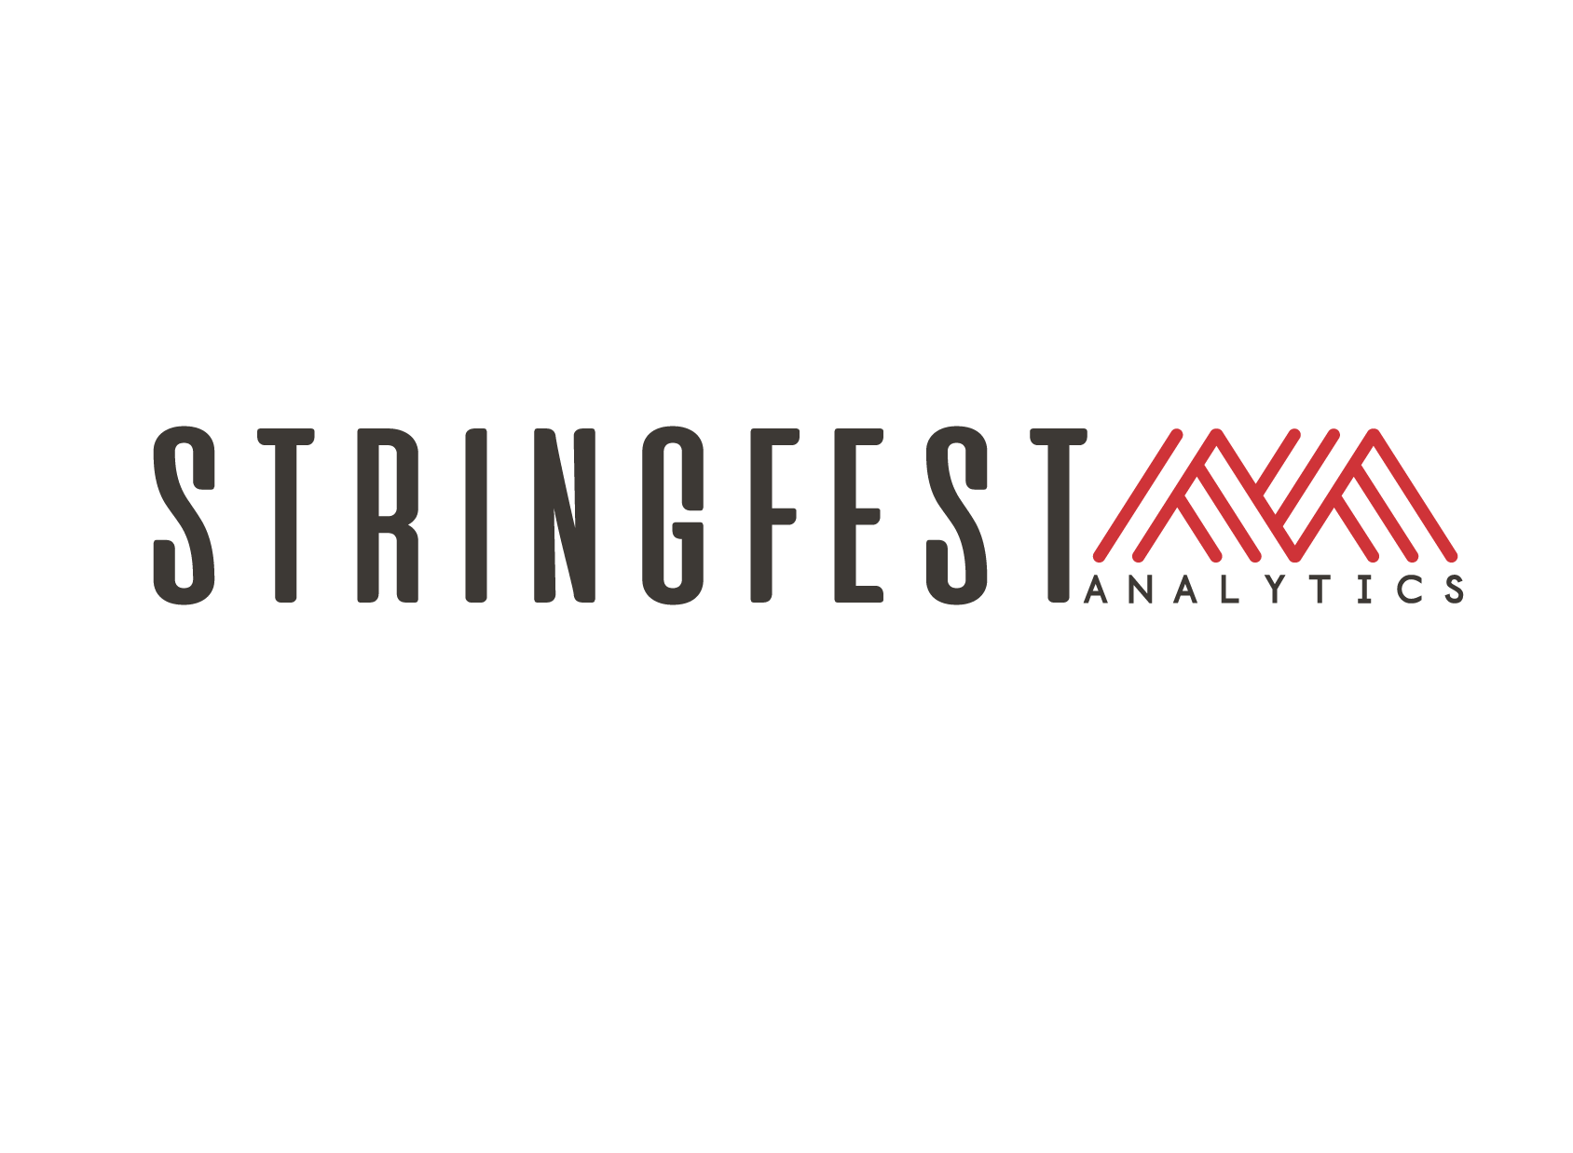

The Modern AI Excel Stack for Finance and Accounting Professionals

Slide 2
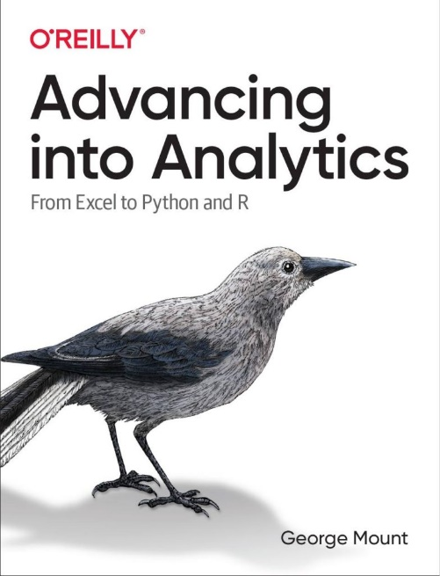
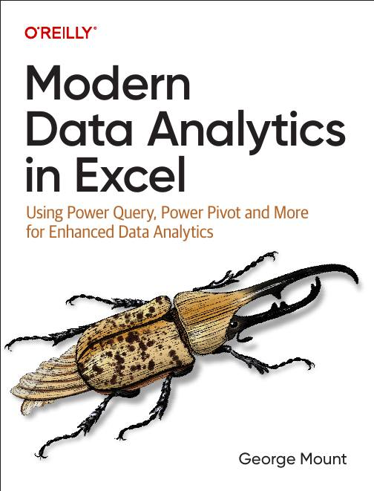

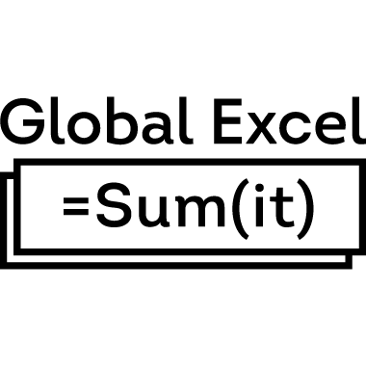


About me
I help Excel users move from fragile spreadsheets
to confident, scalable analysis.

Slide 3

Objectives for this session
Clean and prep data the modern, reliable way
Run forecasting and simulations in Python in Excel
Use Copilot for fast, defensible analysis
Understand where Scripts, Automate, and Agents actually fit
Build a practical modeling workflow you can use tomorrow

Slide 4
The AI sweet spot
AI is just another tool
AI will take my job
AI is useless

Slide 5


Slide 6
Auditable data cleaning with Power Query
Use Copilot to profile for dirty data
Build the reproducible pipeline with Power Query
Improve the documentation with Copilot
Worksheet: EquitySnapshot
Notes:
False!
Function, Formula, Function
Argument

Slide 7
Monte Carlo simulation with Copilot + Python
Specify parameters via natural language
Build the reproducible simulation with Python
Worksheet: EquitySnapshotClean
Notes:
False!
Function, Formula, Function
Argument

Slide 8
Agentic reasoning & analysis with Analyst Agent
Ask Agent Analyst to diagnose valuation patterns, outliers, and sector differences
Let the agent walk through its reasoning and show intermediate steps
Use its findings to draft a concise, defensible executive summary
Worksheet: EquitySnapshotPlus
Notes:
False!
Function, Formula, Function
Argument

Slide 9
Automated workflows with Office Scripts & Power Automate
Record an Office Script for a repetitive modeling step
Use Power Automate to trigger the script automatically on a schedule or event
Show how automation removes manual touchpoints without sacrificing control
Worksheet: EquitySnapshotPlus
Notes:
False!
Function, Formula, Function
Argument

Slide 10
AI-assisted workflows with Agent Mode
Use Agent Mode to coordinate multi-step tasks across sheets, tables, and tools
Let the agent combine formulas, charts, and explanations into one workflow
Review and approve its output to ensure accuracy and maintain auditability
Worksheet: EquitySnapshotPlus
Notes:
False!
Function, Formula, Function
Argument

Slide 12

Questions?

Slide 13
Thank you

