Slide 1

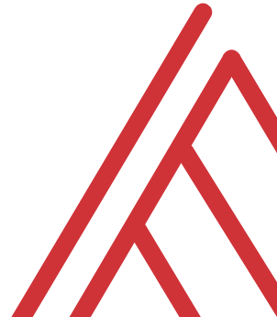

Building Financial and Accounting Data Models with Power Pivot

Slide 2
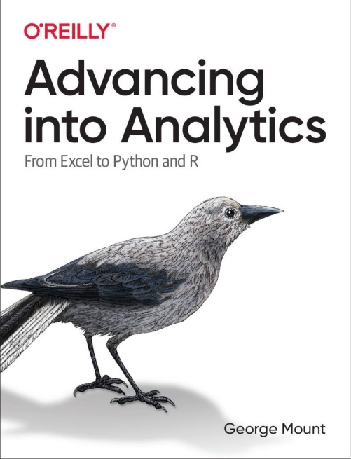
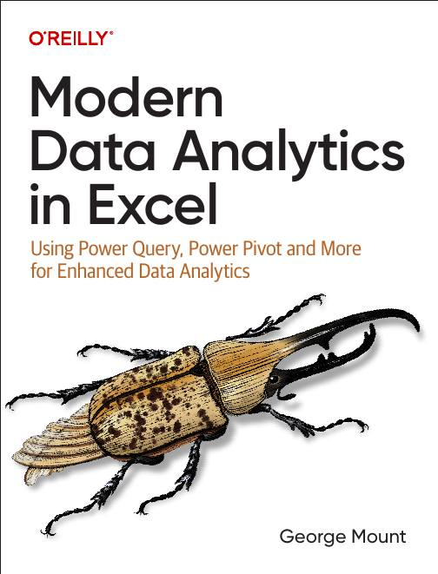

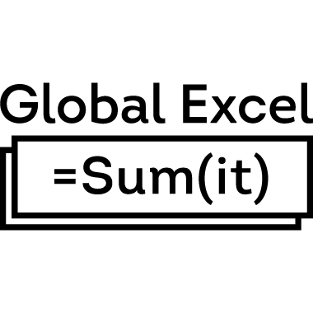


About me
I help Excel users move from fragile spreadsheets
to confident, scalable analysis.

Slide 3

Objectives for today
Understand the Power Pivot data model
Create basic table relationships
Write simple DAX measures and calculated columns
Build dynamic, model-driven PivotTable reports
Notes:
https://globalexcelsummit.com/product/modern-data-analytics-in-excel

Slide 4
Questions?

Slide 5
No more Frankentables
Starter files: data folder
What is the right way to analyze this data if we want to find total sales by person?
Open a blank workbook to start…
Final workbook: superstore-data-model.xlsx
Notes:
https://globalexcelsummit.com/product/modern-data-analytics-in-excel

Slide 6
Creating measures for data analysis
Creating measures with DAX
Implicit vs explicit measures
Continue with your Superstore data model
Notes:
https://globalexcelsummit.com/product/modern-data-analytics-in-excel

Slide 7
Time intelligence with Power Pivot and DAX
Adding a calendar table to enable consistent date-based calculations
Building year-to-date, year-over-year, and other time-intelligence measures with DAX
Notes:
https://globalexcelsummit.com/product/modern-data-analytics-in-excel

Slide 8
Questions?

Slide 9
THANK YOU

