Slide 1

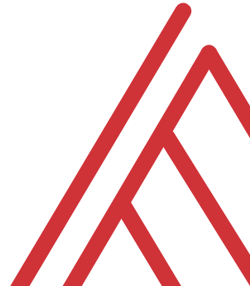

Streamlining Financial and Accounting Data Prep with Power Query

Slide 2






About me

Slide 3

Objectives for today
Import and combine key financial data sources
Clean and standardize data for analysis
Automate refreshable reporting workflows
Load into Excel or Power Pivot for insights
Notes:
https://globalexcelsummit.com/product/modern-data-analytics-in-excel

Slide 4
Questions?

Slide 5
Power Query as Excel’s ETL Tool

Slide 6







1. EXTRACT
2. TRANSFORM
3. LOAD
Notes:
https://globalexcelsummit.com/product/modern-data-analytics-in-excel

Slide 7
What did we do before Power Query?
File: wholesale-customers.xlsx
How would you make this data “PivotTable-ready?”
Notes:
https://globalexcelsummit.com/product/modern-data-analytics-in-excel

Slide 8
Data profiling
File: star.xlsx
Load into Power Query
Explore via Data Preview
Refer to demo notes
Notes:
https://globalexcelsummit.com/product/modern-data-analytics-in-excel

Slide 9
Demo: Manipulating rows
File: office-rsvps.xlsx
Common data quality issues
Blanks
Duplicates
Typos
Refresh workflow to repeat data cleaning steps
Notes:
https://globalexcelsummit.com/product/modern-data-analytics-in-excel

Slide 10
Demo: Unpivot
Let’s to back to wholesale-customers.xlsx
Now how can we prepare this for PivotTable analysis?

Slide 11
Questions?

Slide 12
THANK YOU

