Slide 1


Intro to using AI tools with Excel
or
AI in Excel for Finance: Past, Present, Future
George Mount
Stringfest Analytics

Slide 2
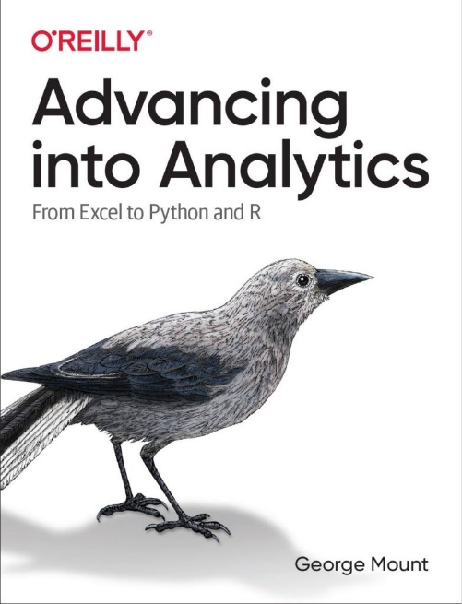
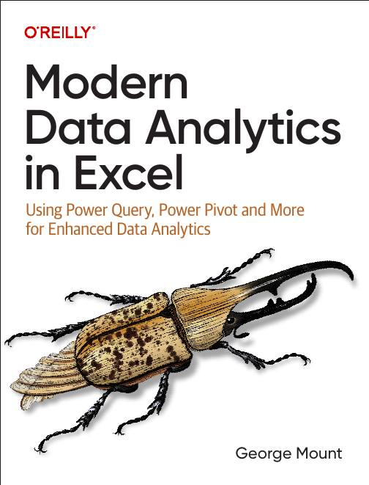




Hi, I’m George

Slide 3

Objectives for this session
Explore AI for Excel: Past, present, future….
Analyze Data and Power Query
Python in Excel and Copilot
Copilot for Finance and Virtual Agents

Slide 4

Following along
Download files: https://swiy.co/meonske

Slide 5
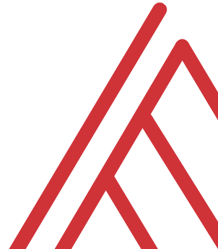
Questions?

Slide 6
AI for Excel past: Analyze Data

Slide 7
AI for Excel past: Analyze Data
Use natural language querying to get high-level summaries and visuals
Very limited intelligence outside of strict data analysis tasks
Data must be in easily machine-readable format (Power Query)…
File: ai-for-excel-past.xlsx
Notes:
False!
Function, Formula, Function
Argument

Slide 8
Questions?

Slide 9
AI for Excel present: Python/Copilot

Slide 10
AI for Excel present: Python/Copilot
Intelligent about a variety of tasks
Basic mathematical reasoning and financial functions
Works very well when problems are translated into code (Python)
File: ai-for-excel-present.xlsx
Notes:
False!
Function, Formula, Function
Argument

Slide 11
Questions?

Slide 12
AI for Excel future: Copilot for finance/Virtual agents

Slide 13
AI for Excel future: Copilot for finance/Virtual agents
AI systems designed to act autonomously or semi-autonomously on behalf of a user or system
Perform tasks, make decisions, or interact with environments based on predefined rules, learned behavior, or real-time input.
File: ai-for-excel-future.xlsx
Notes:
False!
Function, Formula, Function
Argument

Slide 14
Questions?

Slide 15

FREE DOWNLOAD!
“Modern Excel Playbook for Finance & Accounting”
stringfestanalytics.com/meonske

Slide 16
THANK YOU
linkedin.com/in/gjmount
george@stringfestanalytics.com

