Slide 1


Modern Data Analytics in Excel: Getting Started

Slide 2

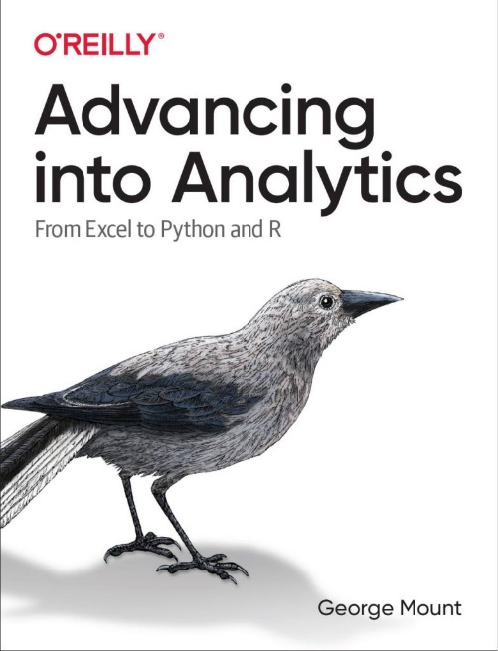
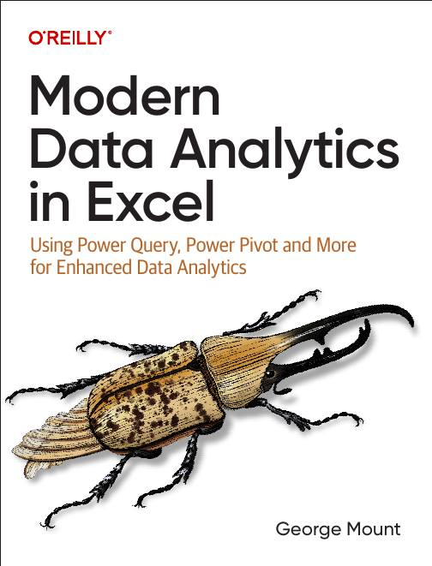



Hi, I’m George

Slide 3

Objectives for this session
Build a complete extract, transform, and load (ETL) workflow using Power Query
Create a relational data model with Power Pivot
Generate AI-powered insights with Analyze Data
Dataset: superstore.xlsx

Slide 4
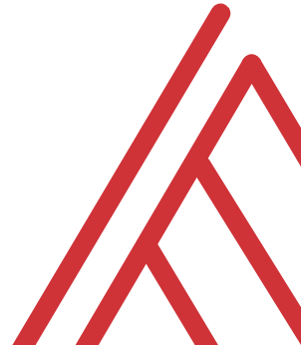
Questions?

Slide 5
Get more with the book
stringfestanalytics.com/maxl
Notes:
False!
Function, Formula, Function
Argument

Slide 6
Questions?

Slide 7
Thank you

