Slide 1
STRINGFEST ANALYTICS
Modern Excel Demo Day
America 250 Edition
Turning 220 years of U.S. census data into insights with modern Excel
George Mount • Friday, June 26, 2026 • 12:00–12:45 PM EDT

Slide 2
STRINGFEST ANALYTICS
I help Excel users move from
fragile spreadsheets
to confident, scalable
analysis.
George Mount — founder, Stringfest Analytics
Author • Trainer • Microsoft MVP

Slide 3
STRINGFEST ANALYTICS
What we're building today
A messy 2-page PDF → a refreshable model → a chart Excel can't natively draw
1
2
3
4
5
Power Query
AI on M Code
Dim + Pivot
Python in Excel
Refresh & reuse
Pull the PDF, combine pages, unpivot decades
Use a prompt to clean up auto-generated M
Add Census regions, build pivot + slicer
One PY cell, one chart Excel can't draw
Future data updates flow through automatically

Slide 4
STRINGFEST ANALYTICS
Why bother with all this?
The old way
The modern way
Copy/paste from the PDF every time data updates
Manual cleanup of "---" cells, footers, totals
Wide-format tables that break pivots
Charts limited to what's in the ribbon
Workbooks that break when anything changes
PDF → Power Query, refresh in one click
Cleanup steps recorded once and replayed
Long-format fact + dim tables, ready for analysis
Python in Excel for charts beyond the ribbon
AI as a sidekick, not a replacement

Slide 5
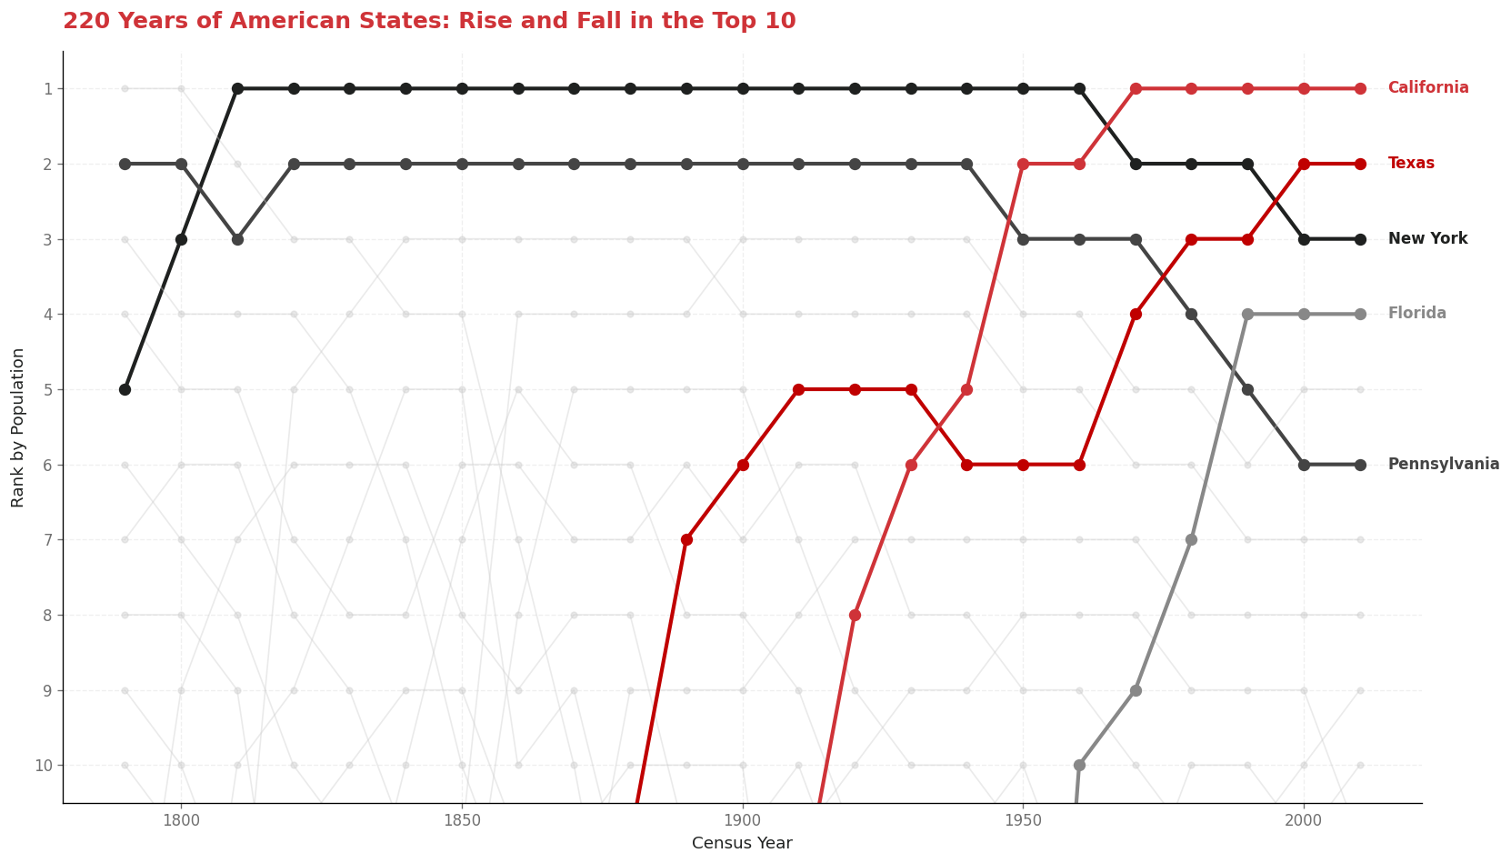
STRINGFEST ANALYTICS
220 years of America in one chart
State population rank, every decade — a chart Excel can't natively draw, built in one Python in Excel cell.

Slide 6
STRINGFEST ANALYTICS
Want the recording?
And every other Modern Excel session I've ever recorded.
Modern Excel + AI Subscription
Subscribe
First week free.
✓ First week free — try it out, see what's inside
✓ Cancel anytime
✓ Recording of today's session + full back catalog
✓ Sample files, templates, prompt libraries
Cancel anytime.
stringfestdata.gumroad.com
/l/mxlais
→ click this panel to subscribe

Slide 7
STRINGFEST ANALYTICS
Thank you.
Bring this workflow into your team.
Training, advisory, and custom workflows for organizations
that want to move beyond fragile spreadsheets.
stringfestanalytics.com
george@stringfestanalytics.com

