Slide 1


Modern Excel Demo Day

Slide 2
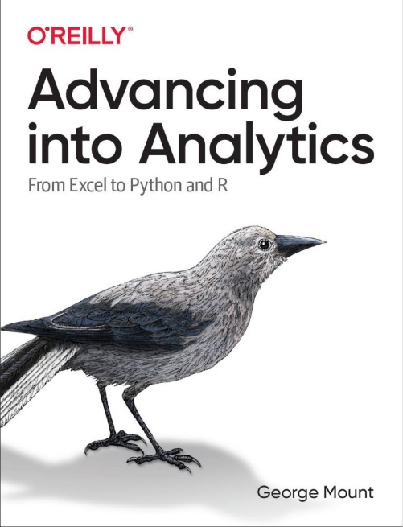
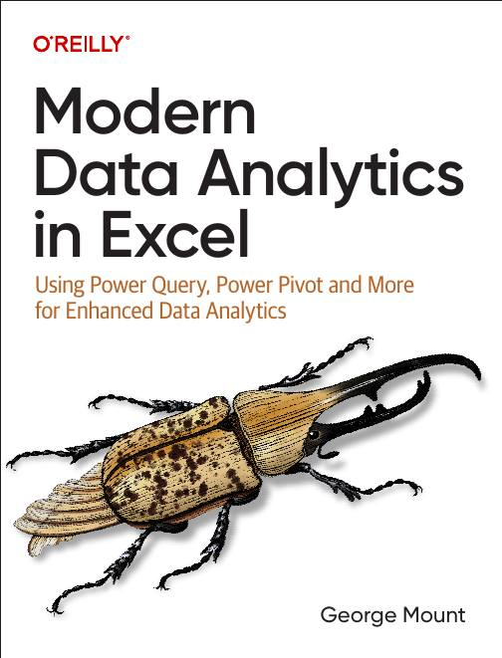




I help Excel users move from fragile spreadsheets
to confident, scalable analysis.

Slide 3

Objectives for today
Structure data reliably with Excel Tables
Generate insights quickly with Analyze Data
Automate data prep with Power Query

Slide 4
Quick Win #1: Reliable Data Inputs with Excel Tables
Problem: Manual range updates and formatting chaos
Demo: Transform ranges into smart Excel Tables
Result: Faster, cleaner spreadsheets
Notes:
So now you have a proper Excel Table. It auto-expands, it has structured references, it’s clean. But here’s what I want you to notice: this Table is still sitting by itself. What happens when you need to connect it to another dataset? Say you have a sales table AND a customer table, and you need to analyze them together. That’s where the Data Model comes in, and that’s where things get really powerful. We’re not going there today, but just know: what you just built is the foundation for something much bigger.

Slide 5
Quick Win #2: Analyze Data (AI in Excel… No Copilot Needed!)
Problem: Overwhelmed by large datasets
Demo: Get instant AI-powered insights from Excel’s Analyze Data
Result: Quick, actionable analysis… no formulas required
Notes:
Pretty cool, right? Analyze Data gave you instant charts and summaries with zero formulas. But I want to be upfront about something: this is great for quick exploration. It’s not great for repeatable analysis. Next week when your boss asks “can you run that same analysis on the new numbers?” you’re starting from scratch. There’s no saved workflow. That’s the gap between a quick insight and a reliable process — and it’s the gap most Excel users never close.

Slide 6
Quick Win #3: Power Query Data Cleanup
Problem: Repetitive, error-prone data prep
Demo: Automate data cleaning with Power Query
Result: Reliable, repeatable data workflows.. AND better analysis results!
Notes:
OK so now your data is clean and it refreshes automatically. Beautiful. But what would you do next? You’d probably load this into the Data Model, create a relationship with another table, build a PivotTable with DAX measures, maybe even bring Python in for a statistical breakdown. That’s the full pipeline — from messy raw data all the way to an insight your team can act on. We just did step one.
I’m not going to pretend steps two through five are simple enough for a demo. That’s the work I do with people in the Modern Excel AI Stack.

Slide 7
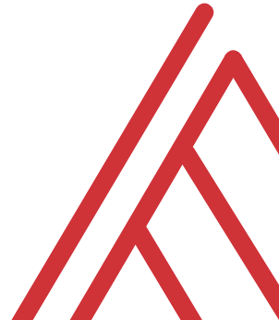
Questions?

Slide 8
What you saw vs. what’s left
Tables → but without a Data Model, still flat
Power Query → but one cleanup isn’t a pipeline
Analyze Data → but quick insights aren’t repeatable
Notes:
Those three things are genuinely useful and you can use them tomorrow. But I’d be doing you a disservice if I pretended that’s the whole story.
Tables give you structure — but a table sitting by itself is still flat. You can’t relate it to other data, you can’t build measures on top of it, you can’t answer questions that span multiple datasets. For that you need the Data Model, and most people never get there.
Power Query cleaned your data beautifully — once. But what happens next month when the source file changes format? Or when you need to merge five files instead of one? Or when someone asks why your numbers don’t match finance’s report? One cleanup is not a pipeline. A pipeline is something that runs reliably every time without you babysitting it.
Analyze Data gave you quick insights — but they’re gone the moment you close the pane. There’s no saved analysis. No audit trail. No way to hand it to a colleague and say “here, run this again next quarter.” Quick insights are great for exploration, but they’re not how you make decisions you can defend.
Each of these is step one of a longer process. And the gap between step one and a reliable workflow is where most people get stuck and give up.

Slide 9
Thank you!
Notes:
Thank you for spending this time with me. I hope you got something useful out of today.

