Slide 1


Modern Excel Demo Day

Slide 2
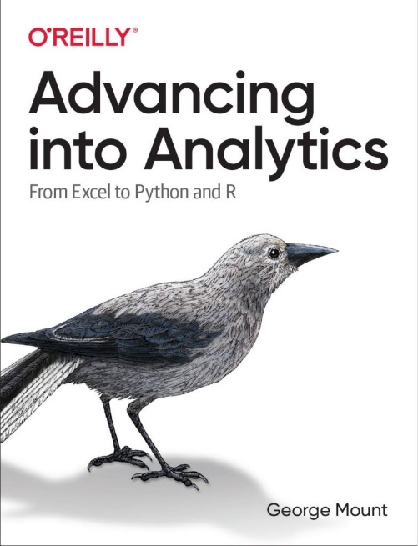
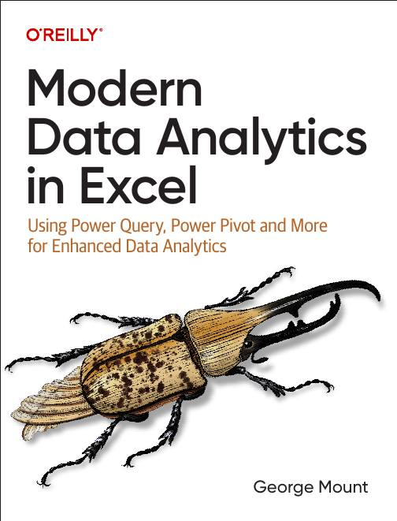




Hi, I’m George

Slide 3

Objectives for this session
Load and transform data in Power BI via Power Query
Create a relational data model with DAX measures
Fundamentals of building interactive reports and dashboards in Power BI

Slide 4
Loading, profiling and transforming data
Using Power Query in Power BI:
Read in workbook data
Profile, explore and transform the data via
Folder: 1-load-worksheet-to-power-bi
Notes:
False!
Function, Formula, Function
Argument

Slide 5
Load Excel data model to Power BI
Port a Power Pivot data model into Power BI
Strengths, weaknesses, limitations
Folder: 2-load-data-model-to-power-bi
Notes:
False!
Function, Formula, Function
Argument

Slide 6
Creating interactive dashboards and reports
Continue with penguins dataset
Creating interactive reports with Power BI
Slicers/Timelines
Cross filter functionality
Additional plot functionality vs Excel
Folder: 3-creating-interactive-visuals
Notes:
False!
Function, Formula, Function
Argument

Slide 7
Exercises
For all data since 1970:
Create stolen base percentage measure: SUM(SB) / (SUM(SB) + SUM(SC))
Compare SBP over time by league
Compare relationship between runs (R) and wins (W)
Add a timeline-based slicer to the report
Folder: 4-power-bi-challenge
Notes:
False!
Function, Formula, Function
Argument

Slide 8
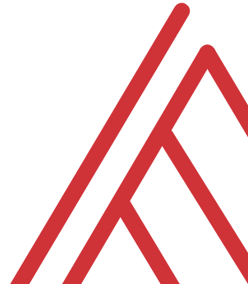
Questions?

Slide 9
Thank you

