Slide 1
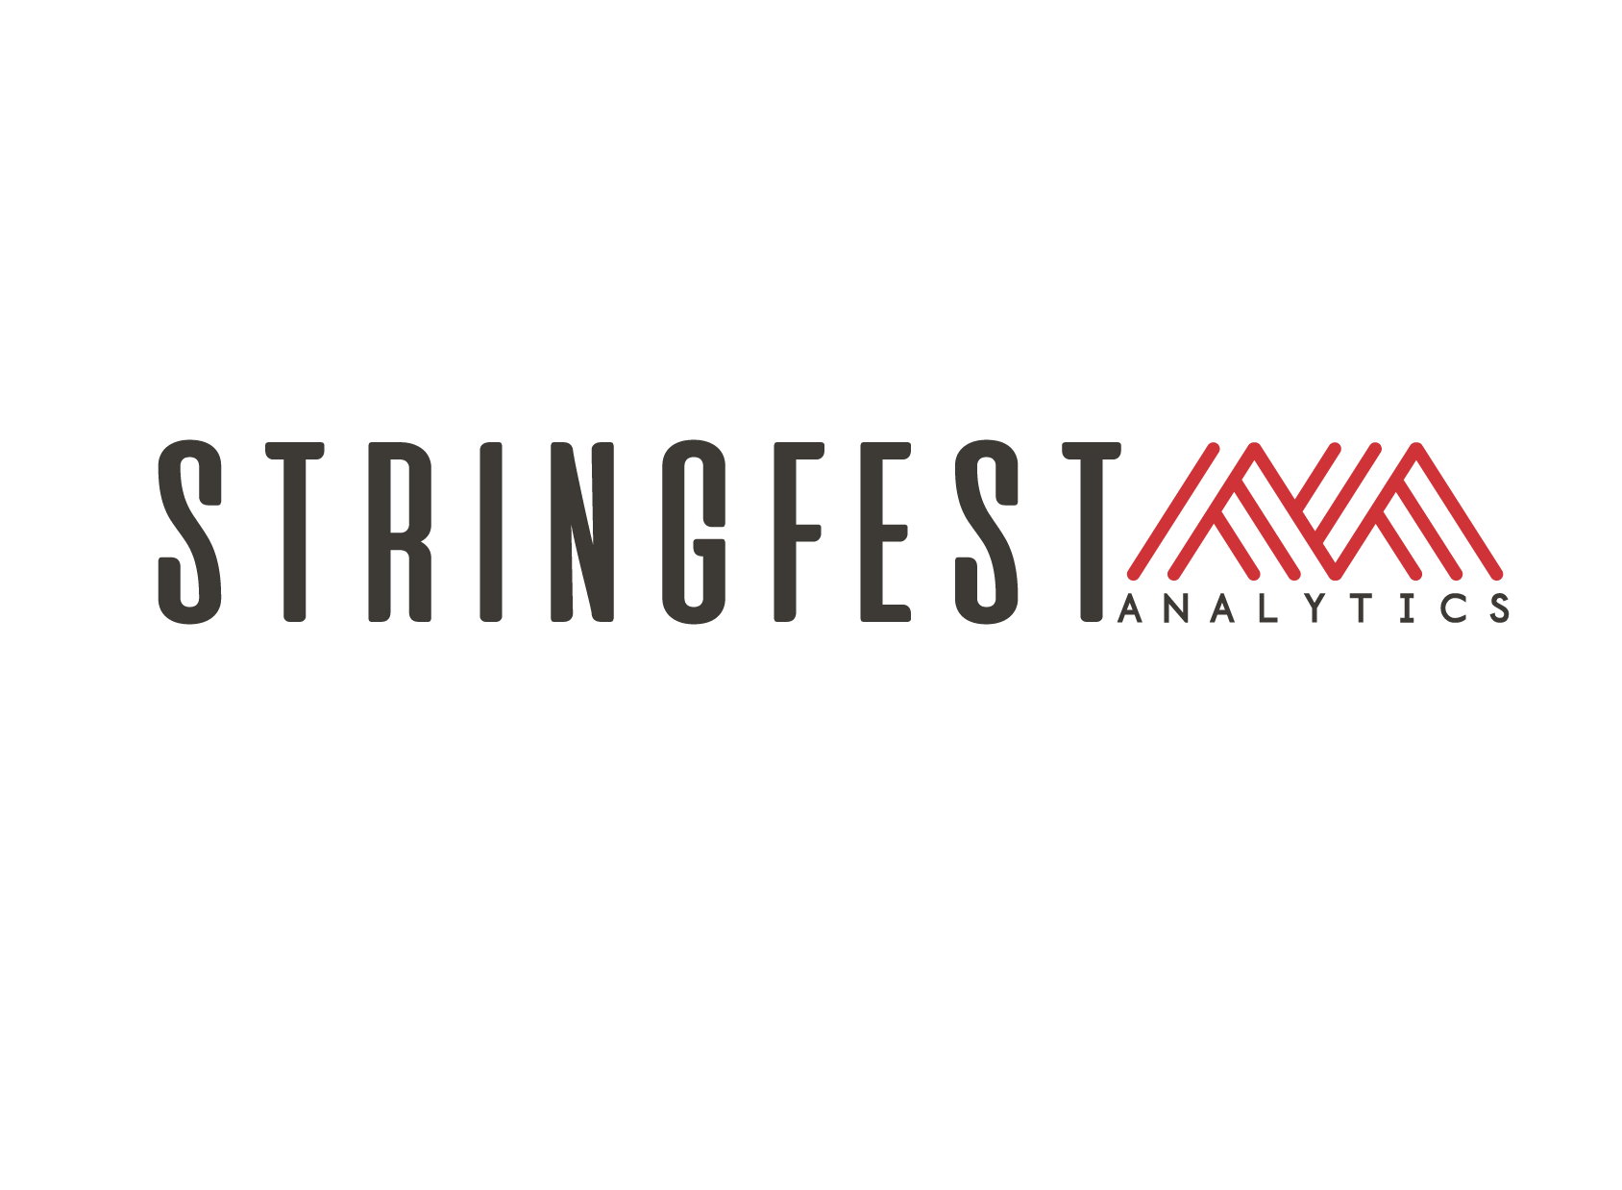

Modern Excel Demo Day
Notes:
https://chatgpt.com/g/g-p-68b1e2dc28d88191812a603bc1a380f7-business-ideas/c/68b1de87-3334-8325-abed-6f68db39c77a

Slide 2
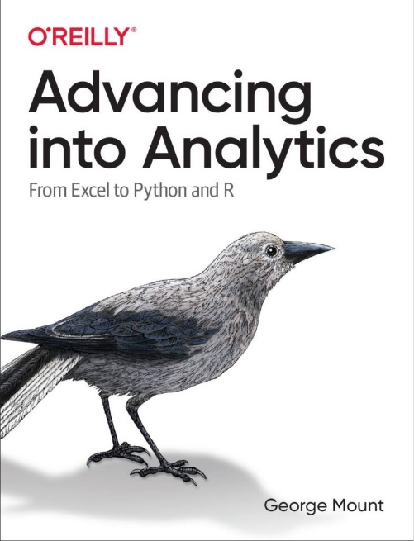
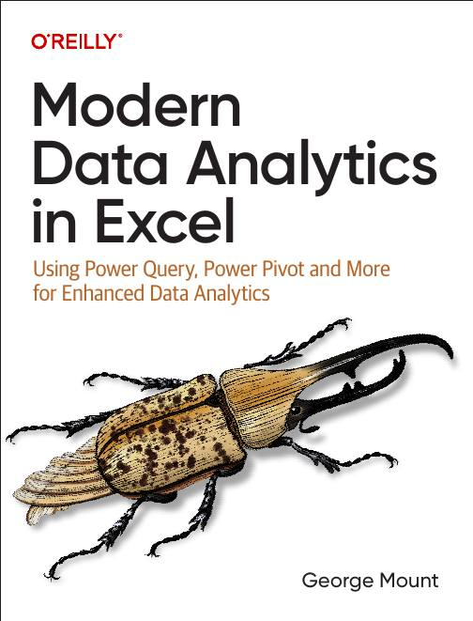




Hi, I’m George

Slide 3

What to expect today
Practical Excel demos
Transparent look at my services and offerings
Referral program & bonus resources

Slide 4
Resources for today
Download at https://swiy.co/mxldd

Slide 5
Quick Win #2: Power Query Data Cleanup
Problem: Manual range updates and formatting chaos
Demo: Transform ranges into smart Excel Tables
Result: Faster, cleaner spreadsheets
Notes:
False!
Function, Formula, Function
Argument

Slide 6
Quick Win #2: Power Query Data Cleanup
Problem: Repetitive, error-prone data prep
Demo: Automate data cleaning with Power Query
Result: Reliable, repeatable data workflows
Notes:
False!
Function, Formula, Function
Argument

Slide 7
Quick Win #3: Analyze Data (Excel AI)
Problem: Overwhelmed by large datasets
Demo: Get instant AI-powered insights from Excel’s Analyze Data
Result: Quick, actionable analysis… no formulas required
Notes:
False!
Function, Formula, Function
Argument

Slide 8
Recap
Tables → Structured efficiency
Power Query → Automated data prep
Analyze Data → Instant insights

Slide 9
My offerings at a glance

Slide 10
Free!
Blog: stringfestanalytics.com
Newsletter: Subscribe at blog!
LinkedIn: Follow for daily(ish) free resources

Slide 11
Books & Online Courses
2 books (O’Reilly Media)
LinkedIn Learning Courses
Quick-win video courses on Gumroad

Slide 12
How my services work
Interactive, tailored workshops
Built around your team’s actual data & workflow challenges
Focused on repeatable methods, clear outcomes
Notes:
When teams bring me in for training, it’s not just another off-the-shelf Excel course. My workshops are highly interactive. Participants aren’t just listening, they’re actively working with actual datasets and real-world scenarios.
Everything we cover is tailored specifically to your team’s daily workflow and the data challenges you actually face. By using real scenarios rather than generic examples, the techniques and solutions immediately make sense.
Most importantly, my goal is always repeatability. I don’t want your team to walk away just impressed—I want them empowered. They'll leave our sessions with clear, practical methods they can apply again and again, long after our engagement ends."

Slide 13
Three tiers of engagement

Slide 14
Tier 1: Essentials Training
1-day focused Excel sessions (Tables, Power Query, Excel AI)
Immediate productivity boost
Notes:
Tier 1 Essentials Training is perfect for teams who need a quick productivity boost. These one-day sessions are tightly focused around specific Excel tools—whether that's mastering Excel Tables for better data structure, using Power Query to automate repetitive data-cleaning tasks, or tapping into Excel's built-in AI capabilities for instant insights.
Teams come out of these sessions with concrete, practical skills that immediately speed up their daily workflow.

Slide 15
Tier 2: Team Enablement
2-day comprehensive Modern Analytics in Excel workshop
Hands-on workflow training
Notes:
Tier 2 is ideal if you're ready to level up your team's analytical capabilities. In this comprehensive two-day workshop, participants learn how to build robust, repeatable data workflows using Modern Excel tools like Power Query, Power Pivot, dynamic arrays, and Excel AI features.
Unlike shorter sessions, this workshop allows time for hands-on, practical exercises using your team's actual data, ensuring everyone leaves confident and capable. The result isn't just productivity—it's a significant leap forward in your team's analytics maturity.

Slide 16
Tier 3: Learning Paths Advisory
Competency frameworks tailored to your organization
Customized learning pathways for 3–5 learner personas
Audit of existing training resources for optimized data literacy
Notes:
Tier 3 is my most strategic offering. With the Learning Paths Advisory, we take a high-level, customized approach to developing data skills across your organization. We'll start by building competency frameworks tailored specifically to your business goals and industry standards, clearly outlining what data literacy and analytics maturity look like at every level of your organization.
From there, I'll design detailed learning pathways for 3–5 unique learner personas—mapping exactly which skills, training modules, and assessments each type of role or employee needs to succeed.
Finally, we’ll audit your existing training resources to determine how best to integrate and leverage what you already have, ensuring your learning initiatives are both efficient and effective

Slide 17
Referrals

Slide 18
Why referrals matter
Most of my best projects come from referrals
Your introductions help my business and your network

Slide 19
Referral program (digital rewards)
Introduce someone who books a discovery call…. One free Gumroad asset
They become a client…. Complete access to my Gumroad library AND a copy of one of my books!

Slide 20
Attendee freebie
Modern Excel Starter Kit PDF
Introduction, learning strategies, additional resources to master Modern Excel
Available in the event downloads folder

Slide 21
Next steps
Book a discovery call
Follow me on LinkedIn
Share this event with your network

Slide 22
Thank you!

Slide 23
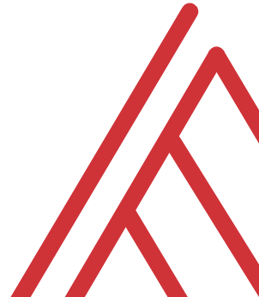
Questions?

