Slide 1
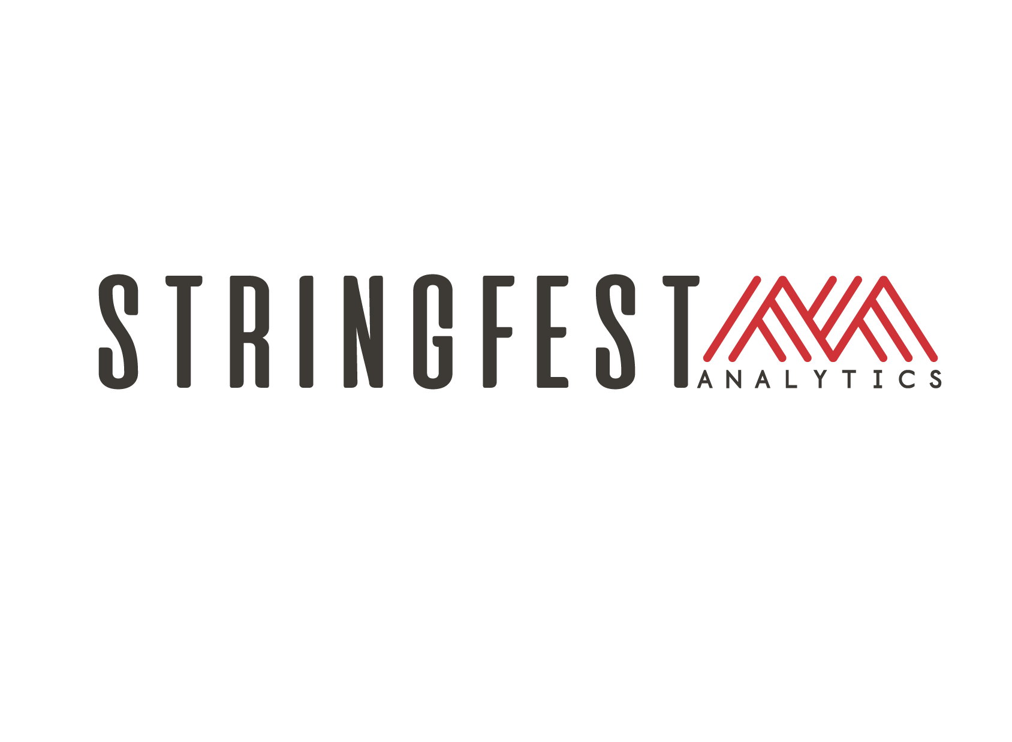

Modern Excel Demo Day

Slide 2
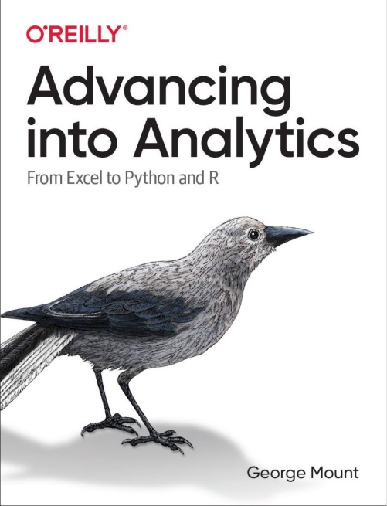
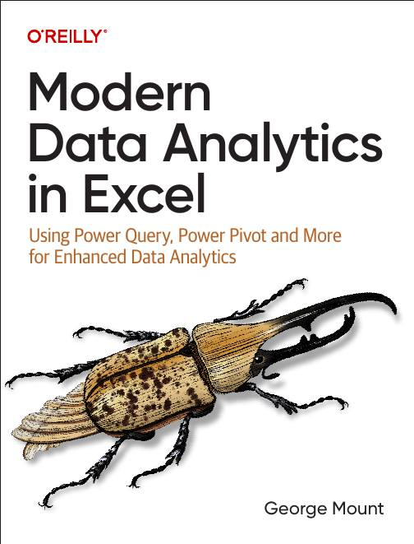




I help Excel users move from fragile spreadsheets
to confident, scalable analysis.

Slide 3

What to expect today
Practical Excel demos
Transparent look at my services and offerings
Bonus resources

Slide 4
Resources for today
Download at https://swiy.co/mxldd

Slide 5
Quick Win #1: Reliable Data Inputs with Excel Tables
Problem: Manual range updates and formatting chaos
Demo: Transform ranges into smart Excel Tables
Result: Faster, cleaner spreadsheets
Notes:
So now you have a proper Excel Table. It auto-expands, it has structured references, it’s clean. But here’s what I want you to notice: this Table is still sitting by itself. What happens when you need to connect it to another dataset? Say you have a sales table AND a customer table, and you need to analyze them together. That’s where the Data Model comes in, and that’s where things get really powerful. We’re not going there today, but just know: what you just built is the foundation for something much bigger.

Slide 6
Quick Win #2: Analyze Data (AI in Excel… No Copilot Needed!)
Problem: Overwhelmed by large datasets
Demo: Get instant AI-powered insights from Excel’s Analyze Data
Result: Quick, actionable analysis… no formulas required
Notes:
Pretty cool, right? Analyze Data gave you instant charts and summaries with zero formulas. But I want to be upfront about something: this is great for quick exploration. It’s not great for repeatable analysis. Next week when your boss asks “can you run that same analysis on the new numbers?” you’re starting from scratch. There’s no saved workflow. That’s the gap between a quick insight and a reliable process — and it’s the gap most Excel users never close.

Slide 7
Quick Win #3: Power Query Data Cleanup
Problem: Repetitive, error-prone data prep
Demo: Automate data cleaning with Power Query
Result: Reliable, repeatable data workflows.. AND better analysis results!
Notes:
OK so now your data is clean and it refreshes automatically. Beautiful. But what would you do next? You’d probably load this into the Data Model, create a relationship with another table, build a PivotTable with DAX measures, maybe even bring Python in for a statistical breakdown. That’s the full pipeline — from messy raw data all the way to an insight your team can act on. We just did step one.
I’m not going to pretend steps two through five are simple enough for a demo. That’s the work I do with people in the Modern Excel AI Stack.

Slide 8
What you saw vs. what’s left
Tables → but without a Data Model, still flat
Power Query → but one cleanup isn’t a pipeline
Analyze Data → but quick insights aren’t repeatable
Notes:
Those three things are genuinely useful and you can use them tomorrow. But I’d be doing you a disservice if I pretended that’s the whole story.
Tables give you structure — but a table sitting by itself is still flat. You can’t relate it to other data, you can’t build measures on top of it, you can’t answer questions that span multiple datasets. For that you need the Data Model, and most people never get there.
Power Query cleaned your data beautifully — once. But what happens next month when the source file changes format? Or when you need to merge five files instead of one? Or when someone asks why your numbers don’t match finance’s report? One cleanup is not a pipeline. A pipeline is something that runs reliably every time without you babysitting it.
Analyze Data gave you quick insights — but they’re gone the moment you close the pane. There’s no saved analysis. No audit trail. No way to hand it to a colleague and say “here, run this again next quarter.” Quick insights are great for exploration, but they’re not how you make decisions you can defend.
Each of these is step one of a longer process. And the gap between step one and a reliable workflow is where most people get stuck and give up.

Slide 9
My offerings at a glance
Notes:
I want to give you a clear picture of everything I offer so you can decide what’s right for you. I’m not going to be coy about the fact that I have paid offerings. I think you deserve to know what exists.

Slide 10
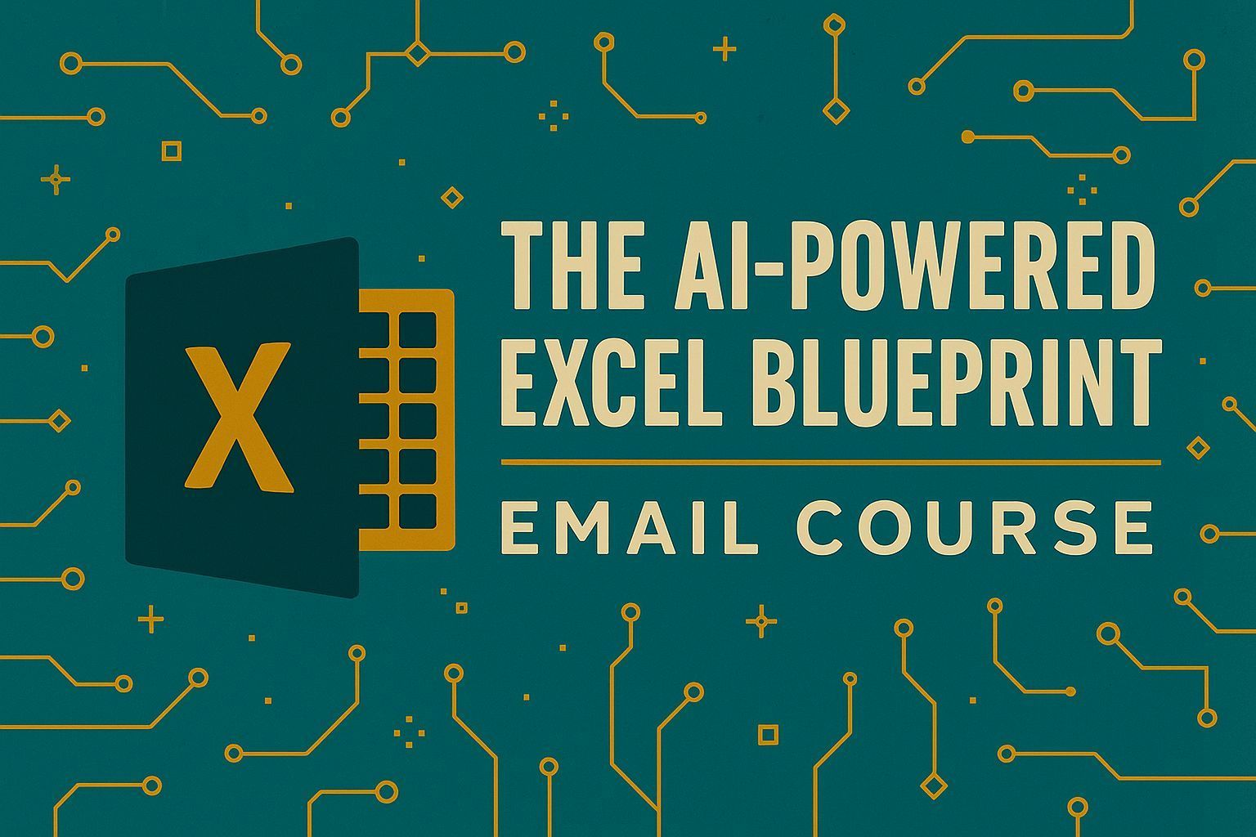
Free!
Blog: stringfestanalytics.com
Newsletter/email course: Subscribe at blog
LinkedIn: Follow for daily(ish) free resources
Notes:
All of this is free and I mean it. I publish regularly, it’s substantive, and it’s not gated behind anything. If free is where you want to stay, I’m genuinely fine with that.

Slide 11

Why not stop at free?
Free content is good for
Seeing what’s possible (like today)
Knowing features exist
Getting inspired to try things
Paid content is good for
Building the full pipeline you saw gaps in
Someone saying “do this next, skip that”
Not starting over every time tools change
Notes:
You just saw three genuinely useful things. And you could absolutely go home and use all of them tomorrow. But here’s what I’ve seen happen hundreds of times: someone watches a demo like this, tries it on Monday, hits a snag that wasn’t in the demo, Googles around for 45 minutes, gets a partial answer, and moves on. Two weeks later they’re back to doing it the old way.
Free content — including today — is great at showing you what’s possible. What it can’t do is hold your hand through the messy middle when your actual data doesn’t look like the demo data. That’s not a flaw in the content. It’s just the nature of free. If you’re here for the third or fourth time and still feel stuck, that’s not a failure — it’s a signal that you need structure, not more content.

Slide 12
How I work
Individuals
Self-paced courses & live workshops
Learn when to use formulas, Power Query, Python, and Copilot
Focus on clarity, maintainability, and confidence
Teams
Practical corporate training
Apply modern Excel patterns to real workflows
Reduce errors, rework, and one-off fixes
Organizations
Guided, multi-week modernization program
Teams learn to build pipelines, automation, and documentation
Internal ownership of reliable, auditable workflows
Notes:
I work with individuals, teams, and organizations at different levels, but the philosophy is always the same: reduce chaos, increase clarity, and build workflows that actually hold up over time.
For individuals, this usually means self-paced courses or live workshops focused not just on learning features, but on developing judgment — understanding when to use formulas, Power Query, Python, or Copilot, and when not to.
With teams, the work becomes more applied and workflow-driven — practical corporate training that helps reduce errors, rework, and fragile one-off fixes by applying modern Excel patterns to real business processes.
At the organizational level, this often takes the form of a guided, multi-week modernization program where teams learn to build pipelines, automation, and documentation around Excel-based systems.

Slide 13
Where to go next
Want the full pipeline, not just demos? → The Modern Excel AI Stack
Want to go deep on one topic? → Try Python in Excel: Quick Wins
Prefer self-paced? → My LinkedIn Learning courses
Want live training? → Join an O’Reilly session or Eventbrite workshop
For teams/organizations → Book a discovery call
Notes:
If you got value from today and you want to keep going — not just watch another demo in six months, but actually build the full pipeline we talked about — the Modern Excel AI Stack is where that happens. It’s a membership, not a big course. You get ongoing guidance as tools change, and you’re not starting from scratch every time Microsoft ships something new.
If you want to go deep on one specific topic, I have standalone courses like Python in Excel: Quick Wins. If you prefer self-paced, my LinkedIn Learning courses are designed to be clear and sequenced. If you want live, hands-on training, that’s what my O’Reilly sessions and Eventbrite workshops are for.
And if you’re a manager or team lead and you’re thinking “my whole team needs this,” book a discovery call. That link is on the slide.

Slide 14
Free download
Download: Modern Excel Starter Kit PDF
Introduction, learning strategies, additional resources to master Modern Excel
The kit shows you what exists. Ongoing resources show you what to do with them
Notes:
The Starter Kit is in your downloads. It’s a great orientation to everything Modern Excel can do. Just know that the kit is a map, not a guide. If you want someone walking beside you telling you where to go, that’s what the membership is for.

Slide 15
Next steps
Follow me on LinkedIn
Share this event with someone who’s still doing it the hard way
For teams/organizations: Book a discovery call at https://stringfestanalytics.com/book-me/
Notes:
If you know someone who’s still manually cleaning data every Monday morning or rebuilding the same report from scratch every month, send them this recording. That’s the person this is for.

Slide 16

Next steps
Download files stay up at https://swiy.co/mxldd
Recording is at https://stringfestdata.gumroad.com/l/mxlais, join first week free
Notes:
If you know someone who’s still manually cleaning data every Monday morning or rebuilding the same report from scratch every month, send them this recording. That’s the person this is for.

Slide 17
Thank you!
Notes:
Thank you for spending this time with me. I hope you got something useful out of today.

Slide 18
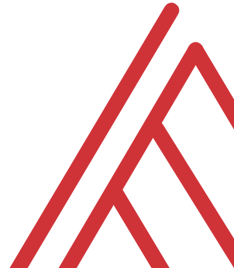
Questions?

