Slide 1


Dynamic Arrays: Excel Formulas Reinvented

Slide 2

Warmup
What questions do you have about Power Pivot?

Slide 3
Objectives for this session
Use dynamic array functions like SORT(), FILTER(), and UNIQUE() for efficient data analysis.
Automate array updates to eliminate manual adjustments.
Perform advanced lookups with XLOOKUP().

Slide 4
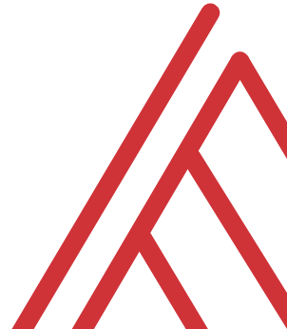
Questions?

Slide 5
THANK YOU
See you tomorrow for Copilot!

