Slide 1

POWER PIVOT: POWERFUL DATA MODELS SIMPLIFIED
Notes:
https://swiy.co/musopen

Slide 2

WARMUP
What questions do you have about Power Query?

Slide 3
OBJECTIVES
Importing and viewing data sources via Power Query
Creating relationships and defining measures in the data model
Analyzing trends with time intelligence functions

Slide 4

No more Frankentables!
Files: data folder
What is the right way to analyze this data if we want to find total sales by person?
Open a blank workbook to start…
Final workbook: superstore-data-model.xlsx
Notes:
Now you are hyped up Power Query, I think you are going to love it and it will be hard for you to remember the days when you didn’t have it. So let’s think about what we would do without Power Query.

Slide 5
Start the Power Pivot add-in for Excel
Excel for Microsoft 365 Excel 2021 Excel 2019 Excel 2016 Excel 2013
https://swiy.co/HO7G

Slide 6
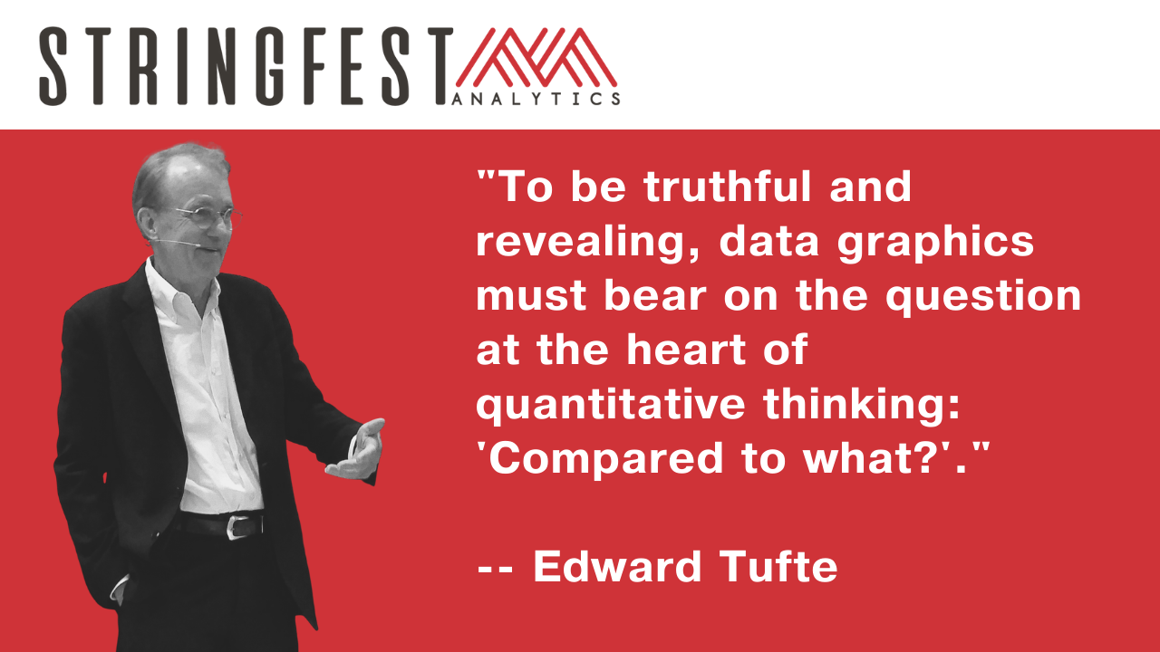

Slide 7
QUESTIONS?

Slide 8
FINAL QUESTIONS?
See you tomorrow for dynamic arrays…
Notes:
Any questions on descriptive statistics?

