Slide 1
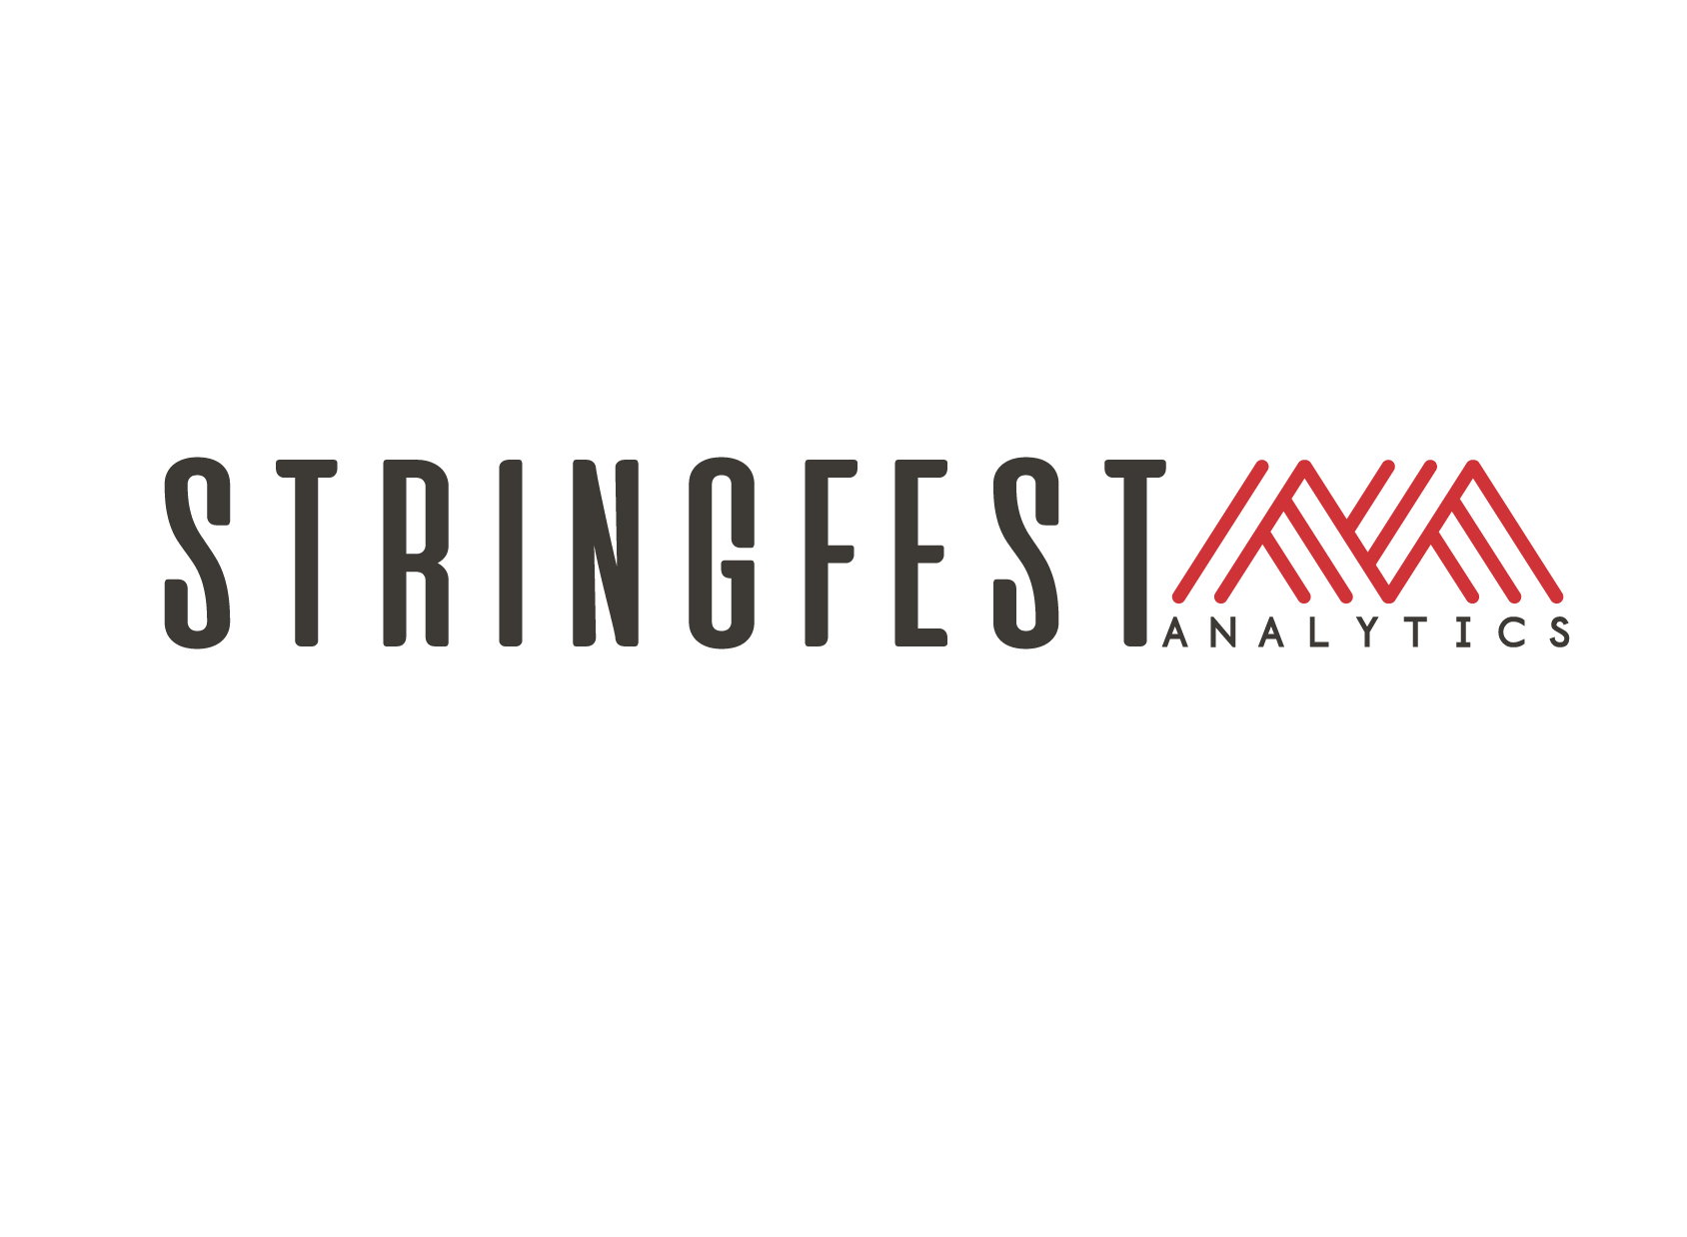

Python in Excel: Programming Meets Spreadsheets

Slide 2

Objectives for this session
Understand the Python in Excel environment
Create analyses and visualizations that would otherwise be difficult in Excel
Explore what is and isn’t possible with current integration

Slide 3
Warmup
What questions do you have about dynamic arrays?

Slide 4
1. Understanding the Python in Excel environment

Slide 5

Understanding the Python in Excel environment
What packages are available and why?
Loading Excel data into Python
Crossing between Python objects and Excel values
File: pie-environment.xlsx
Notes:
False!
Function, Formula, Function
Argument

Slide 6
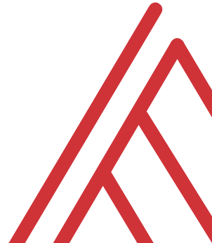
Questions?

Slide 7
2. From “that’s hard in Excel” to “that’s easy in Python”

Slide 8
From “that’s hard in Excel” to “that’s easy in Python”
Data profiling: What is the shape, size, completeness?
Time series: pandas for panel data
Visualizations: What are the distributions and relationships in this data?
File: hard-excel-easy-python.xlsx
Notes:
False!
Function, Formula, Function
Argument

Slide 9
3. Interactive visualizations with Python in Excel

Slide 10
Interactive visualizations with Python in Excel
Python in Excel can’t include tooltips (yet)…
… but we can add user inputs and data validation via Excel
Let’s make an interactive rolling average chart where the user defines the # of periods
File: interactive-viz-pie.xlsx
Notes:
False!
Function, Formula, Function
Argument

Slide 11
Questions?

Slide 12
Questions?

Slide 13
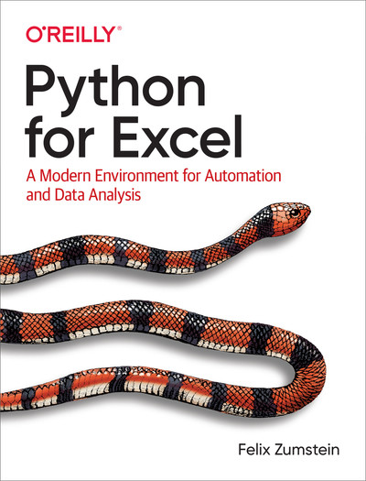
Resource: Python for Excel
xlwings.org/book
Notes:
False!
Function, Formula, Function
Argument

Slide 14
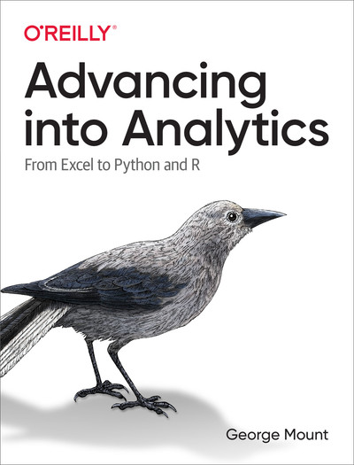
Resource: Advancing into Analytics
stringfestanalytics.com/book/
Notes:
False!
Function, Formula, Function
Argument

Slide 15
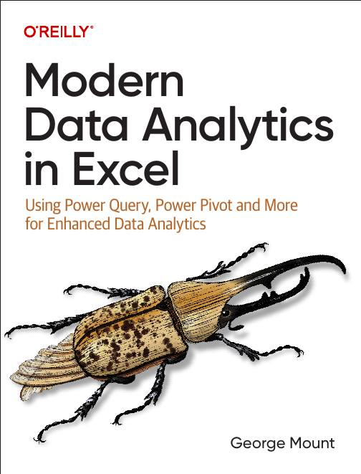
Resource: Modern Data Analytics in Excel
stringfestanalytics.com/maxl/
Notes:
False!
Function, Formula, Function
Argument

Slide 16
THANK YOU
See you tomorrow for Copilot!

