Slide 1


First Steps with Copilot for Excel

Slide 2
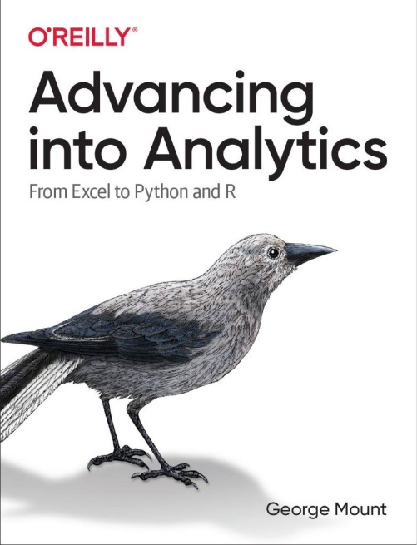
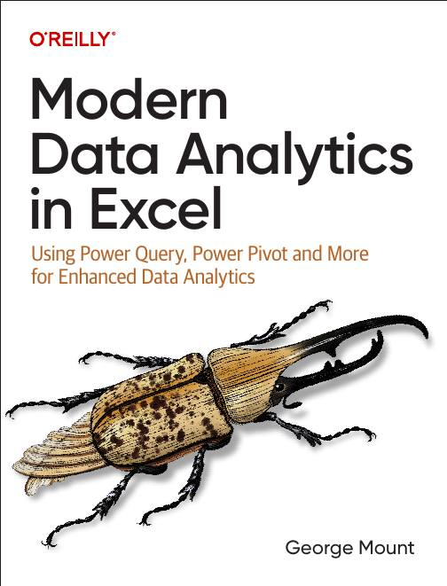



Hi, I’m George

Slide 3

Objectives for this session
Getting the best results with Copilot for Excel
Use cases
Copilot for Excel vs Copilot 365
(Time permitting) Advanced Analysis with Python
File: wholesale-customers.xlsx
(Source: https://archive.ics.uci.edu/dataset/292/wholesale+customers)

Slide 4
Product availability
Microsoft 365 Copilot: https://www.microsoft.com/en-us/microsoft-365/copilot
Advanced Analysis with Copilot requires Insiders: https://techcommunity.microsoft.com/t5/excel-blog/python-in-excel-available-now/ba-p/4240212
Follow these pages for product availability and roadmaps for most accurate and up to date information

Slide 5
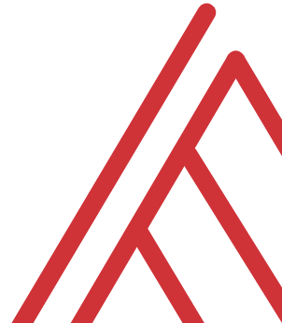
Questions?

Slide 6
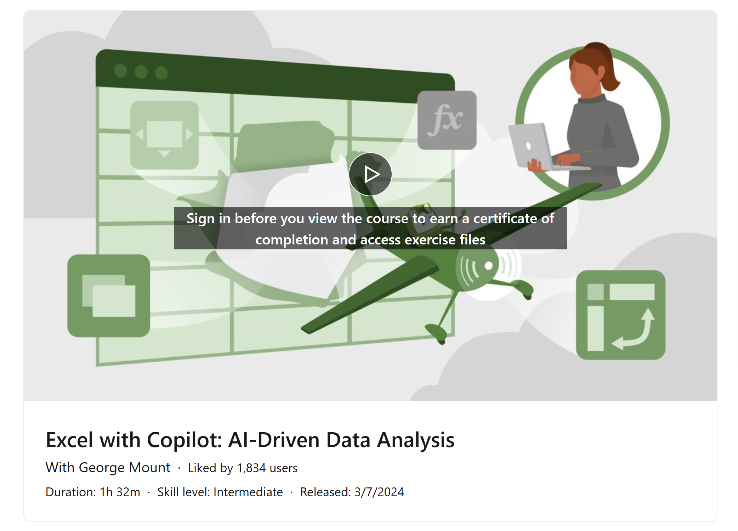
Resource: “Excel with Copilot” on LinkedIn Learning
FREE through the end of the year!
https://www.linkedin.com/learning/excel-with-copilot-ai-driven-data-analysis
Notes:
False!
Function, Formula, Function
Argument

Slide 7
Resource: Modern Data Analytics in Excel
stringfestanalytics.com/maxl/
Notes:
False!
Function, Formula, Function
Argument

Slide 8
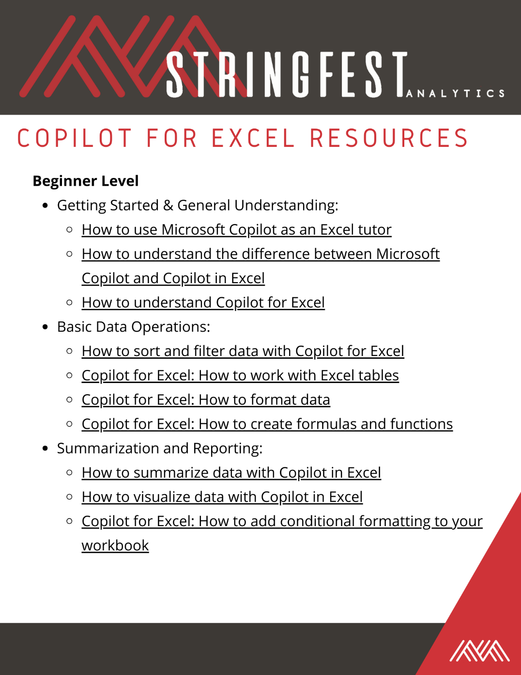
Resource: Copilot in Excel Resource Guide
See downloads folder
Notes:
False!
Function, Formula, Function
Argument

Slide 9
THANK YOU
Linkedin.com/in/gjmount
george@stringfestanalytics.com

