Slide 1



Monte Carlo Methods with Python in Excel

Slide 2
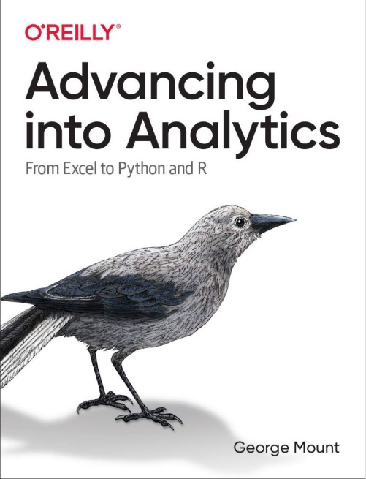
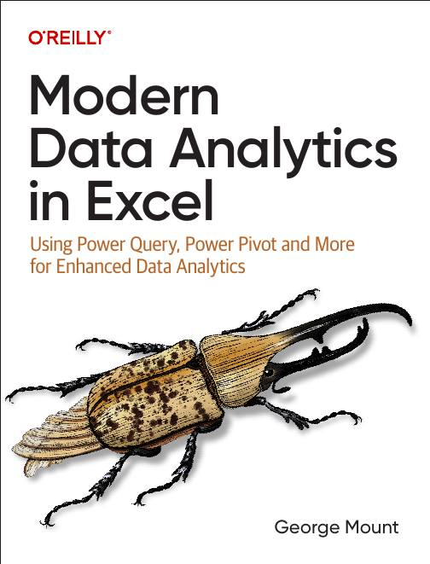



Hi, I’m George

Slide 3

Objectives for this session
Simulating business outcomes with Python in Excel
Generating synthetic data with Faker
Simulating profit distributions & sales trends with Monte Carlo simulations

Slide 4
1. Synthetic data simulation with Faker

Slide 5
Synthetic data simulation with Faker
Creating synthetic cells, ranges & tables with categorical & quantitative data
Setting the seed for reproducibility
Worksheet: faker
Resource: https://stringfestanalytics.com/python-in-excel-how-to-generate-fake-data-with-faker/
Notes:
False!
Function, Formula, Function
Argument

Slide 6
Synthetic data simulation with Faker EXERCISE
Generate 5 random email addresses (fake.email())
Generate 3 random city names (fake.city())
Modify your code to set a random seed
Create a DataFrame with 10 rows of fake
Name (fake.name())
Phone number (fake.phone_number())
Company (fake.company())
Credit card number (fake.credit_card_number())
Job (fake.job())
Worksheet: faker-exercise-solutions.xlsx
Notes:
False!
Function, Formula, Function
Argument

Slide 7
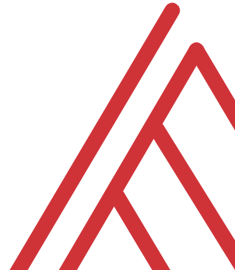
Questions?

Slide 8
2. Monte Carlo simulation with Python in Excel

Slide 9
Monte Carlo simulation with Python in Excel
Driving Python outputs with Python inputs
Creating simulations in Python
Visualizing the results
Worksheet: monte-carlo-1
Resource: https://stringfestanalytics.com/python-in-excel-how-to-run-a-monte-carlo-simulation/
Notes:
False!
Function, Formula, Function
Argument

Slide 10
Monte Carlo simulation with Python in Excel EXERCISE
Simulate the distribution of profit per unit assuming the following
Revenue per unit average, standard deviation: 50, 10
Cost per unit average, standard deviation: 80, 20
Both follow the normal distribution
Experiment with # simulations!
Worksheet: monte-carlo-exercise
Notes:
False!
Function, Formula, Function
Argument

Slide 11
Simulating non-normal distributions with Python in Excel
Not all variables in the real world follow the real distribution
How can we adjust our Monte Carlo models to account for this?
Worksheet: monte-carlo-2
Notes:
False!
Function, Formula, Function
Argument

Slide 12
Simulating sales trends with Python in Excel
Simulating trends over time
Visualizing the results
Worksheet: profit-path
Notes:
False!
Function, Formula, Function
Argument

Slide 13
Questions?

Slide 14
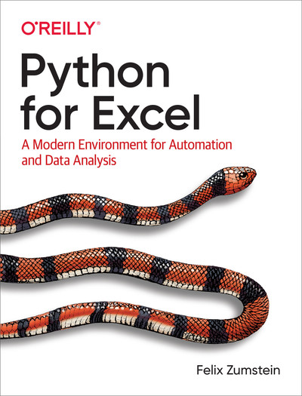
Resource: Python for Excel
xlwings.org/book
Notes:
False!
Function, Formula, Function
Argument

Slide 15
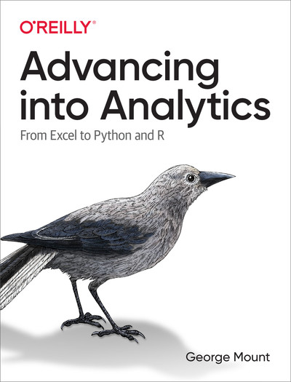
Resource: Advancing into Analytics
stringfestanalytics.com/book/
Notes:
False!
Function, Formula, Function
Argument

Slide 16
Resource: Modern Data Analytics in Excel
stringfestanalytics.com/maxl/
Notes:
False!
Function, Formula, Function
Argument

Slide 17
Thank you

