Slide 1
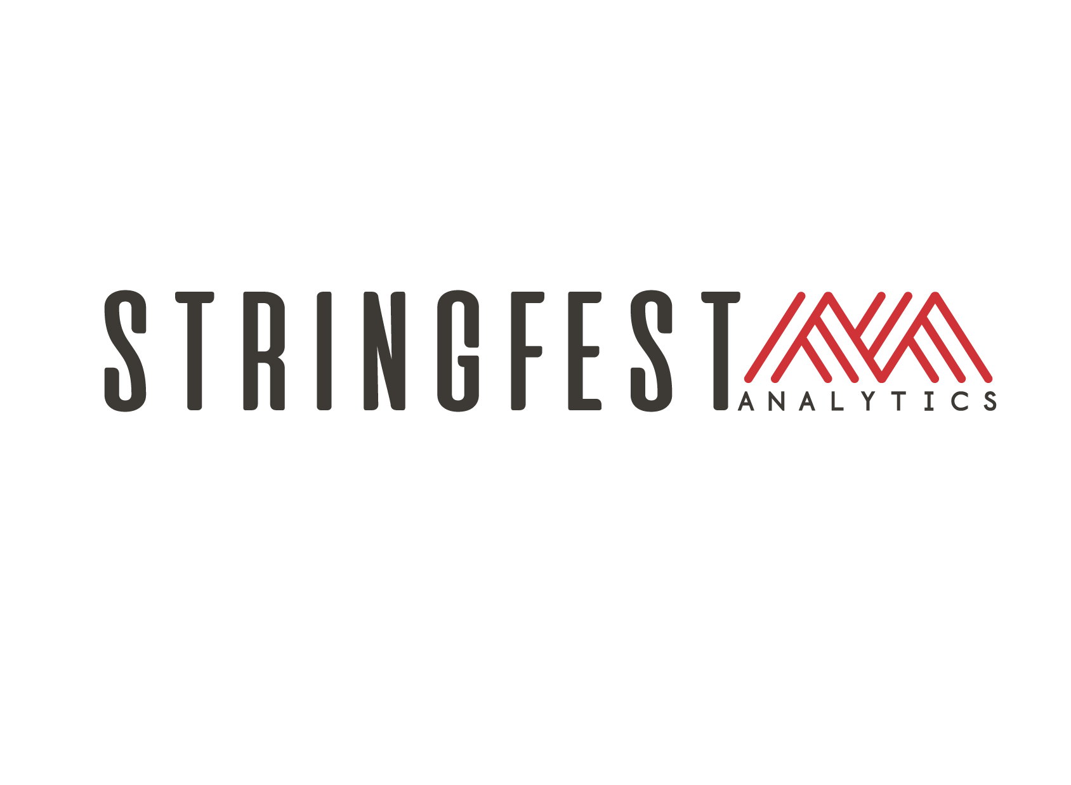


Introduction to Python for Excel

Slide 2
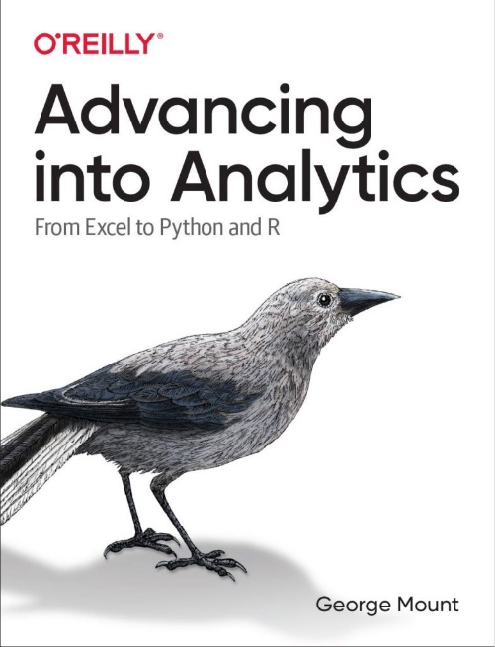
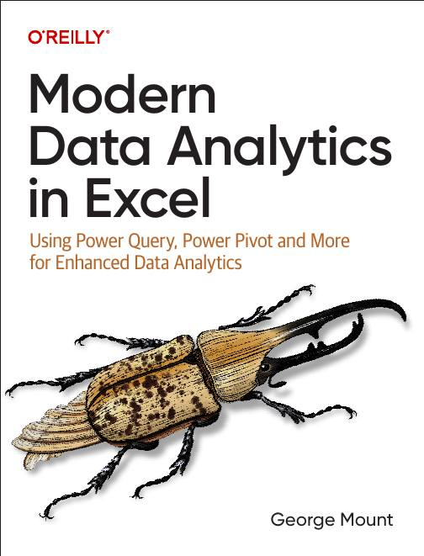



Hi, I’m George

Slide 3

Objectives for this session
Why Python & Excel for financial modelers?
Time series analysis
Data visualization
Report automation

Slide 4
1. Understanding the Python in Excel environment

Slide 5
Understanding the Python in Excel environment
What packages are available and why?
Loading Excel data into Python
Crossing between Python objects and Excel values
File: pie-environment.xlsx
Notes:
False!
Function, Formula, Function
Argument

Slide 6
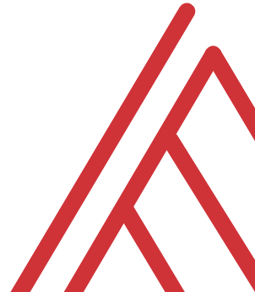
Questions?

Slide 7
2. From “that’s hard in Excel” to “that’s easy in Python”

Slide 8
From “that’s hard in Excel” to “that’s easy in Python”
Data profiling: What is the shape, size, completeness?
Time series: pandas for panel data
Visualizations: What are the distributions and relationships in this data?
File: hard-excel-easy-python.xlsx
Notes:
False!
Function, Formula, Function
Argument

Slide 9
Questions?

Slide 10
3. There’s more to Python and Excel than Python in Excel

Slide 11
There’s more to Python and Excel than Python in Excel
Python in Excel is all about data analysis, visualization, statistics & ML
It lacks Excel automation capabilities
You can automate an entire Excel workbook from Python… without opening Excel!
File: pae-pie.ipynb
Notes:
False!
Function, Formula, Function
Argument

Slide 12
Questions?

Slide 13
4. Conclusion

Slide 14
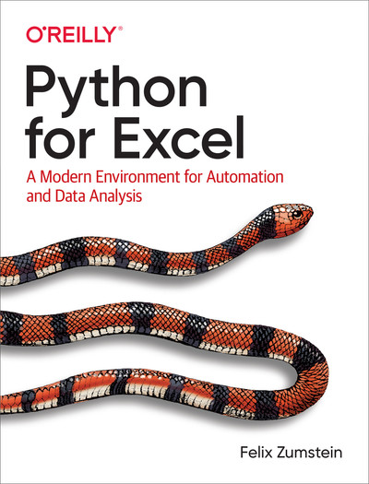
Resource: Python for Excel
Notes:
False!
Function, Formula, Function
Argument

Slide 15
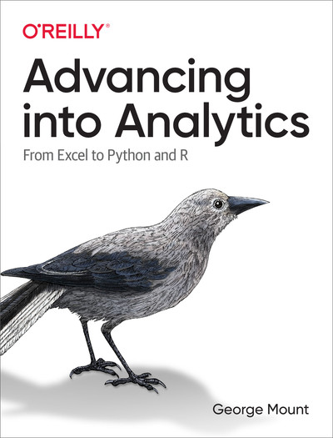
Resource: Advancing into Analytics
Notes:
False!
Function, Formula, Function
Argument

Slide 16
Resource: stringfestanalytics.com
Subscribe for updates & access to my data analytics learning resource library
Notes:
False!
Function, Formula, Function
Argument

Slide 17
Thank you

