Slide 1


Getting Started with Copilot in Excel

Slide 2

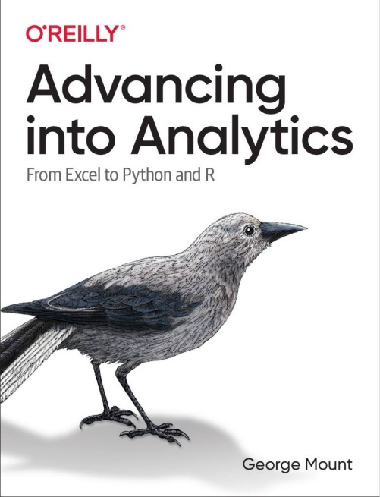
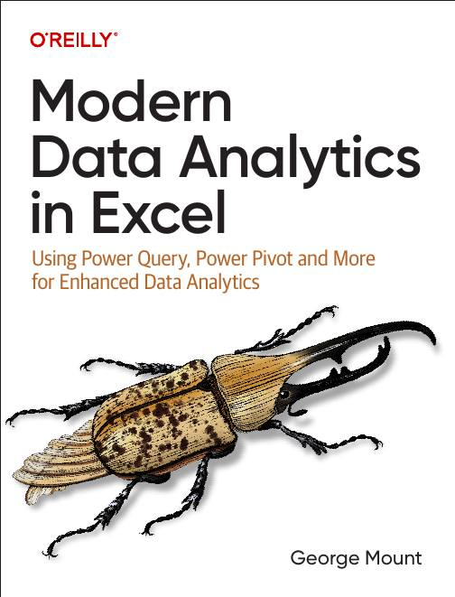



Hi, I’m George

Slide 3

Objectives for this session
Getting the best results with Copilot for Excel
Use cases
Copilot for Excel vs Copilot 365
(Time permitting) Advanced Analysis with Python
File: wholesale-customers.xlsx
(Source: https://archive.ics.uci.edu/dataset/292/wholesale+customers)

Slide 4
Formatting data for Copilot in Excel
Use tables for optimal results
Use Power Query to format your data
Resource: https://support.microsoft.com/en-us/topic/format-data-for-copilot-in-excel-1604c8eb-57f1-4db1-8363-d53336228c65

Slide 5
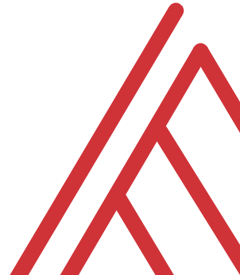
Questions?

Slide 6
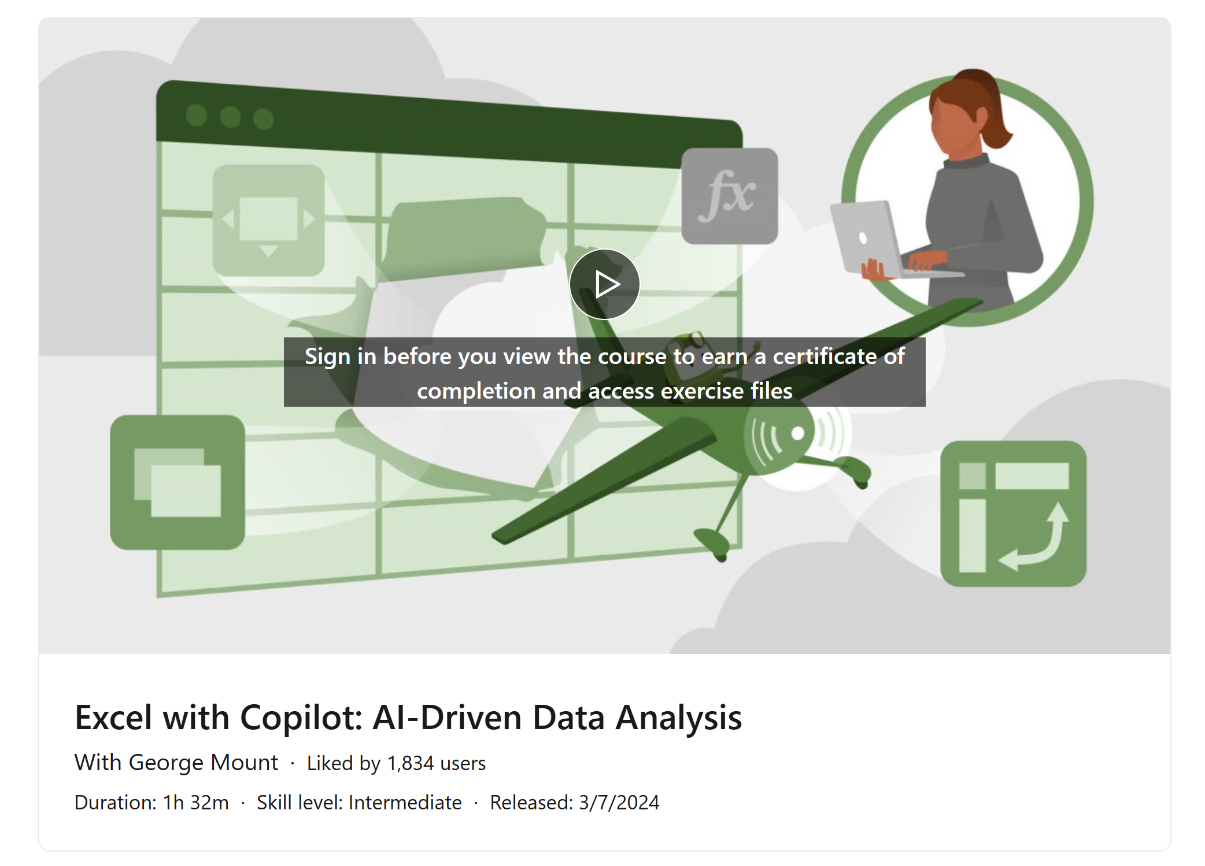
Resource: “Excel with Copilot” on LinkedIn Learning
FREE until the end of next year!
https://www.linkedin.com/learning/excel-with-copilot-ai-driven-data-analysis
Notes:
False!
Function, Formula, Function
Argument

Slide 7
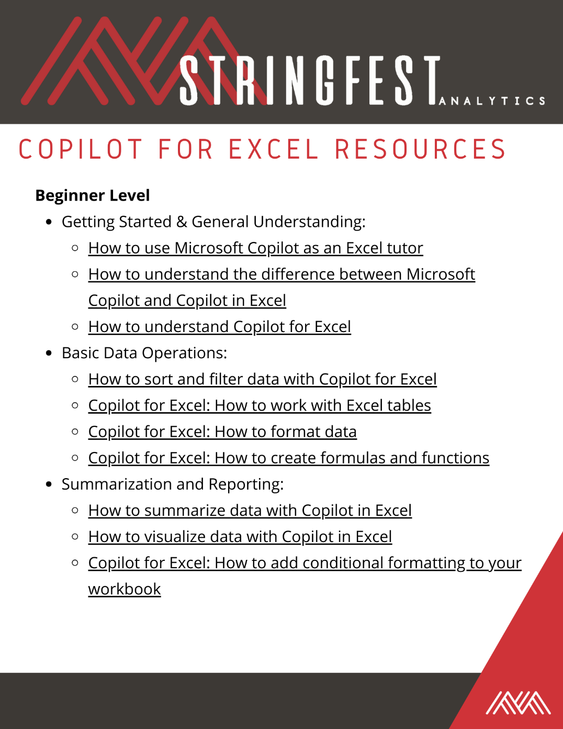
Resource: Copilot in Excel Resource Guide
See downloads folder
Notes:
False!
Function, Formula, Function
Argument

Slide 8
Resource: Modern Data Analytics in Excel
stringfestanalytics.com/maxl/
Notes:
False!
Function, Formula, Function
Argument

Slide 9
THANK YOU
Linkedin.com/in/gjmount
george@stringfestanalytics.com

