Slide 1


Must-know features for Python in Excel

Slide 2
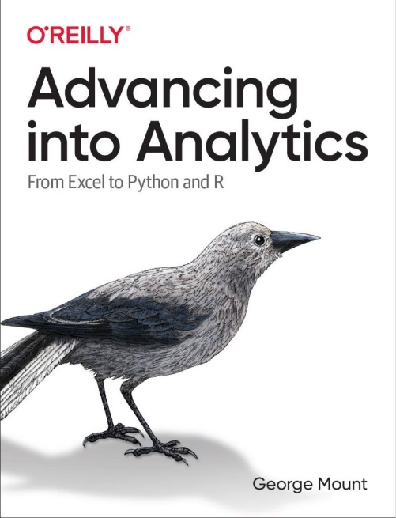
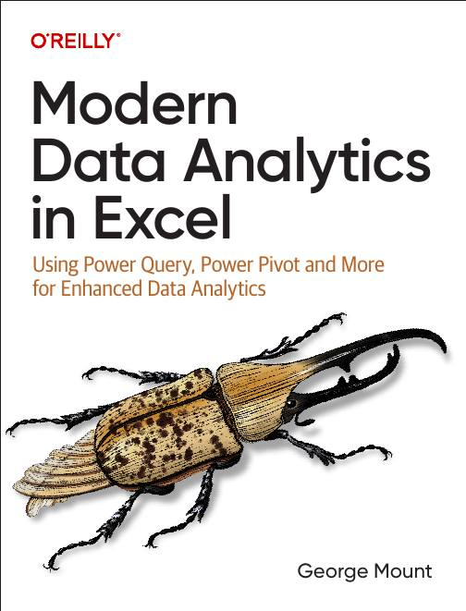



Hi, I’m George

Slide 3

Objectives for this session
Import web data with Power Query and link Python to the connection
Preview and explore Python objects using linked data types
Load data with tables and structured references
Combine Python outputs and Excel formulas using dynamic arrays
Embed and resize Python plots with Excel’s image-in-cell feature

Slide 4
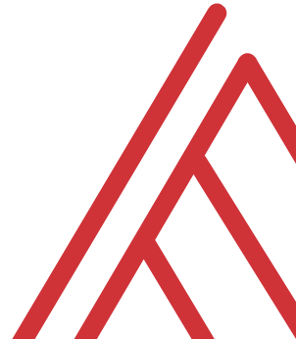
Questions?

Slide 5
THANK YOU
Linkedin.com/in/gjmount
george@stringfestanalytics.com

