Slide 1


Office Scripts for Excel: Getting Started

Slide 2
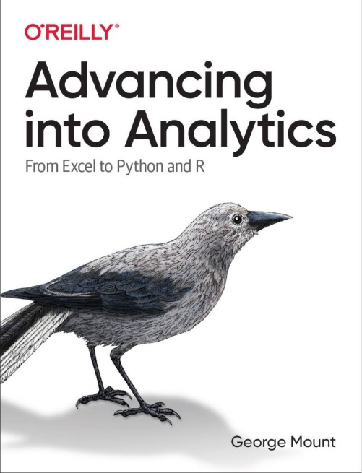
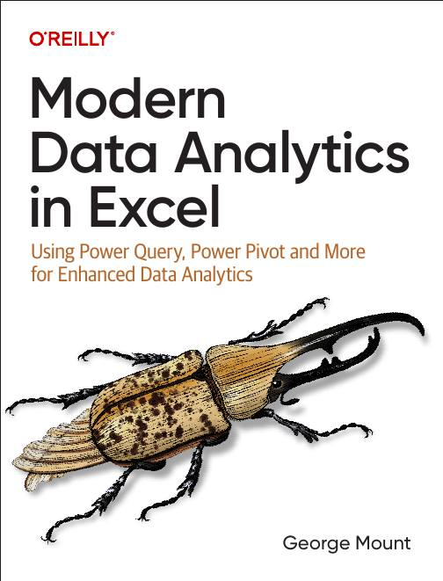



Hi, I’m George

Slide 3

Objectives for this session
Learn to automate Excel tasks with Office Scripts, improving efficiency.
Use the Script Recorder and main() function to create and modify scripts easily.
Debug and share Office Scripts to streamline team workflows.
Integrate Office Scripts with Power Automate for cross-platform automation.

Slide 4
Office Scripts availability
Please see https://learn.microsoft.com/en-us/office/dev/scripts/testing/platform-limits?tabs=business

Slide 5
1. Office Scripts vs VBA

Slide 6
Office Scripts vs VBA
Aspect | Office Scripts | VBA (Visual Basic for Applications)
Platform Compatibility | Primarily designed for Excel on the web. | Primarily used in Excel desktop applications.
Language | TypeScript/JavaScript. | VBA (a subset of Visual Basic).
Ease of Use | Requires familiarity with the JavaScript programming language, particularly the TypeScript superset. | Requires familiarity with the VBA programming language.
Integration | Can be integrated with Power Automate for automation across Microsoft 365. | Can interact with other Office applications through COM (Component Object Model).
Security | Runs in a more controlled environment, offering a higher level of security. | Macros can be a security risk if not properly managed.
Accessibility | Accessible primarily through Excel on the web. | Accessible through Excel desktop applications.

Slide 7
Office Scripts vs VBA (contd)
Recording Capability | Offers a macro recorder to generate scripts. | Offers a macro recorder to generate VBA code.
Deployment | Scripts can be shared across an organization through OneDrive and SharePoint. | Macros are typically shared through the distribution of Excel files.
Performance | Optimized for cloud-based spreadsheets and collaboration. | Optimized for desktop applications, can handle complex tasks efficiently.
Development Environment | Integrated development environment (IDE) in Excel. | VBA Editor (VBE) – a separate environment within Excel.
Learning Resources | Limited compared to VBA, but growing as Office Scripts is newer. | Extensive, given VBA’s long history and wide usage.
Automation Capabilities | Suited for lightweight to medium complexity automation tasks. | Capable of handling complex automation tasks, including interaction with Windows API and other external libraries.
https://stringfestanalytics.com/how-to-compare-office-scripts-and-vba-for-excel/

Slide 8
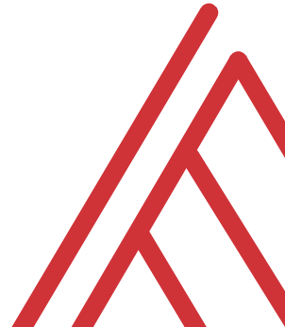
Questions?

Slide 9
2. Getting started with Office Scripts

Slide 10
Record Actions in Office Scripts
Creating a script with Record Actions
Advantages and disadvantages of Record Actions
File: record-actions.xlsx
Resource: https://stringfestanalytics.com/how-to-understand-record-actions-in-office-scripts-for-excel/
Notes:
False!
Function, Formula, Function
Argument

Slide 11
function main() in Office Scripts
function main() as the heart of Office Scripts
‘Hello, world!’ in Office Scripts
Customizing function main()’s parameters
File: Open a blank workbook to proceed
Resource: https://stringfestanalytics.com/how-to-understand-function-main-in-office-scripts-for-excel/
Notes:
False!
Function, Formula, Function
Argument

Slide 12
Exercises
Use Record Actions to:
Format cells D4-D8 as dates (fixing the serial numbers)
Sum hours worked in cells C4-C8 and display the total in B1
Add color to header cells A3-D3
Enhance the script by:
Modifying it to include a user form that asks the user to select the header color
Use a variable in the `main` function to apply the user’s chosen color to the headers
File: getting-started-challenge.xlsx
Notes:
False!
Function, Formula, Function
Argument

Slide 13
3. Debugging & sharing Office Scripts

Slide 14
Debugging with console.log()
Print to console with console.log()
How to use this for debugging, particularly in loops
File: Open a blank workbook to proceed
Resource: https://stringfestanalytics.com/how-to-understand-console-log-in-office-scripts-for-excel/
Notes:
False!
Function, Formula, Function
Argument

Slide 15
Sharing your Office Scripts
Sharing within a workbook
Sharing with other users in an organization
Sharing outside your organization
File: sharing-office-scripts.xlsx
Resource: https://stringfestanalytics.com/office-scripts-for-excel-how-to-share-your-scripts/
Notes:
False!
Function, Formula, Function
Argument

Slide 16
Questions?

Slide 17
4. Office Scripts & Power Automate

Slide 18
Record Actions in Office Scripts
Creating a script with Record Actions
Advantages and disadvantages of Record Actions
File: record-actions.xlsx
Resource: https://stringfestanalytics.com/how-to-understand-record-actions-in-office-scripts-for-excel/
Notes:
False!
Function, Formula, Function
Argument

Slide 19
function main() in Office Scripts
function main() as the heart of Office Scripts
‘Hello, world!’ in Office Scripts
Customizing function main()’s parameters
File: Open a blank workbook to proceed
Resource: https://stringfestanalytics.com/how-to-understand-function-main-in-office-scripts-for-excel/
Notes:
False!
Function, Formula, Function
Argument

Slide 20
Resource: stringfestanalytics.com
Subscribe for updates & access to my data analytics learning resource library
Notes:
False!
Function, Formula, Function
Argument

Slide 21
Exercises
Use Record Actions to:
Format cells D4-D8 as dates (fixing the serial numbers)
Sum hours worked in cells C4-C8 and display the total in B1
Add color to header cells A3-D3
Enhance the script by:
Modifying it to include a user form that asks the user to select the header color
Use a variable in the `main` function to apply the user’s chosen color to the headers
File: 01-challenge.xlsx
Notes:
False!
Function, Formula, Function
Argument

Slide 22
Questions?

Slide 23
Thank you

