Slide 1
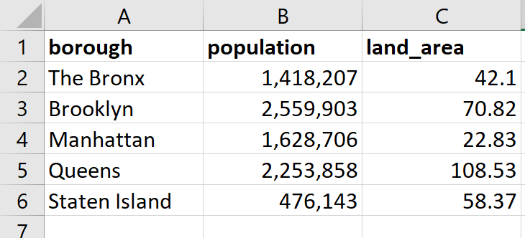
first_row = 0
first_col = 0
0 1 2
0
1
2
3
4
5

