Slide 1



HOSTED BY
Financial Analytics with
Python in Excel
Financial Modelling
in Excel meetup
Forecasting, simulation, and analytics that go beyond formulas
A hands-on, 60-minute working session
Presented by George Mount · Stringfest Analytics
Notes:
Welcome, everyone, and thank you so much for having me tonight. It is great to be here with the Plum Solutions Financial Modelling in Excel community. Here is how tonight works. This is a working session, not a lecture, so if you have Excel open with the datasets I shared, you are in great shape. By the end of the hour you will have run a real forecast and a real simulation right inside Excel, and you will leave with all the code, the data, and a cheat sheet. Let us dive in.

Slide 2
Thanks for having me
To Plum Solutions and the Financial Modelling in Excel meetup for hosting tonight.
This community lives at the intersection of Excel and rigorous financial modelling, exactly where Python in Excel earns its keep.
Tonight we push past what formulas do comfortably: forecasting, simulation, and analytics on real-sized financial data.
Notes:
Before we get going, a genuine thank you to Plum Solutions and the Financial Modelling in Excel meetup for hosting tonight. This community sits right where Excel meets serious financial modelling, and that is exactly where Python in Excel earns its place. You already know Scenario Manager, Data Tables, and three statement models. Tonight I want to add two tools to that kit. I am not here to replace anything you already do well.

Slide 3
What you'll walk away with
Summarize and analyze larger financial datasets without leaving Excel
Build and evaluate data-driven forecasts (trend + seasonality)
Run Monte Carlo simulations to model risk and uncertainty
Test many assumptions and scenarios at once, and visualize the range
Every line of code, the datasets, and a copy-paste cheat sheet to keep
Notes:
Here is what you will walk away with tonight. You will be able to summarize and analyze larger financial datasets without ever leaving Excel. You will build a forecast that respects both trend and seasonality, and you will know how to check whether it is any good. You will run a Monte Carlo simulation that puts a real number on risk. And you will test many scenarios at once and see the whole range of outcomes. Everything I show you goes home with you, so please relax and follow along rather than racing to write things down.

Slide 4
HOW TODAY WORKS
Open Excel and follow along with me
You'll need Python in Excel enabled (Microsoft 365 on the Current Channel).
Open the datasets workbook I shared, Revenue, Bookings, Simulation sheets.
In a cell, type =PY( and Excel drops into Python. Ctrl+Enter runs it.
When you see the red PY() CELL card, type the code and run it with me.
Your numbers will match mine, we set a random seed for reproducibility.
PY() CELL
=PY(
import pandas as pd
import numpy as np
df = xl("revenue[#All]",
headers=True)
df.head()
)
Notes:
Let us all get hands on right now, so any setup issues show up early. In any cell, type equals, P, Y, and an open parenthesis, and Excel drops into Python. To pull an Excel table into Python you use the x l function, like the one on the card. Go ahead and load the revenue table now. Whenever you see one of these red P Y cell cards during the session, that is your cue to type the code and run it with me. Because we set a random seed, your numbers will match mine.

Slide 5
THE MENTAL MODEL
Where formulas stop, Python starts
EXCEL FORMULAS DO WELL
PYTHON IN EXCEL UNLOCKS
Single-point what-if (Data Tables)
A handful of named scenarios
Straight-line trend / FORECAST
Fixed, well-understood inputs
Live, linked model cells
Trend + seasonality forecasting
Thousands of Monte Carlo trials
Full distributions, not one number
Decomposition & diagnostics
Repeatable, seeded, auditable code
Notes:
Here is the mental model for the whole session. On the left are the things Excel formulas already do beautifully. A quick what if with a Data Table. A handful of named scenarios. A straight line trend. Please keep using all of those. On the right are the things that get painful with formulas alone. Forecasting with seasonality. Running thousands of simulations. Working with a full distribution instead of a single number. That right hand column is where Python in Excel shines, and that is where we are spending our time tonight.

Slide 6
PART 1 OF 2
Forecasting revenue
Resample · smooth · decompose · Holt-Winters · evaluate
Notes:
Let us start with forecasting. We are going to take six years of monthly revenue that has both a trend and a seasonal pattern, and build a forecast we can actually defend. We will load it, reduce the noise, separate the pieces, fit the model, and then prove that it beats a naive guess.

Slide 7
STEP 1, UNDERSTAND THE SERIES
Load revenue and index it by time
xl() pulls the Revenue table straight into a pandas DataFrame.
Convert the date column so Python treats it as real time, not text.
Set date as the index, now you can resample, shift, and compare by time.
This monthly SaaS revenue rises over six years with a clear yearly rhythm.
PY() CELL
df = xl("revenue[#All]",
headers=True)
df['date'] = pd.to_datetime(
df['date'])
df = df.set_index('date')
df.head()
Notes:
First we load the revenue table with x l. Two quick housekeeping steps matter here, and they are the ones that trip people up. First, convert the date column so Python treats it as a real date and not as text. Second, set that date column as the index, which simply means we are organizing the data by time. Once the index is time based, everything after this becomes a one liner. Run it, and you will see the first few rows spill into the grid.

Slide 8
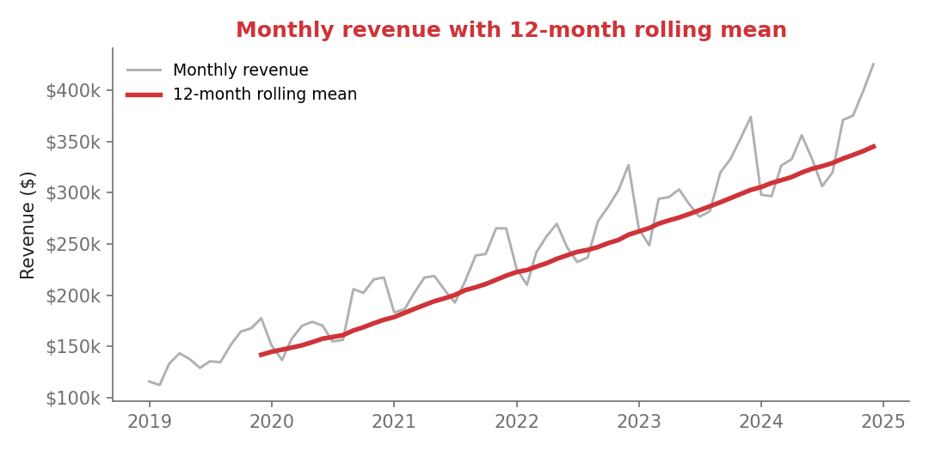
STEP 2, REDUCE THE NOISE
Resample and smooth to see the trend
resample('QE').mean() rolls months into quarters.
rolling(window=12).mean() is the moving average you know, over a full year it cancels the seasonal swing.
The red line makes the underlying growth unmistakable.
PY() CELL
quarterly = df.resample('QE').mean()
df['rolling'] = df['revenue'].rolling(window=12).mean()
Notes:
Now let us cut through the noise so we can see the trend. There are two moves here. Resampling changes the frequency, so we roll the monthly data up into quarters. A rolling mean keeps the monthly frequency but smooths it, and it is exactly the moving average you already use in Excel. A twelve month window covers a full year, so the seasonal ups and downs average out and the growth becomes obvious. One heads up. The first eleven rolling values come back empty and show as pound N U M in the grid. That is expected, and it is not a mistake.

Slide 9
STEP 3, SEPARATE THE PIECES
Decompose: trend + seasonal + residual
Observed = Trend + Seasonal + Residual.
The trend is the smooth long-term climb; the seasonal wave repeats every 12 months.
A near-random residual means trend + seasonality explain most of the variation.
The verdict: both trend AND seasonality are present, so the method must handle both.
PY() CELL
from statsmodels.tsa.seasonal \
import seasonal_decompose
result = seasonal_decompose(
df['revenue'],
model='additive',
period=12)
result.plot()
Notes:
This next step is the one that tells us which model to use. We break the series into three parts. The trend. The repeating seasonal pattern. And the leftover residual. Look at the seasonal panel. It is a clean wave that repeats every twelve months. Now look at the residual. It is close to random, which tells us that trend and season together explain most of what is going on. So the verdict is simple. Both a trend and seasonality are present, which means whatever model we choose has to handle both.

Slide 10
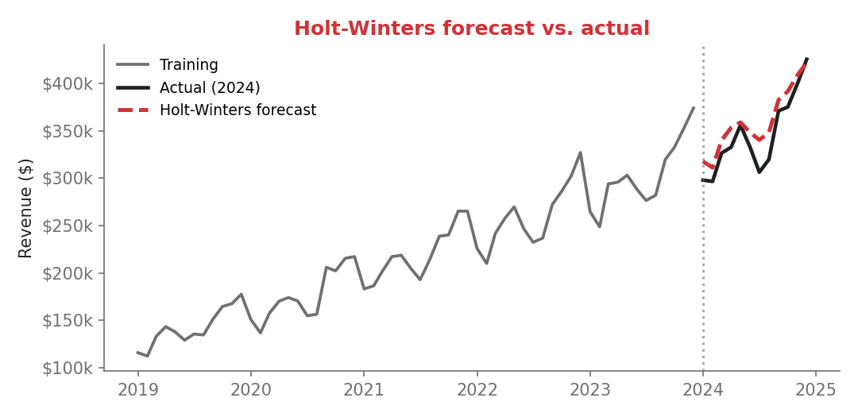
STEP 4, FORECAST
Holt-Winters: trend and seasonality together
Holt-Winters extends exponential smoothing to model trend AND seasonality.
The forecast doesn't run in a straight line, it keeps rising AND keeps the yearly rhythm.
A plain trendline would flatten those seasonal peaks and troughs.
PY() CELL
from statsmodels.tsa.holtwinters import ExponentialSmoothing
fit = ExponentialSmoothing(df['revenue'], trend='add', seasonal='add', seasonal_periods=12).fit()
forecast = fit.forecast(12)
Notes:
This is the payoff for part one. Holt Winters is built for exactly this situation, data with both a trend and seasonality. The three settings just describe what we saw in the decomposition. Add a trend. Add a seasonal pattern. And the season repeats every twelve months. We fit the model, then we forecast a year ahead. Notice that the forecast does not run off in a straight line. It keeps climbing, and it keeps the yearly rhythm. A plain trendline would have flattened those peaks and troughs right out.

Slide 11
STEP 5, PROVE IT
Evaluate against a naive baseline
Split in time: train through 2023, hold out 2024. Never shuffle time series.
Mean Absolute Error (MAE) = average miss, in dollars, easy to defend.
Baseline = 'next month equals last month.' Always beat something.
Here Holt-Winters MAE is roughly a third of the naive baseline's.
PY() CELL
train = df[df.index < '2024-01-01']
test = df[df.index >= '2024-01-01']
fit = ExponentialSmoothing(
train['revenue'], trend='add',
seasonal='add',
seasonal_periods=12).fit()
fc = fit.forecast(len(test))
mae = (fc - test['revenue']).abs().mean()
Notes:
A forecast that looks nice on a chart is not the same as a forecast you can trust, so let us put a number on it. There are two rules. First, split by time, never at random. We train on everything through 2023 and hold out 2024, so the model never gets to peek at the future. Second, always compare against a baseline. The simplest baseline is next month equals last month. On this data, Holt Winters is off by about sixteen thousand dollars a month, while that naive baseline is off by about forty two thousand. So the model is genuinely earning its keep.

Slide 12
THE JUDGMENT CALL
Match the method to the data
Revenue: strong trend + stable seasonality -> Holt-Winters.
Bookings: trend but NO reliable yearly pattern -> Holt's method (trend only).
Force seasonality onto the bookings series and the model invents peaks that aren't there.
The decomposition plot tells you which camp you're in before you fit anything.
Bigger toolbox beats a bigger hammer. Trend + seasonality -> Holt-Winters. Trend only -> Holt. Neither -> simple smoothing.
Notes:
Here is the judgment call that really matters, and it is a transferable skill, not just a recipe. Our revenue had a strong trend and stable seasonality, so Holt Winters was the right pick. But the bookings series is different. It trends upward, but there is no reliable yearly pattern. If you force seasonality onto it, the model will invent peaks that are not really there. So read the decomposition first, and then choose. Trend plus seasonality, use Holt Winters. Trend only, use Holt. Neither one, keep it simple.

Slide 13
PART 2 OF 2
Simulating risk
From single-point estimates to full distributions of outcomes
Notes:
Now let us shift from forecasting a single path to simulating thousands of them. This is Monte Carlo simulation, and it is the part a risk aware finance audience really leans into. We will see why one number can mislead you, then build a simulation step by step, and use it to actually compare decisions.

Slide 14
THE PROBLEM
One number hides the risk
Stock 1,100 units at $30, sell at $50. Expected demand 1,000 -> 'profit $20,000.'
But demand is uncertain. Sell 800 and profit falls to $7,000.
Sell 1,300 and you cap out at inventory, the upside is limited, the downside isn't.
A single forecast tells you the middle. It never tells you how often the bad case shows up.
$20,000
the single-point answer
?
how wide is the range,
and how often do we lose?
Notes:
Let us start with why one number can fool you. Say we stock eleven hundred units at thirty dollars each, and we sell them at fifty. If demand lands right at expectation, a thousand units, the profit looks fine. But demand is never exactly the expectation. Sell only eight hundred and profit drops hard. Sell thirteen hundred and we cap out at our inventory, so the upside is limited, but the downside is wide open. A single forecast gives you the middle of the story. It never tells you how often the bad case shows up. That is what we are about to fix.

Slide 15
STEP 1, MODEL THE UNCERTAINTY
Generate thousands of demand draws
Pick a distribution that encodes your assumption, here, normal demand.
NumPy draws 10,000 demand values centered on 1,000, s.d. 200.
np.maximum(..., 0) keeps demand realistic (never negative).
One seed makes the whole simulation reproducible and auditable.
PY() CELL
np.random.seed(42)
N = 10000
demand = np.maximum(
np.random.normal(
1000, 200, N),
0)
Notes:
Simulation is driven by assumptions, so we start from a blank sheet, with no dataset at all. The distribution we choose is the assumption. Here we say demand is normally distributed, centered on a thousand units, give or take two hundred. NumPy draws ten thousand possible demand values in one shot. We floor it at zero so demand never goes negative. And that seed at the top matters for this crowd. It makes the whole simulation reproducible and reviewable, unlike the volatile random cells you may be used to.

Slide 16
STEP 2, APPLY THE BUSINESS LOGIC
Compute profit for every scenario
Units sold = MIN(demand, inventory), you can't sell what you don't stock.
That MIN is the whole story: it caps the upside but not the downside.
Revenue minus the cost of ALL inventory (sold or not) gives profit.
Vectorized: 10,000 scenarios calculated in one shot, no drag-fill.
PY() CELL
price, cost, inv = 50, 30, 1100
units = np.minimum(
demand, inv)
revenue = units * price
profit = revenue - inv*cost
Notes:
Now we apply the business logic to every one of those ten thousand scenarios. The key line is units sold equals the minimum of demand and inventory, which is just the M I N function you already know from Excel. That minimum is the whole story. When demand is below inventory, revenue falls short. When demand is above inventory, sales are capped, so the extra demand earns us nothing. Cost is charged on all the inventory either way. And notice we did ten thousand scenarios with plain array math, with no ten thousand row data table to drag down the sheet.

Slide 17
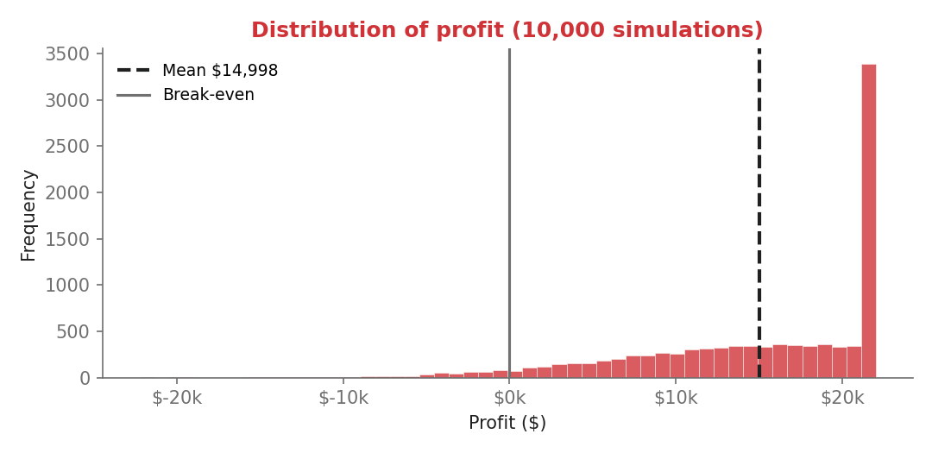
STEP 3, READ THE DISTRIBUTION
Summarize with percentiles, not just the mean
Mean and median: the typical outcome.
10th / 90th percentiles: a concrete 'reasonable range' you can plan against.
Probability of loss answers the question the mean can't: how often do we lose?
PY() CELL
p10, p90 = np.percentile(profit, [10, 90])
prob_loss = (profit < 0).mean()
summary = pd.DataFrame({'mean':[profit.mean()], 'p10':[p10], 'p90':[p90], 'p_loss':[prob_loss]})
Notes:
Now let us read the results, and here is the mindset shift. Instead of asking what the expected profit is, we ask what the range is, and how bad it can get. The tenth and ninetieth percentiles give you a concrete, reasonable range to plan against, which is much easier to act on than a standard deviation. And probability of loss answers the question the average simply cannot. How often do we actually lose money. Now look at the histogram. Even though we fed in symmetric demand, the profit is skewed, because that inventory cap chopped off the upside. That skew is the whole reason we simulate.

Slide 18
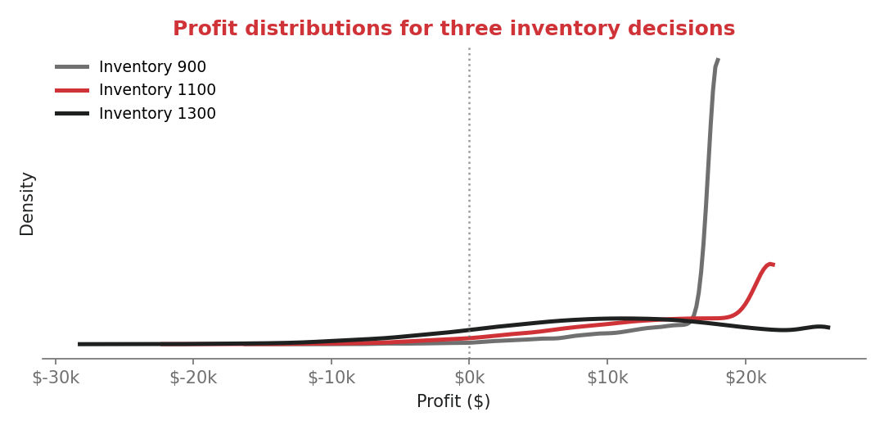
STEP 4, THE MAIN EXERCISE
Compare decisions, not just averages
Hold demand fixed; vary the decision, inventory of 900, 1,100, 1,300.
Conservative (900): tight distribution, limited downside.
Aggressive (1,300): more upside, but the tail crosses into losses.
Now it's a risk-tolerance choice, not a single ranking.
PY() CELL
for inv in [900, 1100, 1300]:
p = np.minimum(demand, inv) * price - inv * cost
print(inv, round(p.mean()), round(np.percentile(p,10)), (p<0).mean())
Notes:
This is the main exercise, so let us give it some room, and I want you to run this one with me. We keep the same demand draws, and we only change the decision. Inventory of nine hundred, eleven hundred, or thirteen hundred. Holding demand fixed isolates the effect of the choice itself. Now look at the shapes. The conservative option is tight, with limited downside. The aggressive option reaches for more upside, but its tail crosses into losses. So the question is no longer which number is biggest. It is which risk profile we actually want. And that is a much better conversation to bring to a decision maker.

Slide 19
HOW THIS CONNECTS TO EXCEL
You already do this, Python scales it
Scenario Manager -> a few named cases. Data Tables -> one or two inputs on a grid.
Monte Carlo -> you define distributions and let the model explore thousands of combinations automatically.
Python adds a seed for reproducibility, richer distributions (skew, rare events), and full distributions instead of a grid of points.
Same instincts you already have, just past the point where the grid gets unwieldy.
Notes:
Let me connect this back to the tools you already own, because none of this is a rejection of Excel. Scenario Manager handles a few named cases. A Data Table varies one or two inputs across a grid. Both are perfect at small scale. Simulation is the same instinct, just taken further. Instead of predefining the cases, you define the distributions and let the model explore thousands of combinations for you. Python adds a reproducible seed, richer distributions that can capture skew and rare events, and the full distribution instead of a grid of points. Think of it as an extension of your toolkit, not a rival to it.

Slide 20
RECAP
Two new tools in your Excel toolkit
FORECASTING
SIMULATION
Index by time, then smooth
Decompose to see structure
Holt-Winters for trend + season
Split by time; beat a baseline
Match the method to the data
Sample from a distribution
Apply the business logic
Summarize with percentiles
Read probability of loss
Compare decisions by risk
Notes:
Let us tie it together. You are leaving with two patterns you can reuse tomorrow. For forecasting. Index by time, smooth to see the structure, decompose, fit Holt Winters, and always check it against a baseline. For simulation. Sample from a distribution, apply your business logic, summarize with percentiles, read the probability of loss, and compare decisions by their risk. Different problems, but the same spirit. Make the uncertainty visible, and make it defensible.

Slide 21
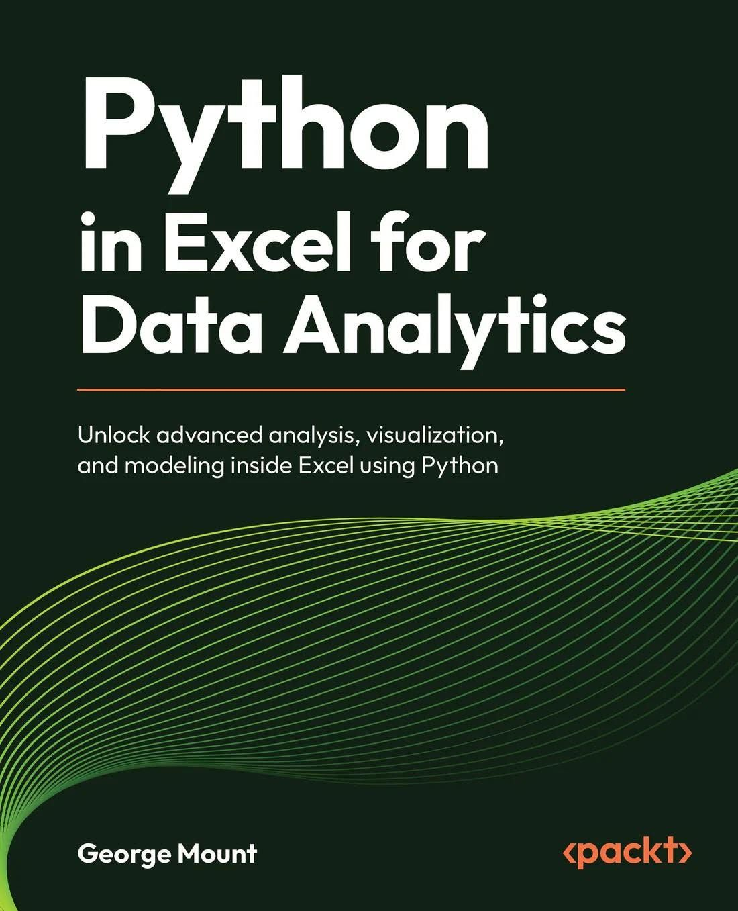
Want the whole toolkit?
Everything tonight, and much more, is in my forthcoming book:
Python in Excel for Data Analytics
Unlock advanced analysis, visualization, and modeling inside Excel using Python (Packt).
Forecasting, Monte Carlo simulation, regression, text analytics, and more, all inside Excel.
Rolling out by the end of the year.
Get launch-day notice: stringfestanalytics.com/book
Notes:
If you would like the full toolkit, everything from tonight, and quite a bit more, is in my forthcoming book, Python in Excel for Data Analytics, from Packt. It covers these forecasting and simulation chapters, plus regression, text and sentiment analytics, and visualization, all inside Excel. It is rolling out by the end of the year. So here is the one thing I will ask. If this was useful, join the notify list so you hear the moment it launches. I will drop the link in the chat as well.

Slide 22
BEFORE YOU GO
Your take-home kit + one action
You're leaving with:
The datasets workbook (Revenue · Bookings · Simulation)
The prompt/code cheat sheet, every line from tonight
The follow-along exercises with solutions
This week: open one of your own monthly series and run a Holt-Winters forecast, then beat the naive baseline.
Notes:
Before we wrap, here is what is going home with you. The datasets workbook. A cheat sheet with every line of code from tonight. And a set of follow along exercises with full solutions. And if you do just one thing this week, do this. Take one of your own monthly series, maybe revenue, headcount, or volumes, run a Holt Winters forecast on it, and check that it beats the naive baseline. It is small, it is doable, and it locks in both of tonight's big ideas.

Slide 23

Thank you
George Mount · Stringfest Analytics
george@stringfestanalytics.com · stringfestanalytics.com
Thanks to Plum Solutions & the Financial Modelling in Excel meetup for hosting.
Book launching end of year -> stringfestanalytics.com/book
Notes:
That is a wrap, and thank you once more to Plum Solutions and the Financial Modelling in Excel meetup for having me. My contact details and the book link are on the screen, and I am glad to stay on for as many questions as you have. Please do grab the three files and the datasets. They are yours to keep. And keep an eye out for the book at the end of the year. Thank you, everyone.

