Slide 1


Power Automate for Excel: Getting Started

Slide 2
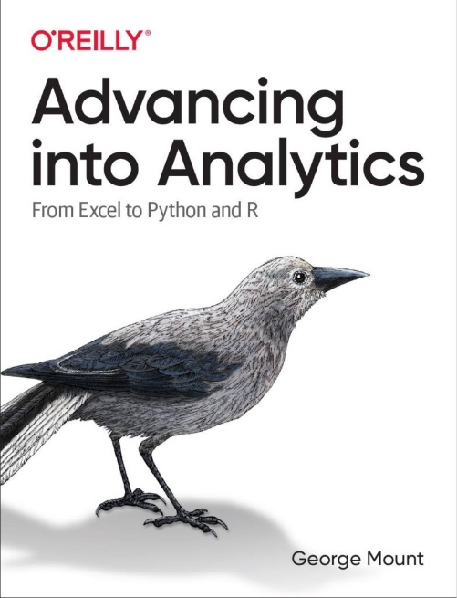
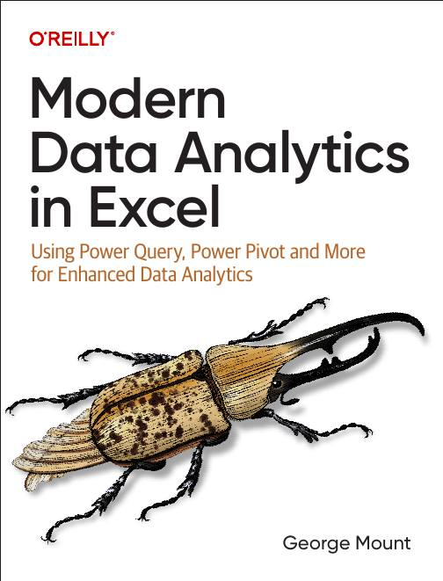



Hi, I’m George

Slide 3

Objectives for this session
Understand how Power Automate enhances Excel tasks and automation capabilities
Build, customize, and troubleshoot Power Automate workflows for Excel
Automate repetitive tasks, integrate conditional logic, and extract data into Excel
Gain insights into Power Automate's role within the Power Platform for further professional growth

Slide 4
Power Automate availability
Power Apps Developer Plan: https://www.microsoft.com/en-us/power-platform/products/power-apps/free
Office Scripts: Please see https://learn.microsoft.com/en-us/office/dev/scripts/testing/platform-limits?tabs=business

Slide 5
1. First Steps with Power Automate

Slide 6
First flow with Power Automate
Use Power Automate templates for Excel
Create clock in/clock out workflow
File: first-flow.xlsx
Notes:
False!
Function, Formula, Function
Argument

Slide 7
Customizing outputs with Power Fx
Continue with the previous example
How can we improve appearance of outputs in Excel?
Resource: https://stringfestanalytics.com/power-automate-for-excel-how-to-understand-the-power-fx-programming-language/
Notes:
False!
Function, Formula, Function
Argument

Slide 8
Building flows with Copilot
Get AI assistance to build a flow
Create a monthly email/post to Teams based on data in a workbook
File: power-automate-copilot.xlsx
Resource: https://stringfestanalytics.com/power-automate-for-excel-how-to-build-flows-with-copilot/
Notes:
False!
Function, Formula, Function
Argument

Slide 9
Exercises
Build on the clock in/clock out workflow
Task: Modify the flow to prompt users for comments when clocking in or out
Add the comment prompt where the in/out criteria is built with a yes/no checkbox
Save the clock in/out data, including comments, to the worksheet
Post an update to Teams with details (who clocked in/out, time, and comments)
File: 01-exercise.xlsx
Notes:
False!
Function, Formula, Function
Argument

Slide 10
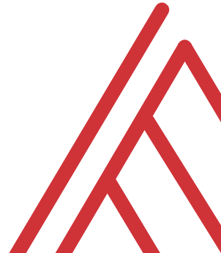
Questions?

Slide 11
2. Building and managing Excel-related flows

Slide 12
Automating Excel entry with Power Automate
Create emails only when project is delayed
Test flow and put on schedule
File: conditional-logic.xlsx
Resource: https://stringfestanalytics.com/power-automate-for-excel-how-to-understand-conditional-flows/
Notes:
False!
Function, Formula, Function
Argument

Slide 13
Creating conditional flows
Create emails only when project is delayed
Test flow and put on schedule
File: conditional-logic.xlsx
Resource: https://stringfestanalytics.com/power-automate-for-excel-how-to-understand-conditional-flows/
Notes:
False!
Function, Formula, Function
Argument

Slide 14
Office Scripts + Power Automate, part 1
Create emails only when project is delayed
Test flow and put on schedule
File: conditional-logic.xlsx
Resource: https://stringfestanalytics.com/power-automate-for-excel-how-to-understand-conditional-flows/
Notes:
False!
Function, Formula, Function
Argument

Slide 15
Office Scripts + Power Automate, part 2
Create emails only when project is delayed
Test flow and put on schedule
File: conditional-logic.xlsx
Resource: https://stringfestanalytics.com/power-automate-for-excel-how-to-understand-conditional-flows/
Notes:
False!
Function, Formula, Function
Argument

Slide 16
Exercises
Folder: 02-challenge
Task: Create a log in file-log.xlsx every time a workbook is uploaded to incoming-files folder
Trigger: When a file is created (properties only)
Use conditional logic for file type
Consider using Power Fx to format upload date
Notes:
False!
Function, Formula, Function
Argument

Slide 17
3. Debugging & sharing Office Scripts

Slide 18
Debugging with console.log()
Print to console with console.log()
How to use this for debugging, particularly in loops
File: Open a blank workbook to proceed
Resource: https://stringfestanalytics.com/how-to-understand-console-log-in-office-scripts-for-excel/
Notes:
False!
Function, Formula, Function
Argument

Slide 19
Sharing your Office Scripts
Sharing within a workbook
Sharing with other users in an organization
Sharing outside your organization
File: sharing-office-scripts.xlsx
Resource: https://stringfestanalytics.com/office-scripts-for-excel-how-to-share-your-scripts/
Notes:
False!
Function, Formula, Function
Argument

Slide 20
Questions?

Slide 21
4. Office Scripts & Power Automate

Slide 22
Record Actions in Office Scripts
Creating a script with Record Actions
Advantages and disadvantages of Record Actions
File: record-actions.xlsx
Resource: https://stringfestanalytics.com/how-to-understand-record-actions-in-office-scripts-for-excel/
Notes:
False!
Function, Formula, Function
Argument

Slide 23
function main() in Office Scripts
function main() as the heart of Office Scripts
‘Hello, world!’ in Office Scripts
Customizing function main()’s parameters
File: Open a blank workbook to proceed
Resource: https://stringfestanalytics.com/how-to-understand-function-main-in-office-scripts-for-excel/
Notes:
False!
Function, Formula, Function
Argument

Slide 24
Resource: stringfestanalytics.com
Subscribe for updates & access to my data analytics learning resource library
Notes:
False!
Function, Formula, Function
Argument

Slide 25
Exercises
Use Record Actions to:
Format cells D4-D8 as dates (fixing the serial numbers)
Sum hours worked in cells C4-C8 and display the total in B1
Add color to header cells A3-D3
Enhance the script by:
Modifying it to include a user form that asks the user to select the header color
Use a variable in the `main` function to apply the user’s chosen color to the headers
File: 01-challenge.xlsx
Notes:
False!
Function, Formula, Function
Argument

Slide 26
Questions?

Slide 27
Thank you

