Slide 1

Notes:
https://swiy.co/musopen

Slide 2

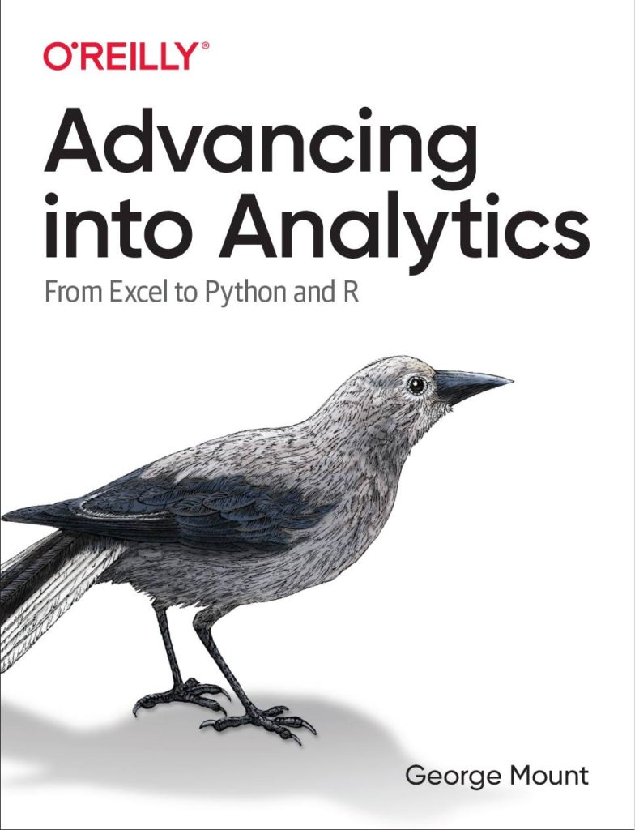


HI, I’M GEORGE
Power Query PDQ!

Slide 3
OBJECTIVES
Importing and viewing data sources via Power Query
Creating relationships and defining measures in the data model
Analyzing trends with time intelligence functions
Power Pivot PDQ!

Slide 4

FOLLOWING ALONG
Download resources with link or QR code:
https://swiy.co/pp-pdq
Power Pivot PDQ!
Notes:
This is an Excel class, so we won’t be looking at PowerPoint the whole time – to follow along, you will see that all assets are divided by section.
Some of our Excel time will be Demos – for this I will be walking through some procedure in Excel.
If you need any datasets they will be included in each sub-folder.
Then there may be a Drill where you will work on it for yourself during some specified period of time.
I have provided written notes/instructions about the Demos which you can refer to while working on the Drills.

Slide 5

No more Frankentables!
Files: data folder
What is the right way to analyze this data if we want to find total sales by person?
Open a blank workbook to start…
Final workbook: superstore-data-model.xlsx
Notes:
Now you are hyped up Power Query, I think you are going to love it and it will be hard for you to remember the days when you didn’t have it. So let’s think about what we would do without Power Query.

Slide 6
Start the Power Pivot add-in for Excel
Excel for Microsoft 365 Excel 2021 Excel 2019 Excel 2016 Excel 2013
https://swiy.co/HO7G

Slide 7
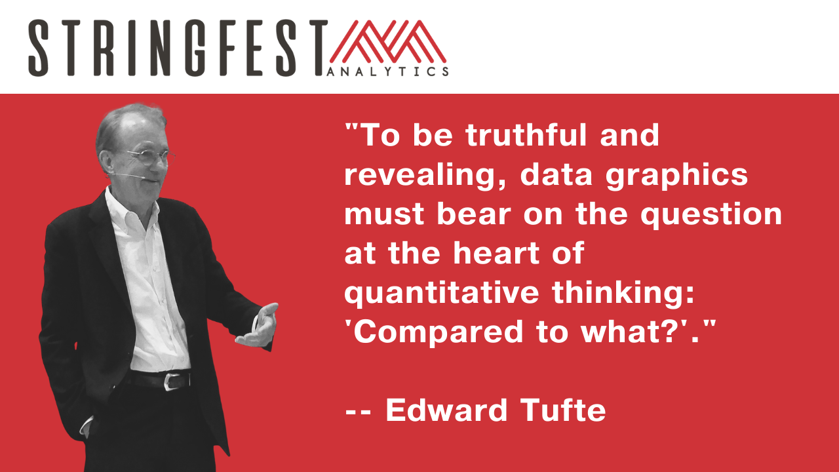

Slide 8
QUESTIONS?

Slide 9

THANK YOU
LINKEDIN
linkedin.com/in/gjmount
EMAIL ADDRESS
george@stringfestanalytics.com
WEBSITE
stringfestanalytics.com
TWITTER
twitter.com/gjmount
Notes:
Thanks for coming! Feel free to contact me anytime, find me on LinkedIn, I also write frequently on this stuff so check out my website too.

Slide 10
REFERRAL PROGRAM
Refer me to a training client & get
Two 45-minute coaching sessions
Signed copy of Advancing into Analytics
Free access to my on-demand Power Query training course
Get in touch: https://stringfestanalytics.com/client-referrals/
Notes:
There’s also let and lambda

Slide 11
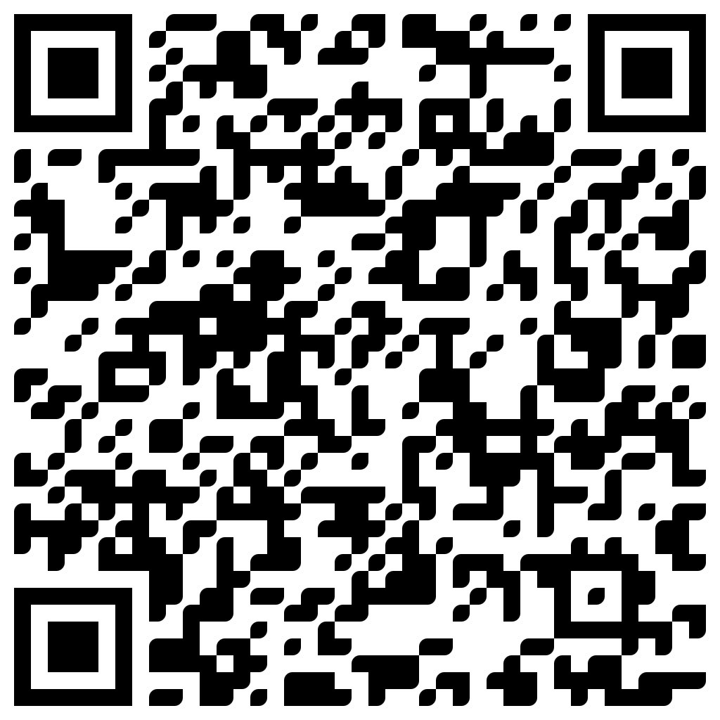
TAKE THE SURVEY
How did I do today? Testimonials or other data welcome!
https://social.stringfestanalytics.com/event-feedback
Notes:
I’m a data analyst give me data on how I did
Testimonials also VERY helpful.

Slide 12
FINAL QUESTIONS?
Thanks for joining!
A recap email with recording, survey and more will be coming…
The recording stays up for seven days!
Notes:
Any questions on descriptive statistics?

