Slide 1


FIRST STEPS FOR POWER QUERY WITH MICROSOFT EXCEL
Notes:
https://swiy.co/musopen

Slide 2




HI, I’M GEORGE
Power Query PDQ!

Slide 3
OBJECTIVES
How tables serve as the "missing link" between Excel and Power Query
How Power Query serves as an "extract, transform, load" tool
How to load your first data sources into Power Query... including how to find the menu for this (not so easy!)
How to explore and profile your data right from Power Query
How to perform repeatable data cleaning operations... no code or formulas required.
Power Query PDQ!

Slide 4

FOLLOWING ALONG
Download resources with link or QR code:
https://swiy.co/pq-pdq-zip
Power Query PDQ!
Notes:
This is an Excel class, so we won’t be looking at PowerPoint the whole time – to follow along, you will see that all assets are divided by section.
Some of our Excel time will be Demos – for this I will be walking through some procedure in Excel.
If you need any datasets they will be included in each sub-folder.
Then there may be a Drill where you will work on it for yourself during some specified period of time.
I have provided written notes/instructions about the Demos which you can refer to while working on the Drills.

Slide 5

What the @%&! is ETL?
“A properly designed ETL system extracts data from the source systems, enforces data quality and consistency standards, conforms data so that separate sources can be used together, and finally delivers data in a presentation-ready format so that application developers can build applications and end users can make decisions.”
-- (where else but) Wikipedia
Notes:
Now I’m going to be very scientific here and go to Wikipedia to explain how extract, transform, load or ETL methodologies work.

Slide 6








1. EXTRACT
2. TRANSFORM
3. LOAD
Notes:
So, you can see ETL achieves quite a few purposes, and as the name implies it works in three steps:
- First, you want to extract the information from some outside source, this can be anything from a database to a web page.
- Then, you want to transform it. This could be cleaning the data, filtering it, checking for assumptions, you get the idea.
- Finally, loading the data, this places it in a format that is accessible for end users to work with.
https://unsplash.com/photos/QUHlPs4y8PQ
https://pixabay.com/photos/tee-tea-bags-teas-drink-herbal-tea-1252397/
https://pixabay.com/photos/construction-worker-welding-welder-1717893/
https://pixabay.com/photos/gift-box-gifts-packaging-box-2458012/

Slide 7
What did we do before Power Query?
File: wholesale-customers.xlsx
How would you make this data “PivotTable-ready?”
Notes:
Now you are hyped up Power Query, I think you are going to love it and it will be hard for you to remember the days when you didn’t have it. So let’s think about what we would do without Power Query.

Slide 8
QUESTIONS?

Slide 9
DEMO: PROFILING DATA
File: star.xlsx
Load into Power Query
Explore via Data Preview
Refer to demo notes
Notes:
Now Power Query is more for data cleaning and transformation but of course we can’t clean unless we know what needs to be cleaned. So let’s look at some ways to do this. We will explore the data and see what we’re working with.

Slide 10
DEMO: MANIPULATING ROWS
File: office-rsvps.xlsx
Notes:
Let’s practice on this
Of course there is a LOT more you can do here, you can work on rows, multiple datasets etc but we’ll focus on the very beginning stuff here.

Slide 11
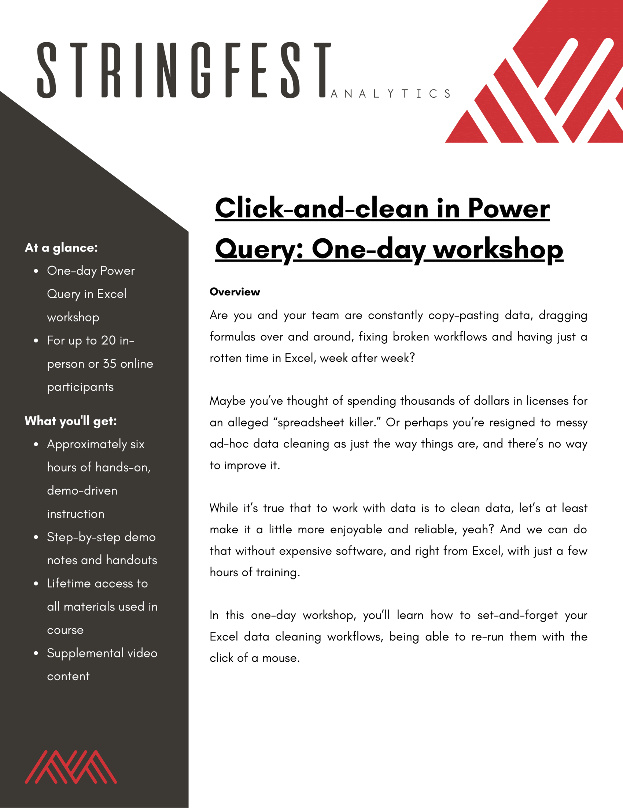

Power Query corporate training
Learn more and connect at https://social.stringfestanalytics.com/pq-workshops
Human Centered Design • MDLS 2020
Notes:
If you are looking to individually take a Power Query class I have a surprise here at the end…

Slide 12
THANK YOU
LINKEDIN
linkedin.com/in/gjmount
EMAIL ADDRESS
george@stringfestanalytics.com
WEBSITE
stringfestanalytics.com
TWITTER
twitter.com/gjmount
Notes:
Thanks for coming! Feel free to contact me anytime, find me on LinkedIn, I also write frequently on this stuff so check out my website too.

Slide 13

TAKE THE SURVEY
How did I do today? Testimonials or other data welcome!
https://social.stringfestanalytics.com/event-feedback
Notes:
I’m a data analyst give me data on how I did
Testimonials also VERY helpful.

Slide 14
FINAL QUESTIONS?
Thanks for joining!
A recap email with recording, survey and more will be coming…
The recording stays up for seven days!
Notes:
Any questions on descriptive statistics?

Slide 15


BUT WAIT THERE’S MORE
50% OFF MY POWER QUERY COURSE THIS WEEK
PROMOCODE NOHARDCODES
https://swiy.co/learn-pq
Notes:
Any questions on descriptive statistics?

