Slide 1


FIRST STEPS FOR POWER QUERY WITH MICROSOFT EXCEL

Slide 2




HI, I’M GEORGE
Power Query PDQ!

Slide 3
OBJECTIVES
How tables serve as the "missing link" between Excel and Power Query
How Power Query serves as an "extract, transform, load" tool
How to load your first data sources into Power Query... including how to find the menu for this (not so easy!)
How to explore and profile your data right from Power Query
How to perform repeatable data cleaning operations... no code or formulas required.
Power Query PDQ!

Slide 4

FOLLOWING ALONG
Download resources with link or QR code:
https://swiy.co/pq-pdq-zip
Power Query PDQ!
Notes:
This is an Excel class, so we won’t be looking at PowerPoint the whole time – to follow along, you will see that all assets are divided by section.
Some of our Excel time will be Demos – for this I will be walking through some procedure in Excel.
If you need any datasets they will be included in each sub-folder.
Then there may be a Drill where you will work on it for yourself during some specified period of time.
I have provided written notes/instructions about the Demos which you can refer to while working on the Drills.

Slide 5

What the @%&! is ETL?
“A properly designed ETL system extracts data from the source systems, enforces data quality and consistency standards, conforms data so that separate sources can be used together, and finally delivers data in a presentation-ready format so that application developers can build applications and end users can make decisions.”
-- (where else but) Wikipedia
Notes:
Now I’m going to be very scientific here and go to Wikipedia to explain how extract, transform, load or ETL methodologies work.

Slide 6








1. EXTRACT
2. TRANSFORM
3. LOAD
Notes:
So, you can see ETL achieves quite a few purposes, and as the name implies it works in three steps:
- First, you want to extract the information from some outside source, this can be anything from a database to a web page.
- Then, you want to transform it. This could be cleaning the data, filtering it, checking for assumptions, you get the idea.
- Finally, loading the data, this places it in a format that is accessible for end users to work with.
https://unsplash.com/photos/QUHlPs4y8PQ
https://pixabay.com/photos/tee-tea-bags-teas-drink-herbal-tea-1252397/
https://pixabay.com/photos/construction-worker-welding-welder-1717893/
https://pixabay.com/photos/gift-box-gifts-packaging-box-2458012/

Slide 7
Power Query & Excel Myth-busting
https://giphy.com/gifs/mythbusters-gif-qVuWpc7MxvGz6
Notes:
As I mentioned, ETL is all over the IT landscape and is considered a best practice when you are working with large amounts of disparate data that need to be “fit for general office consumption.” It’s not just an Excel thing, and in fact this is a pretty disruptive tool to have in Excel, and it really busts a lot of the myths about what Excel can and can’t be which I would like to cover right now.

Slide 8

1. “EXCEL IS NOT REPRODUCIBLE”
Notes:
https://pixabay.com/photos/laboratory-analysis-chemistry-2815641/
Now, the idea of reproducibility is that, the process of getting to some output is fully transparent and it’s possible to walk through each step of the process and get the same result at the end. A lot of typical Excel reporting is not fully reproducible, for example consider a report that depends on you deleting columns A through C to work. Now, if I was going into that final report to understand how it was built, there would really be no way for me to know that, right? On the other hand, a fully reproducible report would show me that, and ideally I’d just click a button and it would do it for me.
In data work, reproducibility is often achieved by powering an analysis with code, so that you can indeed run a script and watch the results emerge one line at a time. Now, the nice thing about Power Query is that it is a code-driven process, so it is reproducible. So does this mean you need to learn how to code in this class? Not necessarily right now. For everyday data cleaning processes, we can use menu-driven options, that will produce code in a Microsoft computer language called M, and now our data-cleaning steps are fully reproducible, in Excel, with no code needed. So that is really cool and a huge myth busted.

Slide 9

2. “EXCEL ONLY DOES STRUCTURED DATA”
Notes:
https://pixabay.com/illustrations/grid-isolation-table-lamp-beetle-2088884/
This is the type of data that in fairness we are more used to working with in classic Excel, data that comes in a nice rectangular shape, usually coming from an Excel workbook or csv file. If the data were in a so-called “unstructured” format, such as song lyrics or a website structure, good luck with using Excel for that.
Come over to Power Query and there is quite an expanded range of possibilities for where data can come from [list on the next page]

Slide 10
Access
.txt and .csv files
SQL Server & other relational databases
XML, HTML & Web data
SharePoint
Hadoop
oData
Combinations of the above…
Notes:
All these types of data and more are fair game to be loaded into Power Query. Where things get really interesting is you are able to combine data from these disparate sources into one consumable data source.

Slide 11

3. “EXCEL CAN’T HANDLE LARGE DATASETS”
Notes:
And that’s the last myth I want to bust here, is that Excel can’t handle large datasets. Now, with “classical Excel” this was probably true, that Excel just couldn’t handle some of those bigger datasets that a lot of data analysts are working with these days, but that’s just not true when you are using Power Query [example on next slide]
https://pixabay.com/photos/amphibian-turtle-animal-armor-blur-1850190/

Slide 12
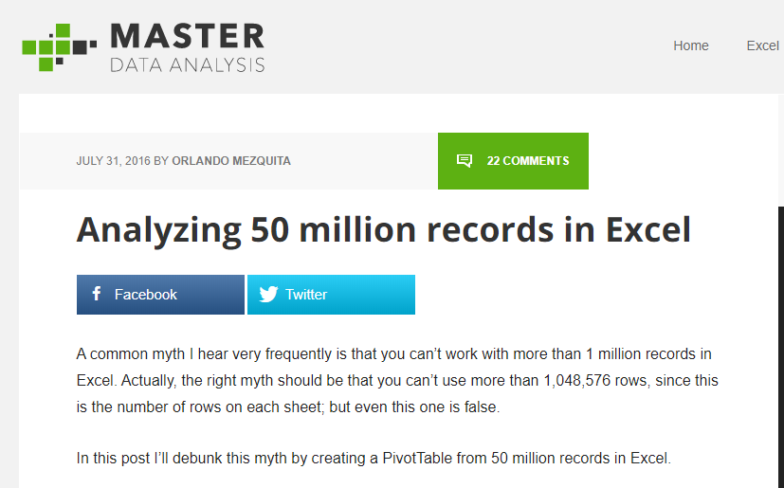
https://www.masterdataanalysis.com/ms-excel/analyzing-50-million-records-excel/
Notes:
Here is an example of that, a blog post about analyzing 50 million records using Excel. 50 million is pretty significant for most anyone, and Excel could handle it, so dismissing Excel out of hand on account of performance is just not as true anymore with Power Query.

Slide 13
What did we do before Power Query?
File: wholesale-customers.xlsx
How would you make this data “PivotTable-ready?”
Notes:
Now you are hyped up Power Query, I think you are going to love it and it will be hard for you to remember the days when you didn’t have it. So let’s think about what we would do without Power Query.

Slide 14
QUESTIONS?

Slide 15
DEMO: PROFILING DATA
File: star.xlsx
Load into Power Query
Explore via Data Preview
Refer to demo notes
Notes:
Open this file. We will get into Power Query now.

Slide 16
DEMO: MANIPULATING ROWS
File: office-rsvps.xlsx
Notes:
Any questions on descriptive statistics?

Slide 17
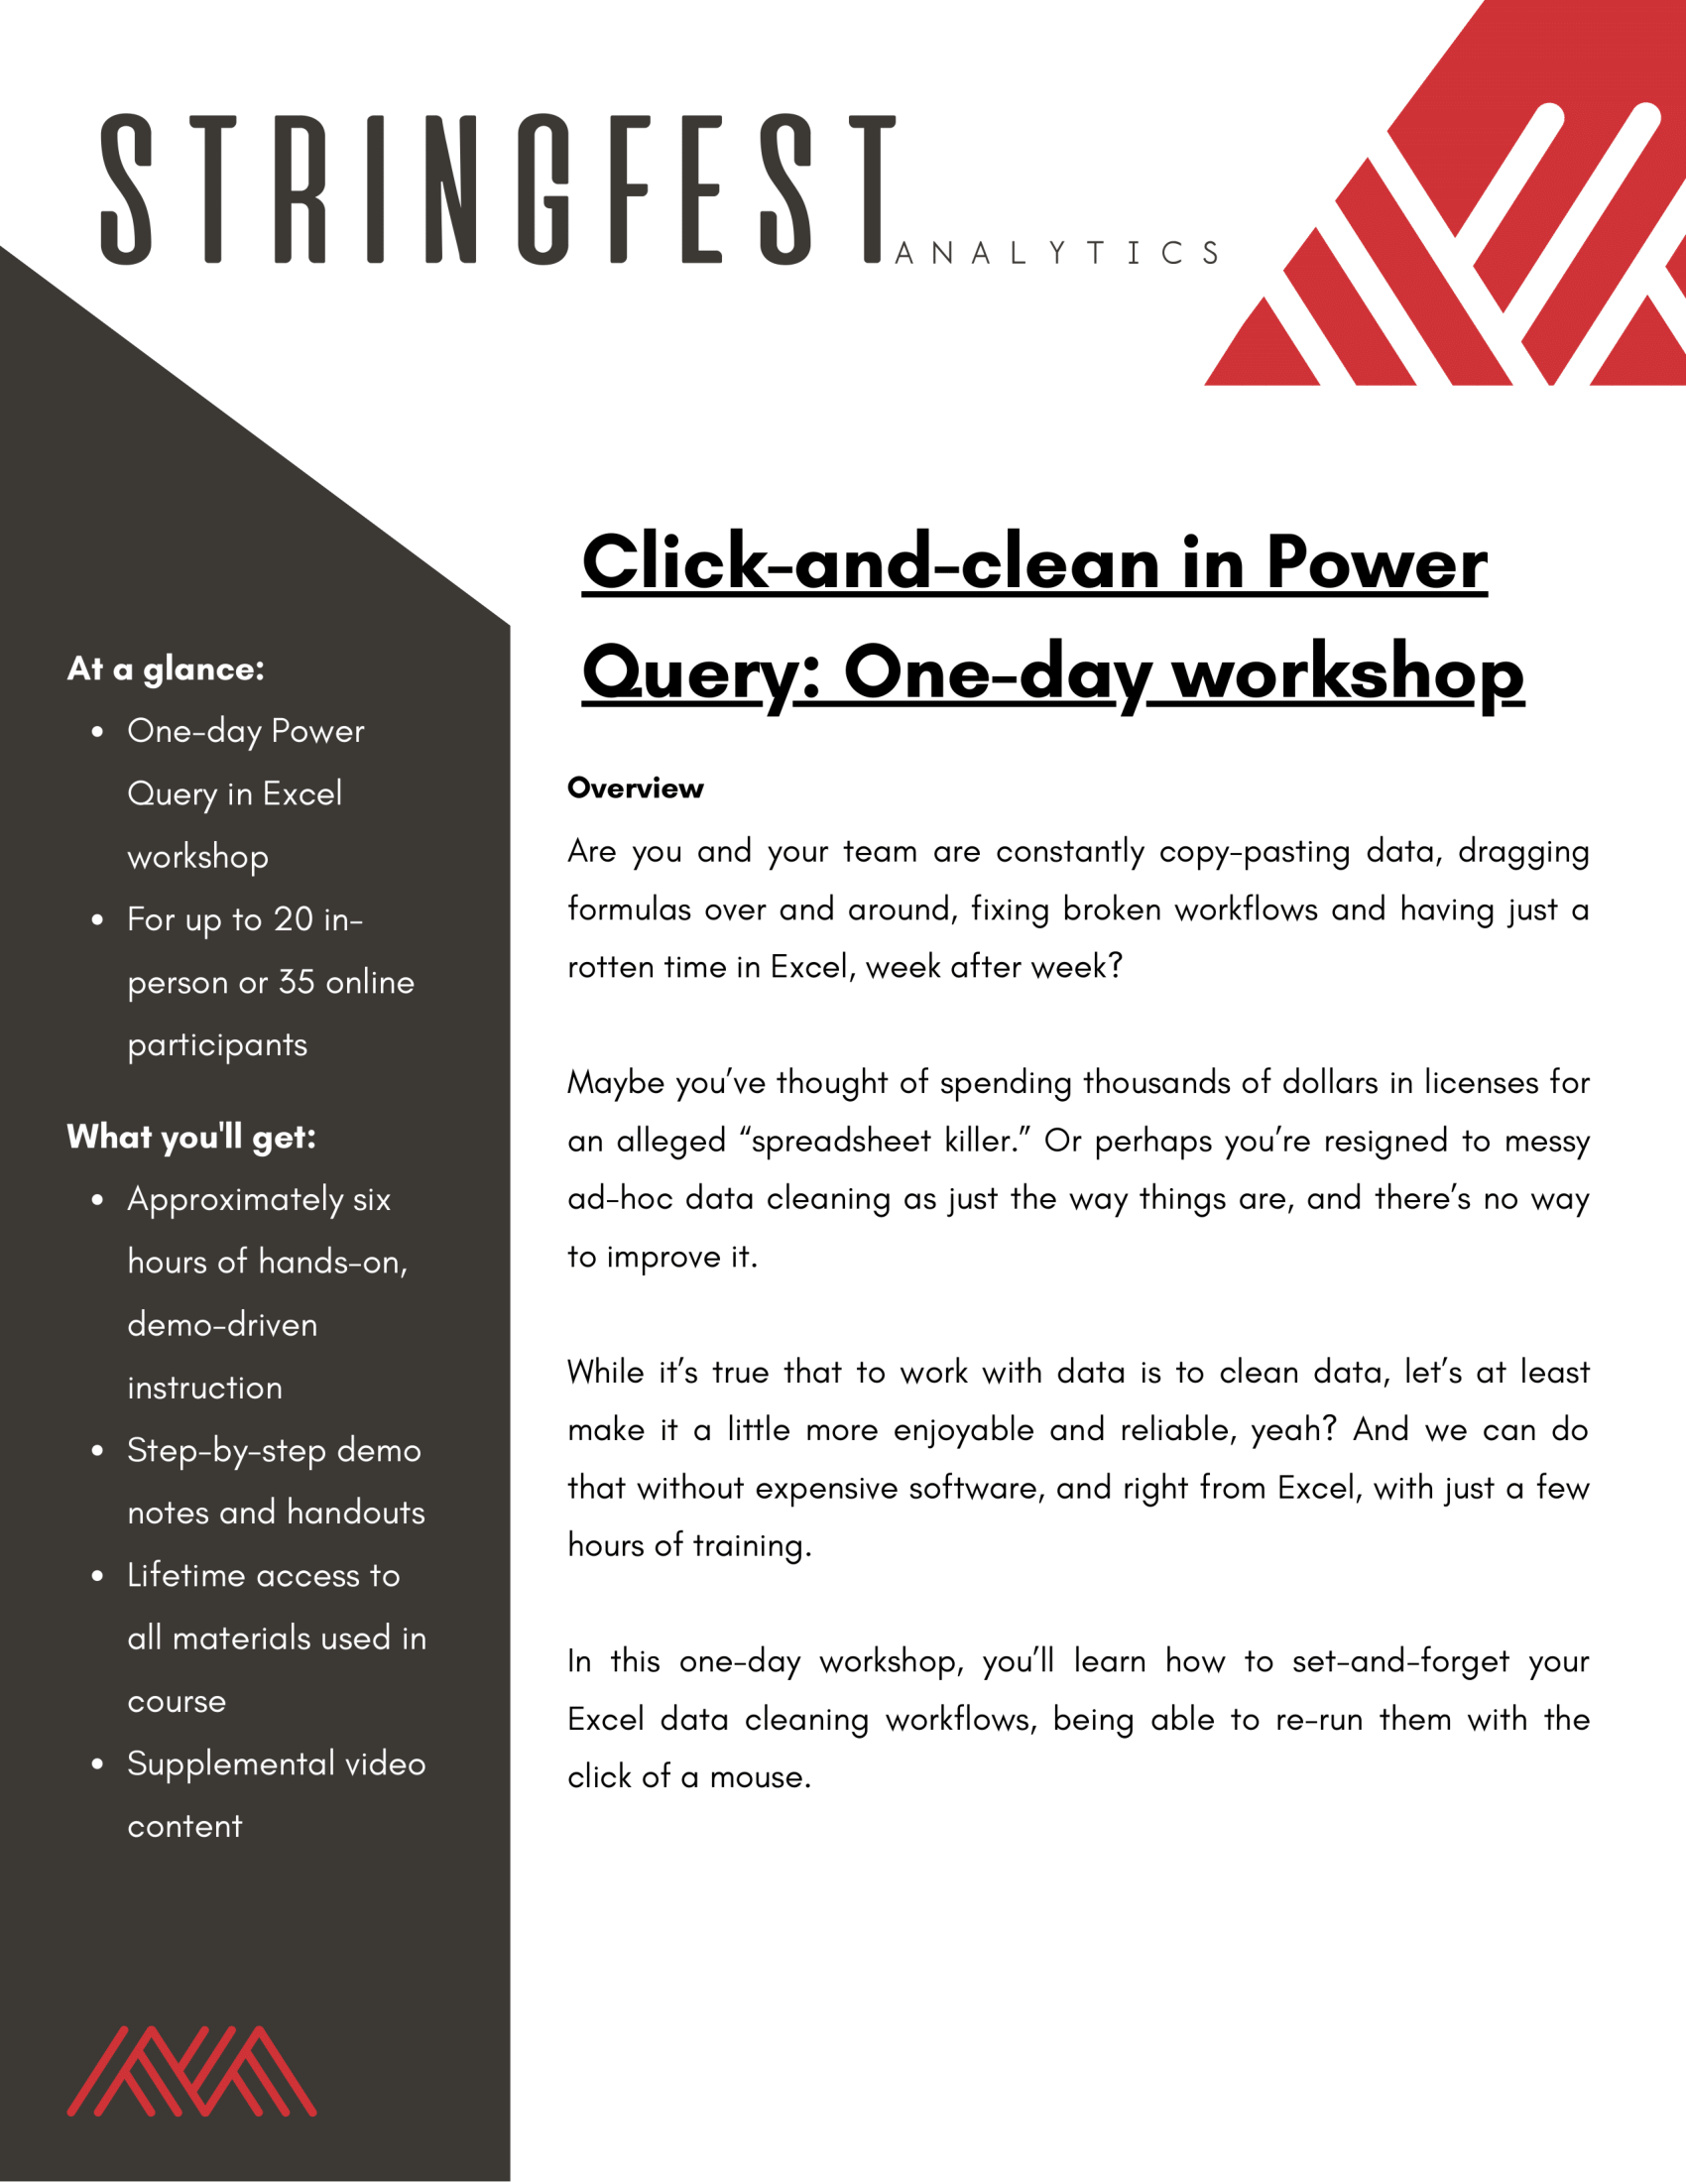
Power Query corporate training
Learn more and connect at https://stringfestanalytics.com/click-and-clean-pq-workshop/
Human Centered Design • MDLS 2020
Notes:
This one is a little more user friendly, it focuses on Excel and you will also learn about Power Pivot as well.

Slide 18

Power Query on-demand training
Download:
20% off with promocode PDQ
Human Centered Design • MDLS 2020
Notes:
This one is a little more user friendly, it focuses on Excel and you will also learn about Power Pivot as well.

Slide 19
LET'S TALK
LINKEDIN
linkedin.com/in/gjmount
EMAIL ADDRESS
george@stringfestanalytics.com
WEBSITE
stringfestanalytics.com
GITHUB
github.com/summerofgeorge
Notes:
Thanks for coming! Feel free to contact me anytime, find me on LinkedIn, I also write frequently on this stuff so check out my website too.

Slide 20
QUESTIONS?
Thanks for joining!
A recap email with recording, survey and more will be coming…
The recording stays up for seven days!
Notes:
Any questions on descriptive statistics?

Slide 21


BUT WAIT THERE’S MORE
50% OFF MY POWER QUERY COURSE THIS WEEK
PROMOCODE NOHARDCODES
https://swiy.co/learn-pq
Notes:
Any questions on descriptive statistics?

