Slide 1


Intro to Copilot for Excel

Slide 2

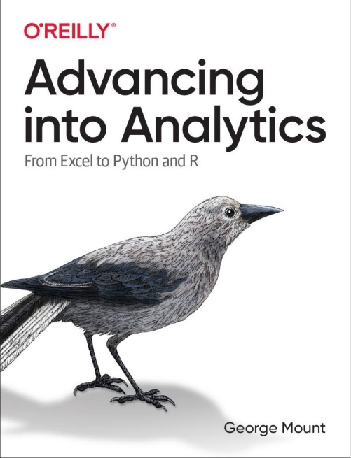
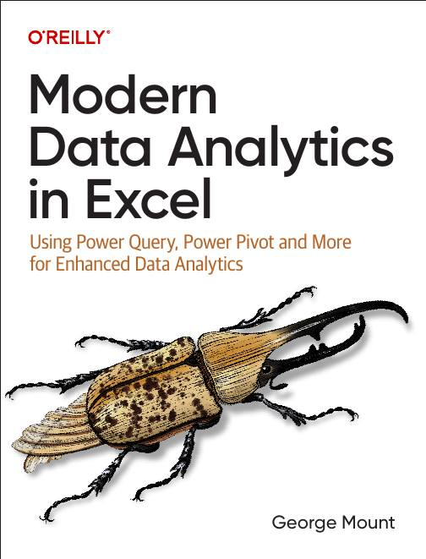



Hi, I’m George

Slide 3

Objectives for this session
Analyze Data: Free early alternative to Copilot 🧮
Power Query for clean, structured data ⚡
Copilot on penguins data: formatting, calculated columns, charts, PivotTables 🐧
(time permitting) Advanced Analysis with Python 🐍

Slide 4
Exercise files for today
Download at https://github.com/stringfestdata/profitable-ai-copilot-excel/archive/refs/heads/main.zip
Be sure to decompress folder

Slide 5
Starting point: Analyze Data
Workbook: wholesale-customers.xlsx
Explore Analyze Data for quick insights
Try natural language querying
How can we get better results with cleaner data?
Notes:
False!
Function, Formula, Function
Argument

Slide 6
Why Power Query?
Copilot works best with clean, structured data
Power Query makes data machine-readable
Ensures better results with Copilot and Analyze Data
Notes:
False!
Function, Formula, Function
Argument

Slide 7
Studying penguins with Copilot
Workbook: penguins.xlsx
Getting data Copilot-friendly
Formatting data as a Table
Creating calculated columns
Building summary charts
Using PivotTables
Exploring advanced analysis with Python in Excel
Notes:
False!
Function, Formula, Function
Argument

Slide 8
Studying penguins with Copilot
Workbook: penguins.xlsx
Getting data Copilot-friendly
Formatting data as a Table
Creating calculated columns
Building summary charts
Using PivotTables
Exploring advanced analysis with Python in Excel
Notes:
False!
Function, Formula, Function
Argument

Slide 9
Key takeaways for today

Slide 10
Wrap-up and resources
What questions do you have?
Resources: https://github.com/stringfestdata/profitable-ai-copilot-excel/archive/refs/heads/main.zip
Follow me: stringfestanalytics.com
Connect: linkedin.com/in/gjmount
Free until end of year: Copilot in Excel Course at https://www.linkedin.com/learning/excel-with-copilot-ai-driven-data-analysis
Notes:
False!
Function, Formula, Function
Argument

Slide 11
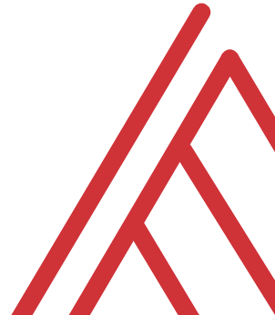
Questions?

Slide 12
Thank you

