Slide 1


Slide 2

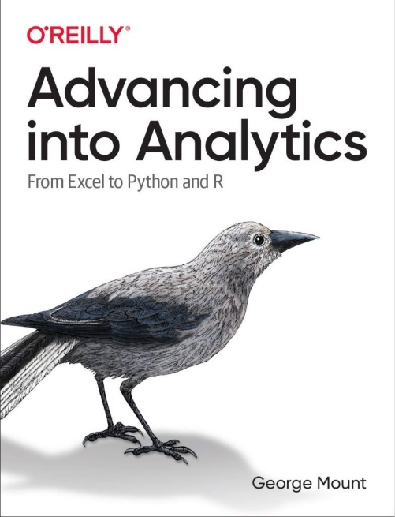
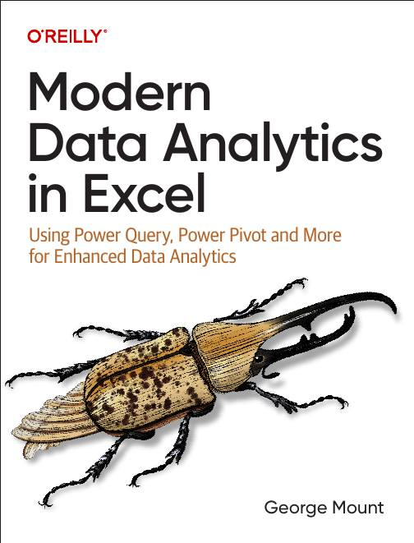



About me

Slide 3

Objectives for this session
Structured data foundations with Tables & Power Query
Instant insights with Copilot, PivotTables & charts
Python in Excel for flexible analysis
Agent Mode in action and how it relates vs Copilot
The new AI-powered Excel workflow

Slide 4
Exercise files for today
Download at https://github.com/stringfestdata/profitable-ai-copilot-excel/archive/refs/heads/main.zip
Be sure to decompress folder

Slide 5
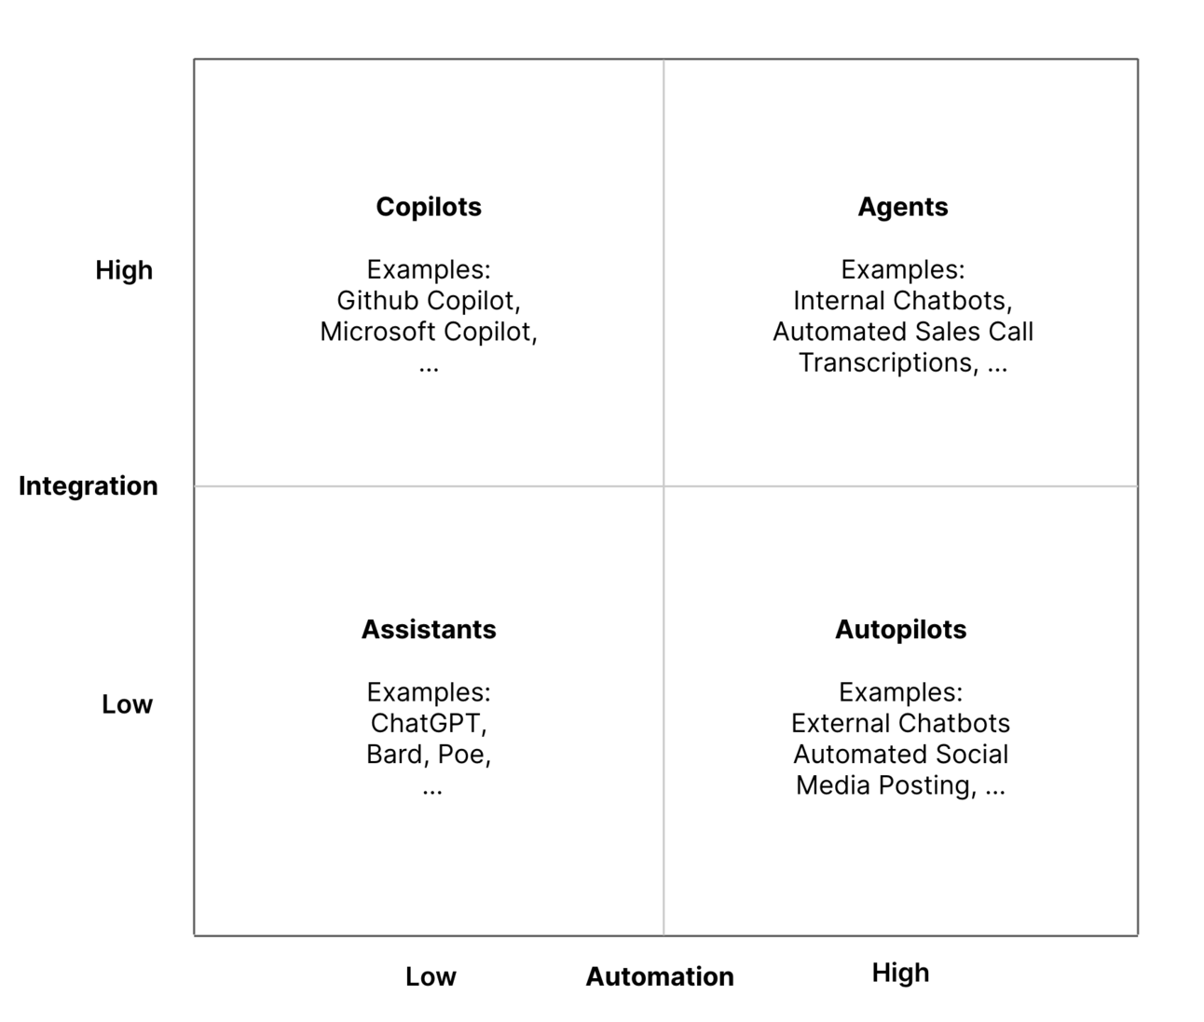
The integration-automation AI framework
https://blog.tobiaszwingmann.com/p/integration-automation-ai-framework
Notes:
This chart shows the spectrum of AI tools based on two dimensions: how deeply they’re integrated into your workflow, and how much they can automate on their own.
In the bottom left, we have Assistants like ChatGPT or Bard. These tools are conversational and flexible, but they exist outside your main work environment. They can generate ideas, write text, or help explain concepts, but you have to feed them the context yourself. They don’t automatically connect to your files or data.
Moving up to the top left are Copilots, like Microsoft Copilot in Excel. These tools are highly integrated into your daily work tools. Copilot in Excel knows your workbook, formulas, and tables. It can help you analyze data, write formulas, and generate summaries—all inside Excel. But it’s still assistive, not autonomous. You’re in control, and it only acts when you prompt it.
On the bottom right are Autopilots, which handle repetitive processes automatically but without much awareness of your data. These might include automated social media posting or simple scheduled tasks. They act independently but lack real integration with your work context.
Finally, in the top right are Agents. These combine deep integration with high automation. Agents can understand your business data and act proactively—like automatically generating reports, summarizing meetings, or triggering workflows across apps.
Copilot in Excel sits in the “Copilot” quadrant—it’s deeply embedded in your tools but still relies on you to guide it. Agent Mode is what happens when that same intelligence gains the ability to take initiative. It builds on Copilot’s understanding of your data but can connect across multiple apps and act without waiting for your command.
In short, Copilot helps you do the work; Agent Mode will start doing the work for you.

Slide 6
Starting point: Analyze Data
Workbook: wholesale-customers.xlsx
Explore Analyze Data for quick insights
Try natural language querying
How can we get better results with cleaner data?

Slide 7
Why Power Query?
Copilot works best with clean, structured data
Power Query makes data machine-readable
Ensures better results with Copilot and Analyze Data

Slide 8
Studying penguins with Copilot
Workbook: penguins.xlsx
Getting data Copilot-friendly
Formatting data as a Table
Creating calculated columns
Building summary charts
Using PivotTables
Exploring advanced analysis with Python in Excel

Slide 9
Excel Copilot vs Excel Agent Mode
Feature | Excel Copilot | Agent Mode
Interaction | One-shot prompts | Iterative, self-guided workflow
Task Scope | Single actions (formulas, charts, summaries) | Multi-step processes across sheets
Error Handling | User re-prompts or fixes | Agent reviews, retries, self-corrects
User Role | You do, Copilot helps | You manage, Agent executes
Output Quality | Fast but shallow | Verified and repeatable
Best For | Quick wins, ad-hoc tasks | Structured, high-stakes workflows
Analogy | Smart assistant | Junior analyst
Notes:
When people hear Copilot and Agent Mode, they often assume they are the same thing, but they represent very different stages in how AI works inside Excel.
Copilot is what most of us have used so far. It is a great assistant when you need to generate a formula, summarize some data, or clean up a quick report. You ask it a question, it gives an answer, and then it is up to you to decide what to do next. It is reactive. It waits for your prompt each time.
Agent Mode takes this a step further. Instead of a single prompt and response, the agent can plan, execute, and evaluate multiple steps on its own. It does not just answer you, it actually works with you, refining its approach until it gets the result right. Think of it as the difference between giving someone an instruction versus giving them a project.
That also changes your role as the analyst. With Copilot, you are still the one doing the work, just faster. With Agent Mode, you become more of a manager or reviewer, someone who guides, oversees, and checks the agent’s work. The focus shifts from “Can I get this formula right?” to “Can I structure and verify the workflow my agent is running?”
In terms of output, Copilot is great for speed. You will get something usable right away. Agent Mode is built for reliability. It double checks itself, validates formulas, and produces outputs that are more auditable and refreshable. That is what makes it better suited for more complex or higher stakes workflows like financial models, reconciliations, or recurring dashboards.
So the short version is: Copilot accelerates your work. Agent Mode begins to do the work. The real opportunity for Excel professionals is learning how to manage and guide these new digital teammates effectively.

Slide 10
Demo: Agent Mode in action
Loan calculator
Variance analysis
Monthly close pack
What does Agent Mode do well, poorly, or not at all?
How does this relate to other tools in the Excel AI stack?

Slide 11
The emerging Excel AI stack
Stage | Purpose | Tools
1. Data Foundation | Store, structure, and retrieve data | Power BI, Dataverse
2. Data Preparation | Clean, shape, and combine data | Power Query/Dataflows
3. Analysis & Intelligence | Explore data and get insights | Excel (with Copilot, Python, Agent Mode)
4. Automation & Extension | Repeat, scale, and connect processes | Office Scripts, Power Automate
5. Customization & Governance | Control, deploy, and monitor AI agents | Copilot Studio
Notes:
This table shows how the tools in the Excel AI stack fit together and build on one another. It follows the natural flow of how data moves through a modern analytics process — from storage, to preparation, to analysis, to automation, and finally to customization and governance.
At the foundation are Power BI and Dataverse, which serve as the data backbone. They provide the structured, secure, and governed data sources that every other layer depends on. This is where the organization’s single source of truth lives.
Just above that are Power Query and Dataflows, which handle data preparation. Power Query is built into Excel and Power BI, allowing users to clean, reshape, and combine data within a workbook or report. Dataflows take those same transformation steps and run them in the cloud, making them reusable across different files and apps. Together, they form the data preparation layer that ensures agents and copilots are working from high-quality, consistent information.
Then we reach the Excel layer, which is where most users spend their time. Inside Excel we now have three main AI tools: Copilot in Excel, Python in Excel, and Agent Mode. Copilot helps with quick insights and formula generation through natural language. Python in Excel brings advanced analytics, modeling, and visualization right inside the workbook. And Agent Mode takes it further by allowing AI to plan, act, and refine multi-step tasks on its own. These three tools make Excel both a familiar workspace and a full-fledged AI analysis platform.
Above that come Office Scripts and Power Automate, which handle logic and automation. Office Scripts define repeatable workflows that can be triggered inside Excel, while Power Automate connects those workflows across Microsoft 365 and beyond. They turn your Excel agents into active participants in larger business processes.
At the top is Copilot Studio, which provides customization and governance. This is where organizations build, deploy, and manage their own copilots and agents, deciding what they can do, how they behave, and what data they can access.
Altogether, this stack shows how Excel has evolved from a standalone spreadsheet into a connected, intelligent platform. Power Query and Dataflows prepare the data, Excel tools like Copilot, Python, and Agent Mode turn that data into insight, and automation layers like Office Scripts and Power Automate put it into action — all governed and managed through Copilot Studio.

Slide 12
Wrap-up and resources
What questions do you have?
Resources: https://github.com/stringfestdata/profitable-ai-copilot-excel/archive/refs/heads/main.zip
Follow me: stringfestanalytics.com
Connect: linkedin.com/in/gjmount
Free until end of year: Copilot in Excel course at https://www.linkedin.com/learning/excel-with-copilot-ai-driven-data-analysis
Notes:
False!
Function, Formula, Function
Argument

Slide 13

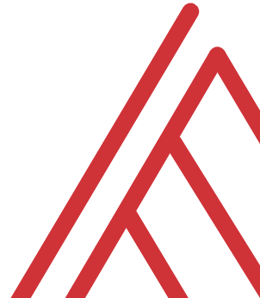

Questions?

Slide 14
Thank you

