Slide 1


Intro to Copilot for Excel

Slide 2

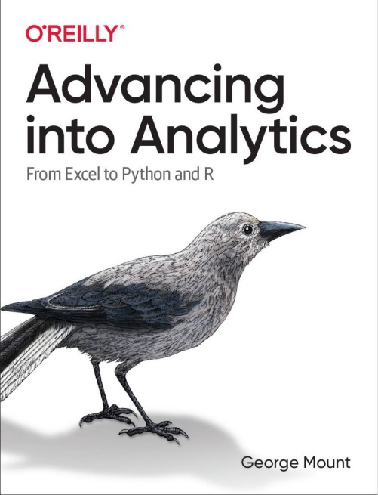
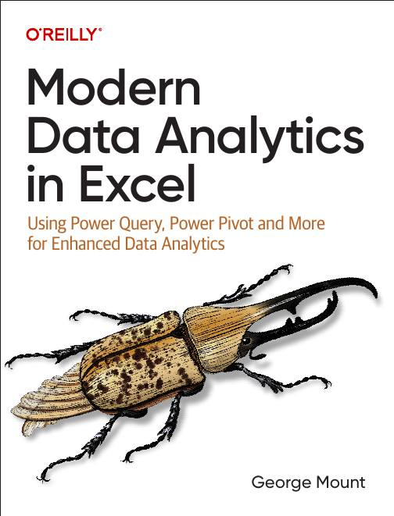



Hi, I’m George

Slide 3

Objectives for this session
Analyze Data: Free early alternative to Copilot 🧮
Power Query for clean, structured data ⚡
Copilot on penguins data: formatting, calculated columns, charts, PivotTables 🐧
(time permitting) Advanced Analysis with Python 🐍

Slide 4
Exercise files for today
Download at
Be sure to decompress folder

Slide 5
First flow with Power Automate
Use Power Automate templates for Excel
Create clock in/clock out workflow
File: first-flow.xlsx
Notes:
False!
Function, Formula, Function
Argument

Slide 6
Customizing outputs with Power Fx
Continue with the previous example
How can we improve appearance of outputs in Excel?
Resource: https://stringfestanalytics.com/power-automate-for-excel-how-to-understand-the-power-fx-programming-language/
Notes:
False!
Function, Formula, Function
Argument

Slide 7
Building flows with Copilot
Get AI assistance to build a flow
Create a monthly email/post to Teams based on data in a workbook
File: power-automate-copilot.xlsx
Resource: https://stringfestanalytics.com/power-automate-for-excel-how-to-build-flows-with-copilot/
Notes:
False!
Function, Formula, Function
Argument

Slide 8
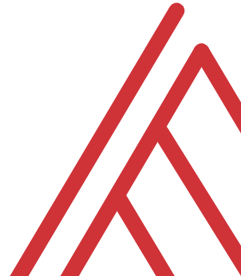
Questions?

Slide 9
Thank you

