Slide 1
A LIVE WORKSHOP
Python in Excel:
Your First Hour
Load a real dataset · Explore it with pandas · Build a chart Excel can't touch
Notes:
Welcome in. If you're seeing this slide, you're in the right place, this is Python in Excel: Your First Hour.
Here's the deal for the next sixty minutes. We're going to load a real dataset together. We're going to explore it with pandas. And we're going to build a chart Excel can't touch.
You don't need to be a programmer. You just need to be comfortable in Excel. I'll do everything live, you can follow along, and you'll leave with the files we used today.

Slide 2
This is for you if…
→ You've heard the words "Python in Excel" but haven't typed =PY( yet.
→ You're comfortable in Excel: formulas, tables, PivotTables, but the next step feels intimidating.
→ You want to leave the next hour having actually done it, not just watched a demo.
Notes:
Quick gut check. This session is for you if you've heard the words "Python in Excel" but haven't actually typed equals-P-Y yet.
It's for you if you're comfortable in Excel, formulas, tables, PivotTables, but the jump into code feels intimidating.
And it's for you if you want to leave the next hour having actually done it, not just watched a demo.
If that's you, you're in the right room. Let's go.

Slide 3
By minute 60, you will have…
1
2
3
Written your first PY() cell
Profiled a real dataset
Built a chart that earns gasps
Hello-world inside Excel, and you'll know exactly why your A1 reference broke.
200 sales orders, six pandas moves, fewer formulas than you'd guess.
A correlation heatmap in one line of code. Try doing that natively.
Notes:
Three things you'll walk out with.
One: you'll have written your first PY cell. Hello-world inside Excel. And, this is the part nobody warns you about, you'll know exactly why your A1 reference broke.
Two: you'll have profiled a real dataset. Two hundred sales orders, six pandas moves, fewer formulas than you'd guess.
Three: you'll have built a chart that earns gasps. A correlation heatmap in one line of code. Try doing that natively in Excel.
Three things. One hour. Let's get into it.

Slide 4
Part 1
Why Python in Excel exists
…and when to reach for it instead of formulas or Power Query.
≈ 10 minutes
Notes:
Part one. Why Python in Excel even exists, and when to reach for it instead of formulas or Power Query. About ten minutes here.

Slide 5
Where formulas start to feel cumbersome
Excel's grid is brilliant. Some tasks just don't fit on it.
Counting missing values across every column
Native Excel: nested COUNTBLANK per column. | pandas: sales_df.isna().sum()
Resampling and rolling-window time series
Native Excel: heroic helper columns. | pandas: one .resample() call.
Small multiples, jitter plots, heatmaps
Native Excel: not really. | seaborn: one line.
Multi-variable descriptive statistics
Native Excel: Analysis ToolPak round-trip. | pandas: .describe()
Notes:
Excel's grid is brilliant. I love it. I built my career in it. But some tasks just don't fit on a grid.
Counting missing values across every column. Native Excel: nested COUNTBLANK per column. Pandas: one expression, sales_df dot is-na dot sum.
Resampling a time series. Excel: heroic helper columns. Pandas: one dot resample call.
Small multiples, jitter plots, heatmaps. Excel: not really. Seaborn: one line.
Multi-variable descriptive stats. Excel: Analysis ToolPak round-trip. Pandas: dot describe.
This is the gap Python in Excel fills.

Slide 6
When to reach for what
Three tools, three jobs. They are not competitors.
Formulas
Power Query
Python in Excel
Quick lookups, references, ad-hoc math
Repeatable data prep & connections
Analysis, stats, custom viz
Best when the answer lives in nearby cells.
Best when the same prep runs again next month.
Best when you need pandas, seaborn, or statsmodels.
▸ XLOOKUP, IF, SUMIFS
▸ Cell-anchored logic
▸ Volatile recalc
▸ Connect & combine
▸ Clean & shape
▸ Refresh on demand
▸ DataFrames & groupby
▸ Heatmaps, pairplots
▸ One-line summaries
Notes:
Here's the part I want you to remember. Python in Excel is not a competitor to formulas or Power Query. They each have a job.
Formulas are for quick lookups, references, ad-hoc math. Cell-anchored logic. XLOOKUP, IF, SUMIFS.
Power Query is for repeatable data prep. When the same cleanup has to run again next month, that's Power Query.
Python in Excel is for analysis. Statistics. Custom visualizations. DataFrames, group-by, heatmaps.
Three tools, three jobs. Reach for the right one and your life gets easier.

Slide 7
Part 2
Hello, world: in a cell.
How a PY() cell works · output modes · the calc-order gotcha.
≈ 10 minutes • open ch_01.xlsx
Notes:
Part two. How a PY cell actually works. If you're following along, open the first workbook, zero one dash your dash first dash py dash cell. About ten minutes here.

Slide 8
Three ways to insert a PY() cell
Use whichever feels least like work.
1
2
3
Ribbon
Type it
Keyboard
Formulas tab → Insert Python.
=PY( in any cell.
Ctrl + Alt + Shift + P
The discoverable one.
Once you trust it.
Once you're showing off.
Look for the green PY badge in the cell + formula bar, that's your confirmation.
Notes:
Three ways to insert a Python cell. Use whichever feels least like work.
One: the ribbon. Formulas tab, Insert Python. That's the discoverable one, especially the first few times.
Two: just type equals-P-Y, open paren. Once you trust it, this is fastest.
Three: keyboard shortcut. Control Alt Shift P. Once you're showing off in a meeting.
Whichever you use, look for the green P-Y badge in the cell and the formula bar. That's your confirmation you're in a Python cell, not a regular one.

Slide 9
Two ways to see your output
Toggle: Ctrl + Alt + Shift + M (or click the icon left of the formula bar)
Python Object (default)
Excel Value
Shows a card icon, dimensions, preview
Stays in one cell: no spill
Best mid-analysis: chain operations on it
Acts like a linked data type
Spills into the grid as a dynamic array
Format with normal Excel tools
Best at the end: hand-off to formulas / charts
Reference it like any spilled range
Notes:
Once a Python cell runs, there are two ways to see the output. Toggle is Control Alt Shift M.
Default is Python Object. You'll see a little card icon, the dimensions, and a preview. The output stays in one cell. That's great mid-analysis because you can chain operations on it.
The other mode is Excel Value. The output spills into the grid as a dynamic array. Format it with normal Excel tools, reference it with normal formulas. That's great at the end, when you're handing off to charts.
I'll stay in Python Object mode most of today. We'll flip to Excel Value when it makes sense.

Slide 10
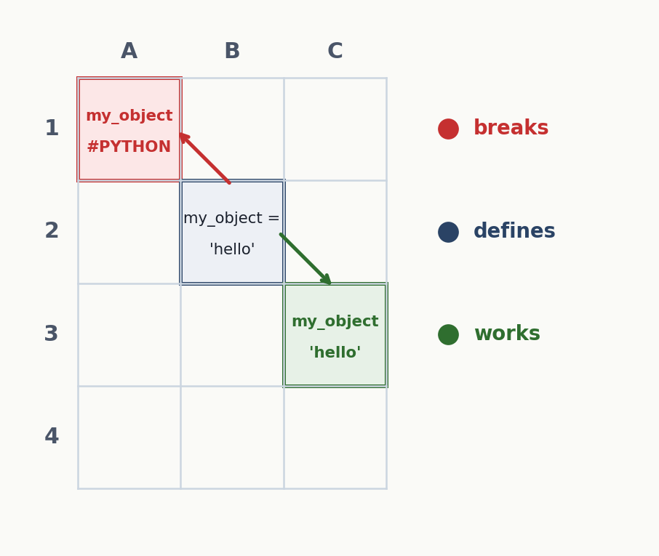
The one gotcha that will trip you up
Python in Excel runs cells left-to-right, top-to-bottom, like reading a page.
If you define my_object in B2, you can reference it in:
any cell to the right of B2 in row 2
any cell in rows 3, 4, 5, …
NOT in row 1, A1 throws #PYTHON
Recovery move:
Put your imports and variables in the top-left. Build down and right.
Notes:
Pay attention to this one, because it will bite you.
Python in Excel runs cells left to right, top to bottom. Like reading a page.
So if you define a variable in B2, you can reference it in any cell to the right of B2 in the same row. You can reference it in any cell in row three, row four, and below. But you cannot reference it in row one, A1 is above B2, and you'll get a hash-PYTHON error.
The fix is simple. Put your imports and your variables in the top-left of the worksheet. Build down and to the right. Read it like a page.

Slide 11
Part 3
Exploring a real dataset with pandas
200 orders. Six methods. Zero pivot tables.
≈ 25 minutes • switch to ch_02.xlsx
Notes:
Part three. This is the meat of the session. Switch over to the second workbook, zero two dash explore dash with dash pandas. Two hundred orders, six pandas methods, no pivot tables. About twenty-five minutes.

Slide 12
Step 1: Get the data into a DataFrame
Convert the range to an Excel Table first (Insert → Table). Name it.
sales_df = xl("sales[#All]", headers=True)
sales_df
Two things to notice:
xl() is the bridge from a worksheet range/table into Python.
headers=True is auto-added when you point it at a table, keep it.
Returning the DataFrame on its own line shows the data card preview.
Notes:
First step: get the data into a DataFrame. One detail before we touch Python: convert your range to an Excel Table first. Insert, Table. Give it a name. Mine is called sales.
Now in a PY cell, sales_df equals x-l, in parentheses, the string "sales hash all", then headers equals True. That x-l function is the bridge from a worksheet range into Python.
Heads-up: headers equals True is added automatically when you point x-l at a Table. Keep it.
And if you return the DataFrame on its own line, just type sales_df and press enter, you'll see the data card preview. Sanity check that the data made it in.

Slide 13
Profile in 30 seconds
Four moves before you do anything serious.
sales_df.head()
First 5 rows. Sanity check that it loaded.
sales_df.tail()
Last 5. Sanity check the bottom (often messier).
sales_df.sample(5)
Random 5. Catches issues a head/tail can hide.
sales_df.shape
Rows × columns. Mine for today: (200, 7).
Notes:
Four moves I run before I do anything serious with a dataset.
Dot head: first five rows. Sanity check it loaded.
Dot tail: last five rows. Sanity check the bottom, which is often messier than the top.
Dot sample five: five random rows. Catches issues a head or tail can hide.
Dot shape: rows by columns. Today's dataset is two hundred by seven. Now I know what I'm working with.

Slide 14
Two more profiling wins
describe()
isna().sum()
Summary stats in one shot
Missing values per column
sales_df.describe()
sales_df.describe(
percentiles=[.1, .5, .9])
sales_df.describe(
exclude='number')
sales_df.isna().sum()
# as a %
sales_df.isna().sum() / len(sales_df)
# sort & chain
(sales_df.isna().sum()
.sort_values(ascending=False))
Our customer_age has six gaps, perfect teaching moment.
Numeric by default. exclude='number' for text columns.
Notes:
Two more profiling wins.
Dot describe gives you summary stats in one shot. Mean, standard deviation, min, max, quartiles. Numeric by default. Pass exclude equals number and it'll describe the text columns instead.
Dot is-na dot sum gives you missing values per column. Divide by len of the DataFrame if you want a percent. Sort it if you want the worst columns first.
In our dataset, customer-age has six gaps. That's perfect: gives us a teaching moment about missing data.

Slide 15
Counting categories: value_counts()
The PivotTable replacement for frequency.
Code
Expected output
sales_df['country']
.value_counts()
# proportions
sales_df['category']
.value_counts(
normalize=True)
United States
77
Germany
43
United Kingdom
39
Canada
26
Australia
15
Notes:
Value counts. This is your PivotTable replacement for frequency.
Sales_df, square brackets country, dot value-counts. You get a sorted count of every country in the data. United States seventy-seven, Germany forty-three, U-K thirty-nine, Canada twenty-six, Australia fifteen.
Want proportions instead of raw counts? Pass normalize equals True. Now you're looking at percentages.
One line. In a PivotTable you'd be dragging fields. Not bad.

Slide 16
groupby(): the PivotTable, in code
Split → apply → combine.
# Average price by country
sales_df.groupby('country')['unit_price'].mean()
# Multiple stats at once
sales_df.groupby('country')['unit_price'].agg(['mean','min','max'])
# Group by two columns
sales_df.groupby(['country','category'])['unit_price'].mean()
Like an Excel PivotTable, except you can chain it, filter it, and feed it into a chart.
Notes:
Group-by is the PivotTable, in code. Split. Apply. Combine.
Sales_df dot group-by country, then bracket unit_price, dot mean. That's average unit price by country.
Want multiple stats at once? Dot a-g-g, list of mean, min, max. Boom: three columns of summary.
Group by two columns? Pass a list: country and category. Now you have a nested summary.
It's like a PivotTable, except you can chain it. You can filter it. You can feed it directly into a chart.

Slide 17
Stitching it together
"What's the average price by category, but only in the US, sorted high to low?"
us = sales_df[sales_df['country'] == 'United States']
by_cat = us.groupby('category')['unit_price'].mean()
by_cat.sort_values(ascending=False)
Filter → group → sort. Same shape as an Excel workflow, just spelled in code.
Notes:
Now let's stitch it together. Real question: "What's the average price by category, but only in the U-S, sorted high to low?"
First line: filter sales_df where country equals United States. Call that "us".
Second line: group us by category, take the mean of unit_price. Call that "by_cat".
Third line: by_cat dot sort-values, ascending equals False.
Filter. Group. Sort. Same shape as an Excel workflow. Just spelled in code.

Slide 18
Bonus pandas moves, if we have time
Three more PivotTable-replacements. Each is one line.
# Sort by a column, descending
sales_df.sort_values('unit_price', ascending=False)
# Filter rows with .query()
sales_df.query("unit_price > 100 and country == 'Germany'")
# Top N rows by a metric
sales_df.nlargest(5, 'quantity')
sort_values, .query(), nlargest: the three I reach for after groupby.
Notes:
If we're moving fast, here are three more I reach for after group-by.
Sort_values: sort the whole DataFrame by a column. Pass ascending equals False if you want descending.
Dot query: filter rows with an English-like expression. Quote the whole filter as a string. Unit_price greater than one hundred, and country equals Germany.
Dot n-largest: top N rows by a metric. N-largest five, quantity, gives you the five biggest orders.
Three more lines. Three more PivotTable replacements. Skip this slide if we're short on time.

Slide 19
Part 4
One chart that earns gasps.
A correlation heatmap. In one line of code.
≈ 10 minutes
Notes:
Part four. One chart Excel can't natively produce. About ten minutes.

Slide 20
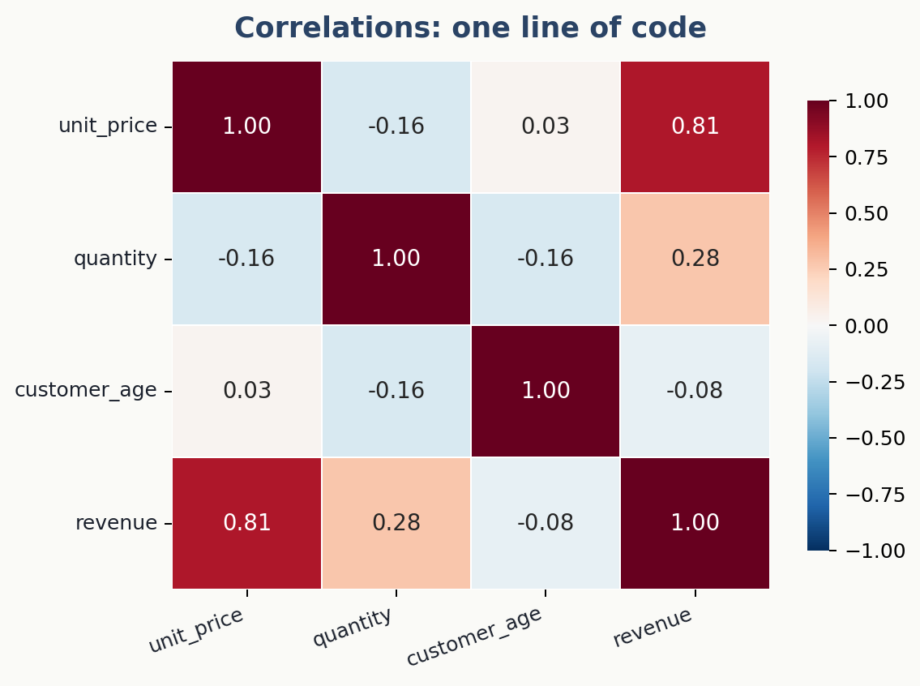
The whole recipe
import seaborn as sns
sales_df['revenue'] = (
sales_df['unit_price']
* sales_df['quantity']
)
sns.heatmap(
sales_df.corr(numeric_only=True),
annot=True,
cmap='RdBu_r',
center=0
)
Eight lines. A chart you'd lose 20 minutes to in native Excel.
Notes:
Here's the whole recipe. Eight lines.
Import seaborn as s-n-s.
Compute a revenue column as unit_price times quantity. Just so we have one more numeric column to play with.
Then, s-n-s dot heatmap, sales_df dot corr with numeric_only equals True, annot equals True so we see the numbers, c-map equals R-d-B-u underscore r so red is negative and blue is positive, center equals zero so the color scale balances around zero.
Run it. That's a correlation heatmap. You'd lose twenty minutes to that natively in Excel. We did it in eight lines.

Slide 21
Bonus flourish, if we have time
sns.pairplot(sales_df, hue='category')
One line. Every numeric variable plotted against every other one, color-coded by category.
Note: pairplots render slowly in cloud-backed PY() cells. Show, don't dwell.
Where Excel charts feel ceremonial, seaborn one-liners feel like cheating.
Notes:
If we have time, here's a bonus flourish. One line.
S-n-s dot pair-plot, sales_df, hue equals category. Every numeric variable plotted against every other one, color-coded by category.
Heads-up: pair-plots render slowly in cloud-backed PY cells. Show it, don't dwell on it.
Where Excel charts feel ceremonial, seaborn one-liners feel like cheating.

Slide 22
More chart one-liners, if we have time
Three more seaborn views: each a single line of code.
# Distribution of one numeric column
sns.histplot(sales_df, x='unit_price', bins=20)
# Spread of a metric across categories
sns.boxplot(sales_df, x='category', y='unit_price')
# Scatter with a fitted regression line
sns.regplot(sales_df, x='quantity', y='unit_price')
Histogram, boxplot, regression scatter. Each would be a 10-minute fight in native Excel.
Notes:
Three more seaborn one-liners worth having in your back pocket.
Hist-plot: distribution of one numeric column. Sales_df, x equals unit_price, bins equals twenty.
Box-plot: spread of a metric across categories. X equals category, y equals unit_price.
Reg-plot: scatter with a fitted regression line. X equals quantity, y equals unit_price.
Each one's a line. Each would be a ten-minute fight in native Excel. Skip if we're running long.

Slide 23
Part 5
Where to go from here.
Reading list · my book · the cheat sheet you'll get.
Notes:
Part five. Where to go from here. Quick section: about five minutes including takeaways.

Slide 24
Take this further
OFFICIAL DOCS
PRACTICE
GO DEEPER
Microsoft's Python in Excel docs
Today's workbooks
Advancing into Analytics
The source of truth for available packages, version requirements, and the latest features. The platform is still moving fast, bookmark it.
The two files from this workshop are yours to keep. Re-run the demos in your own time, then point xl() at one of your own tables and see what falls out.
My O’Reilly book. Builds on today’s mindset: taking spreadsheet skills into a real analytics stack with statistics, EDA, and your first scripts in both Python and R.
learn.microsoft.com
in your inbox
stringfestanalytics.com/book
Notes:
Three resources to take this further.
First: Microsoft's Python in Excel docs. Bookmark them. The platform is still moving fast. Packages and features get added. That's where you check what's current.
Second: today's workbooks. The two files we used are yours to keep. Re-run the demos in your own time. Then, and this is the part that makes it stick, point x-l at one of your own tables and see what falls out.
Third: if you want to go all the way from Excel into the analytics stack, my O'Reilly book, Advancing into Analytics, walks you through statistics, exploratory data analysis, and your first scripts in both Python and R. Link is stringfest analytics dot com slash book.

Slide 25
Three things to remember tomorrow
Save yourself the support ticket.
1
Cells run top-left to bottom-right.
If you reference a variable in a cell above or to the left of where it's defined, you'll get #PYTHON. Put your imports in the top-left and build down.
2
It runs in the cloud.
No internet, no PY(). And don't expect web-scraping or local file I/O, you can only pull data from inside the workbook.
3
Default is Python Object, not Excel Value.
If you want the data to spill into the grid, toggle: Ctrl + Alt + Shift + M. Otherwise you'll think nothing happened.
Notes:
If you remember three things tomorrow, make it these.
One. Cells run top-left to bottom-right. If you reference a variable above or to the left of where it's defined, you'll get hash-PYTHON. Put your imports in the top-left and build down.
Two. It runs in the cloud. No internet, no PY. And don't expect web scraping or local file I-O, you can only pull data from inside the workbook.
Three. The default output is Python Object, not Excel Value. If you want data to spill into the grid, toggle, Control Alt Shift M. Otherwise you'll think nothing happened.

Slide 26
Questions?
Drop them in chat, we'll work through as many as we can.
Cheat sheet + sample files in your inbox after we wrap.
Notes:
That's the hour. Drop questions in chat, we'll work through as many as we can.
Cheat sheet and sample files will be in your inbox after we wrap. Thanks for spending the hour with me.

