Slide 1



Python-Powered Excel

Slide 2
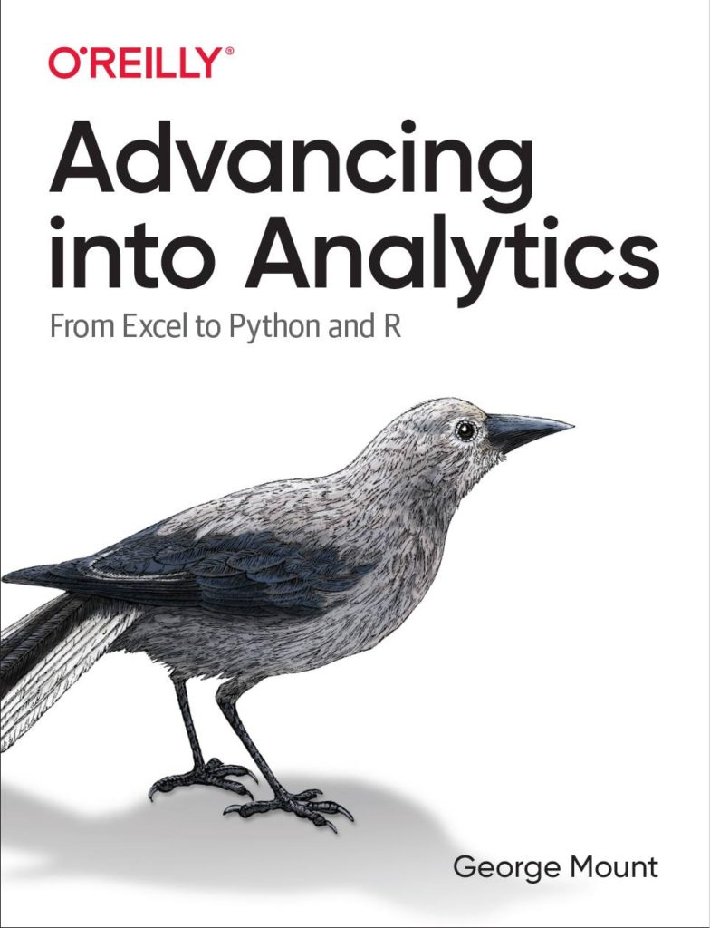

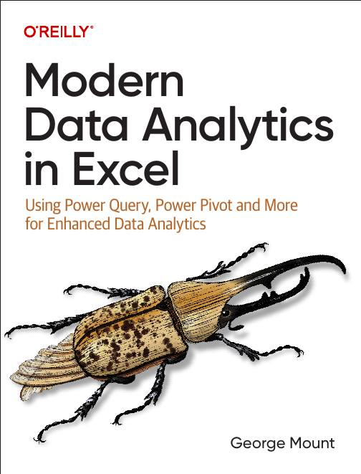


Hi, I’m George

Slide 3

Objectives for this session
Execute Python code directly within your Excel workbook.
Generate data analyses and visualizations with Python that would be difficult or impossible in Excel
Navigate and run code within Jupyter notebooks.
Completely automate the production of Excel workbooks using Python

Slide 4
Sections
Python in Excel: First steps
From “That’s hard in Excel” to “That’s easy in Python!”
There’s more to Python and Excel than Python in Excel

Slide 5
Following along
Each section is a folder
Follow demos with me
Solutions also available
Exercise folders with solutions for each section

Slide 6
1. Python in Excel: First Steps

Slide 7
Python in Excel: First steps
Understanding the Python in Excel environment
Loading Excel data into Python
Converting Python objects to Excel values
File: python-excel-first-steps.xlsx
Notes:
False!
Function, Formula, Function
Argument

Slide 8
Python in Excel: First steps EXERCISE
Load the penguins dataset into a DataFrame called penguins_df
Check the resulting dataset’s columns: run penguins_df.columns. Swith the output to display in Excel
Visualize relationship b/w bill length and body mass: run sns.scatterplot(x='bill_length_mm', y='body_mass_g', data=penguins_df). Practice resizing this plot.
File: python-excel-first-steps-exercise.xlsx
Notes:
False!
Function, Formula, Function
Argument

Slide 9
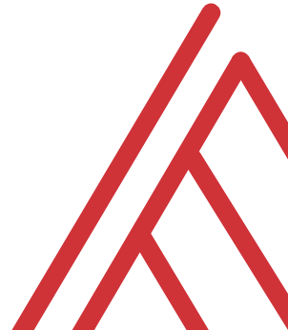
Questions?

Slide 10
2. From “that’s hard in Excel” to “that’s easy in Python”

Slide 11
From “that’s hard in Excel” to “that’s easy in Python” analysis
Data profiling: What is the shape, size, completeness?
Time series: pandas for panel data
Descriptive statistics/EDA: What stories might be told in this data?
File: hard-excel-easy-python-analysis.xlsx
Notes:
False!
Function, Formula, Function
Argument

Slide 12
From “that’s hard in Excel” to “that’s easy in Python” analysis EXERCISE
Explore relationship between sales, temperature, customer count over time
Fill in the blanks to complete the code
File: hard-excel-easy-python-analysis-exercise.xlsx
Notes:
False!
Function, Formula, Function
Argument

Slide 13
From “that’s hard in Excel” to “that’s easy in Python” visualization
Inserting and resizing Python plots in the workbook
Building plots in Python that would be difficult in Excel
Customizing the results of seaborn plots
File: hard-excel-easy-python-viz.xlsx
Notes:
False!
Function, Formula, Function
Argument

Slide 14
From “that’s hard in Excel” to “that’s easy in Python” visualization EXERCISE
Visualize this data to analyze sales, customer ratings, and more
Fill in the blanks to complete the code
File: hard-excel-easy-python-viz-exercise.xlsx
Notes:
False!
Function, Formula, Function
Argument

Slide 15
Questions?

Slide 16
3. There’s more to Python and Excel than Python in Excel

Slide 17
There’s more to Python and Excel than Python in Excel
Python in Excel is all about data analysis, visualization, statistics & ML
It lacks Excel automation capabilities
Let’s automate an entire Excel workbook from Python… without opening Excel!
File: pae-pie.ipynb
Notes:
False!
Function, Formula, Function
Argument

Slide 18
There’s more to Python and Excel than Python in Excel EXERCISE
Automate production of a workbook comparing website visitors versus rating
Fill in the blanks to create the script
File: pae-pie-exercise.ipynb
Notes:
False!
Function, Formula, Function
Argument

Slide 19
Questions?

Slide 20
4. Conclusion

Slide 21
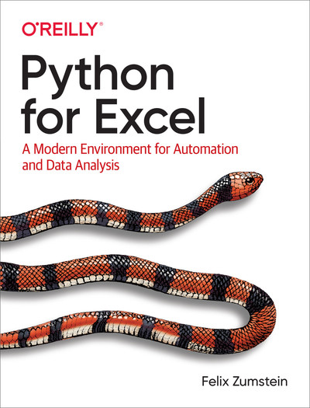
Resource: Python for Excel
Available on O’Reilly Online Learning: https://learning.oreilly.com/library/view/python-for-excel/9781492080992/
Notes:
False!
Function, Formula, Function
Argument

Slide 22

Resource: Advancing into Analytics
Available on O’Reilly Online Learning: https://learning.oreilly.com/library/view/advancing-into-analytics/9781492094333/
Notes:
False!
Function, Formula, Function
Argument

Slide 23
Resource: stringfestanalytics.com
Subscribe for updates & access to my data analytics learning resource library
Notes:
False!
Function, Formula, Function
Argument

Slide 24
THANK YOU
Linkedin.com/in/gjmount
Twitter: @gjmount
george@stringfestanalytics.com

