Slide 1
✓ Microphone off?
✓ Camera off?
✓ Fun on?

Slide 2


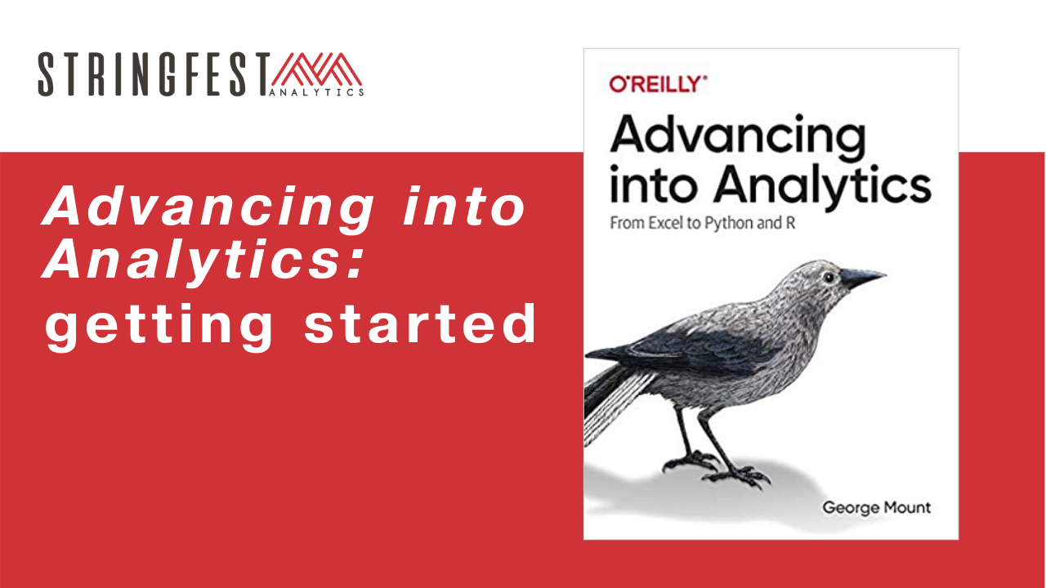
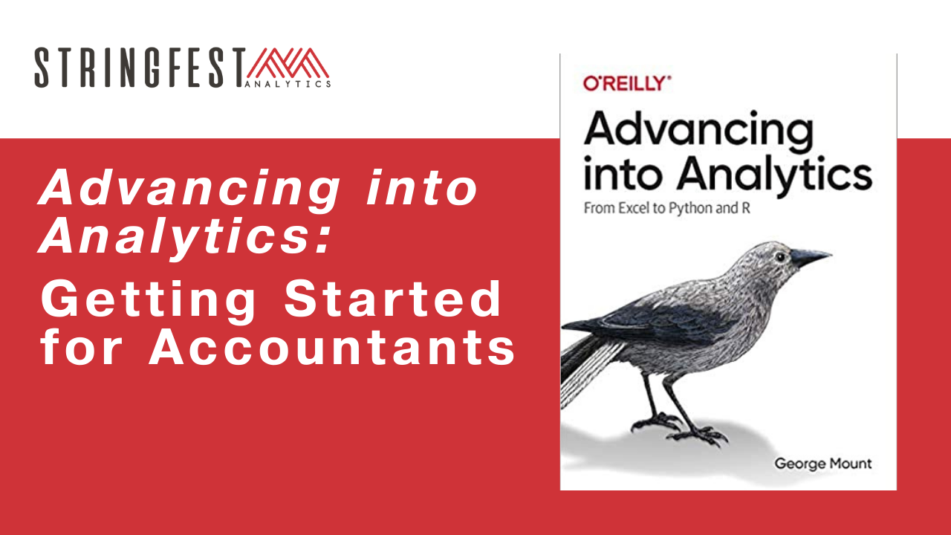
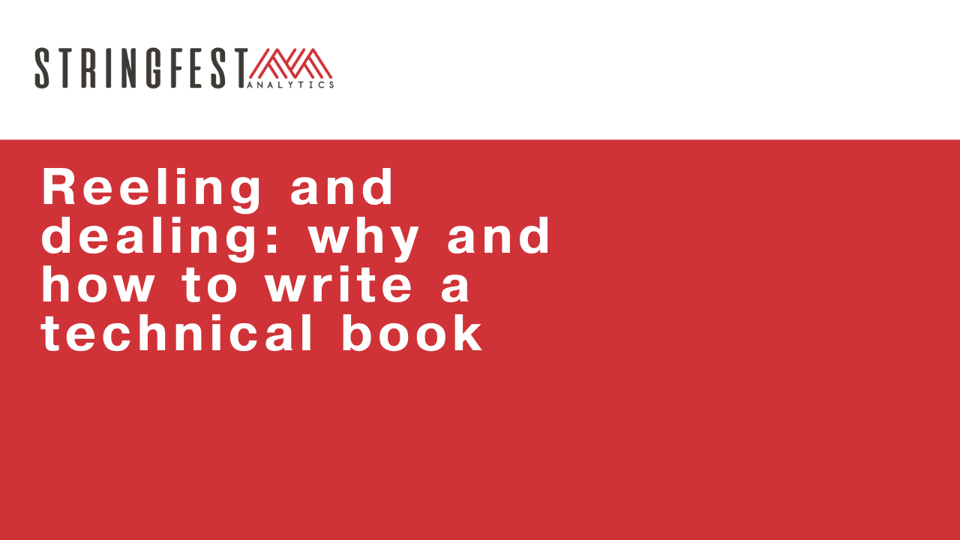
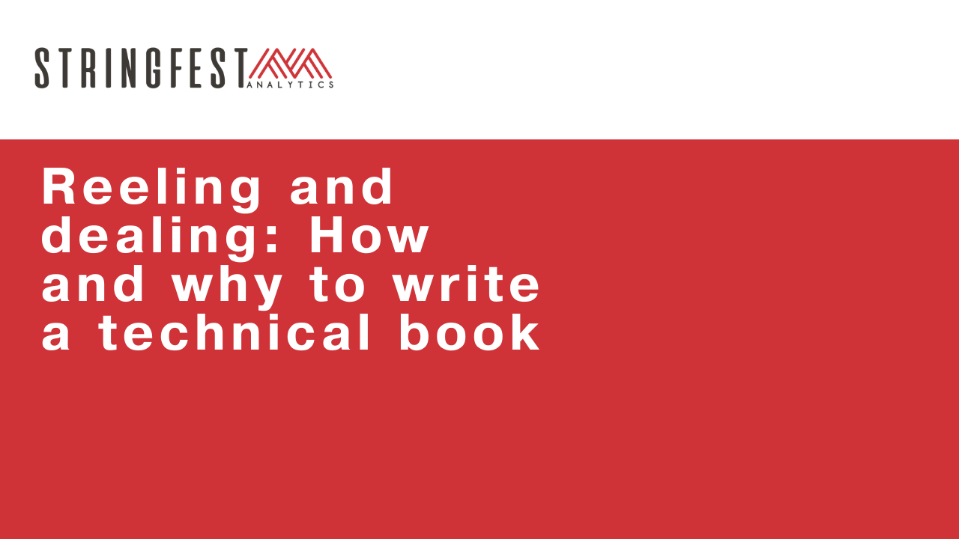
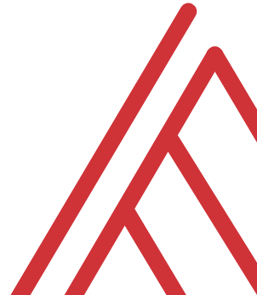
Advancing into Analytics: From Excel to R and Python

Slide 3
In the chat…
What excites you about doing a technical book? What scares you?
What field or topics are you considering?
Any questions? Lines are open throughout…
Notes:
Managerial
Audit
Tax
Something else

Slide 4
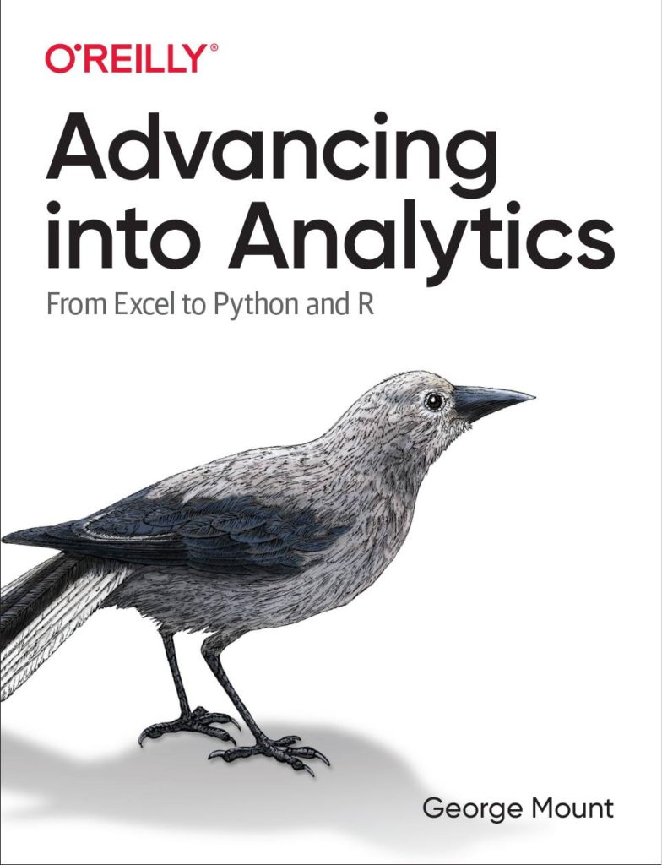
Learning objectives
Should you write a technical book?
What will it take?
How do you get started?

Slide 5
Assumptions
You’re planning to work with a publisher
You have some experience creating technical content
You don’t plan to become rich from book royalties
Notes:
If you’d like to follow along with the presentation, all resources are available at this link.
I also wanted to give a shout-out to Alan Turing, born on this day in 1912.

Slide 6
Follow along
Download resources: https://github.com/stringfestdata/reeling-dealing-technical-book/archive/refs/heads/main.zip
Notes:
If you’d like to follow along with the presentation, all resources are available at this link.
I also wanted to give a shout-out to Alan Turing, born on this day in 1912.

Slide 7
The context

Slide 8
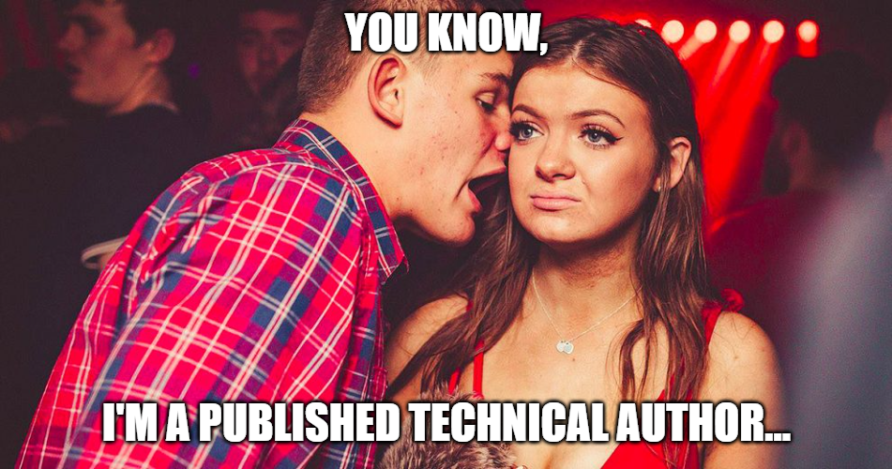
Why you shouldn’t do it
To make money
To impress outsiders
This could even mean customers
Notes:
If you’d like to follow along with the presentation, all resources are available at this link.
I also wanted to give a shout-out to Alan Turing, born on this day in 1912.

Slide 9
Why you should do it
Because you’ve always wanted to
To impress insiders

Slide 10
Questions?

Slide 11
The beginning

Slide 12
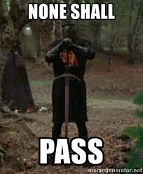
How it works
The acquisitions editor decides
Most are actively looking!
Each publisher has its own aesthetic
find one that matches what you’re going for
Notes:
If you’d like to follow along with the presentation, all resources are available at this link.
I also wanted to give a shout-out to Alan Turing, born on this day in 1912.

Slide 13
Pitching to the editor
Have 2-4 solid topics ready to discuss
Full proposal not necessary yet… but be ready to fill it out
After some back and forth, you may be asked to write proposal

Slide 14
How to pick a good topic
Don’t reinvent the Bible
Combining tools works well
So does “A topic for B audience”

Slide 15
How does the deal work?
An advance is very unlikely for first-time authors
Ask about how you’ll receive copies

Slide 16
The middle

Slide 17
The development editor’s turn
Break bad habits
Monitor schedule
Be transparent with them… be their friend

Slide 18
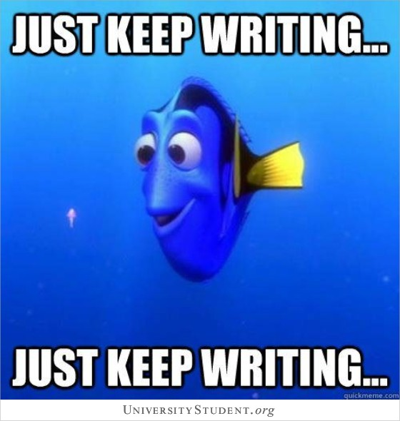
Here’s the rub…
Write
Write
Write

Slide 19

Your writing squad
Development editor: non-technical view
Technical reviewers: which peers owe you a favor?
Less-technical reviewers: who else owes you a favor?

Slide 20
Questions?

Slide 21
The end

Slide 22
Onto production…
Copy editing
Proofreading
Indexing
Art
Marketing
This will take some weeks… good time for you to prepare for launch 🚀

Slide 23
Getting ready to launch
Create a campaign if you wish
Another great time to call in favors

Slide 24
You’re published… now what?
How can you turn the book into a product?
What does the data tell you about next steps?

Slide 25
Questions?

Slide 26
Conclusion/Next steps

Slide 27
Reeling and dealing
It is uniquely rewarding…
… but consider the opportunity cost

Slide 28

Resources
https://beltpublishing.com/products/so-you-want-to-publish-a-book
FREE getting started worksheet – check your downloads!

Slide 29
Technical book coaching
Eight 60-minute coaching and consulting calls
Manuscript review
Two fifteen-minute inspiration calls
Worksheets, templates and related resources
Learn more and get started: https://stringfestanalytics.com/technical-book-coaching/

Slide 30
Questions?

Slide 31
THANK YOU
george@stringfestanalytics.com
linkedin.com/in/gjmount
stringfestanalytics.com/contact

Slide 32
Questions?

