Slide 1
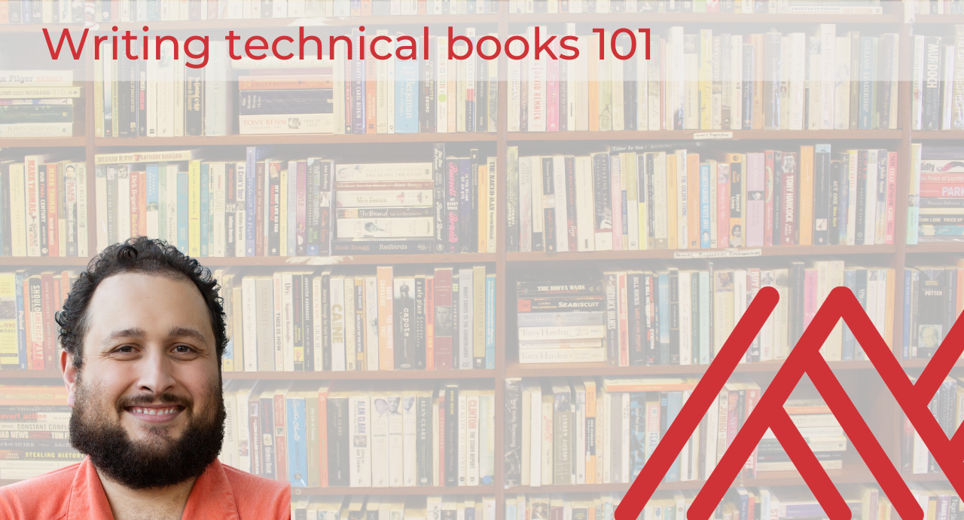

Slide 2
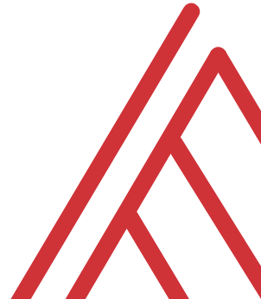
In the chat…
What excites you about doing a technical book? What scares you?
What field or topics are you considering?
Any questions? Lines are open throughout…
Notes:
Managerial
Audit
Tax
Something else

Slide 3
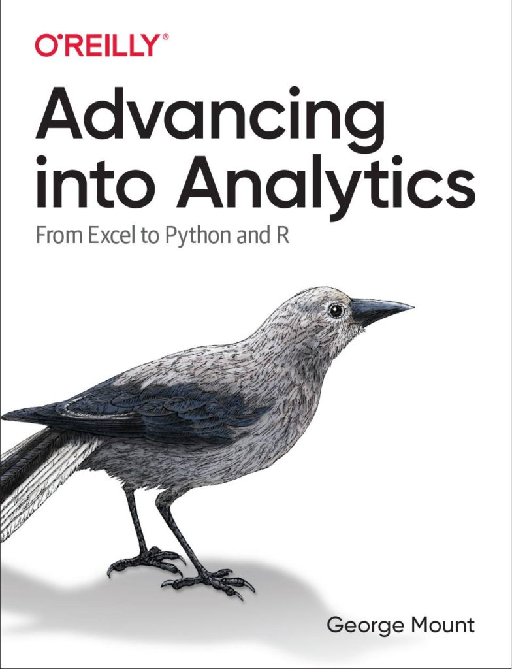
Learning objectives
Should you write a technical book?
What will it take?
How do you get started?

Slide 4
Assumptions
You’re planning to work with a publisher
You have some experience creating technical content
You don’t plan to become rich from book royalties
Notes:
If you’d like to follow along with the presentation, all resources are available at this link.
I also wanted to give a shout-out to Alan Turing, born on this day in 1912.

Slide 5
Follow along
Download resources: https://swiy.co/GVvH
Notes:
If you’d like to follow along with the presentation, all resources are available at this link.
I also wanted to give a shout-out to Alan Turing, born on this day in 1912.

Slide 6
The context

Slide 7
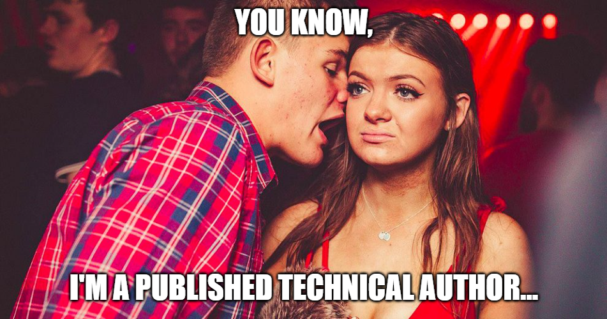
Why you shouldn’t do it
To make money
To impress outsiders
This could even mean customers
Notes:
If you’d like to follow along with the presentation, all resources are available at this link.
I also wanted to give a shout-out to Alan Turing, born on this day in 1912.

Slide 8
Why you should do it
Because you’ve always wanted to
To impress insiders

Slide 9

Questions?

Slide 10
The beginning

Slide 11
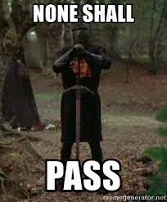
How it works
The acquisitions editor decides
Most are actively looking!
Each publisher has its own aesthetic
find one that matches what you’re going for
Notes:
If you’d like to follow along with the presentation, all resources are available at this link.
I also wanted to give a shout-out to Alan Turing, born on this day in 1912.

Slide 12
Pitching to the editor
Have 2-4 solid topics ready to discuss
Full proposal not necessary yet… but be ready to fill it out
After some back and forth, you may be asked to write proposal

Slide 13
How to pick a good topic
Don’t reinvent the Bible
Combining tools works well
So does “A topic for B audience”

Slide 14
How does the deal work?
An advance is very unlikely for first-time authors
Ask about how you’ll receive copies

Slide 15
The middle

Slide 16
The development editor’s turn
Break bad habits
Monitor schedule
Be transparent with them… be their friend

Slide 17
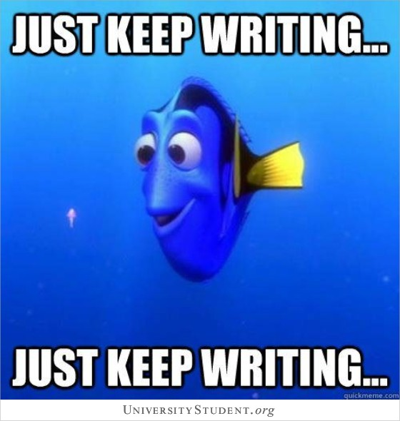
Here’s the rub…
Write
Write
Write

Slide 18

Your writing squad
Development editor: non-technical view
Technical reviewers: which peers owe you a favor?
Less-technical reviewers: who else owes you a favor?

Slide 19
Questions?

Slide 20
The end

Slide 21
Onto production…
Copy editing
Proofreading
Indexing
Art
Marketing
This will take some weeks… good time for you to prepare for launch 🚀

Slide 22
Getting ready to launch
Create a campaign if you wish
Another great time to call in favors

Slide 23
You’re published… now what?
How can you turn the book into a product?
What does the data tell you about next steps?

Slide 24
Questions?

Slide 25
Conclusion/Next steps

Slide 26
Writing technical books 101
It is uniquely rewarding…
… but consider the opportunity cost

Slide 27

Resources
https://beltpublishing.com/products/so-you-want-to-publish-a-book
FREE getting started worksheet – check your downloads!

Slide 28
Technical book coaching
Eight 60-minute coaching and consulting calls
Manuscript review
Two fifteen-minute inspiration calls
Worksheets, templates and related resources
Learn more and get started: https://stringfestanalytics.com/technical-book-coaching/

Slide 29
Technical book coaching
Learn more and get started: https://stringfestanalytics.com/technical-book-coaching/
Free half-hour discovery call for first three to email George@stringfestanalytics.com

Slide 30
Questions?

Slide 31
THANK YOU
george@stringfestanalytics.com
linkedin.com/in/gjmount
stringfestanalytics.com/contact

Slide 32
Questions?

