Slide 1


Advancing into Analytics: From Excel to R and Python
Notes:
Welcome everyone to the presentation, I am looking forward to it.

Slide 2
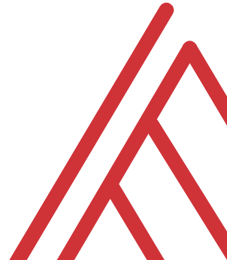
Learning objectives
What is the analytics stack?
How does Python fit into Microsoft’s?
Notes:
So what do we want to do today – well this is an Excel meetup, so this would be a weird meetup for me to be trashing Excel as an inherently inferior tool. I love Excel and it’s my home base for working with data, and I’ve found for some tasks that R and Python are just better fits. I want to contextualize R and Python as complementary resources.
So if you are interested in learning these tools as an Excel user, I want to give you a clear learning path and provide you an overview here. Now it probably seems really intimidating to go anywhere near R or Python but by the end of this hour you’ll have a good lay of the land – I’ll have some demos here where you can use the industry standard software for these languages without having to download anything.
I also want to go a bit further than I necessarily do in the book and show some tangible demos for combining these two tools – again I want to show that you should think of these tools as complements and not substitutes.
So those are the official learning objectives.

Slide 3
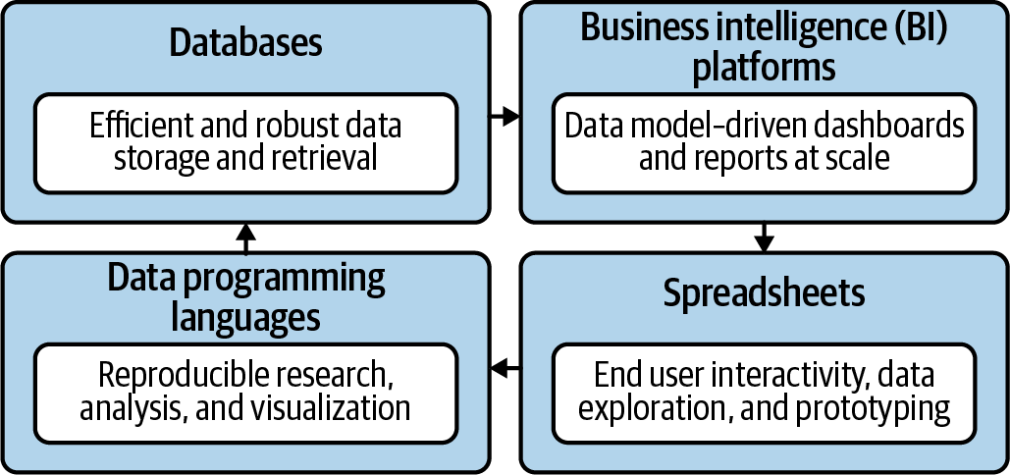
The data analytics stack
Mount, George. Advancing into Analytics: From Excel to Python and R. O’Reilly Media, 2021
Notes:
Now this figure comes from my book and it’s a very broad conceptualization of the various slices of the stack. You know we hear engineers or web developers talk about being “full stack” all the time but it’s not so common an expression as it could be.

Slide 4
Python-Powered Excel
Notes:
OK, first let’s start with R, and yes its full name is the R Project for Statistical Computing.

Slide 5
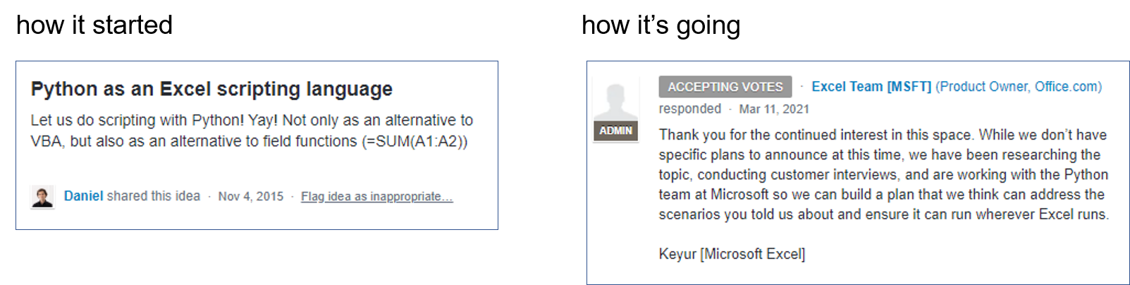
Python for Excel is coming (probably)…
Page has been deleted: https://support.microsoft.com/en-us/office/uservoice-pages-430e1a78-e016-472a-a10f-dc2a3df3450a
Notes:
The page

Slide 6
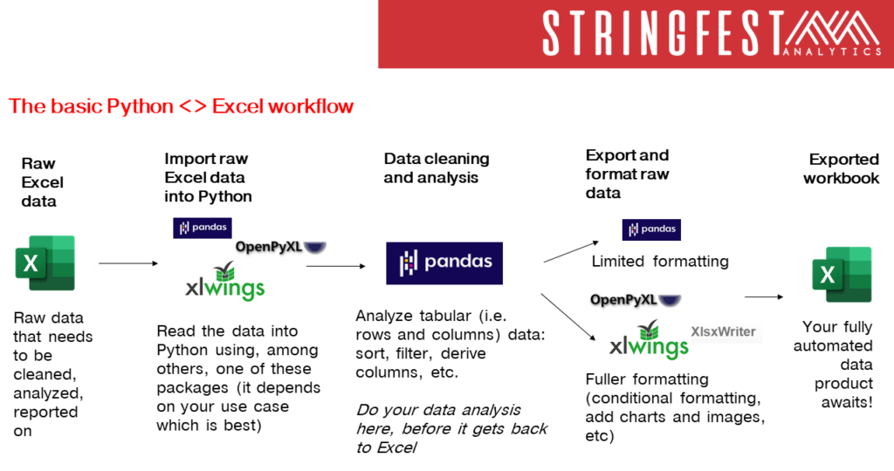
https://stringfestanalytics.com/basic-python-excel-workflow/
Notes:
The page

Slide 7

Demo
Python-Powered Excel
File: python-powered-excel.ipynb
Add custom cell formats
Re-size column widths
Add charts (from Excel or Python)
Notes:
OK so what we are going to do here is go back to your session or open a new one. Go to the diamonds.r dataset. And let’s actually conduct the analysis that was hinted at earlier.

Slide 8
Python-Powered Power BI
Notes:
OK, first let’s start with R, and yes its full name is the R Project for Statistical Computing.

Slide 9
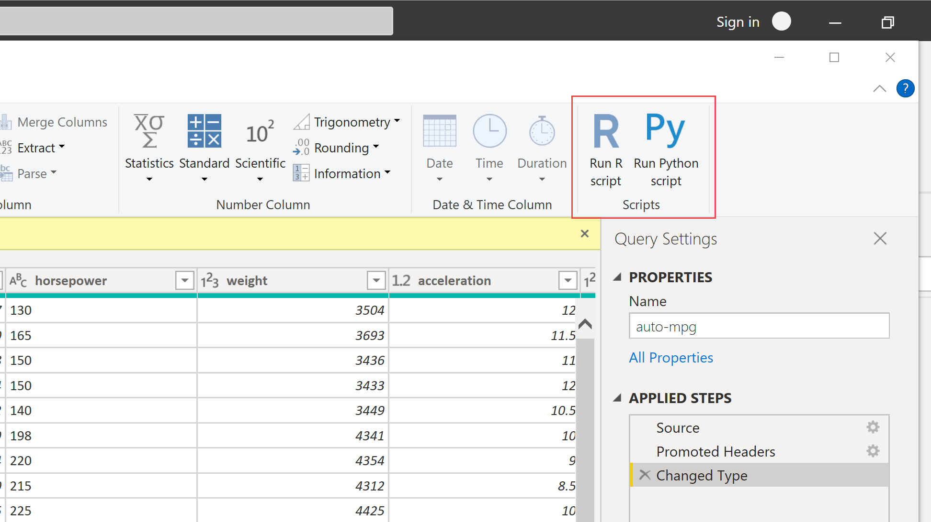
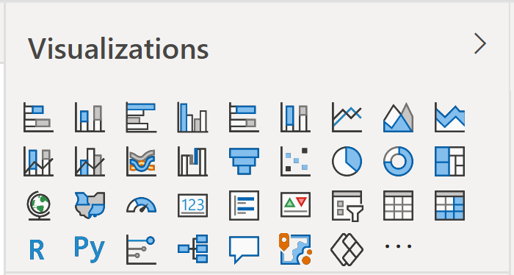
Python for Power BI is here already…
Remote or unstructured data sources
Feature engineering (missing values, PCA)
Regular expressions
Visualizations

Slide 10
Demo
Python-Powered Power BI
File: python-powered-power-bi.pbix
Impute missing values
Insert visualization
Notes:
OK so what we are going to do here is go back to your session or open a new one. Go to the diamonds.r dataset. And let’s actually conduct the analysis that was hinted at earlier.

Slide 11
What is Excel good for?
Good at…
Visual calculations
End-user interactivity
Rapid prototyping
Not so much…
Storing data
Mobilizing data
Implementing advanced analytics
Notes:
So this seems patronizing
How about add a slide defining what analytics is.

Slide 12
Welcome to the R Project for Statistical Computing
Notes:
OK, first let’s start with R, and yes its full name is the R Project for Statistical Computing.

Slide 13

Packages: “There’s an App for that!”
Install the package (usually from CRAN)
Open the package
Notes:
Now another thing unique to open source programs is this idea of packages. You can kind of think of this as like add-ins for Excel – the analogy I like to use is as apps on a phone.

Slide 14
Demo
Speaking the language of data with the tidyverse
Load and explore diamonds dataset
Write a “sentence” in dplyr:
“Get me the average price for each cut, sorted from high to low.”
How would you pseudo-code this?
Group by cut
Find average for each group
Sort the results
File: diamonds.r
Notes:
OK so what we are going to do here is go back to your session or open a new one. Go to the diamonds.r dataset. And let’s actually conduct the analysis that was hinted at earlier.

Slide 15
Questions?
Notes:
Any questions about Python?

Slide 16
Conclusion/Resources
Notes:
OK now for one last demo. I want to show you an example of “remixing” some of these different tools and really using each resource to its full potential. And the pun here is “shell” as in a programming shell.

Slide 17
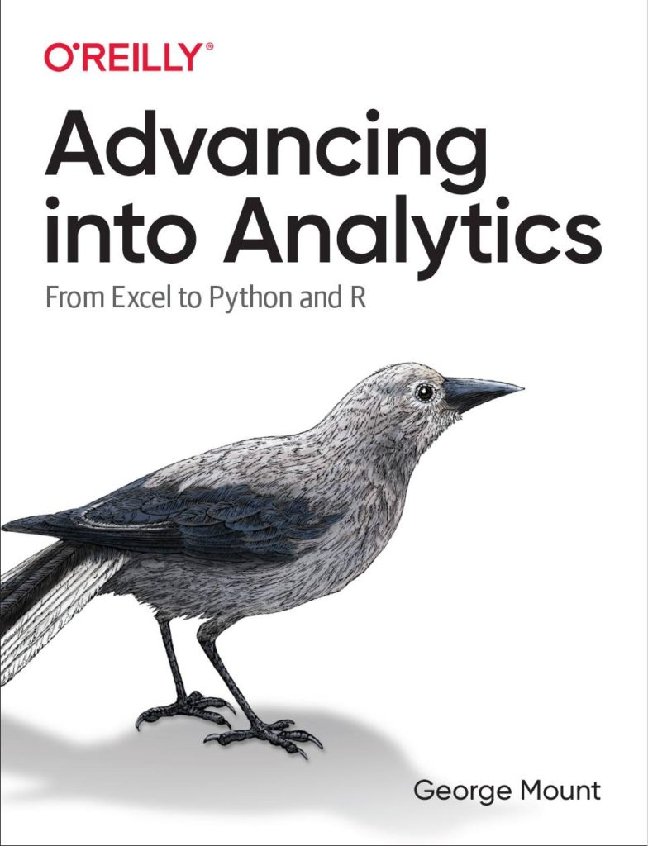
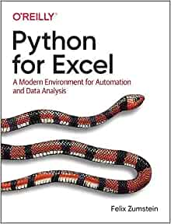
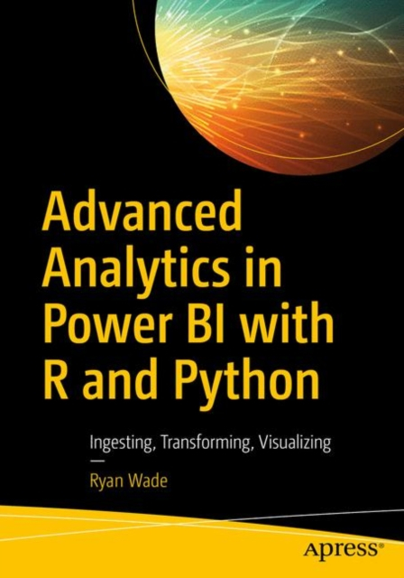
Recommended reading

Slide 18
Get in touch
george@stringfestanalytics.com
stringfestanalytics.com/book
linkedin.com/in/gjmount

Slide 19
Questions?
Who wants to win a book?

