Slide 1


Advancing into Analytics: From Excel to R and Python
Notes:
Welcome everyone to the presentation, I am looking forward to it.

Slide 2
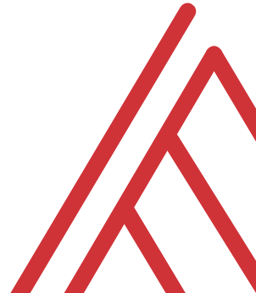
Learning objectives
What is the analytics stack?
How does Python fit into Microsoft’s?
Excel
Power BI
Notes:
What I want to do today is give a broad overview of what I call the data analytics stack, with particular emphasis on Microsoft’s and where Python can fit in. So I’ll give you a few use cases of automating spreadsheets and then using it inside of Power BI, how does that sound?

Slide 3
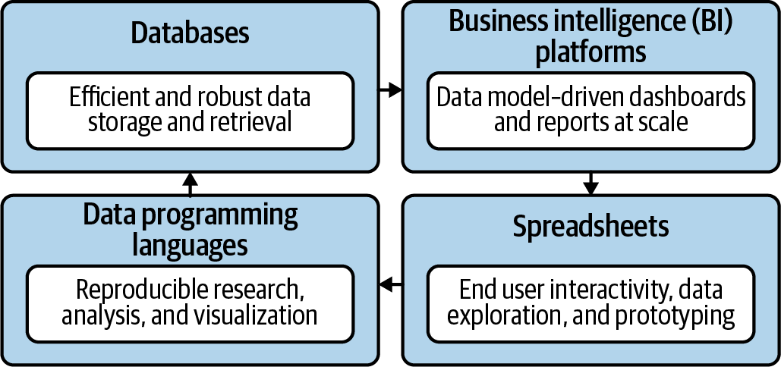
The data analytics stack
Mount, George. Advancing into Analytics: From Excel to Python and R. O’Reilly Media, 2021
Notes:
Now this figure comes from my book and it’s a very broad conceptualization of the various slices of the stack. You know we hear engineers or web developers talk about being “full stack” all the time but it’s not so common an expression as it could be.

Slide 4
Python-Powered Excel
Notes:
OK, let’s start with Excel – there is always a need to get data there. I think of Excel as our prototyping tool.

Slide 5
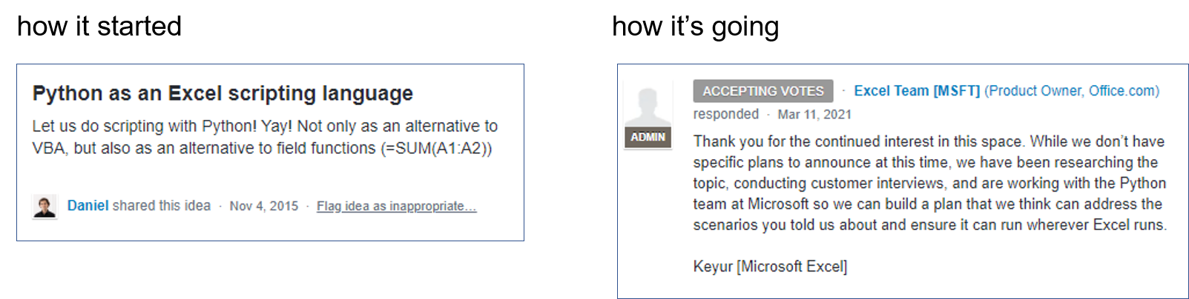
Python for Excel is coming (probably)…
Page has been deleted: https://support.microsoft.com/en-us/office/uservoice-pages-430e1a78-e016-472a-a10f-dc2a3df3450a
Notes:
The page

Slide 6
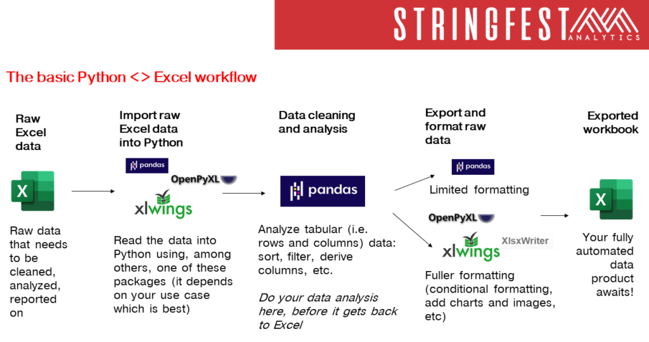
https://stringfestanalytics.com/basic-python-excel-workflow/
Notes:
The page

Slide 7

Demo
Python-Powered Excel
File: python-powered-excel.ipynb
Add custom cell formats
Re-size column widths
Add charts (from Excel or Python)
Notes:
OK so what we are going to do here is go back to your session or open a new one. Go to the diamonds.r dataset. And let’s actually conduct the analysis that was hinted at earlier.

Slide 8
Python-Powered Power BI

Slide 9
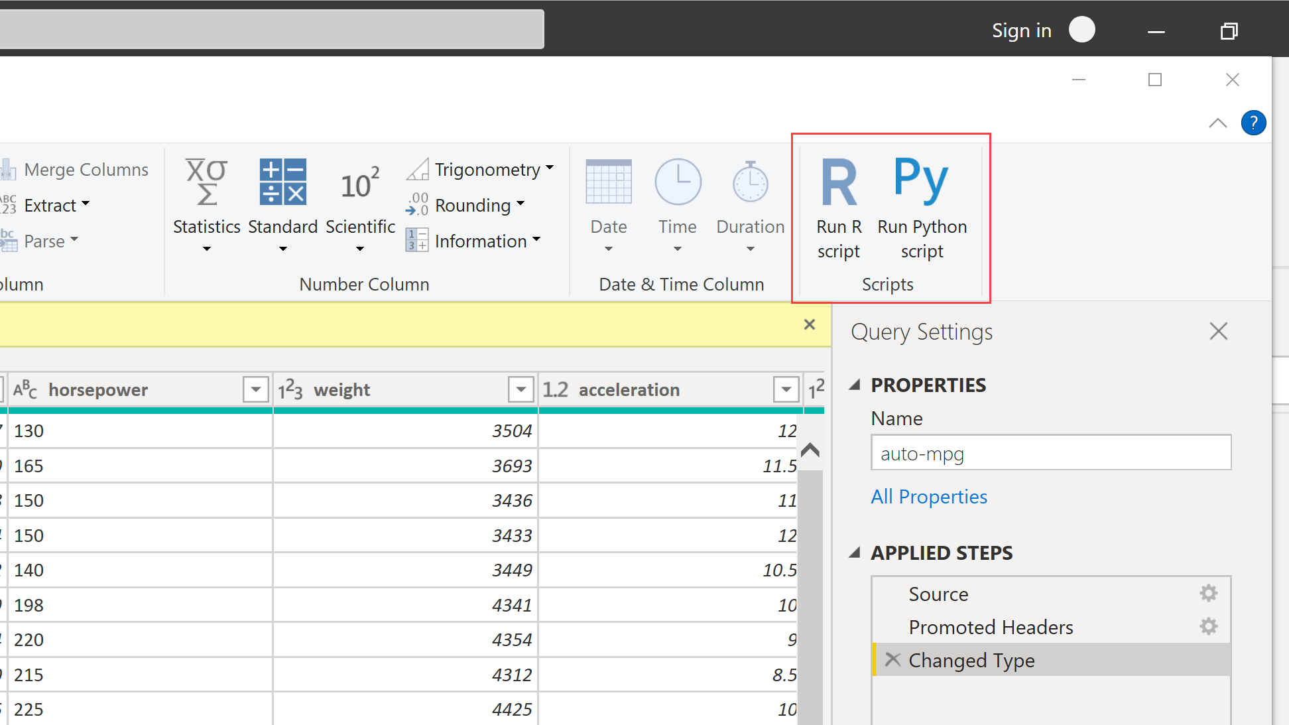
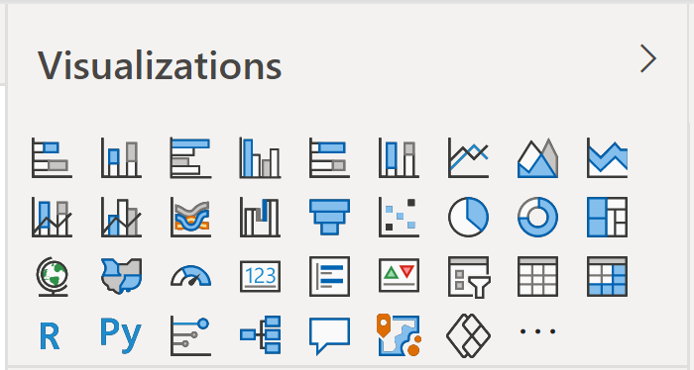
Python for Power BI is here already…
Remote or unstructured data sources (APIs, images, audio)
Feature engineering (missing values, PCA)
Regular expressions
Visualizations
Machine learning

Slide 10
Demo
Python-Powered Power BI
File: python-powered-power-bi.pbix
Impute missing values
Insert visualization
Notes:
OK so what we are going to do here is go back to your session or open a new one. Go to the diamonds.r dataset. And let’s actually conduct the analysis that was hinted at earlier.

Slide 11
Conclusion/Resources
Notes:
OK now for one last demo. I want to show you an example of “remixing” some of these different tools and really using each resource to its full potential. And the pun here is “shell” as in a programming shell.

Slide 12
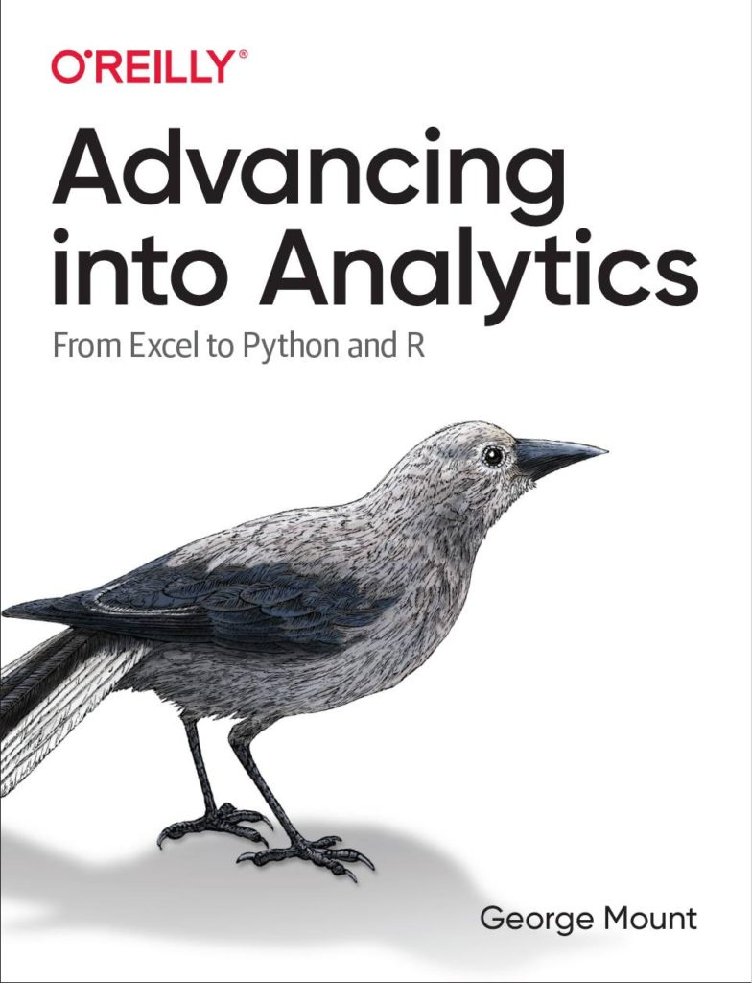
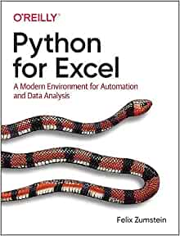
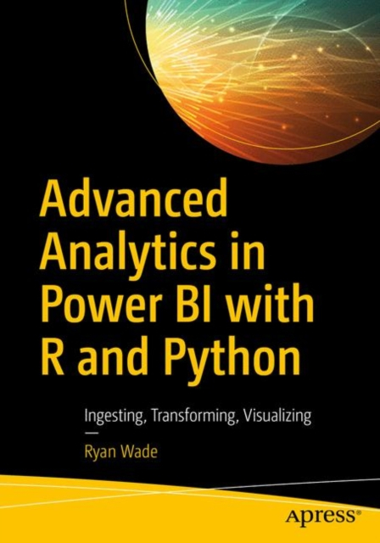
Recommended reading

Slide 13
Get in touch
george@stringfestanalytics.com
stringfestanalytics.com/book
linkedin.com/in/gjmount

Slide 14
Questions?
Who wants to win a book?

