Slide 1


Where do these tools
let you down?
Notes:
How many of you are using Power Query or Power BI? What about VBA? You may see some parallels here…
I get a lot of questions from Excel users about why they should learn Python when Power Query is on the scene.
Excel is good at a lot of things, otherwise it wouldn’t be so predominant in the business world. Depending on the tasks you need to do, Excel may be just fine. However, if you try to deviate from that menu at all, things can get complicated.
Some examples follow on the next page…
I have the link to the sources on each slide if you want to check them out later.

Slide 2

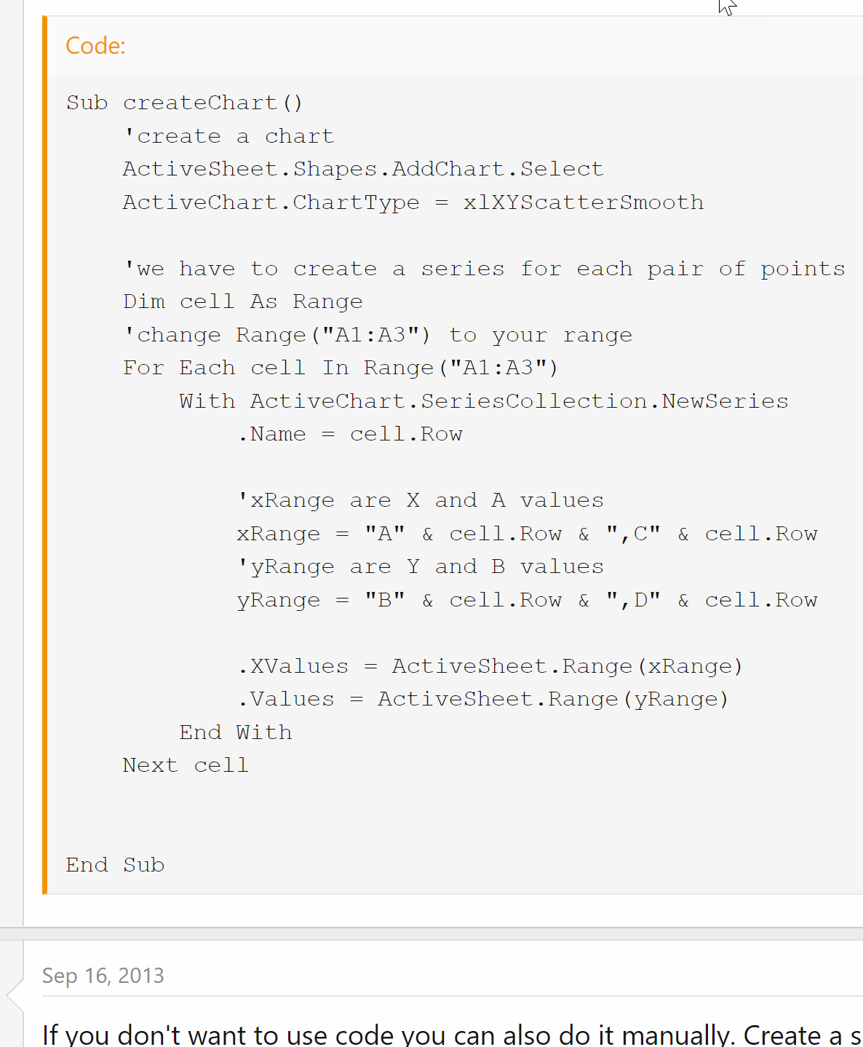
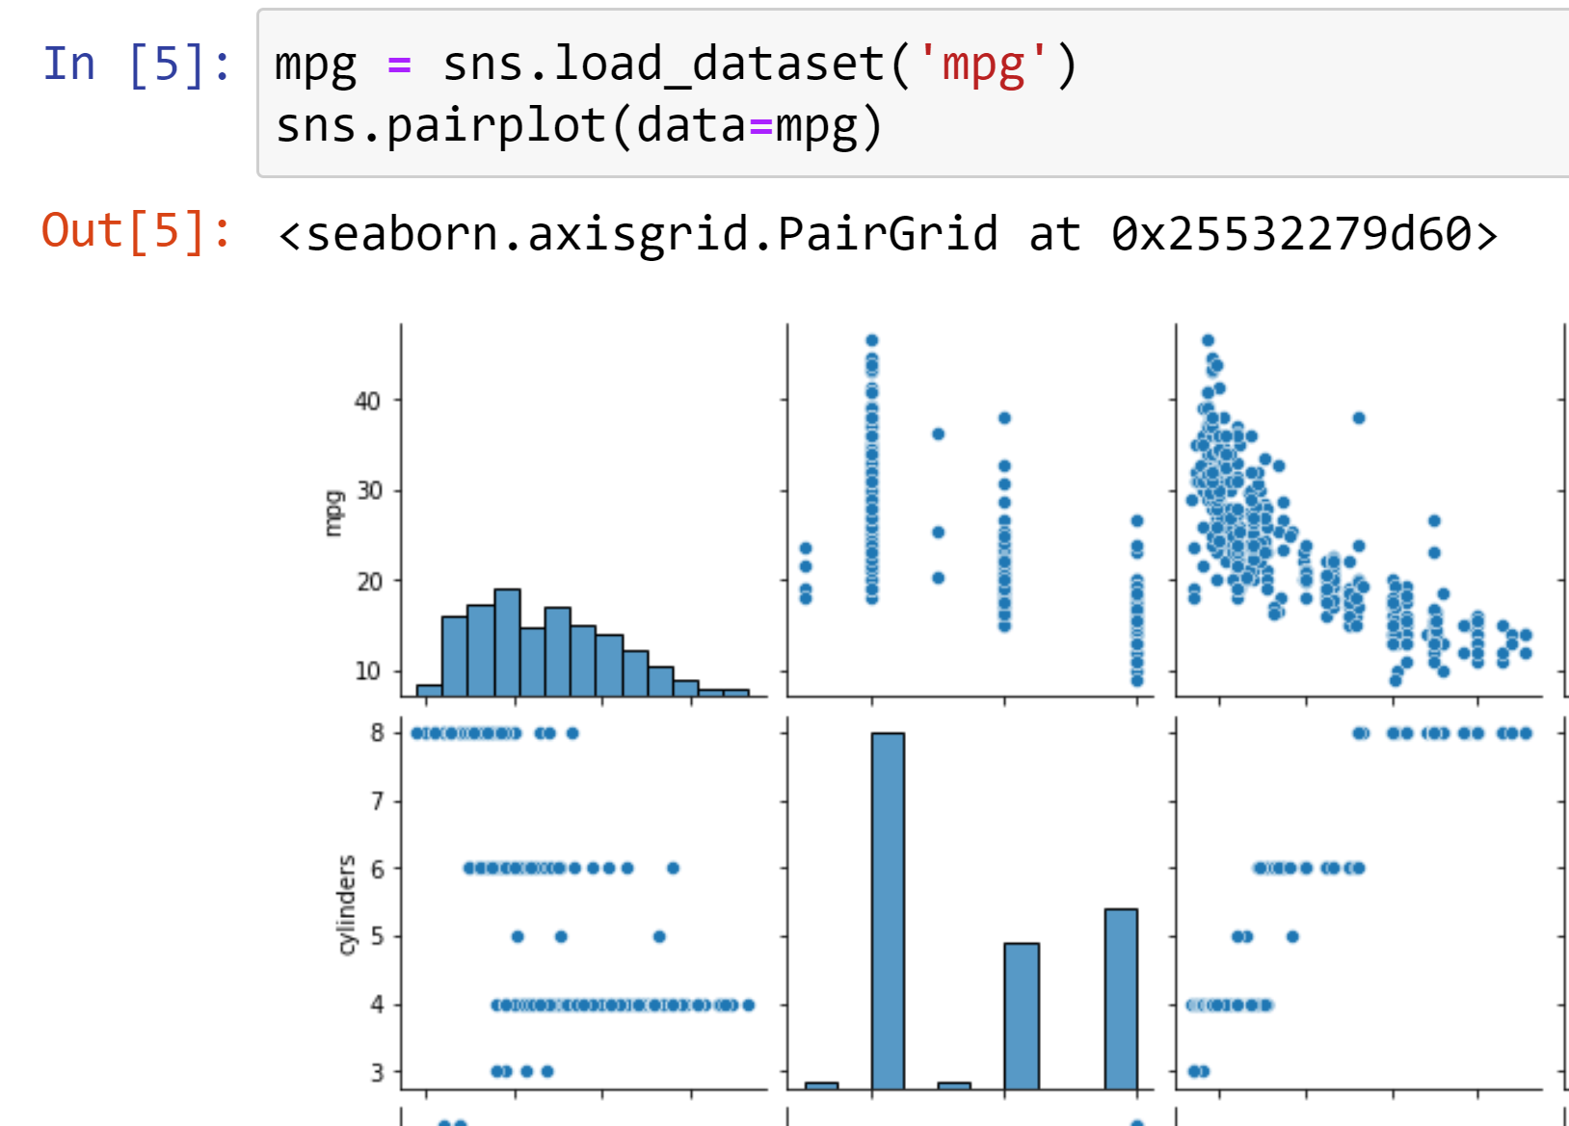
“I want to make a scatterplot for every pair of variables”
VS.
https://www.mrexcel.com/board/threads/excel-2010-plot-lines-between-multiple-ordered-pairs.726760/
https://gist.github.com/summerofgeorge/cb214a5c350c378b2107c5cc6385e73f
Notes:
Plotting and visualization is a particularly clunky thing in Excel, again particularly if you want to scale it up and operate on multiple things at once. So if you wanted to make multiple scatterplots at once, you’d have to try to use VBA, and again you have to do your work in one place and see your plots in another.
Python, we are using a Jupyter notebook and we just have to

Slide 3
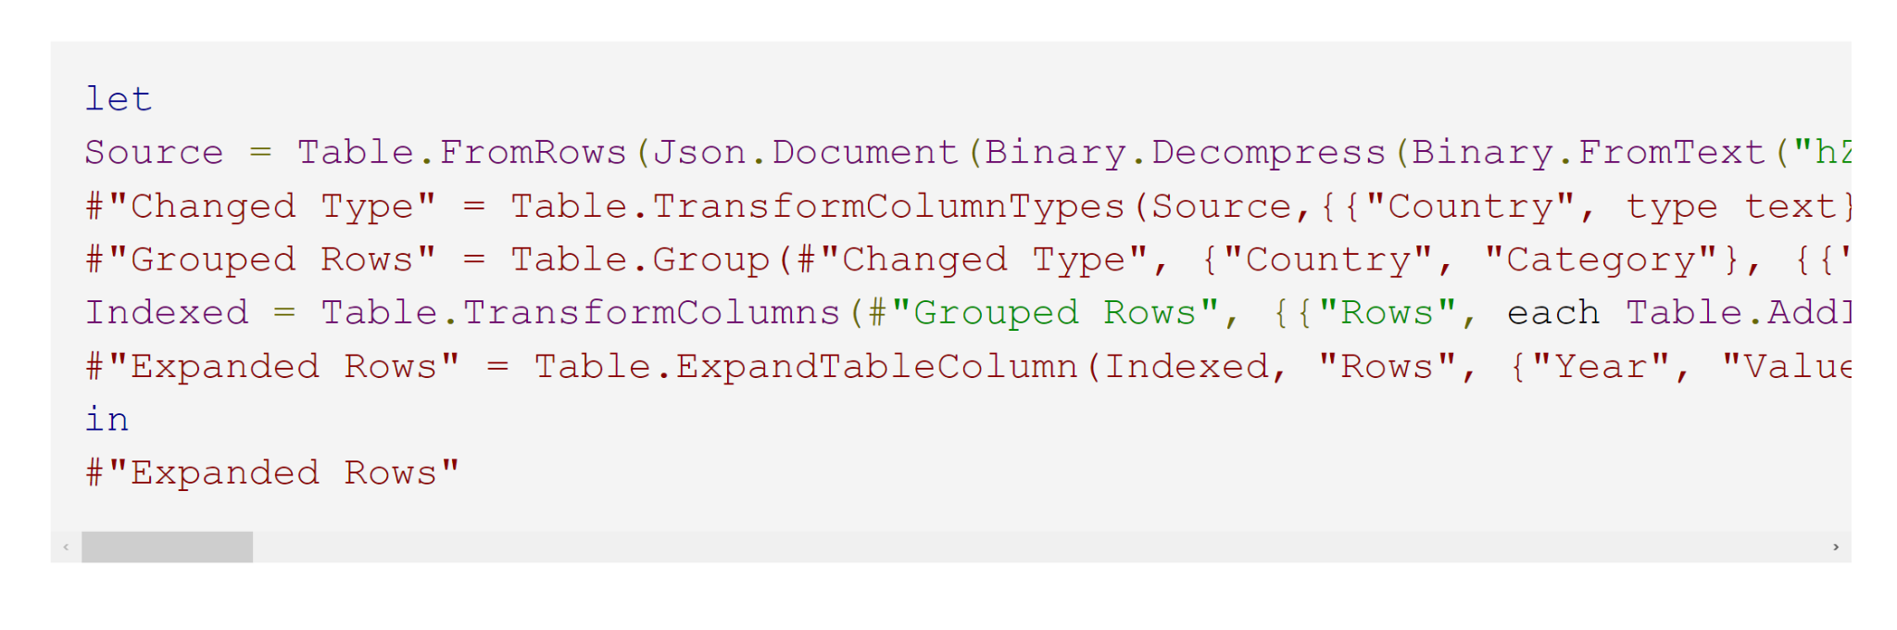
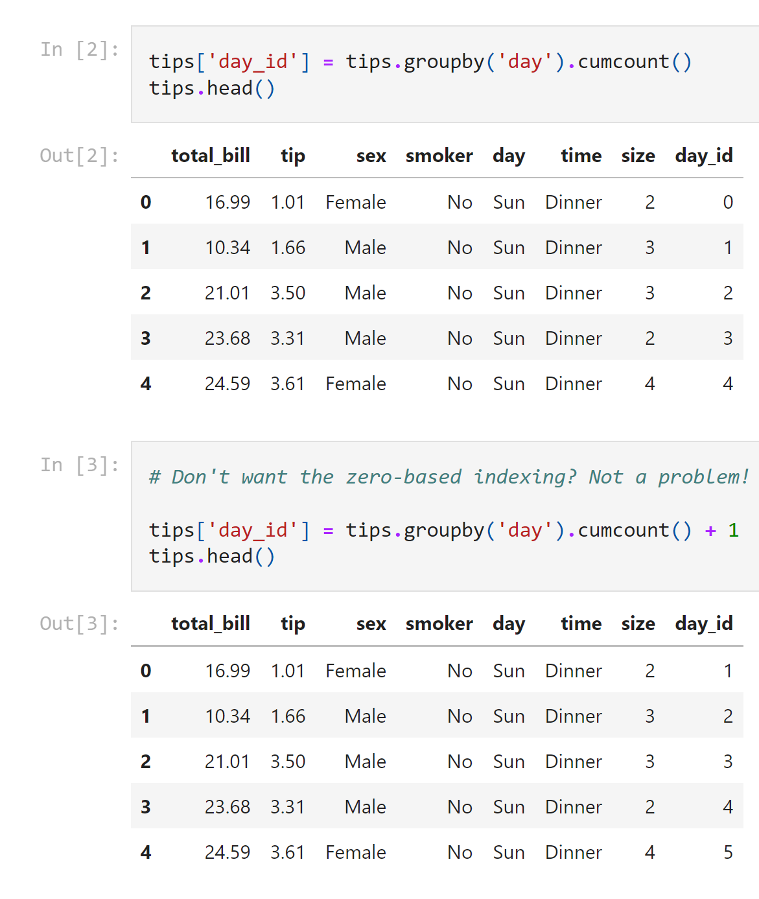
“I want to create a index column by group”
VS.
https://datacornering.com/how-to-create-group-index-with-power-query-or-r/
https://gist.github.com/summerofgeorge/59642030a112b90d5b04bebf77f53ddd
Notes:
We have transactions from a restaurant, we want to number these transactions so that we can say “the third transaction from Monday” or the “fifth transaction from Friday,” this is called an index number.
Any time you need to perform some unusual operation one group at a time, things can get hairy in Excel. Let’s say you want to create an index column by each group, this is what you would need to do with Power Query. It doesn’t even fit on the slide!
By contrast, here’s Python.

Slide 4
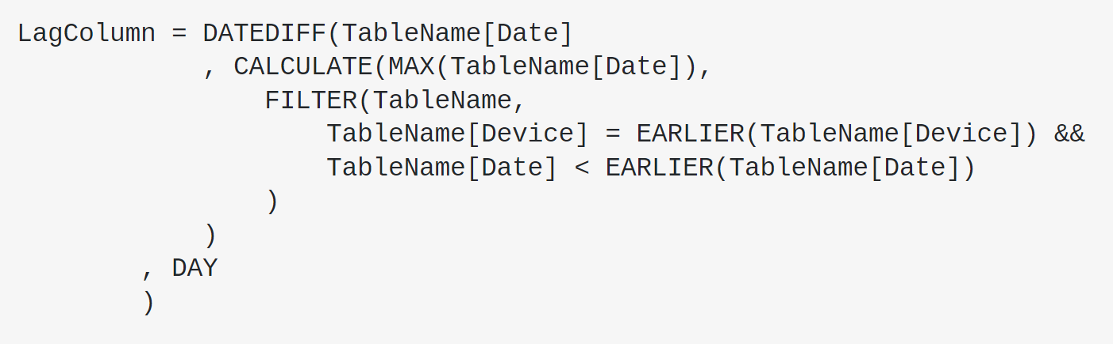
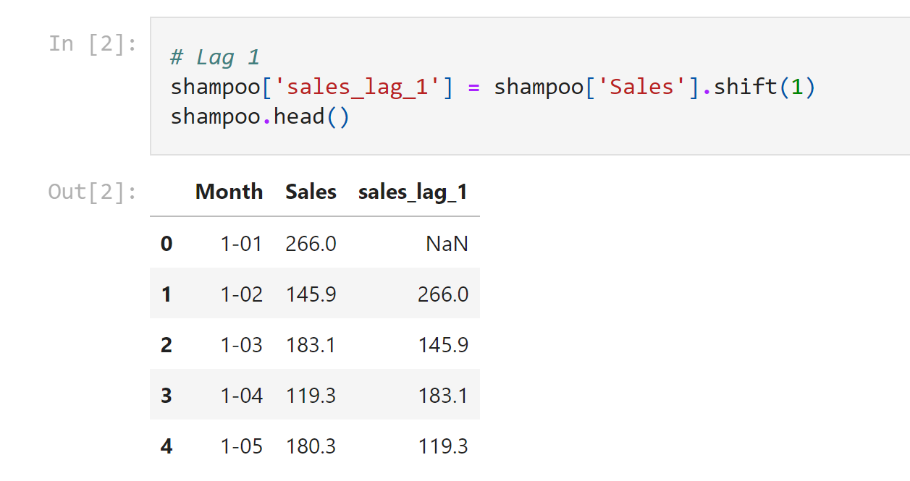
“I want to create a lagged variable”
VS.
https://stackoverflow.com/questions/37446950/powerbi-time-lag-calculation-in-dates-using-query-editor
https://gist.github.com/summerofgeorge/a53be111c3d2b4da5ffaf0d732f3bb53
Notes:
Now if you’re doing any kind of financial analysis, you may need to create a lead or lagging variable which basically means shifting a variable in time up or down a few records from when it was recorded.
This is really not an unusual task but look how much harder it is in Power Query vs Python.

Slide 5
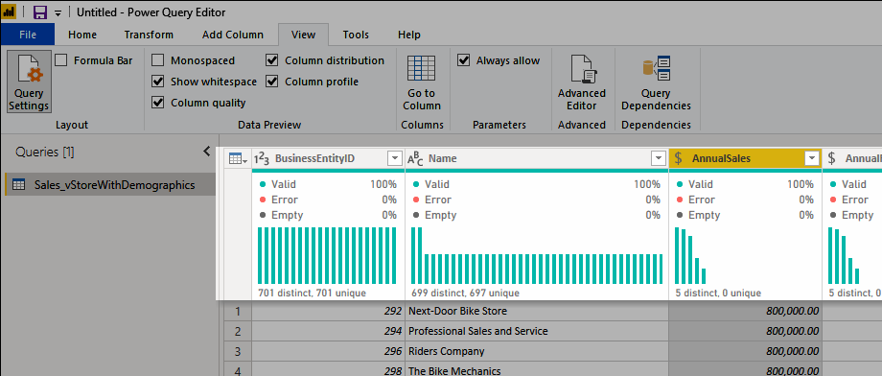
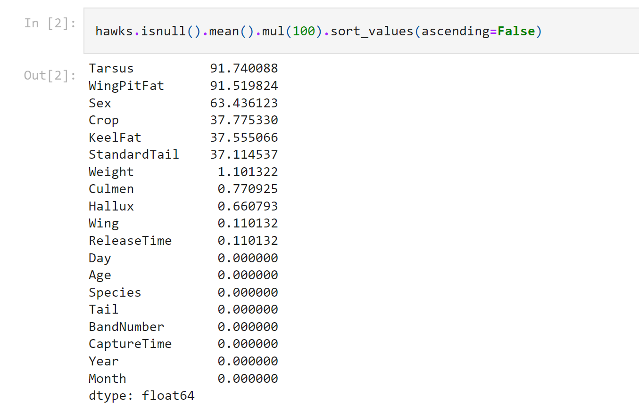
“I want to know what percent of each column are missing values”
VS.
https://docs.microsoft.com/en-us/power-query/data-profiling-tools
https://gist.github.com/summerofgeorge/23202b54454af7518dd9fe5c3baec7dc
Notes:
Now especially if you are getting into more advanced analytics, you need to know if your dataset is missing values, how many, etc .There are some nifty menus in Power Query to help you with this, but you really don’t have much control over how it’s displayed and what you can do with it. Ideally everything you do should be saved in memory to your computer as an object, then you can do any kind of operation you want to on that object.

Slide 6
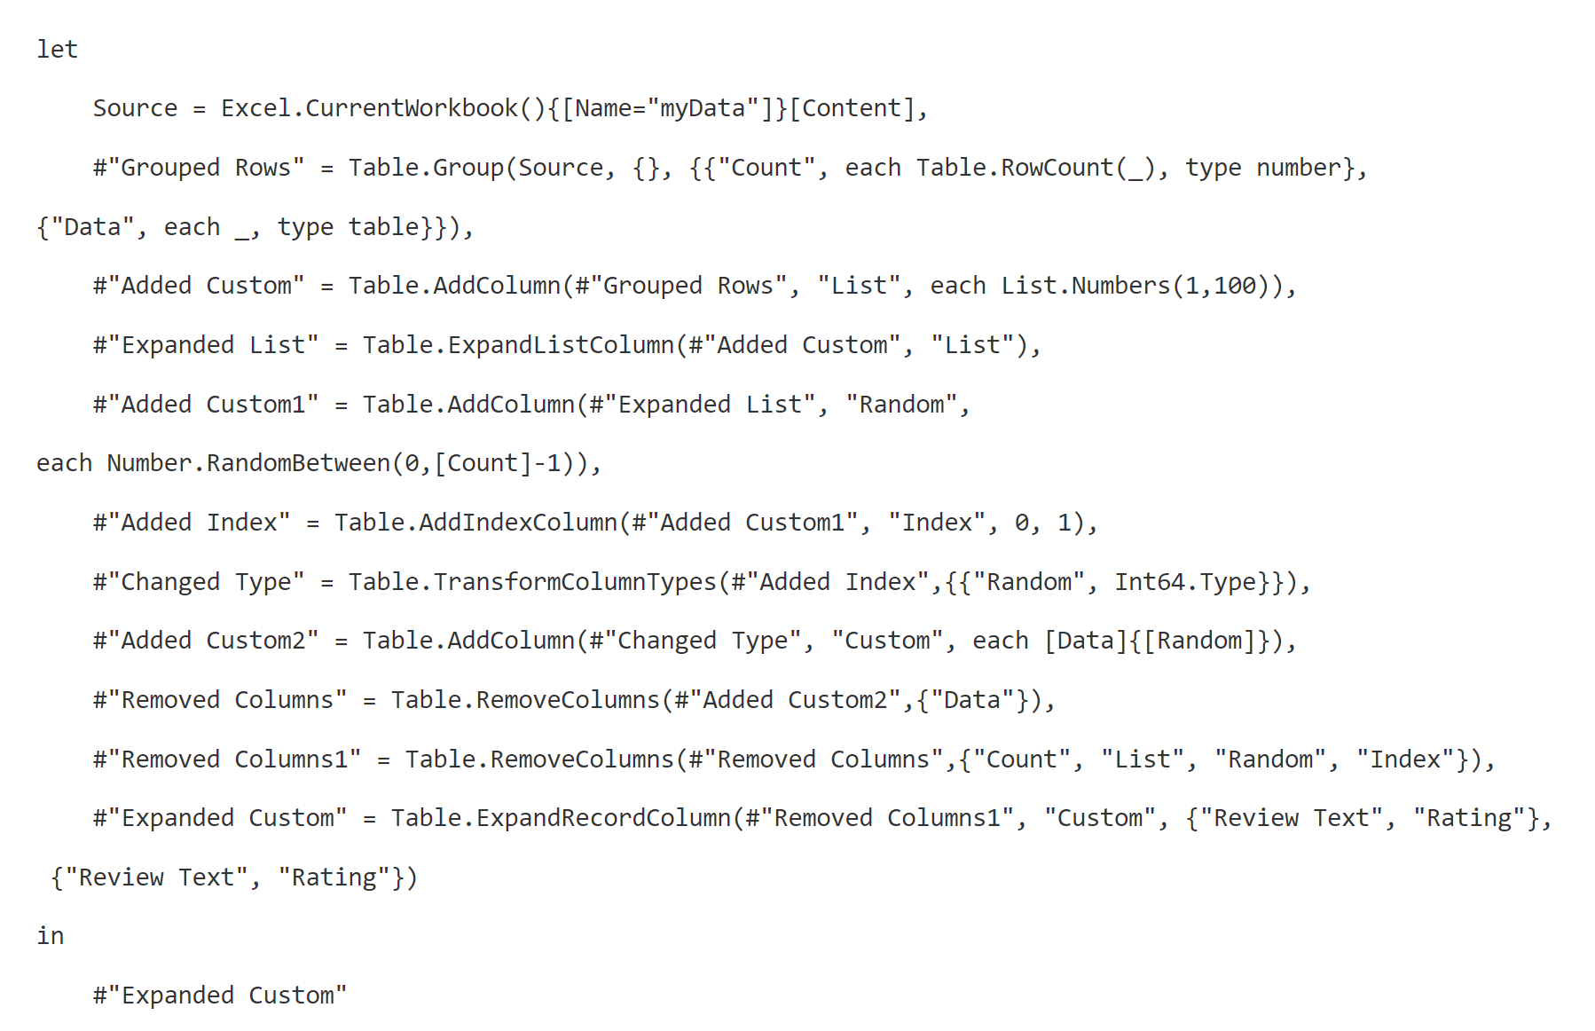
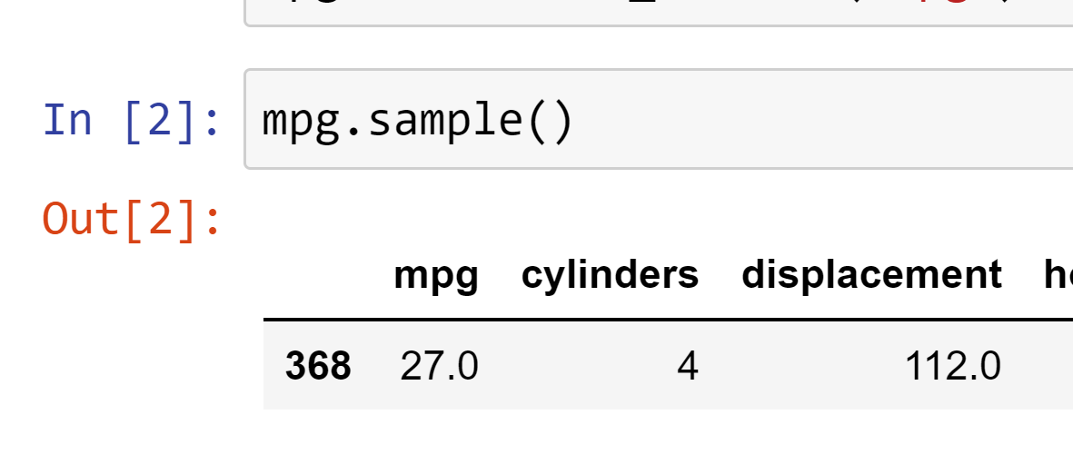
“I want to pick a row at random from my very large dataset”
VS.
https://chandoo.org/wp/power-query-random-sample/
https://gist.github.com/summerofgeorge/631ad40ef849886aee6840a497088aa7
Notes:
This is another very common data science-type task, you may have a very big dataset and you want to spot check. Or to extend to this, you may want to split your dataset into a training and test group. This takes working with random numbers and saving data to memory, etc and these sorts of tasks are quite difficult to do in Excel.

Slide 7
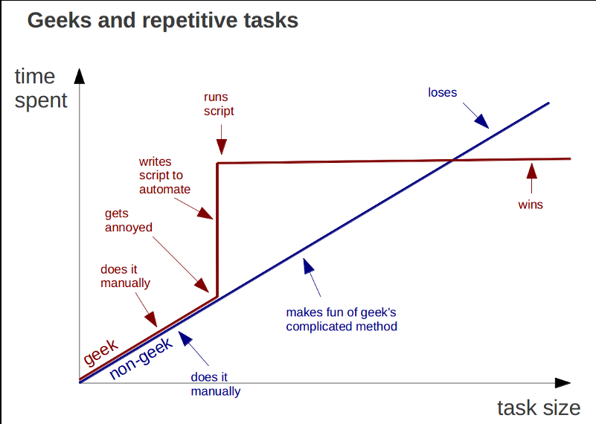
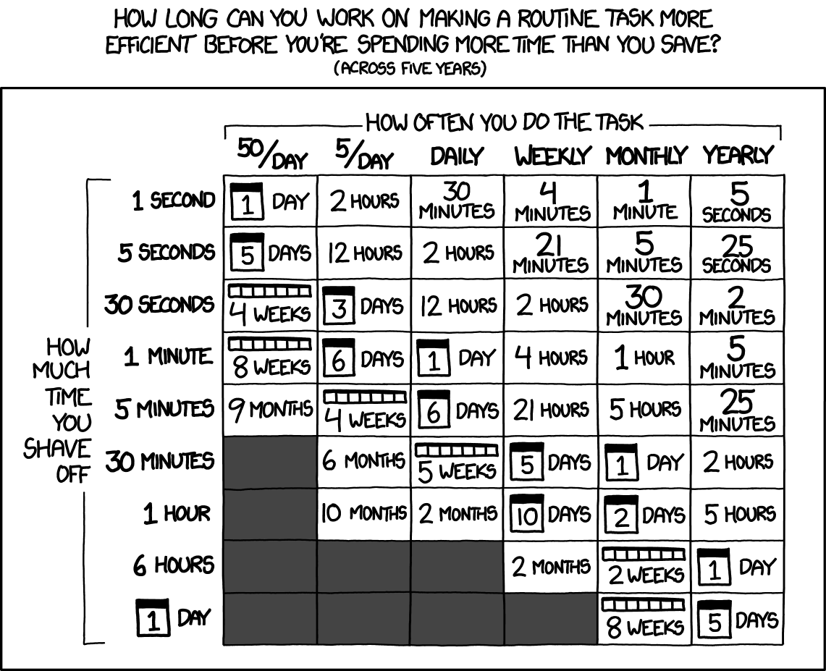
Learning Python is a knowledge investment that pays off (just don’t overdo it)
https://marcgg.com/blog/2015/09/30/automate-repetitive-tasks/ https://xkcd.com/1205/
Notes:
I hope you’re seeing there are places where Python makes things way easier than Excel. However at the same time there is a real learning curve with paying Python. It’s an investment in your knowledge and generally something that will pay off, but it may look especially frustrating at first, you may be tempted to go back doing things manually because that seems faster at first. But keep with it because ultimately you will win with using Python which will let you automate anything, however I will say it is tempting to try to automate everything when doing it manually may be really more effective, this is just an occupational hazard!

