Slide 1
✓ Microphone off?
✓ Camera off?
✓ Fun on?

Slide 2


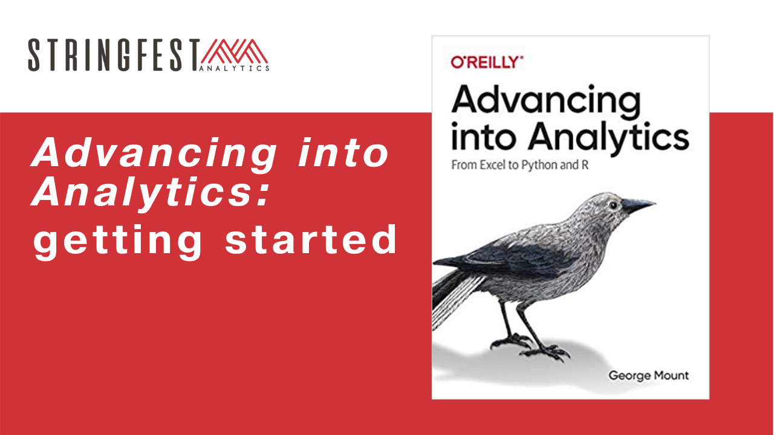
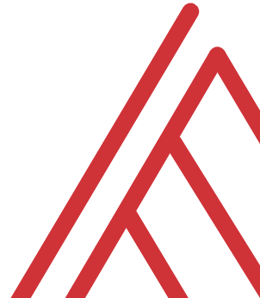
Advancing into Analytics: From Excel to R and Python

Slide 3
Chat me up…
What excites you about these topics? What scares you?
What has blocked you?

Slide 4
Learning objectives
Situate Excel, R and Python in the data analytics stack
Prepare a Windows computer to work in all three
Run summary statistics on a dataset in all three

Slide 5
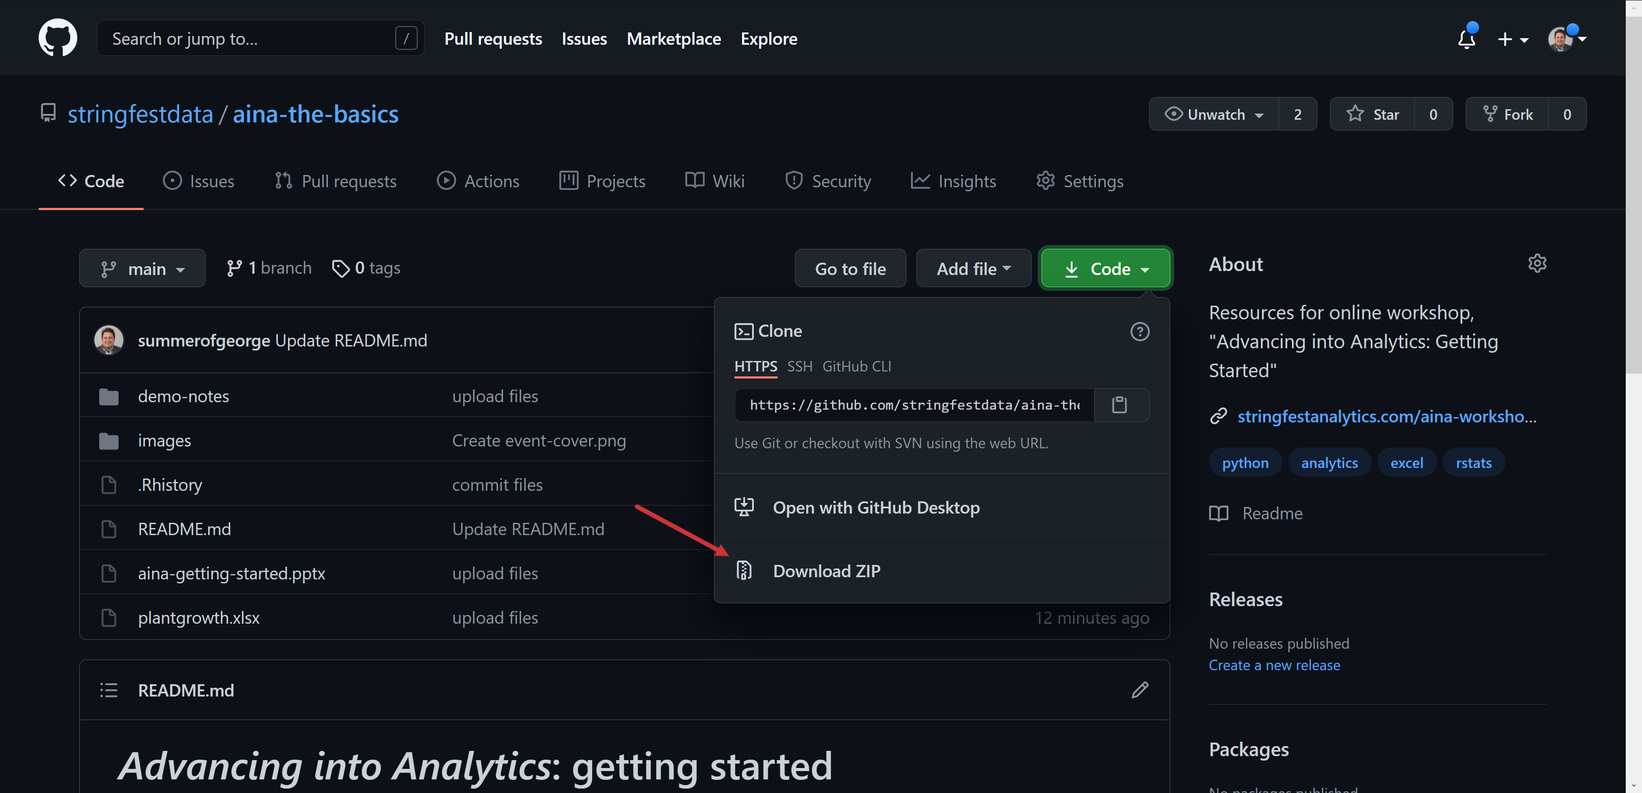
Follow along
Download resources: https://github.com/stringfestdata/aina-getting-started
Notes:
If you’d like to follow along with the presentation, all resources are available at this link.
I also wanted to give a shout-out to Alan Turing, born on this day in 1912.

Slide 6
Questions?

Slide 7
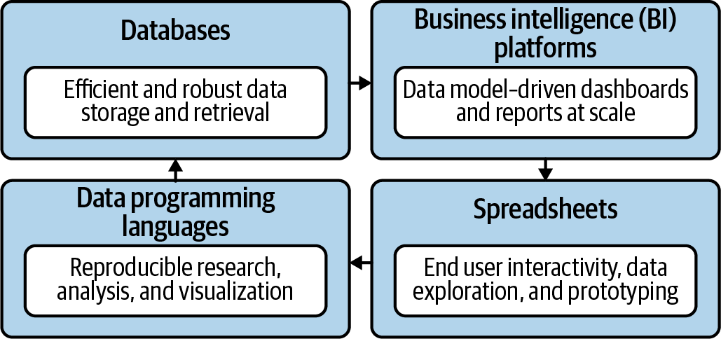
Become a full-stack analyst
Mount, George. Advancing into Analytics: From Excel to Python and R. O’Reilly Media, 2021
Notes:
Now this figure comes from my book and it’s a very broad conceptualization of the various slices of the stack. You know we hear engineers or web developers talk about being “full stack” all the time but it’s not so common an expression as it could be.

Slide 8

Demos
Downloads and summary statistics:
Excel
R
Python
Follow along with demo notes for each
Let’s get situated…
File to summarize: plantgrowth.xlsx
Notes:
OK so now you will see R’s equivalent to some of those features you saw with Python. I think that for different reasons Python seems to be taking the lead on Excel automation, but R has some pretty robust features and in some ways are richer than Python’s.

Slide 9
Questions?

Slide 10
Conclusion/Next steps

Slide 11

Take-home activity
Folder: take-home
Dataset: tips.xlsx… load and print summary statistics, then…
Notes & solutions included
R:
File > New File > R Script
Place code to run summary statistics in script
Run code & save
Python:
Print the first few rows with the head() method (works the same as describe())
Give the notebook a name (click and write over Untitled)
Notes:
By the end of this book, you should be able to conduct exploratory data analysis and
hypothesis testing using a programming language.

Slide 12
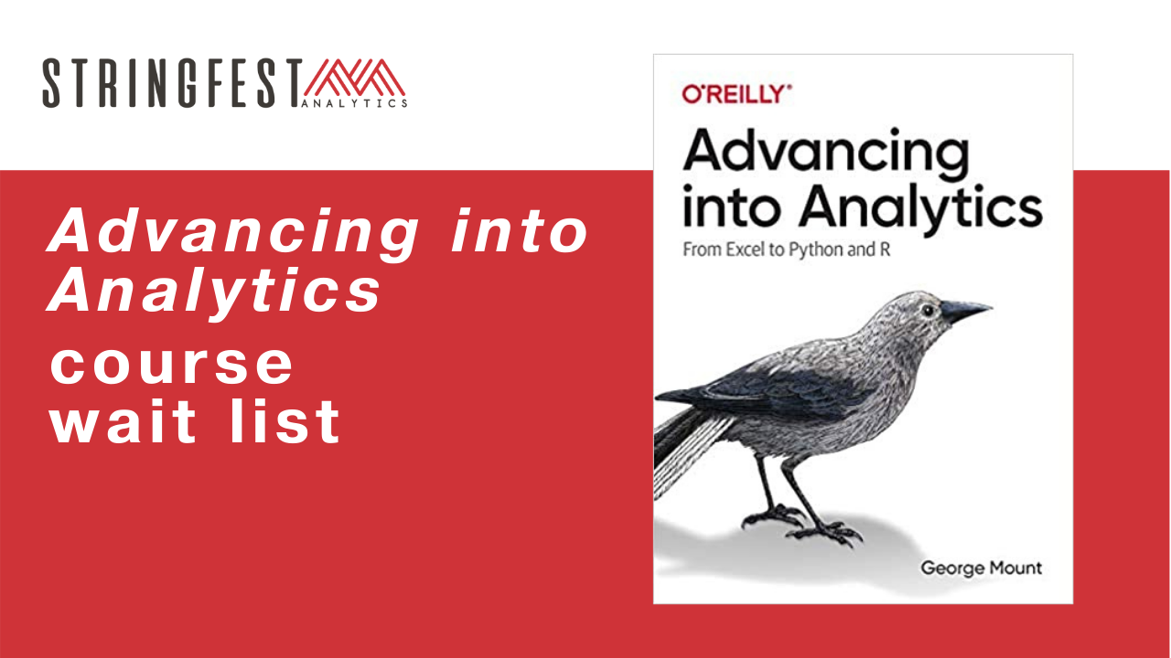
Want more?
Sign up for course waiting list: https://stringfestanalytics.com/aina-waiting/
Notes:
By the end of this book, you should be able to conduct exploratory data analysis and
hypothesis testing using a programming language.

Slide 13
Event survey: https://forms.office.com/r/0ZnD0LxpZy

Slide 14
Questions?

Slide 15
THANK YOU
george@stringfestanalytics.com
linkedin.com/in/gjmount
stringfestanalytics.com/contact

