Slide 1


Advancing into Analytics: From Excel to R and Python

Slide 2
Or… PoweR BI 🤦‍♂️

Slide 3
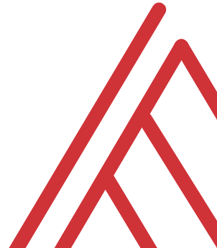
Learning objectives
R in Power BI: when and why?
Setup
Use cases
Follow along: https://github.com/stringfestdata/satrday-r-power-bi
r-pbi-scripts.r: scripts used
r-pbi.pbix: completed PBI file
Notes:
OK, now I want to have enough time for us to participate and assess the situation here together. What are the pros and cons of using R in Power BI; when have you had success, what has blocked you, etc.
After that I’ll briefly walk through the setup and demonstrate a few use cases that may come in handy. And hopefully the use cases I identify will square well with the ones you identify….
I’m also going to be giving away a copy of my book, and I’ll actually set this up in Power BI with R ☺
All the resources are available at the GitHub repo…In particular there will be a file with the R scripts and one with the completed Power BI file.

Slide 4
Chat me up
Do you use Power BI? How/when/why?
Do you use R in Power BI? How/when/why?
Pros/cons to Power BI vs Shiny?
Brainstorm it! https://tinyurl.com/59hzc4ca
Notes:
OK, I’d like to take some time for a discussion here. Power BI is pretty good, but there is a reason you can R inside it. Now I have my vision for how these should work together, and maybe you do too.
Maybe your vision is just using Shiny… so let’s try this out. I have a Google Doc; let’s take a couple of minutes to brainstorm.

Slide 5

When and why
Remote or unstructured data sources (APIs, images, audio)
Feature engineering (missing values, PCA)
Machine learning
Regular expressions
Advanced, custom visualizations
https://www.windowsblogitalia.com/2019/02/microsoft-migliore-futuro-inner-source/
Notes:
One of the most interesting things to me about all this is Microsoft’s admission that they can’t be the best at everything , and that they should rely on open source languages like R and Python do so some of this analytics work. In particular I find these uses cases are things that Power BI has a very difficult time.

Slide 6
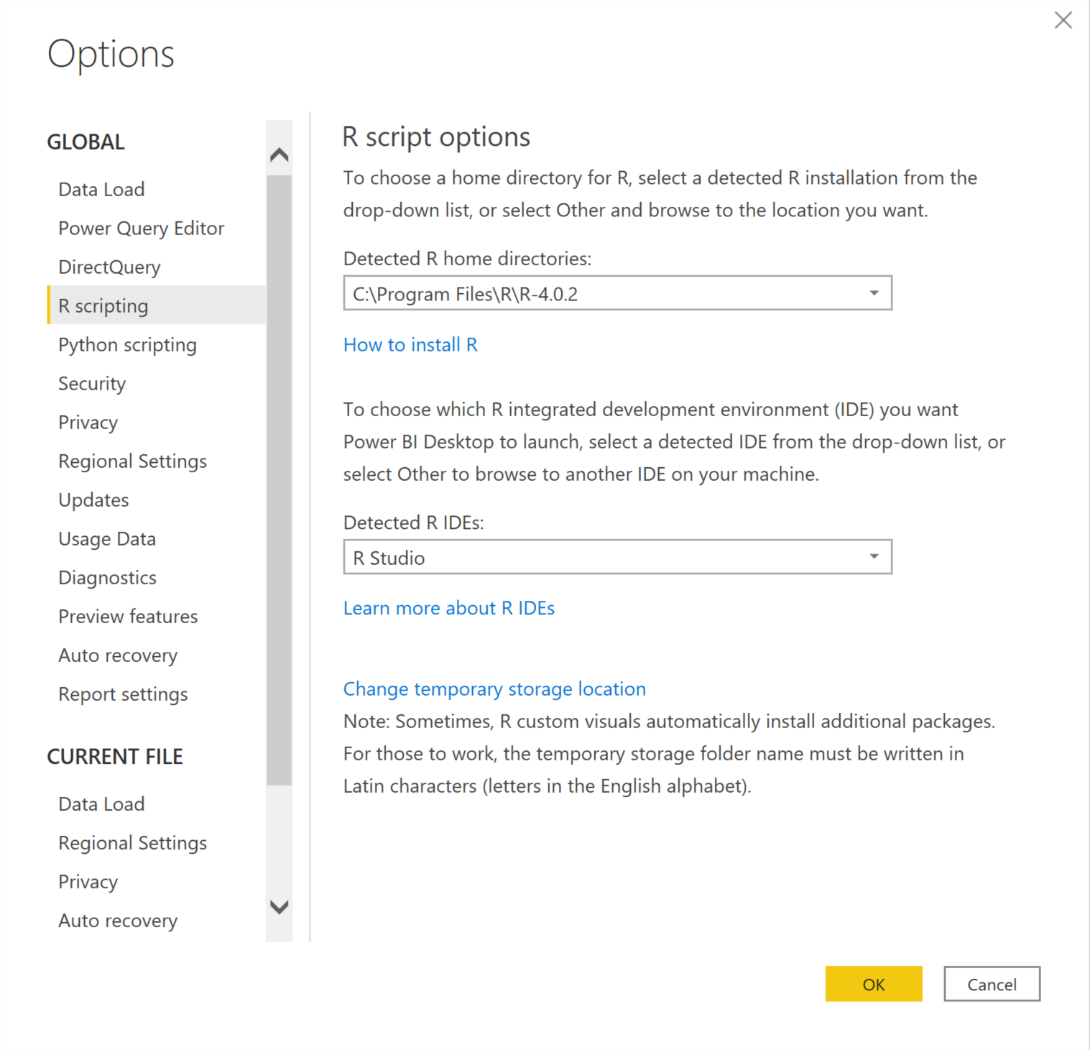
Set up
Freemium, Windows only
Free account can run R scripts
Paid, Pro account is needed to publish R visuals
File > Options & settings > Options > R scripting
Notes:
OK to set this up on your computer there are a couple of things you need to do. You can download from the Microsoft store. Then to set up your R integration you will go to File > .

Slide 7


Demo
Data: data/contestants.csv, data/personal_info.csv
What are the pre- and post-intervention scores among each cohort of a study group?
Import data via R script
Identify invalid email addresses
Visualize pre/post by group (slopeplot)
Follow along: demo-notes.pdf
Notes:
OK let’s walk through a demo of a dataset I mostly made up. We want to put together some sort of dashboard to evaluate the performance of candidates who did and did not participate in a mentoring program. This will involve a few things:

Slide 8
Questions?

Slide 9
Closing thoughts
Use R only when Power BI just can’t
Start in RStudio
Get a text expander for your RStudio shortcuts

Slide 10


Resources

Slide 11
Resources
Time for a giveaway!

Slide 12
THANK YOU
george@stringfestanalytics.com
linkedin.com/in/gjmount
stringfestanalytics.com/contact

