Slide 1


Advancing into Analytics: From Excel to R and Python
Notes:
Thanks to the organizers for having me again… you

Slide 2
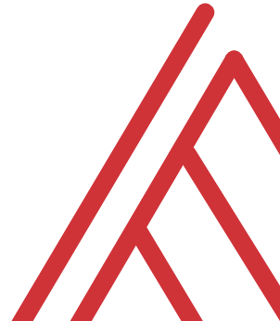
Learning objectives
R in Power BI: when and why?
Setup
Use cases
Giveaway…
Follow along: https://github.com/stringfestdata/satrday-r-power-bi
Notes:
OK so

Slide 3
Chat me up
Do you use Power BI? How/when/why?
Do you use R in Power BI? How/when/why?
Pros/cons to Power BI vs Shiny?
Brainstorm it! https://bit.ly/3nos6Yb

Slide 4
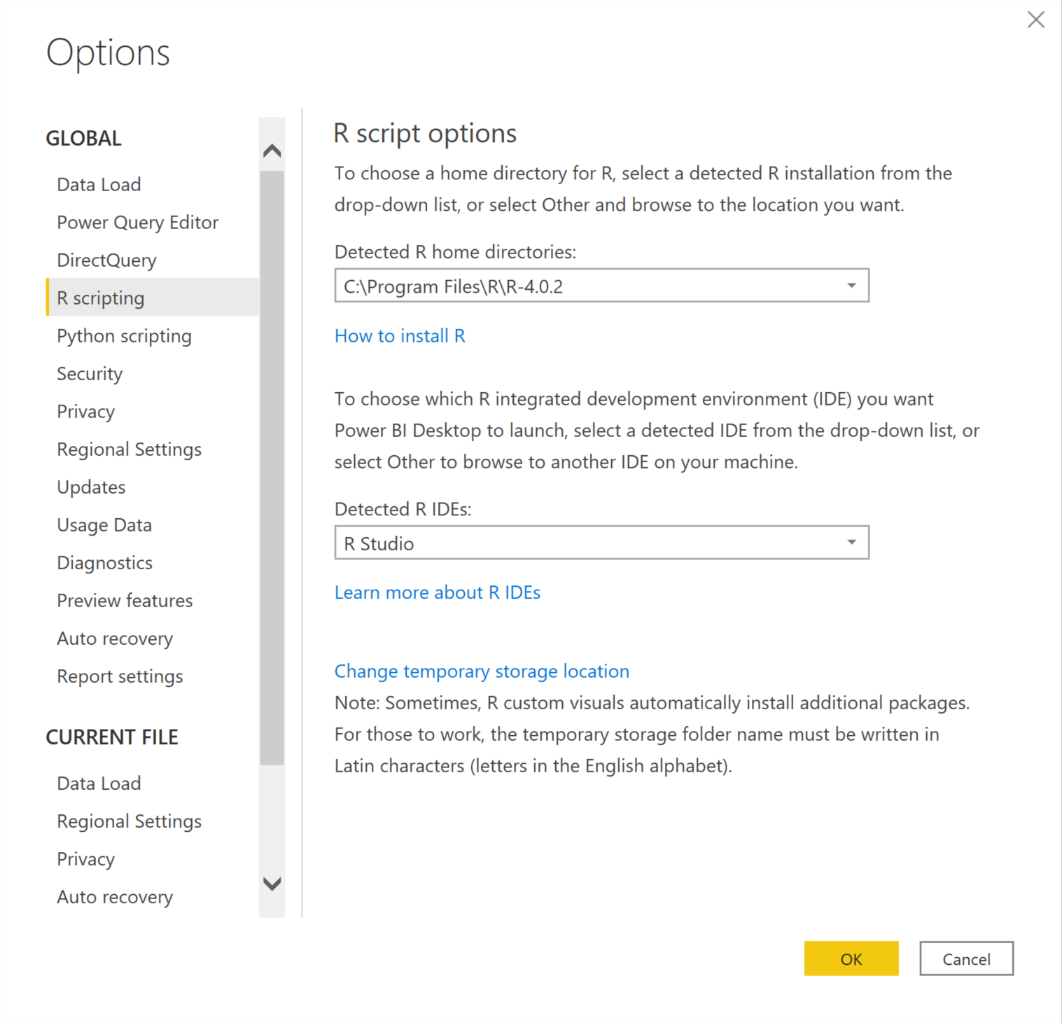
Set up
Freemium, Windows only
File > Options & settings > Options > R scripting

Slide 5

When and why
Remote or unstructured data sources (APIs, web scraping, text)
Feature engineering (missing values, PCA)
Machine learning
Regular expressions
Visualizations
https://www.windowsblogitalia.com/2019/02/microsoft-migliore-futuro-inner-source/

Slide 6
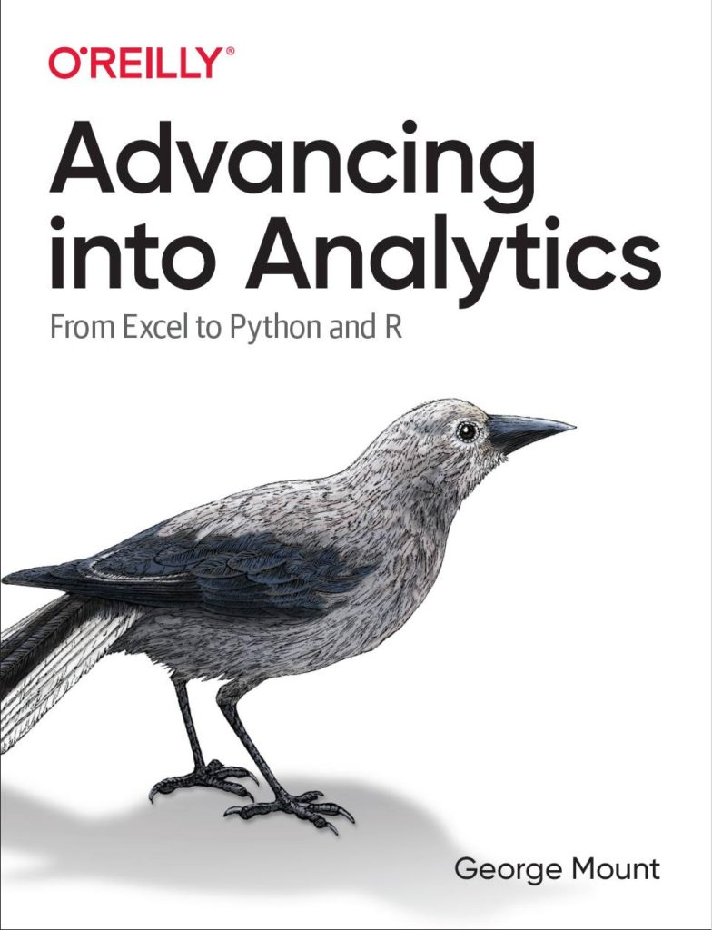
Questions?
Who wants to win a book?

Slide 7


Demo
Dataset: contestants.csv
Elvish Prestley auditions: style and technique scores of contestants who did and didn’t participate
How many email addresses are invalid?
What should we do with the missing values?
What is the relationship between style and technique scores?
Notes:
OK so now you will see R’s equivalent to some of those features you saw with Python. I think that for different reasons Python seems to be taking the lead on Excel automation, but R has some pretty robust features and in some ways are richer than Python’s.

Slide 8
So why not Shiny?
Gain from Microsoft’s BI stack (DAX, Power Query, etc)
Server already provisioned
Lower learning curve

Slide 9
Questions?

Slide 10
Have you downloaded the Analysis ToolPak?
https://bit.ly/3jZaw9X

Slide 11
Conclusion/Next steps

Slide 12
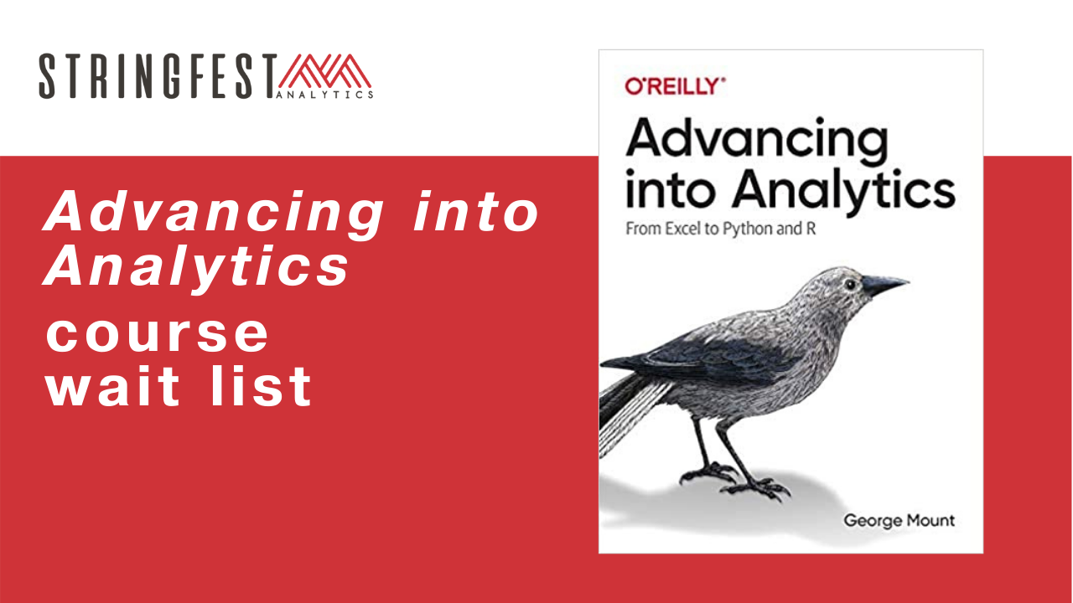
Want more?
Sign up for course waiting list: https://stringfestanalytics.com/aina-waiting/
Notes:
By the end of this book, you should be able to conduct exploratory data analysis and
hypothesis testing using a programming language.

Slide 13
Event survey: https://forms.office.com/r/0ZnD0LxpZy

Slide 14
Questions?

Slide 15
THANK YOU
george@stringfestanalytics.com
linkedin.com/in/gjmount
stringfestanalytics.com/contact

