Slide 1


SQL for Excel Users

Slide 2

Objectives for this course
The basics of relational databases and SQL’s role
The foundational commands used for reading form one or more tables in a database
Schemas, primary keys and foreign keys: what makes relational databases “relational.”

Slide 3
Augment your Excel skills
Use SQL to query a database to extract useful information
Explore basic commands and functions of SQL
Extract data and work with queries to pull the data you need for your analysis

Slide 4
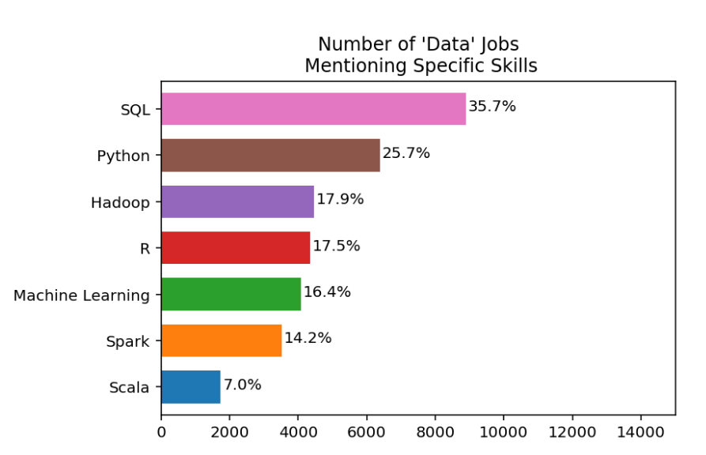
I’m guessing you want work
https://www.dataquest.io/blog/why-sql-is-the-most-important-language-to-learn/

Slide 5
Excel and SQL for Business Analytics
What is a database and when would you use it?

Slide 6
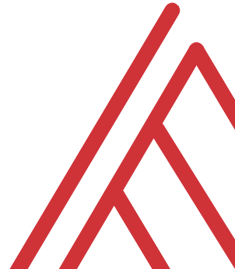
What is a spreadsheet and when would you use it?
Good for……
Browsing data
Entering/editing data
Flexible data structuring
Quick, visual data analysis on small datasets
Not so much at
Archiving data
Big data
Interfacing data
Structured data across multiple datasets

Slide 7






Relational databases
1970s origins…
Still with us today!

Slide 8

Meet your librarian
Structured
Query
Language

Slide 9

Are you ready for some baseball?
Lahman database: complete player statistics since 1871 plus salaries, Hall of Fame inductions and more!
Download here for SQLite

Slide 10

DRILLS
How many columns are in Managers?
How many of these columns are of type INTEGER?
How many rows does Managers have?

Slide 11
Questions?

Slide 12
The grammar of sql
Term | What it does | Example
Identifier | Identifies an object (i.e. table, field) | Master
Operator | Takes some action (perform calculation,, rename something) | +, AS
Expression | Applies criteria to data | birthYear > 1960

Slide 13


FROM VLOOKUP() DUCT TAPE TO JOIN() BLOWTORCH

Slide 14
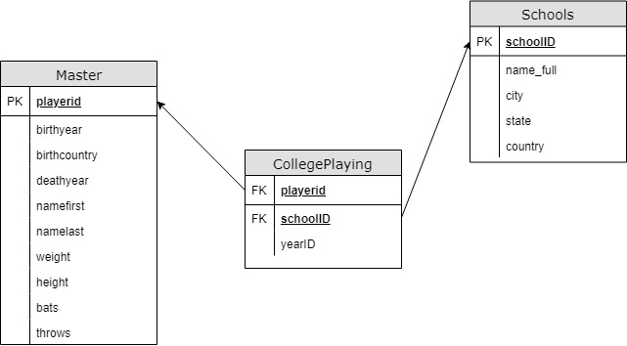
Introducing schemas

