Slide 1


SQL for Excel Users

Slide 2

Objectives for this course
The basics of relational databases and SQL’s role
The foundational commands used for reading form one or more tables in a database
Schemas, primary keys and foreign keys: what makes relational databases “relational.”

Slide 3
Augment your Excel skills
Use SQL to query a database to extract useful information
Explore basic commands and functions of SQL
Extract data and work with queries to pull the data you need for your analysis

Slide 4
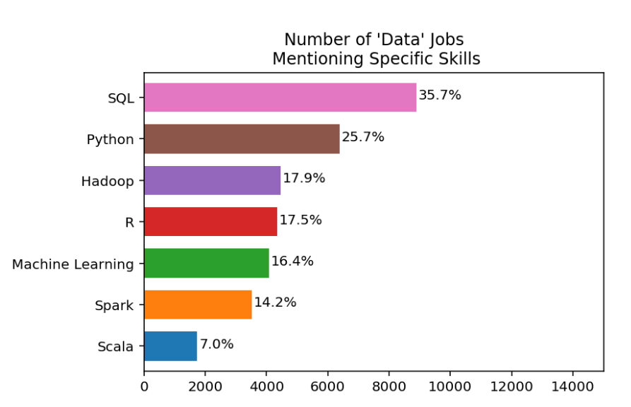
I’m guessing you want work
https://www.dataquest.io/blog/why-sql-is-the-most-important-language-to-learn/

Slide 5
Excel and SQL for Business Analytics
What is a database and when would you use it?

Slide 6
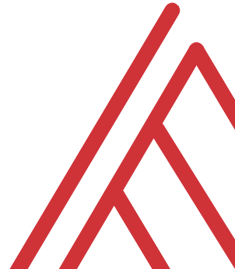
What is a spreadsheet and when would you use it?
Good for…
Browsing data
Entering/editing data
Flexible data structuring
Quick, visual data analysis on small datasets
Not so much at…
Archiving data
Big data
Interfacing data
Structured data across multiple datasets

Slide 7






Relational databases
1970s origins…
Still with us today!

Slide 8

Meet your librarian
Structured
Query
Language

Slide 9

Are you ready for some baseball?
Lahman database: complete player statistics since 1871 plus salaries, Hall of Fame inductions and more!
Download here for SQLite

Slide 10

Onward to SQLite!
+

Slide 11

ARE YOU READY FOR SOME DRILLS?
How many columns are in Managers?
How many of these columns are of type INTEGER?
How many rows does Managers have?

Slide 12
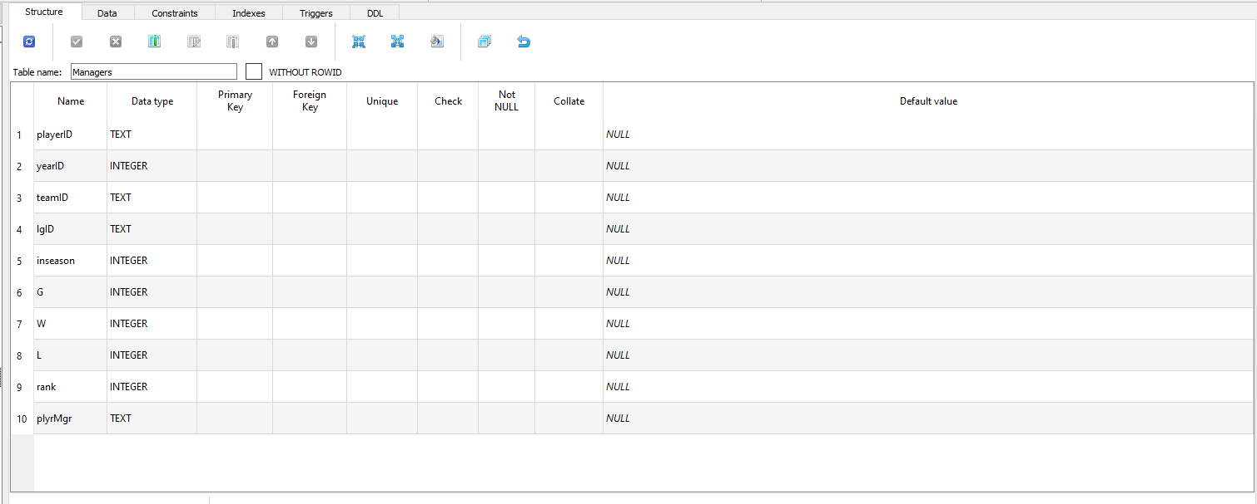
How many columns are in Managers?

Slide 13
2. How many of these columns are of type INTEGER?

Slide 14
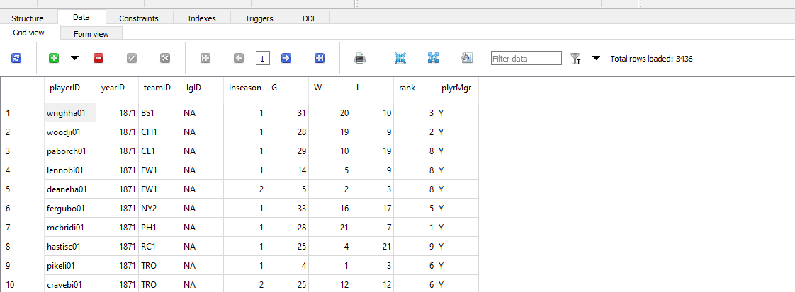
3. How many rows does Managers have?

Slide 15
Questions?

Slide 16
From Excel tables to SQL SELECT

Slide 17
From Excel-ese to SQL-ese
Excel
Data
Calculations
Notes
SQL
Tables
Queries/Scripts
Comments

Slide 18
The grammar of SQL
Term | What it does | Example
Identifier | Identifies an object (i.e. table, field) | Master
Operator | Takes some action (perform calculation,, rename something) | +, AS
Expression | Applies criteria to data | birthYear > 1960

Slide 19

Stylin’ in SQL
0. Good comments starting with –
Each clause on its own line
All operators uppercase (SELECT, ORDER BY, etc.)
Statements end with semicolon (;)

Slide 20
Let’s get coding…
-- List all the tables in our database
SELECT name
FROM sqlite_master
WHERE type='table'
ORDER BY name;
--Get the name and data type from every field in the
--"master" table
PRAGMA table_info(master);

Slide 21
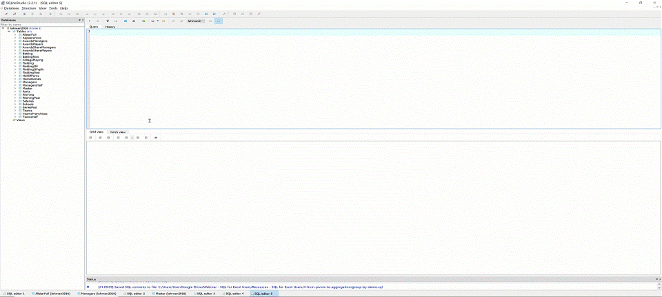
The font is too dang small!

Slide 22
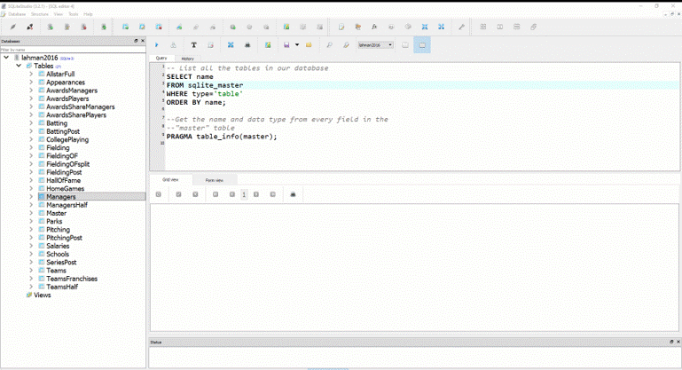
Saving your first .sql script

Slide 23
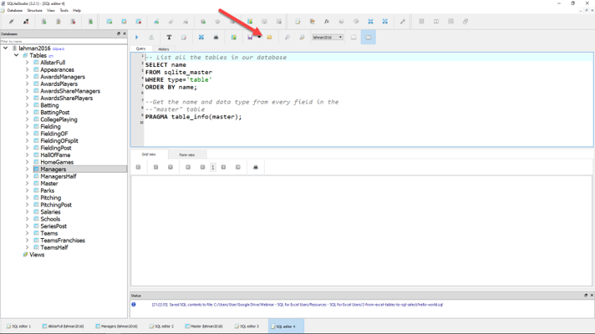
Loading your first .sql script

Slide 24
The SQL reader’s digest
Term | What it does
SELECT | Which fields to look for
FROM | Where to look for those fields
WHERE | What criteria those records should meet
GROUP BY | How to aggregate the results
HAVING | What criteria the aggregated results should meet
ORDER BY | How to sort the results
LIMIT | How many records to limit results to

Slide 25
Demo: sql-tables-example.xlsx

Slide 26
Demo: sql-select-demo.sql

Slide 27
Drills
Using the Teams table:
Select all fields.
Select all fields, first 100 rows.
Select yearID, teamID, W, L.
Select yearID, teamID, and a calculated field win_diff as the difference between W and L.
Create a field team_record such that the first record will read: 1871 Boston Red Stockings: 20-10.

Slide 28
Drills
Using the Teams table:
Select all fields.
Select all fields, first 100 rows.
Select yearID, teamID, W, L.
Select yearID, teamID, and a calculated field win_diff as the difference between W and L.
Create a field team_record such that the first record will read: 1871 Boston Red Stockings: 20-10.
Solutions: sql-select-drills.sql

