Slide 1



Mastering PivotTable Dashboards & Reports

Slide 2




Hi, I’m George

Slide 3

Objectives for this session
Use Pivot Tables to generate summary data, reports, and dashboards in seconds
Create connections across data with the Excel Data Model
Visualize data across multiple tabs

Slide 4
Following along
Each section is a workbook
Solutions in separate workbooks
Follow along with demo notes

Slide 5

1. PivotTables: The WD-40 of Excel

Slide 6

Every PivotTable operation is one of these…
Slice and dice
Drill down/roll up
Pivot/Unpivot
Notes:
Don’t worry too much about the building blocks right now – I have this in here to gauge everyone’s interest

Slide 7
Demo
File: pivot-tables-wd-40-start.xlsx
Using the tips worksheet:
Get the total bill by day, then time
Get the total bill for smokers only on Saturday and Sunday
Get average tips by day for each group size
Notes:
This would be rolling up and drilling down
This is slicing and dicing
This is unpivoting and pivoting

Slide 8
Demo
Using wholesale-customers worksheet:
Get the total sum of sales by Region, then Channel
Notes:
Doesn’t work so well, right?

Slide 9

What makes data “Pivot”-ready?
Each variable is in its own column
Each observation is in its own row
Every cell is an observation-variable intersection
Notes:
The Power Query course will be good to actually shape this data. /

Slide 10
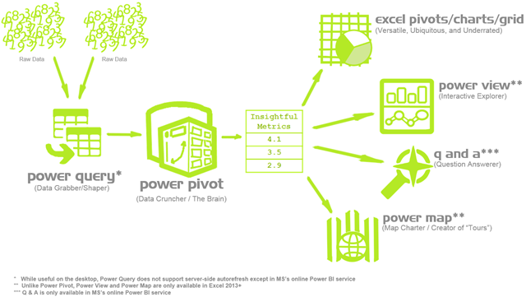
Heavy cleaning is a job for Power Query
https://p3adaptive.com/2014/09/what-is-power-bi/
Notes:
Don’t worry too much about the building blocks right now – I have this in here to gauge everyone’s interest

Slide 11
Demo
sales worksheet:
Create, configure, reformat PivotTables
Update, refresh, maintain data sources
Create calculated columns
Notes:
Doesn’t work so well, right?

Slide 12

Questions?

Slide 13
Exercises
housing worksheet:
Find the average sale price for each sale condition.
Count the number of homes with each roof type for each neighborhood. Hint: Count the number of homes as the count of record ID’s.
Find the average number of above grade bathrooms for each year built. Hint: Calculate the total number of bathrooms as the number of full baths + 1/2 * the number of half baths.
Find the maximum lot area for each combination of street type and building type.
Count the total number of homes with an alley for each neighborhood.
Find the average sale price for homes with each type of garage, along with the number of cars the garage can hold.
Solutions: housing-pivot-table-solutions.xlsx
Notes:
Doesn’t work so well, right?

Slide 14
2. PivotCharts and visualizations

Slide 15
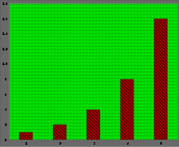
How can we master PivotCharts?
Pros: Pivot + Charts
Cons: Chartjunk
“The purpose of decoration varies—to make the graphic appear more scientific and precise, to enliven the display, to give the designer an opportunity to exercise artistic skills. Regardless of its cause, it is all non-data-ink or redundant data-ink, and it is often chartjunk.” --Edward Tufte
https://en.wikipedia.org/wiki/Chartjunk
Notes:
The Power Query course will be good to actually shape this data. /

Slide 16
Demo
File: pivot-charts-start.xlsx
computers worksheet:
Compare the distribution of computer prices w/ and w/o a CD-ROM
Notes:
Doesn’t work so well, right?

Slide 17
Exercises
tips worksheet:
Visualize the distribution of tips for lunch vs dinner bills as overlapping histograms
Create a stacked bar chart comparing total dinner vs lunch bills for each day of service
Notes:
Doesn’t work so well, right?

Slide 18
MID-COURSE EVALS
https://swiy.co/mcweval
Anonymous pulse check
Pacing
Depth/breadth topics
What else would you like to know?
Notes:
Doesn’t work so well, right?

Slide 19
Demo
hstarts worksheet:
Visualize & resample trends
Summarize & visualize segments as % to total
Notes:
Doesn’t work so well, right?

Slide 20
Demo/Exercises
File: teams-start.xlsx
Use PivotTables, charts and more to analyze & visualize MLB data:
Plot the franchises with the 10 most World Series wins since 1903 vs those franchses’ total number of World Series appearances.
Plot the average number of stolen bases per game from 1990 to 2017
Identify which wild card teams have won the World Series
Plot the average team ERA of AL vs NL teams since 1973
Notes:
Basically let’s see how people feel about these and they can become guided to the right extent

Slide 21
Questions?

Slide 22
3. Introduction to PowerPivot & Excel dashboards

Slide 23

Notes:
The Power Query course will be good to actually shape this data. /

Slide 24
Demo
Data: superstore data folder
Combine data sources with the Data Model
Create a “Power” PivotTable
Open a blank workbook to start…
Notes:
So this is like the Power Pivot PDQ stuff.

Slide 25
Demo + Exercises
Data: superstore model continued
Design a basic Excel dashboard to monitor profitability, regional performance and sales trends
Create additional measures & KPIs
Notes:
Doesn’t work so well, right?

Slide 26
Demo + Exercises
Folder: nycflights13 + blank workbook
Create a Data Model from raw_data files
Build a 3D Map
Analyze cancellation rates by location, carrier, etc.
Solutions: nycflights13-data-model-finish.xlsx
Notes:
Doesn’t work so well, right?

Slide 27




Slide 28
Conclusion & Resources

Slide 29

Excel Power Pivot & Power Query for Dummies, 2nd Edition
by Michael Alexander

Slide 30

Analyzing Data with Power BI and Power Pivot for Excel
by Alberto Ferrari and
Marco Russo

Slide 31
Find me
stringfestanalytics.com
@gjmount
github.com/stringfestdata

Slide 32
Thank you
I hope to see you at future workshops!

