Slide 1


X reasons to love
Excel tables
with George Mount

Slide 2

LEARNING OBJECTIVES
What are Excel tables? How do you make one?
Quick wins
Restructuring your brain
EMPOWERING POWER BI USERS
TO CHANGE THEIR WORLD

Slide 3
DEMO
Data: wholesale-customers.xlsx
Available in the resources
Basic report: What are total sales by channel?
EMPOWERING POWER BI USERS
TO CHANGE THEIR WORLD

Slide 4
1. YOU MUST HAVE COLUMN HEADERS

Slide 5
2. YOU MUST HAVE A TABLE NAME

Slide 6
3. THEY LOOK GOOD

Slide 7
4. YOU CAN ADD AND DELETE DATA EASILY

Slide 8
5. NO REWRITING FORMULAS

Slide 9
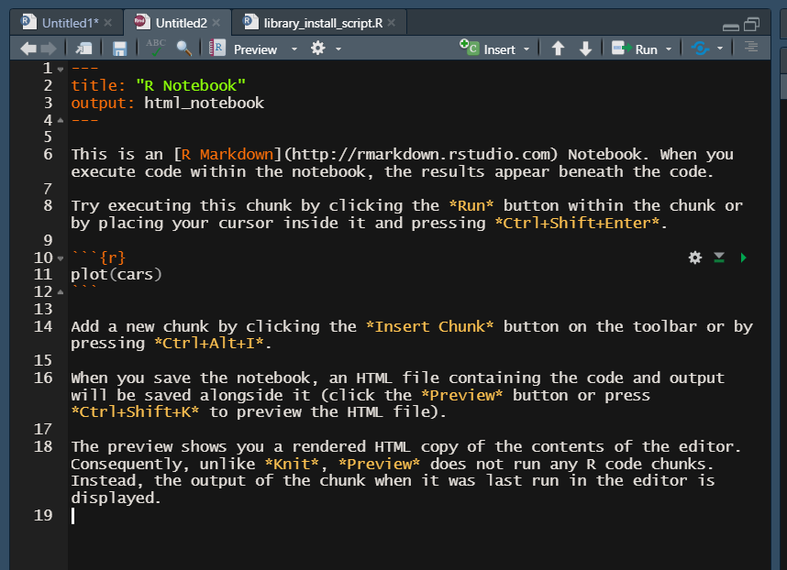
Change title, etc. here
An .rmd file
Preview output in Viewer
Code goes between ```’s
Text is written using R Markdown
EMPOWERING POWER BI USERS
TO CHANGE THEIR WORLD

Slide 10
RECAP
Telling (and retelling) a research report
Create websites, books, blogs with this framework
EMPOWERING POWER BI USERS
TO CHANGE THEIR WORLD

Slide 11



RESOURCES
Advancing into Analytics: https://swiy.co/aina
R for Power BI Users I & II: https://swiy.co/edna-mount
EMPOWERING POWER BI USERS
TO CHANGE THEIR WORLD

Slide 12
THANK YOU

