Slide 1
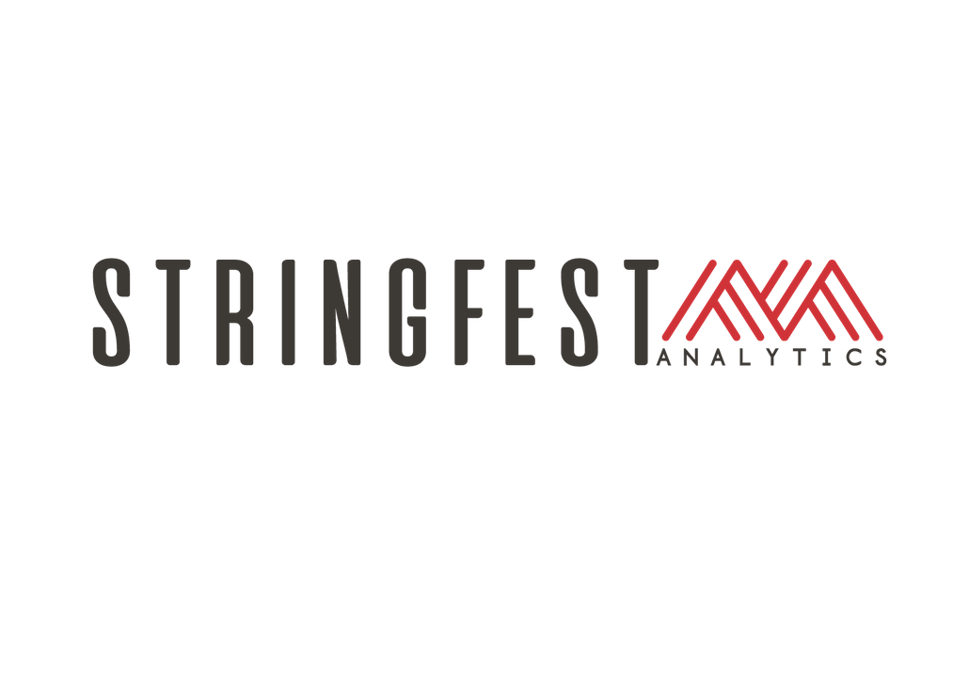

INTRO TO PYTHON FOR FINANCE
Notes:
Welcome!

Slide 2

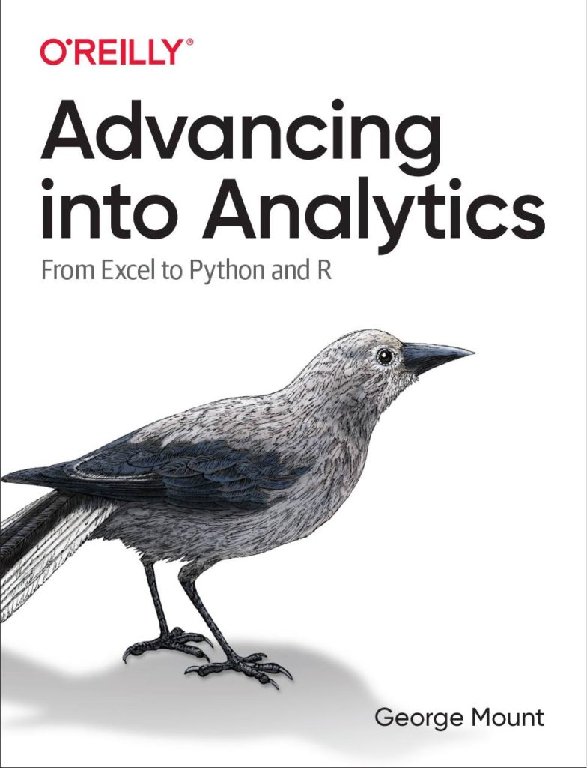
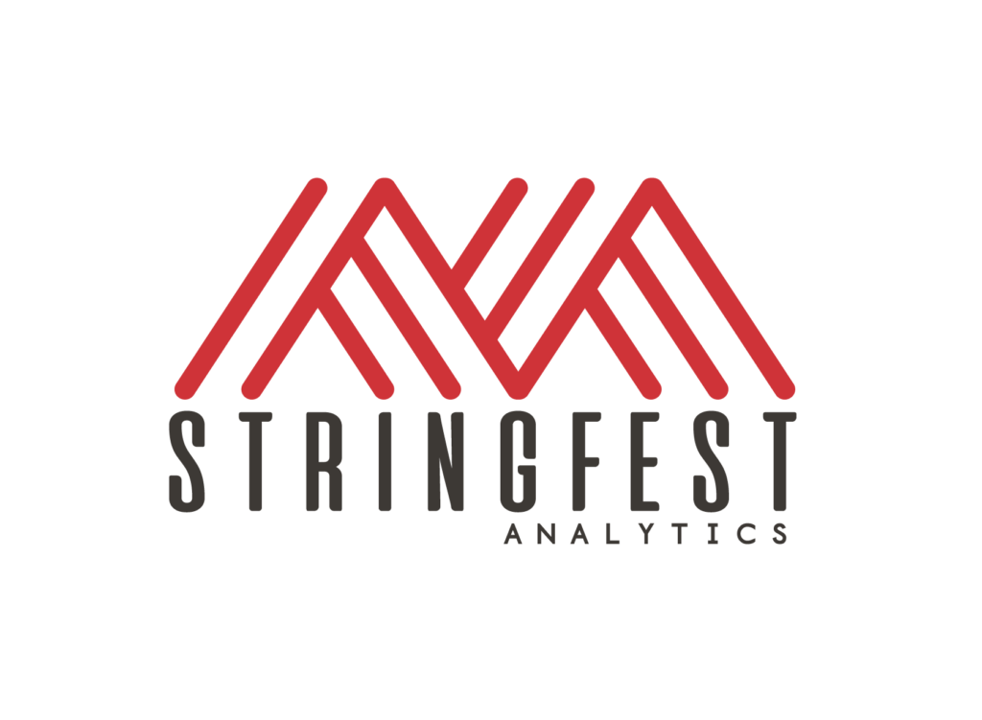

HI, I’M GEORGE
Intro to Python for Finance
Notes:
I want this course to be interactive, learning works best if I show you something and then you do it. If you sit here and listen to me talk for three hours, I don’t know how much you are going to get out of it.
So I will try to stay on pace here so that each section corresponds to about an hour. Most of the time will be spent in Jupyter notebooks and there will be ample time for you to practice, I have what amounts to fill in the blank coding challenges, I also have solution files for you to compare your work and we will go through the solutions together.

Slide 3

HI, I’M GEORGE
Intro to Python for Finance
Notes:
I want this course to be interactive, learning works best if I show you something and then you do it. If you sit here and listen to me talk for three hours, I don’t know how much you are going to get out of it.
So I will try to stay on pace here so that each section corresponds to about an hour. Most of the time will be spent in Jupyter notebooks and there will be ample time for you to practice, I have what amounts to fill in the blank coding challenges, I also have solution files for you to compare your work and we will go through the solutions together.

Slide 4
COURSE OBJECTIVES (with a twist of finance)
Load, view and write spreadsheet files from Python
Perform common data wrangling tasks such as sorting, filtering, and aggregation
Navigate and execute code in Jupyter notebooks
Identify, install and implement useful packages for your needs
Not panicking
Intro to Python for Finance
Notes:
All right, we have a ton of stuff to do today so I apologize now if we don’t get through it all.
We’ll be spending most of our time coding in Python, big surprise and I will make sure to spend some time working with spreadsheet data in Python, to bridge that gap.
But also I want to bridge that knowledge gap, and tap your memories for things that you probably do with data all the time, like sort, filter, and merge. You do this all the time in Excel and you know why they are so important! They are also important in Python, so I want to help you take that mental model of working with data and apply it to Python.
Now as you’ll see working with Python is similar to Excel in some ways but also different, one big difference is our interface for working with Python. We will use Jupyter notebooks which are quite popular, and that will make sense why as we begin to use them, they make code much more beautiful than I thought it would ever be.
And to build on the planetary analogy from Jupyter, Python is a huge universe of packages, we will get into packages later in the course, but you can think of them as like the app store. We will look at what makes these packages so cool – in many ways, it’s cooler than the app store.
Finally this is not easy stuff! So I want to make sure you feel comfortable with your first steps in Python! By relating what we are learning to what you already know that will be a huge help in getting you familiar with this content, I want you not to panic.

Slide 5
FOLLOWING ALONG
Course repo: https://github.com/stringfestdata/thunderbird-intro-python-finance
Each section is a sub-folder
Demos = follow along with me
Drills = try it yourself
Intro to Python for Finance
Notes:
I want this course to be interactive, learning works best if I show you something and then you do it. If you sit here and listen to me talk for three hours, I don’t know how much you are going to get out of it.
So I will try to stay on pace here so that each section corresponds to about an hour. Most of the time will be spent in Jupyter notebooks and there will be ample time for you to practice, I have what amounts to fill in the blank coding challenges, I also have solution files for you to compare your work and we will go through the solutions together.

Slide 6
LAUNCHING JUPYTER
On Windows:
Window key > search “Jupyter Notebook” > Enter
On Mac:
Terminal > type jupyter notebook > Enter
Intro to Python for Finance
Notes:
I want this course to be interactive, learning works best if I show you something and then you do it. If you sit here and listen to me talk for three hours, I don’t know how much you are going to get out of it.
So I will try to stay on pace here so that each section corresponds to about an hour. Most of the time will be spent in Jupyter notebooks and there will be ample time for you to practice, I have what amounts to fill in the blank coding challenges, I also have solution files for you to compare your work and we will go through the solutions together.

Slide 7
1. INTRO TO PYTHON LANGUAGE & ECOSYSTEM
Notes:
OK, a few more slides here and we will jump briefly into Excel and then Python. I know as an attendee I hate listening to this kind of slow wind-up and I just want to start coding ,but it really matters to have all this background knowledge, in fact I would say one of the most important traits you can have as a data person is to be able to contextualize and switch between skills.

Slide 8
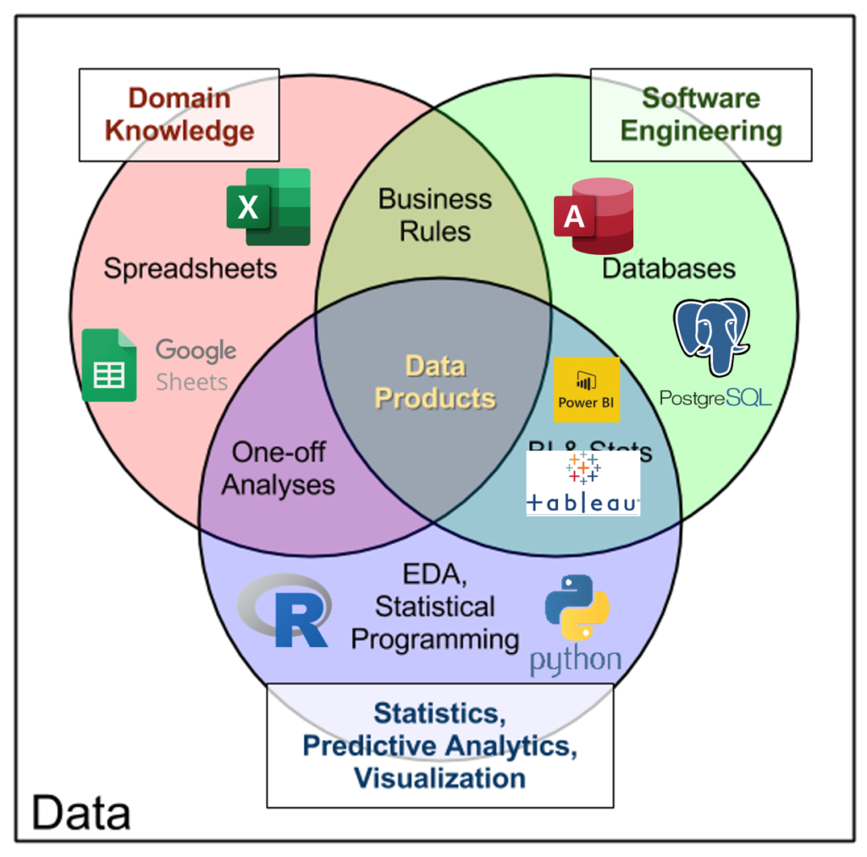
THE DATA ANALYTICS STACK
http://www.datacommunitydc.org/blog/2013/09/the-data-products-venn-diagram
Notes:
I come back to this image a lot, this idea of a “data analytics stack.” These are tools that we often use to build data products, they are all different slices of the same stack, no one is better than the other and they are most effective when we cross different platforms. Excel is a totally valid tool for prototyping and end-user interaction, don’t hate on it! It is a powerful tool. And Python is a powerful tool, it’s best not to put all your eggs into any of these tools, but to know when to use it and when not to, what these tools are and what they are not. Let’s do that with Python.

Slide 9
PYTHON IS: PYTHON IS NOT:
A programming language
Open-source
A spreadsheet
A database
Commercially supported
Notes:
Now, Python is indeed a programming language, I’m assuming you know that already and it hasn’t scared you off yet, congratulations it shouldn’t. One interesting thing with Python is it’s an open-source language, that means that anyone is free to take Python code and do whatever they want with it, and people indeed do all sorts of things with it. They distribute copies of it, they sell code based on it, they mash-up code and pass it around.
Python is not a spreadsheet, by that I mean we can’t go in and execute directly on cells and see the results appear, like we can in regular Excel. It’s also not a database, Python is not really a place to store data, usually you are going to retrieve data from other files such as yes Excel spreadsheets, but also anything from a database to HTML web scraping.
Finally, Python unlike Excel is not commercially supported, that means it’s really powered by amateurs which is really remarkable. Now if you wanted to pay one of those amateurs to help you, you can certainly do that, but this isn’t like Excel where the product is under a closed-shop.

Slide 10
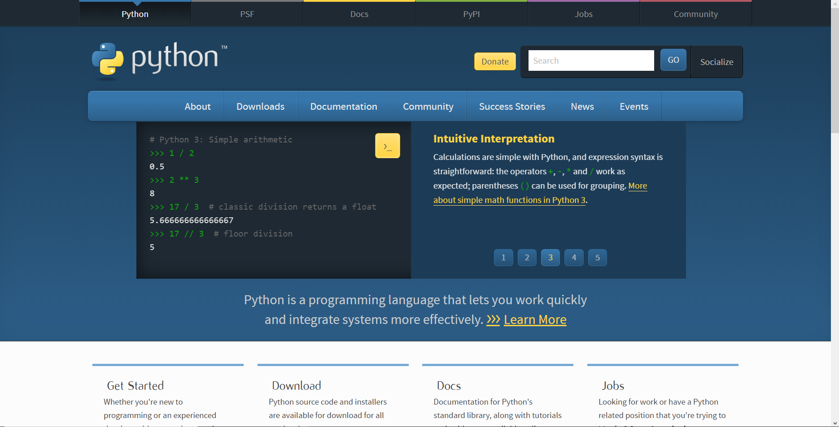
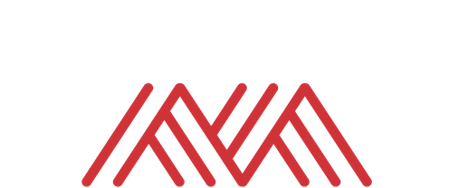
WHERE DOES PYTHON COME FROM?
https://www.python.org
Notes:
Now when you want to get started with Excel it’s pretty simple, you purchase and download a copy of Excel!
With Python it’s a little different. Now you can download the “source code” of Python, from the Python Foundation. This is where the official Python language is maintained. But this is open-source so people are welcome to make copies of it and distribute it on their own.

Slide 11
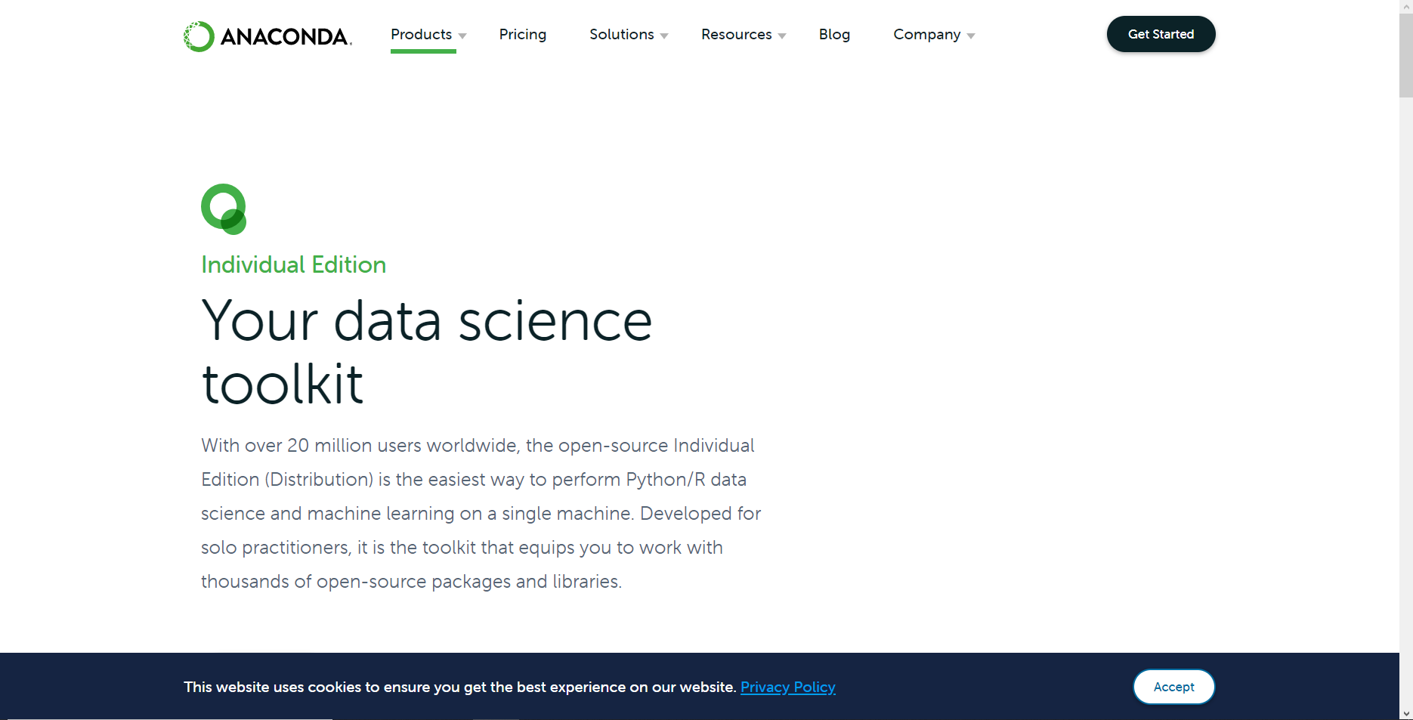
ANACONDA: A PYTHON HAND-ME-DOWN RE-PACKAGING DISTRIBUTION
https://www.anaconda.com/products/individual
Notes:
And this is what the Anaconda distribution does. It’s a _distribution_ or repackaging of the code that includes some extra goodies. Now, we are going to be using a cloud-based instance of Python, so you don’t have to install anything. But if you want to do that after the class, I have this as a recommended follow-up to download Anaconda.

Slide 12
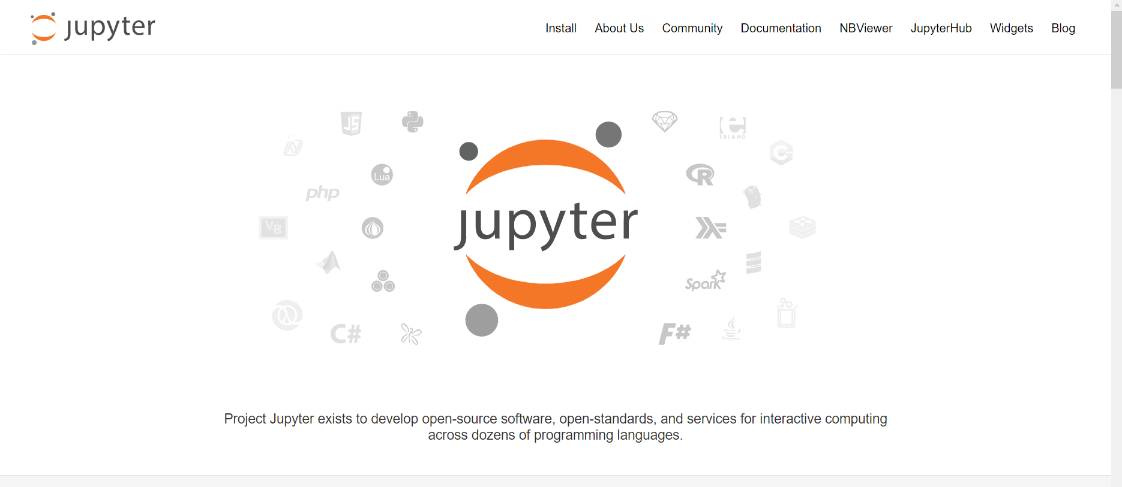
ACCESSING PYTHON FROM JUPYTER
https://jupyter.org/index.html
Notes:
Now remember that Python is open-source which means anyone is welcome to build off of it however they want. This is what Jupyter is, this is a special interface for working with what are known as Python notebooks. There are other ways to execute and work with Python code, for example if you’ve heard of VS Code or PyCharm, those are other code editors that would allow us to run the Python code, but Jupyter notebooks are great teaching tools so we’ll be using those.

Slide 13
DEMO
hello-from-jupyter.ipynb
The rest of course will be in Jupyter, except for the Conclusion
Notes:
OK now finally let’s get into Python, sigh of relief right!

Slide 14
4. CONCLUSION
Notes:
All right, we are at the end of our whirlwind tour! Here is some future learning for you and some things to check out on the O’Reilly learning platform.

Slide 15
Future learning
Programming
Conditional statements
User-defined functions
Loops
Remote data sources
Relational databases
APIs
pandas, matplotlib/seaborn … oh my!
Notes:
Now we got into some common data-wrangling tasks you might do such as sorting and filtering. There is more you can program Python to do to help you process data, this gets into some more intermediate programming techniques such as writing if/else statements, writing your own functions or writing loops. We did not get into these topics but if you check out the books I suggest you will learn more.
Also we really just worked with reading Excel files and csv files into Python however it’s likely you’ll need to get data from other sources, such as relational databases for application programming interfaces or APIs, for APIs especially knowing some things about user-defined functions and loops will help a lot toward collecting that data.
Finally, pandas, matplotlib and seaborn are the bread and butter of working with data in Python so continue learning about them! You will use them for nearly everything you do with data in Python.

Slide 16
Advancing into Analytics, by George Mount
https://learning.oreilly.com/library/view/advancing-into-analytics/9781492094333/
Human Centered Design • MDLS 2020
Notes:
This is my new O’Reilly book. It will be good practice for some of the Python techniques you’ve learned and it will also go deeper into the statistical analysis. You will learn a bit about R as well. By the end of the book you’ll be able to explore

Slide 17
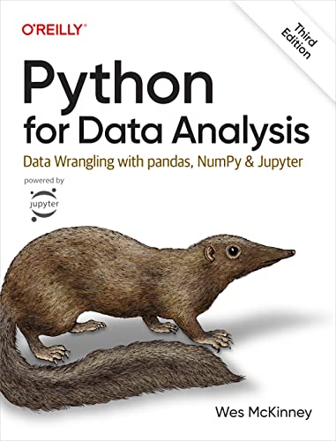
Python for Data Analysis,
3rd Edition by Wes McKinney
On O’Reilly Learning at https://learning.oreilly.com/library/view/python-for-data/9781098104023/
Human Centered Design • MDLS 2020
Notes:
This book is the bible for manipulating data with Pandas, so take a look, it will be a good combination of reinforcing what you’ve learned today and then learning some new things. But I hope you enjoyed working with Pandas because it’s all over your future in Python 😊.

Slide 18
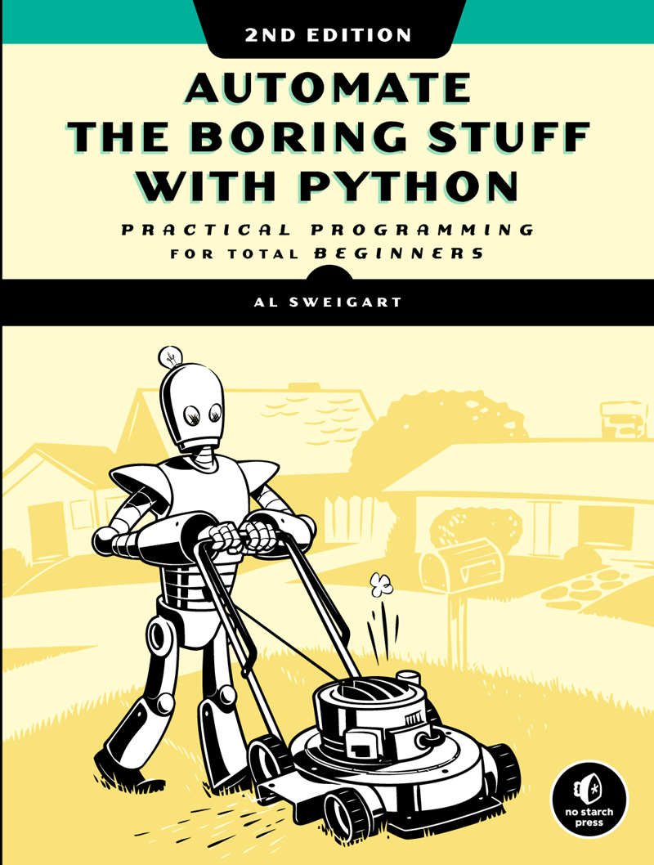
Automate the Boring Stuff with Python, 2nd Editition
by Al Sweigart
On O’Reilly Learning at https://learning.oreilly.com/library/view/automate-the-boring/9781098122584/
Human Centered Design • MDLS 2020
Notes:
I really like this book because it can show you how to automate all sorts of things in Python, including spreadsheets. It will show you how to manipulate Google Sheets, send emails, Word Docs, etc, so maybe you would want to not just write the workbook from Python but then send it out over email, read this book and learn how. You will learn some more advanced programming techniques such as writing your own functions or loops.

Slide 19
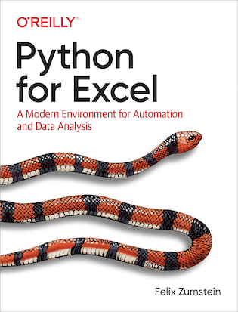
Python for Excel by Felix Zumstein
On O’Reilly Learning at https://learning.oreilly.com/library/view/python-for-excel/9781492080992/
Human Centered Design • MDLS 2020
Notes:
This book is not finished yet but you can see it take form on the O’Reilly site, pretty cool! I showed you some of the possibilities of using Python to drive Excel at the end of the course, this book is going to really focus on that intersection. You will learn a bit more about pandas as well.

Slide 20
LET'S TALK
LINKEDIN
linkedin.com/in/gjmount
EMAIL ADDRESS
george@stringfestanalytics.com
WEBSITE
stringfestanalytics.com
GITHUB
github.com/summerofgeorge
Notes:
Thanks for coming! Feel free to contact me anytime, find me on LinkedIn, I also write frequently on this stuff so check out my website too.

Slide 21
QUESTIONS?
Notes:
Any final questions?

Slide 22

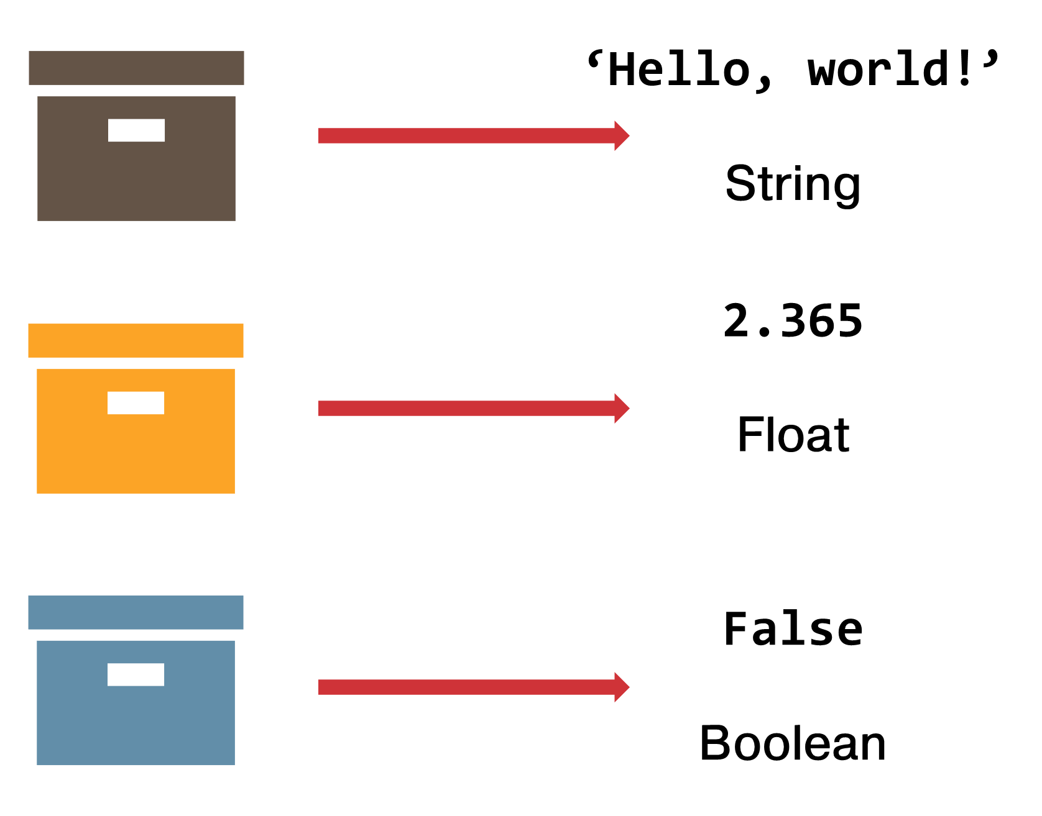


‘Hello, world!’
String
2.365
Float
False
Boolean
Notes:
Any questions on descriptive statistics?

Slide 23

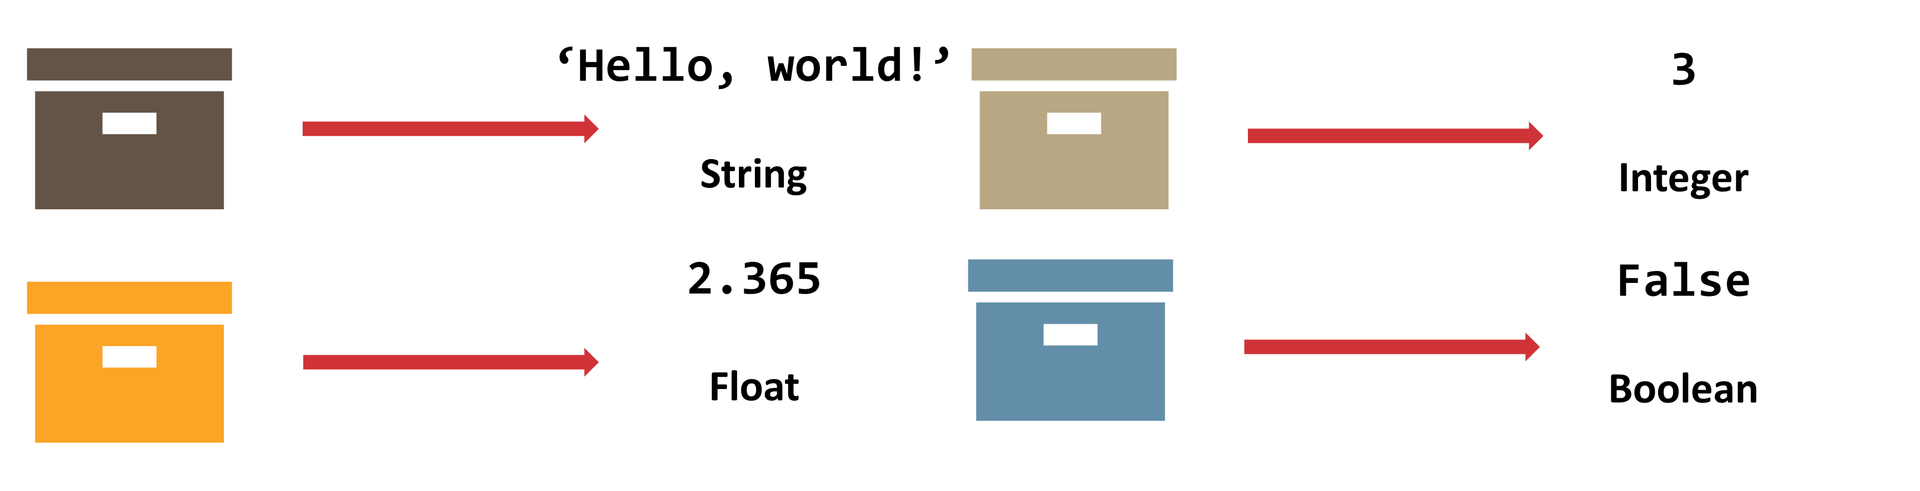
‘Hello, world!’
String
3
Integer
2.365
Float
False
Boolean
Notes:
Any questions on descriptive statistics?

Slide 24
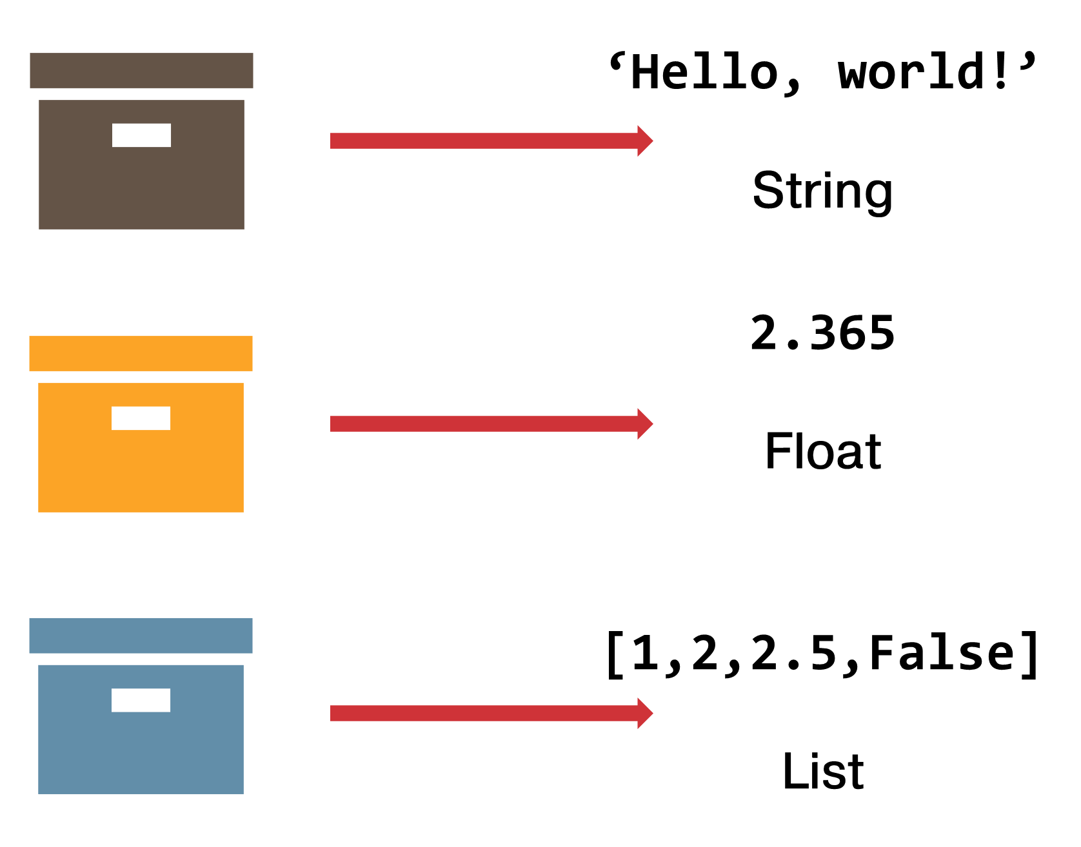
‘Hello, world!’
String
2.365
Float
[1,2,2.5,False]
List
Notes:
Any questions on descriptive statistics?

