Slide 1


Transforming text data with Excel

Slide 2
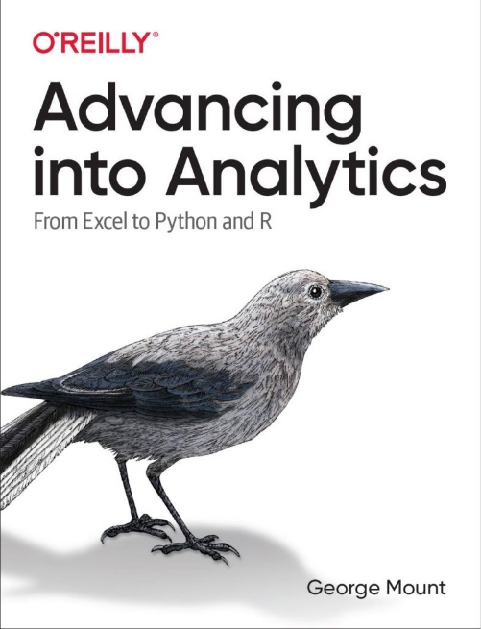
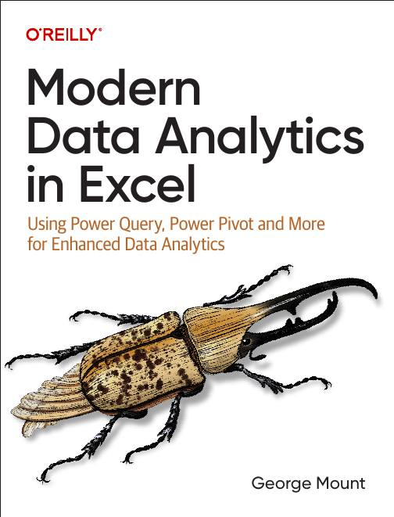




Hi, I’m George

Slide 3

Objectives for this session
Split data by rows in Power Query
Utilize dynamic array functions like TEXTSPLIT() and TEXTJOIN() to streamline text manipulation
Apply regular expression functions in Excel to extract and organize complex text patterns
Analyze text data effectively using Excel's new Copilot features and Python integration.

Slide 4
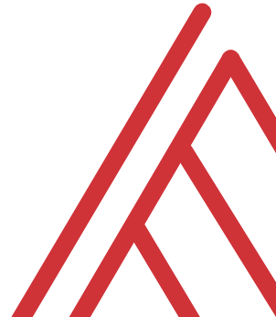
Questions?

Slide 5
Thank you

