Slide 1
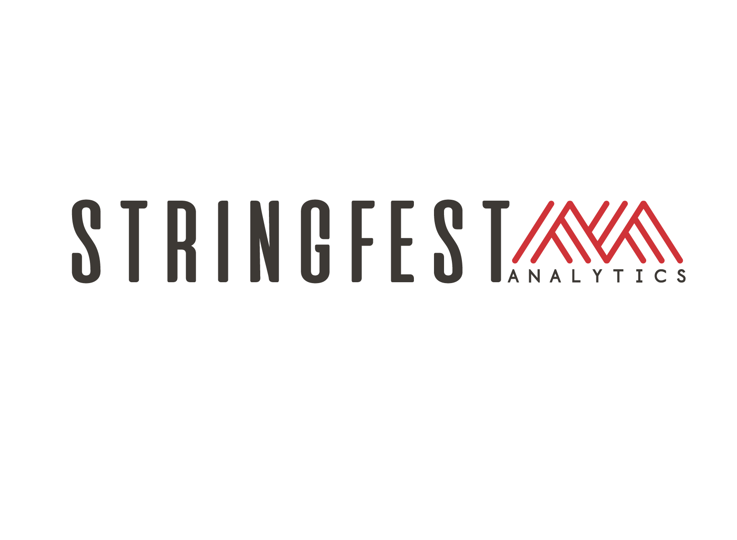

Treating Excel seriously:
A better way to invest in analytics capability
Notes:
"Thanks for joining. Before we get started, I want to set expectations clearly.
This is not an Excel training session. There are no formulas, demos, or walkthroughs today.
This is a short, decision-level conversation about how Excel actually functions inside organizations — and what gets missed when it’s treated as a basic skill instead of a platform."
Pause.
"If you’re responsible for approving tools, training, or workflows, this session is for you."

Slide 2
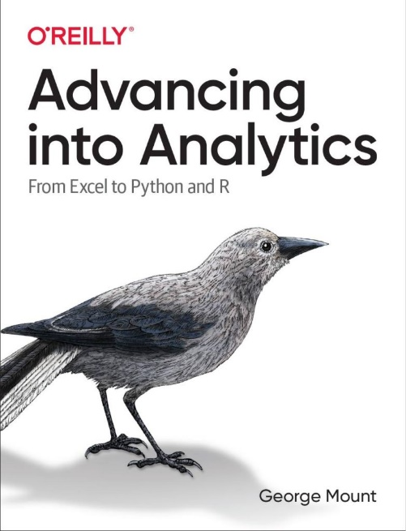
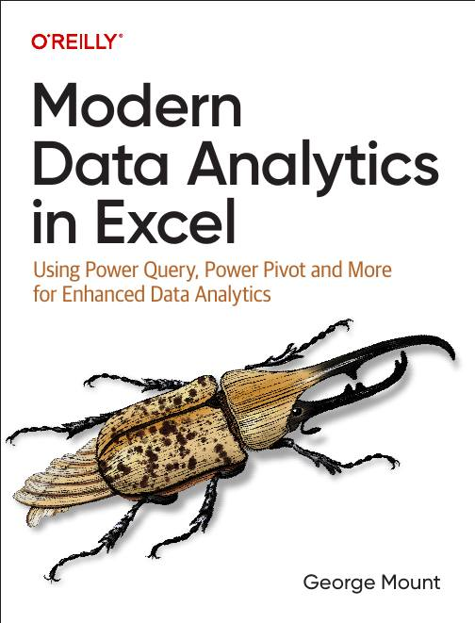




I help Excel users move from fragile spreadsheets
to confident, scalable analysis.
Notes:
“Very briefly, for context — this is the lens I’m coming from.”
“I spend most of my time seeing how Excel is actually used — not how people say it’s used.”
“That means planning models, reconciliation files, exception handling, and last-mile analysis — not toy examples.”

Slide 3

What to expect today
Framing, not training
Real-world patterns I see constantly
A practical way to think about investment decisions
Time for questions
Notes:
“Today is framing, not training.”
Pause.
“I’ll talk through real-world patterns I see constantly — especially around tooling and investment decisions.”
Pause.
“And I’ll give you a practical way to think about those decisions going forward.”
“We’ll leave time for questions at the end.”

Slide 4
The pattern
New tools feel strategic
Familiar tools feel “basic”
Notes:
I want to start with a pattern that shows up almost everywhere I work.
It doesn’t seem to matter whether the team is in finance, operations, analytics, or strategy. The pattern is remarkably consistent. When a new tool is introduced, it immediately feels strategic. There is energy around it. There’s a rollout plan. There’s a roadmap. There’s budget allocated. There’s formal training. There’s often executive sponsorship. Someone is clearly accountable for adoption.
The tool is treated like infrastructure. It gets governance. It gets documentation. It gets measurement. It gets attention.
Excel almost never gets that treatment.
Not because it isn’t powerful. And not because it isn’t widely used. In fact, the opposite is true. Excel is so widely used, and so familiar, that it doesn’t feel like something that requires intentional investment.
Everyone assumes people already know it. Everyone assumes it’s being used appropriately. Everyone assumes its limits are understood.
And familiarity creates confidence.
Sometimes that confidence is justified. Many people are genuinely capable. But sometimes the confidence is inherited rather than examined. It comes from exposure, not from structure.
That’s where the investment decisions start to shift. Instead of assessing Excel capability the way we would assess capability in a new platform, we assume it’s fine. We assume people are consistent. We assume logic is reusable. We assume risk is low.
So we fund new tools while leaving the tool that actually carries much of the analytical load under-managed.
And over time, that mismatch creates friction. Not because Excel is flawed, but because it’s treated as a basic skill rather than as a platform that needs ownership and intention.

Slide 5
Why Excel is treated differently
Everyone uses Excel
No one owns it
Everyone assumes proficiency
Notes:
This combination is really the root of a lot of problems.
Excel is everywhere. It cuts across departments. It cuts across seniority levels. Analysts use it. Managers use it. Directors use it. Executives open files that ultimately came from Excel, even if they do not realize it. It is one of the few tools that truly sits at every layer of an organization.
And yet, despite how pervasive it is, almost no one owns it as a platform.
There is usually no clear steward. No one is responsible for how logic is structured across teams. No one is accountable for whether assumptions are documented consistently. No one is thinking about versioning, reuse, or architectural patterns in a deliberate way.
So instead of managing Excel intentionally, organizations default to an assumption. The assumption is that people already know it, and that they are using it appropriately.
That assumption fills the vacuum where ownership should be.
The problem is not that people are incapable. The problem is that capability is uneven, informal, and rarely assessed. Some teams are doing sophisticated, careful work. Others are building fragile files that carry real risk. But because Excel is familiar, that variation remains mostly invisible.
Now I want to make this personal for a moment.
How many of you rely on Excel for work that influences real decisions?
By real decisions, I mean budget allocations, headcount planning, pricing, forecasting, reconciliation, compliance, strategic direction. Work that affects money, risk, or people.
If that is you, just put a yes in the chat.
Give them space to respond.
Because if Excel is influencing real decisions, then whether it is treated casually or treated intentionally is not a small matter. It is a governance and capability question, not just a skills question.

Slide 6
The cost
The cost rarely shows up as a budget line
Notes:
When Excel is under-invested in, the cost almost never shows up as a clean line item on a budget.
There is no invoice that says, “Spreadsheet fragility: $48,000.” There is no dashboard metric labeled “logic drift.” There is rarely a formal postmortem that traces friction back to spreadsheet architecture.
Instead, the cost leaks out quietly.
It shows up as rework. Someone rebuilding logic that already exists in another file because it is easier than finding and trusting the original.
It shows up as reconciliation loops. Two numbers that should match but do not, so time is spent tracing assumptions cell by cell.
It shows up as manual checks layered on top of formulas because trust is low, even if no one says that explicitly.
It shows up as shadow systems. A second file. A backup model. A parallel tracker built “just in case.”
And over time, it shows up as analyst fatigue.
Not dramatic burnout necessarily, but the steady cognitive load of working in an environment where logic is brittle and ownership is unclear. Where you are never entirely sure whether a result is wrong, or just poorly structured.
It is important to say this clearly: none of this happens because people are careless.
Most analysts I meet are thoughtful and conscientious. They are trying to do the right thing under time pressure. They are responding to shifting definitions and urgent requests.
The problem is structural, not personal.
Excel is often expected to behave like two different things at once. On the one hand, it is treated as a disposable tool. Something quick. Flexible. Informal. Easy to spin up and throw away.
On the other hand, it is also expected to function like a production system. Stable. Auditable. Reusable. Trusted across cycles.
Those two expectations are in tension.
When we do not acknowledge that tension, we end up blaming individuals for outcomes that are really the result of under-investment and unclear standards.
This is the part where the conversation shifts from “Excel skills” to capability design.
Let that sit.
Because once you see the cost in terms of friction and fatigue rather than software licenses, it becomes much harder to dismiss.

Slide 7
The uncomfortable reality
Excel is still where the decisions happen
Notes:
Even in very modern analytics environments, Excel has not gone away.
I work with teams that have BI platforms, data warehouses, cloud pipelines, forecasting tools, automation layers. The stack can look very sophisticated from the outside.
And yet, when you follow the flow of work all the way to the point where someone has to make a decision, Excel is usually still there.
It shows up in the exceptions. The cases that do not quite fit the dashboard logic. The edge scenarios that were not anticipated when the system was designed.
It shows up in scenarios. When someone asks, “What happens if we change this assumption?” or “What if demand shifts by ten percent?” or “What if hiring freezes next quarter?”
It shows up in assumptions. When definitions are still evolving, when metrics are being debated, when people are negotiating what the numbers actually mean.
And ultimately, it shows up in decisions. The last mile before something gets approved, rejected, funded, or delayed.
Dashboards are very good at showing what happened. They are excellent at summarizing history. They create clarity around past performance.
But Excel is still where people ask “what if?”
What if revenue slips.
What if cost assumptions are too optimistic.
What if we restructure the model.
What if we allocate differently.
That exploratory, iterative, assumption-driven thinking often happens in Excel because it is flexible. It allows people to manipulate structure, not just view outputs.
This is why Excel quietly carries more responsibility than it is often credited with.
So I want to ask you something.
Where does Excel quietly carry more responsibility in your organization than leadership acknowledges?
Is it in planning?
In reconciliations?
In forecasting?
In risk modeling?
In pricing?
Take a moment and think about that. Or drop a quick example in the chat.
Because if Excel is sitting at the point where exceptions, scenarios, assumptions, and decisions converge, then how we think about investing in it is not a technical question. It is a governance and capability question.
And that realization is where this conversation starts to shift.

Slide 8
High standardization
Repeatable reporting
Competing needs
Personal analysis & quick checks
Exploration, scenarios, and “What if”
Low uncertainty of work
High uncertainty of work
Low standardization
Notes:
This 2×2 is really the core of how I think about where Excel fits inside organizations and where problems tend to show up.
It is not a comparison of tools. It is not Excel versus BI or Excel versus Python. It is not even really about technology.
It is about different types of work.
If we misunderstand the type of work being done, we end up blaming tools for problems that are actually structural.
Let me walk through the axes first before we look at the quadrants.
Along the horizontal axis is uncertainty of the work.
On the left side, the work has low uncertainty. We know the question. The definitions are stable. The process repeats on a regular cycle. The outputs are predictable. A monthly close report is a good example. A standard KPI dashboard is another.
On the right side, the work has high uncertainty. The question is still evolving. Assumptions are changing. The team is exploring options. People are iterating, refining, testing scenarios. The structure of the problem itself may not be settled.
Now look at the vertical axis, which is standardization.
At the bottom is low standardization. This is personal or small-team work. It is often judgment-heavy. It may not be designed for reuse. It might be exploratory or temporary. It does not need governance because it is not widely shared.
At the top is high standardization. The outputs are shared. Metrics must be consistent. Definitions must be stable across users. Repeatability matters. Visibility is higher, and so is risk.
Once you understand those two dimensions, the quadrants become clearer.
In the bottom-left quadrant, where uncertainty is low and standardization is low, you have personal analysis and quick checks. This is where a lot of thinking starts. Sanity checks. One-off calculations. Ad hoc validation. This is not dangerous territory. Excel is perfectly fine here. In fact, it is often ideal because it is fast and flexible. There is no reason to over-engineer this quadrant.
In the bottom-right quadrant, uncertainty is high but standardization is still low. This is exploration, scenarios, and “what if” work. This is where Excel is incredibly strong. Scenario modeling. Planning. Assumption testing. Exception handling. This is often where the most valuable thinking happens. It is not about producing a final answer. It is about exploring possibilities. This is the space where people argue about assumptions, not answers. And that is healthy. Excel supports that kind of iterative reasoning very well.
Now move to the top-left quadrant. Low uncertainty, but high standardization. This is repeatable reporting. Monthly reports. Shared KPIs. Executive dashboards. The question is stable. The output must be consistent. This is often where Excel ends up by default, even when the work has matured into something that might benefit from more structured tooling. That is not because Excel is inherently wrong. It is because the work has changed, but the process has not evolved with it.
The top-right quadrant is where teams really feel tension. High uncertainty and high standardization at the same time. Forecasts that keep changing but must remain consistent across stakeholders. Planning models used by many people with evolving assumptions. Definitions that shift under executive scrutiny. Teams want flexibility and control simultaneously. They want exploration and governance at the same time. That tension is not solved simply by adopting a different tool. It is a design problem, not a brand problem.
If I zoom out, the main takeaway is this: problems usually do not come from using Excel.
They come from asking Excel to live in the wrong quadrant, or trying to make one tool serve all four quadrants equally well.
When Excel is treated seriously and used intentionally, a lot of this friction disappears because the expectations become clearer. We stop blaming the tool and start clarifying the work.
This is also why Excel is not “basic.” It is powerful. But it is only powerful when we are honest about the kind of work we are asking it to do.
Let me ask you something to ground this.
Which quadrant do you think your team actually lives in most of the time?
And which quadrant do they think they live in?
Those are often not the same answer.
Take a moment to think about that, or share in the chat if you are willing.

Slide 9
The real bottleneck
Most analytics problems are not tool problems
Notes:
When teams struggle, the instinct is often to add tools.
Something feels inefficient or fragile, and the natural response is to look outward. Maybe we need a more advanced analytics platform. Maybe we need automation. Maybe we need to move off spreadsheets entirely.
But very often, what is actually happening is not a tool failure. It is a capability gap around the tool we already rely on most.
This is where the idea of taking Excel seriously becomes concrete.
Because when Excel is not treated as a real platform, a few predictable things happen.
Logic is not reused intentionally. Instead of building durable structures, people copy and paste formulas across files. Slight variations creep in. Assumptions drift. What should be shared logic becomes fragmented logic.
Assumptions are not documented clearly. A number exists, but the reasoning behind it is buried in a cell reference or in someone’s head. That makes the model harder to trust and harder to evolve.
People are not supported with patterns. Each analyst builds according to personal habit rather than shared standards. Some structures are elegant and robust. Others are brittle. The variation itself becomes the risk.
And decisions do not flow cleanly. Outputs move from spreadsheet to spreadsheet, sometimes reworked manually, sometimes adjusted informally, because there is no clear design for how Excel fits into the broader system.
When that happens, it is tempting to say the problem is Excel.
But often the problem is that Excel is being asked to carry real responsibility without being managed as a real platform.
Tools do not solve that by themselves.
Capability does.
Ownership does.
Intentional design does.
Taking Excel seriously means asking questions like:
Where should logic live?
How should assumptions be structured?
What patterns do we expect analysts to follow?
What work belongs in Excel, and what should mature into something else?
Without those conversations, friction accumulates quietly.
So let me ask you something practical.
How much time is spent rebuilding logic that already exists somewhere?
How often does someone say, “It’s faster if I just recreate it”?
That rebuilding time is the hidden tax of not taking Excel seriously. It is not dramatic. It is not visible on a balance sheet. But it compounds.
If we start there, instead of starting with new software, the entire investment conversation changes.

Slide 10
What changes when Excel is treated seriously
Teams:
Spend less time rebuilding
Trust outputs more
Argue about assumptions instead of formulas
Use fewer tools, more effectively
Notes:
When Excel is treated as a real platform rather than as a disposable utility, a few things tend to change.
The first thing that changes is rebuilding behavior.
Teams stop recreating the same logic every cycle. Instead of copying formulas forward or rebuilding models from memory, they start thinking in terms of reusable structures. Logic has a home. Assumptions are centralized. Patterns are repeatable. That alone reduces an enormous amount of friction.
It is not about making everything rigid. It is about reducing unnecessary reinvention.
The second change is trust.
When structures are intentional and assumptions are visible, outputs feel more reliable. People spend less time second-guessing numbers and more time interpreting them. The energy shifts from validation to analysis.
Trust does not come from complexity. It comes from clarity.
The third change is the nature of disagreement.
In fragile environments, teams often end up arguing about formulas. Why is this cell different? Why did that number change? Is this pulling from the right sheet?
When Excel is treated seriously, those arguments diminish. The conversation moves to assumptions. Should we use this growth rate? Should this cost be fixed or variable? Should this scenario be included?
That is a healthier place for disagreement. It is strategic rather than mechanical.
And finally, something counterintuitive tends to happen.
Teams often end up using fewer tools.
Not because other tools are bad. But because Excel is no longer carrying hidden structural weaknesses that force workarounds. When the platform you already rely on is well-designed, you do not need to layer on additional software to compensate for fragility.
That does not mean Excel replaces everything. It means it occupies its space intentionally. Other tools are adopted for clear reasons, not as rescue attempts.
The overall shift is subtle but meaningful.
Work becomes calmer.
Rework decreases.
Confidence increases.
Energy moves from maintenance to thinking.
That is what I mean by taking Excel seriously.
Not doing more. Not making it heavier. But designing it deliberately so that it can support the responsibility it already carries.

Slide 11
How I work
Individuals
Self-paced courses & live workshops
Learn when to use formulas, Power Query, Python, and Copilot
Focus on clarity, maintainability, and confidence
Teams
Practical corporate training
Apply modern Excel patterns to real workflows
Reduce errors, rework, and one-off fixes
Organizations
Guided, multi-week modernization program
Teams learn to build pipelines, automation, and documentation
Internal ownership of reliable, auditable workflows
Notes:
I want to briefly explain how I work, because it connects directly to everything we have just discussed.
Most of the people I work with are not trying to “learn more Excel” in a superficial sense. They are trying to move from fragile spreadsheets to more confident, scalable analysis. They already rely on Excel. The question is how to make that reliance more intentional and less risky.
Sometimes that work takes the form of training. Helping individuals or teams understand patterns for structuring models, reusing logic, documenting assumptions, and knowing when to escalate work into something more standardized.
Sometimes it is advisory work. Stepping back with a team and asking harder questions about where Excel fits in their workflow, where it is carrying too much responsibility, and where it may not be carrying enough.
And sometimes it is surprisingly simple. It is helping teams decide what not to build. Not every request requires a new dashboard. Not every recurring task requires automation. Sometimes the most valuable intervention is clarifying the type of work and aligning the tool accordingly.
What connects all of that is the same theme from this session: taking Excel seriously as part of your analytics capability, not just as a convenience tool.
This session is not meant to push you toward a specific program. It is meant to give you a clearer lens for thinking about these decisions. If you leave with a sharper way to evaluate where Excel fits, where it struggles, and where investment makes sense, then it has done its job.

Slide 12
Closing
The cheapest place to fix many analytics problems…
… is the tool you already rely on most
Notes:
I will leave you with one final thought.
For many organizations, the fastest and least expensive way to improve analytics capability is not buying something new. It is not another migration, another platform, or another layer of tooling. Those investments can absolutely make sense in the right context, but they are often not the first lever that should be pulled.
Very often, the more immediate opportunity is to change how seriously the organization treats the tool that is already deeply embedded in its workflows.
Excel is already there. It is already shaping planning conversations, reconciliation processes, forecasts, and executive decisions. It already carries more responsibility than it is usually credited with. The real question is not whether to use Excel. The real question is whether it is being managed intentionally.
Taking Excel seriously does not mean doing more work or adding bureaucracy. It means being deliberate about how it fits into the broader analytics ecosystem. It means being clear about what kind of work belongs in it, what should be standardized, what should remain exploratory, and how logic and assumptions are structured so that they can be trusted and reused.
When that shift happens, the impact is often disproportionate to the effort. Rework decreases. Trust improves. Conversations move away from debugging mechanics and toward evaluating assumptions and decisions. The organization becomes calmer around its analytical processes because the foundation is more stable.
None of this requires defending Excel as the ultimate solution. It requires acknowledging that it already plays a central role and deciding to design around that reality rather than ignoring it.
If this session has helped clarify that lens, then it has done what it was meant to do.
I’m very happy to continue the conversation and take any questions you may have.

Slide 13
Logistics & next steps
Slides will be shared with registered attendees
Recording will be emailed after the session
Notes:
“A quick logistical note before we go to questions.
I’ll share the slides and the recording with registered attendees after the session.

Slide 14
Q&A
Notes:
“Happy to take questions.”
“I’m glad to talk about decision-making, tooling strategy, and capability.”
“I’m not going to troubleshoot spreadsheets today — but I’m happy to talk about how teams think about these tradeoffs.”

Slide 15
Thank you

