Slide 1






Introducing Excel dynamic array functions

Slide 2
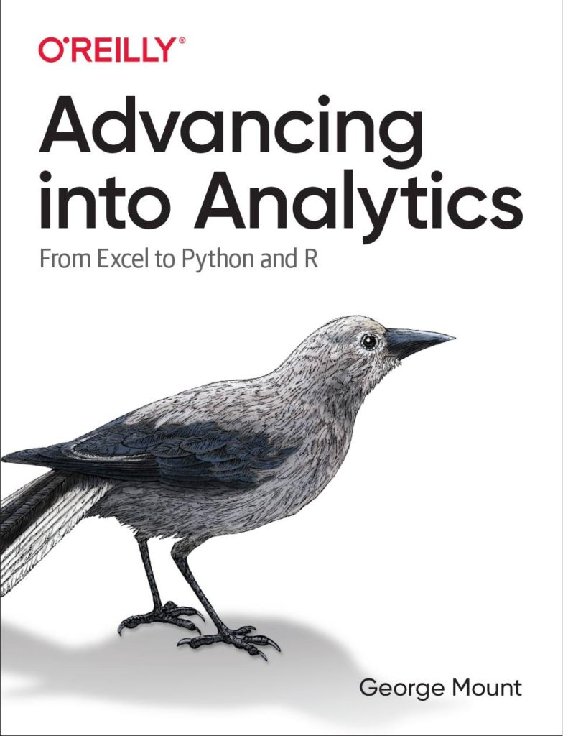



Hi, I’m George

Slide 3

Objectives for this session
Understanding the importance of sample size
Checking for statistical significance in A/B testing
Getting started with correlation & regression

Slide 4
Download the files:
https://swiy.co/FW6U
Feel free to share to latecomers
Downloads & recording will move to Patreon after 48 hrs

Slide 5
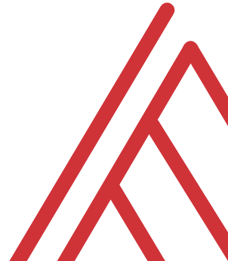
Terms of engagement
Feel free to share the download link with latecomers ☺
Participation is welcome via the chat/unmute
Demos work best with 365 for PC
Recording goes out later today, moves to Patreon after 2 days
I will do my best to answer your questions

Slide 6
Demo
Worksheets: array-references, array-functions
What is an array? Array reference? Array function?
What makes them static? Dynamic?

Slide 7
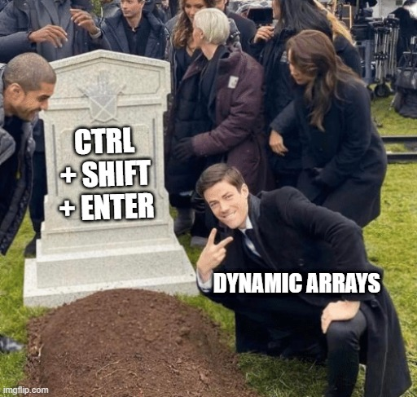
One formula, many cells
Function | What it does
UNIQUE() | Finds the unique items in an array
FILTER() | Filters an array
SORTBY() | Sorts an array
XLOOKUP() | Combines data from two sources
But wait, there’s more: https://support.microsoft.com/en-us/office/dynamic-array-formulas-and-spilled-array-behavior-205c6b06-03ba-4151-89a1-87a7eb36e531
Notes:
Don’t worry too much about the building blocks right now – I have this in here to gauge everyone’s interest

Slide 8
Demo
Worksheet: computers
Pull ad-hoc data quickly using dynamic arrays
Use table references to retrieve matching headers

Slide 9
Exercises
Worksheet: penguins
How many unique species are in this dataset? What are they?
Pull only the records from the Biscoe island.
Pull only the records that are from Biscoe island and that have a body mass greater than average for that group.
Sort the data by body mass ascending, species ascending, sex descending.

Slide 10

Joining data sources with XLOOKUP()

Slide 11

Say bye-bye to VLOOKUP()
XLOOKUP() can:
Easily look up to the left
Handle errors
Search the lookup table in multiple directions
Notes:
Don’t worry too much about the building blocks right now – I have this in here to gauge everyone’s interest

Slide 12
Demo
Worksheet: office-employees
Combine data from outside tables with XLOOKUP()
Look up data to the left
Handle lookup errors

Slide 13
Demo
Worksheet: superstore
Determine which orders were returned as a “Yes/No” column
Find the salesperson responsible for each region

Slide 14
Questions?

Slide 15
Find me
stringfestanalytics.com
Linkedin.com/in/gjmount
Twitter.com/gjmount

Slide 16
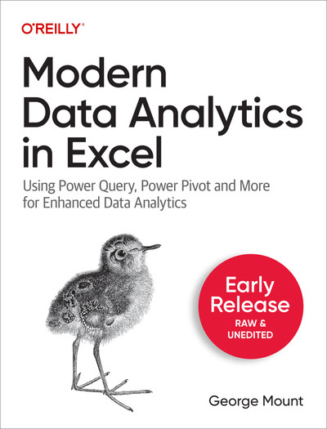
Modern Data Analytics in Excel
Available in early release: https://stringfestanalytics.com/maxl/

Slide 17



TAKE THE SURVEY
How did I do today? Testimonials or other data welcome.
https://social.stringfestanalytics.com/event-feedback
Notes:
I’m a data analyst give me data on how I did
Testimonials also VERY helpful.

Slide 18
FINAL QUESTIONS?
Thanks for joining!
A recap email with recording, survey and more will be coming…
The recording stays up for seven days.
I appreciate your reviews & referrals.
Notes:
Any questions on descriptive statistics?

Slide 19
Thank you

