Slide 1

Excel Analytics 2.0
George Mount
Founder, Stringfest Analytics

Slide 2
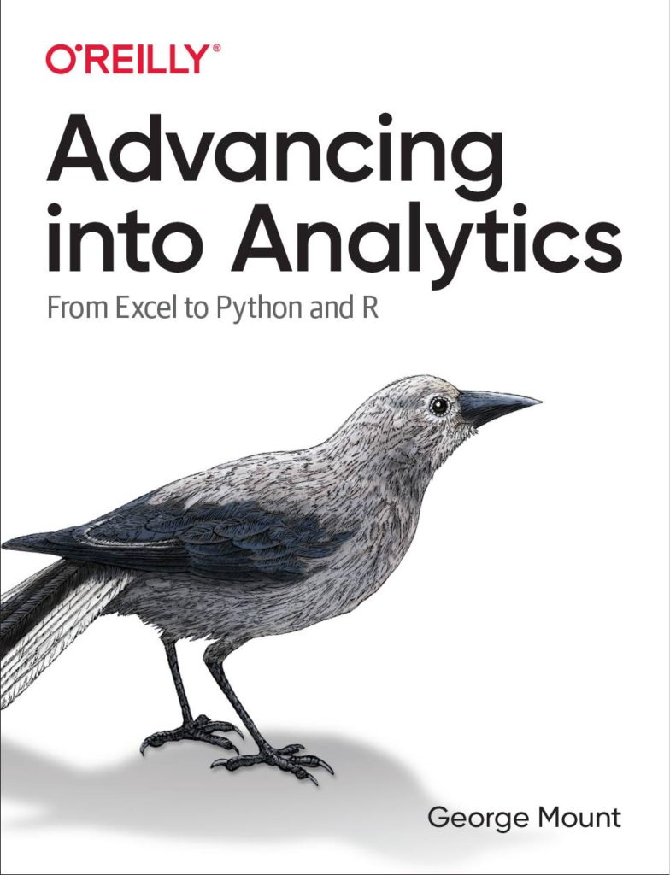



Hi, I’m George

Slide 3

Objectives for this session
Comfortably use formulas like SUMIFS and XLOOKUP
Design and audit complex, nested formulas
Look up data in an instant

Slide 4
Sections
Basics of formulas and functions
Formula design & audit
Conditional logic & formulas
Dynamic arrays
LET(), LAMBDA() and the future of Excel

Slide 5
Following along
Each section is a workbook
Solutions in separate workbooks
Follow along with demo notes

Slide 6
Ctrl + T is your superpower! Intro to Excel tables

Slide 7

1. Basics of formulas and functions

Slide 8

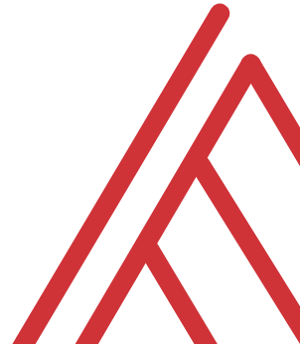

Questions?

Slide 9
Exercises
T/F: Every Excel formula/function must begin with an = sign.
Are the following formulas or functions:
ABS(-10)
B4<B3
SQRT(10*2)
What is the A4 in the following function called?
FORMULATEXT(A4)
Notes:
False!
Function, Formula, Function
Argument

Slide 10
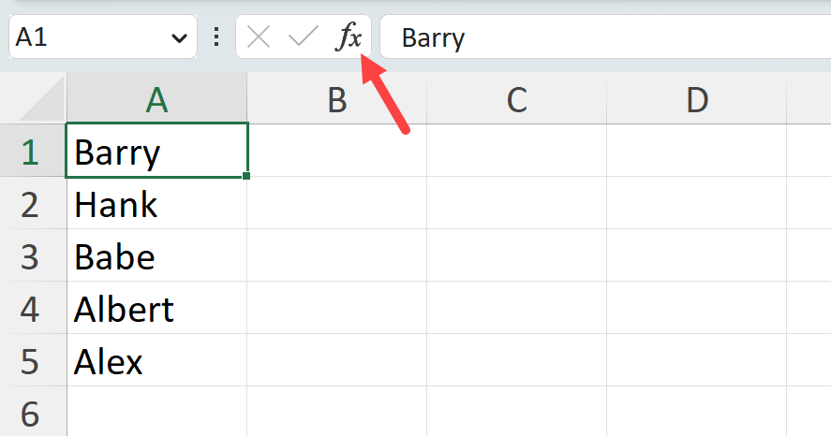
Demo
Worksheet: count-v-counta
Using the Insert Function menu:
Find the results of COUNT() vs COUNTA() for cells A1-A6

Slide 11
Exercise
Learn & teach a new function!
Peruse the Insert Function menu to find an unfamiliar function
Test, evaluate & demonstrate it to class
There are over 450 functions in Excel

Slide 12
Questions?

Slide 13
2. Named ranges and tables

Slide 14
THANK YOU

