Slide 1

Notes:
https://swiy.co/musopen

Slide 2

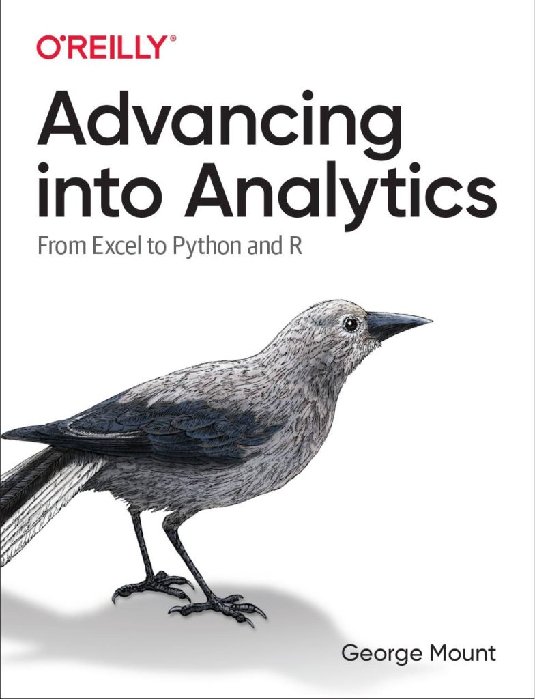
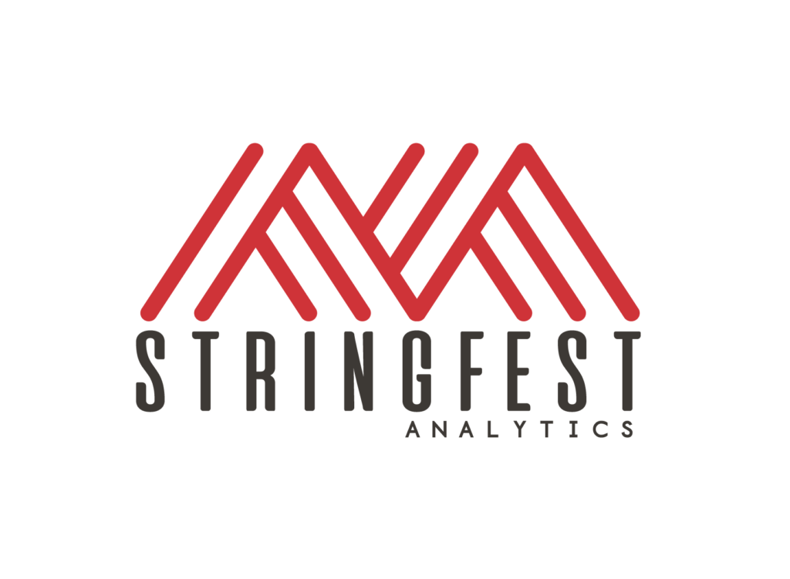

HI, I’M GEORGE
Analytics in Modern Excel

Slide 3
OBJECTIVES
Make first impressions with the data using Power Query profiling
Conduct ad-hoc analysis with PivotTables
Pulling data fast with dynamic arrays
Analytics in Modern Excel

Slide 4
FOLLOWING ALONG
Download resources:
https://swiy.co/amx
Analytics in Modern Excel
Notes:
https://swiy.co/amx

Slide 5
TERMS OF ENGAGEMENT
Feel free to share the download link with latecomers ☺
Participation is welcome via the chat (or please ask to be unmuted!)
Demos work best with 365 on Windows, I cannot guarantee other systems
Recording goes out later today and is up for one week
Analytics in Modern Excel

Slide 6
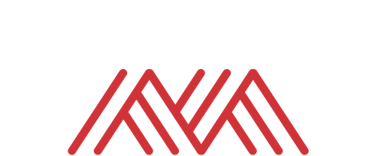
QUESTIONS?

Slide 7
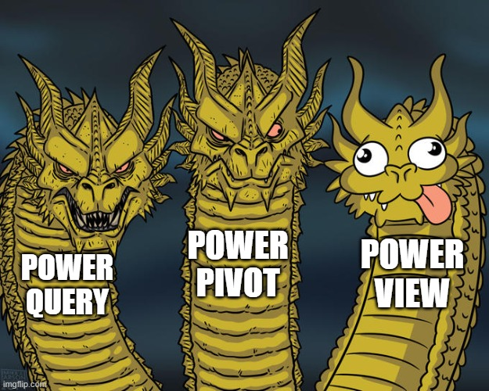
WHAT IS MODERN EXCEL?
Historically:
Power Query
Power Pivot
Power View
We’ll substitute
Dynamic arrays
Notes:
There’s also let and lambda

Slide 8
Data prep & profiling with Power Query
File: computers.xlsx
Profiling the data for potential issues
Adding an index column for slicing and dicing
Notes:
Now you are hyped up Power Query, I think you are going to love it and it will be hard for you to remember the days when you didn’t have it. So let’s think about what we would do without Power Query.

Slide 9
Ad-hoc analyzing with PivotCharts
Continue computers.xlsx
Compare distribution of computer price by category
We want to reshape without aggregating!
Notes:
Now you are hyped up Power Query, I think you are going to love it and it will be hard for you to remember the days when you didn’t have it. So let’s think about what we would do without Power Query.

Slide 10
Pulling data fast with dynamic arrays
Continue computers.xlsx
Sort, filter and de-duplicate right from the spreadsheet
Notes:
Now you are hyped up Power Query, I think you are going to love it and it will be hard for you to remember the days when you didn’t have it. So let’s think about what we would do without Power Query.

Slide 11
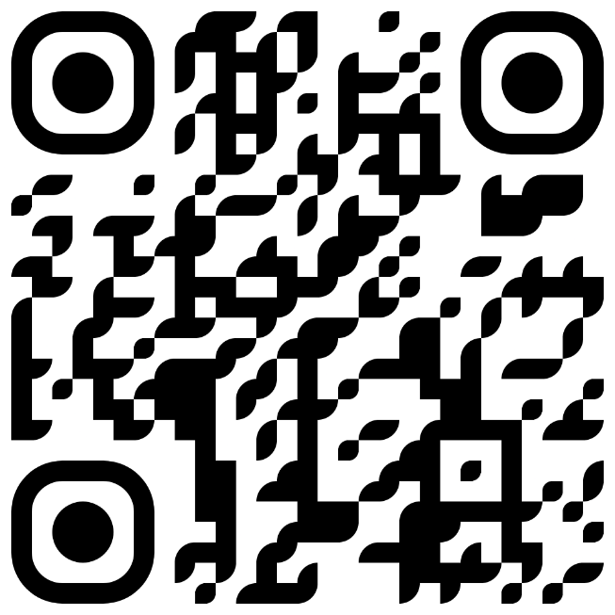
Advancing into Analytics
Learn more and where to get it: stringfestanalytics.com/book
Human Centered Design • MDLS 2020
Notes:
If you are looking to individually take a Power Query class I have a surprise here at the end…

Slide 12
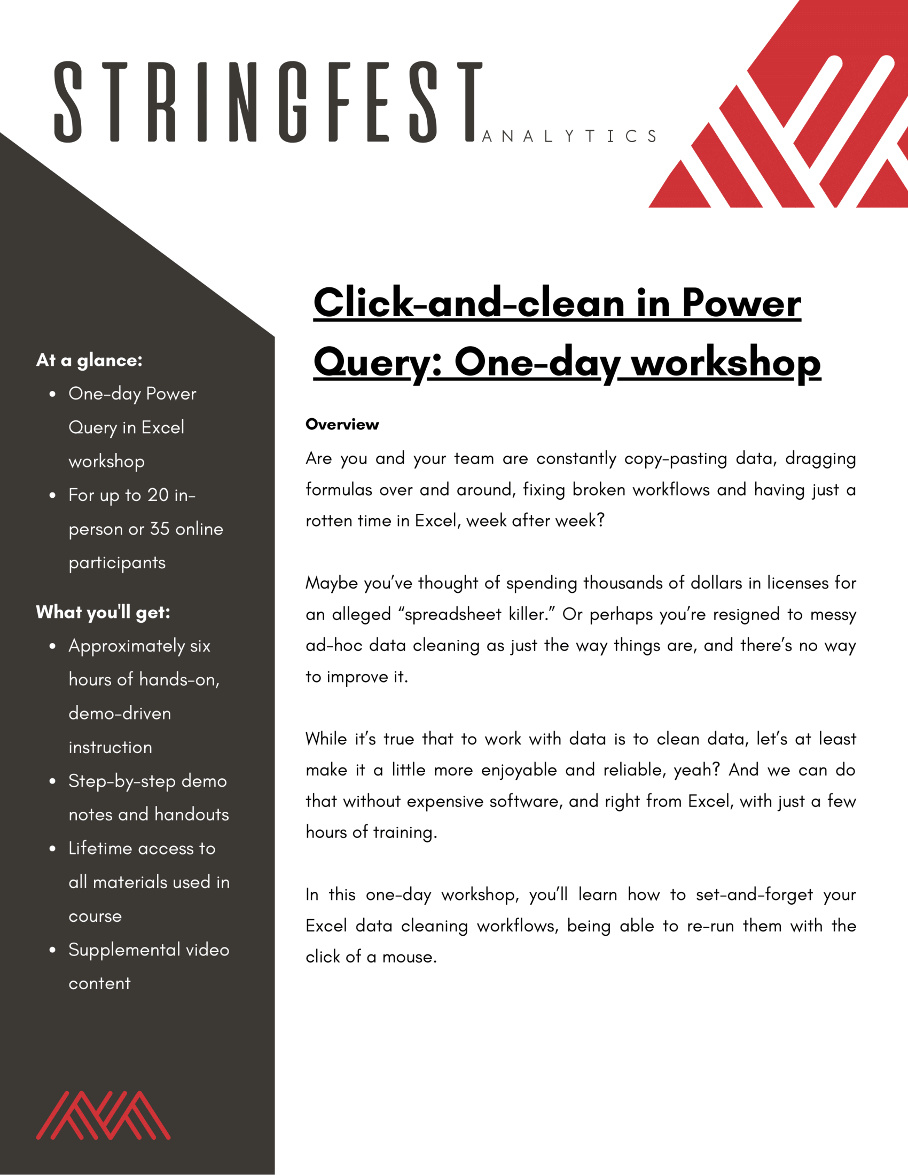
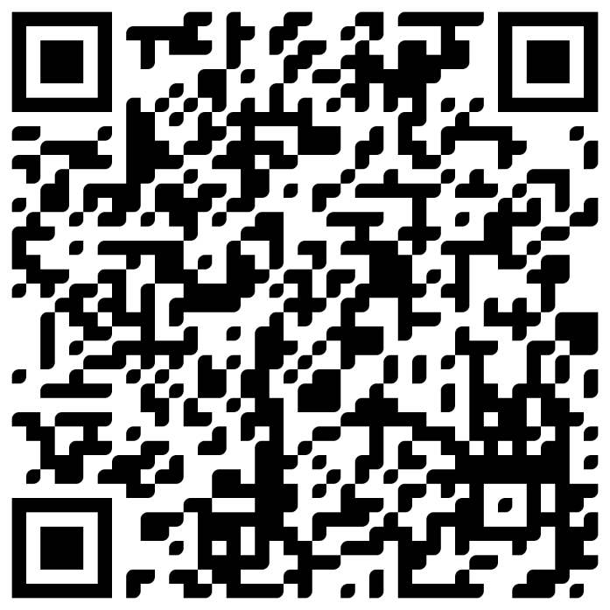
Power Query corporate training
Learn more and connect at https://social.stringfestanalytics.com/pq-workshops
Human Centered Design • MDLS 2020
Notes:
If you are looking to individually take a Power Query class I have a surprise here at the end…

Slide 13
REFERRAL PROGRAM
Refer me to a training client & get
Two 45-minute coaching sessions
Signed copy of Advancing into Analytics
Free access to my on-demand Power Query training course
Get in touch: https://stringfestanalytics.com/contact/
Notes:
There’s also let and lambda

Slide 14

THANK YOU
LINKEDIN
linkedin.com/in/gjmount
EMAIL ADDRESS
george@stringfestanalytics.com
WEBSITE
stringfestanalytics.com
TWITTER
twitter.com/gjmount
Notes:
Thanks for coming! Feel free to contact me anytime, find me on LinkedIn, I also write frequently on this stuff so check out my website too.

Slide 15
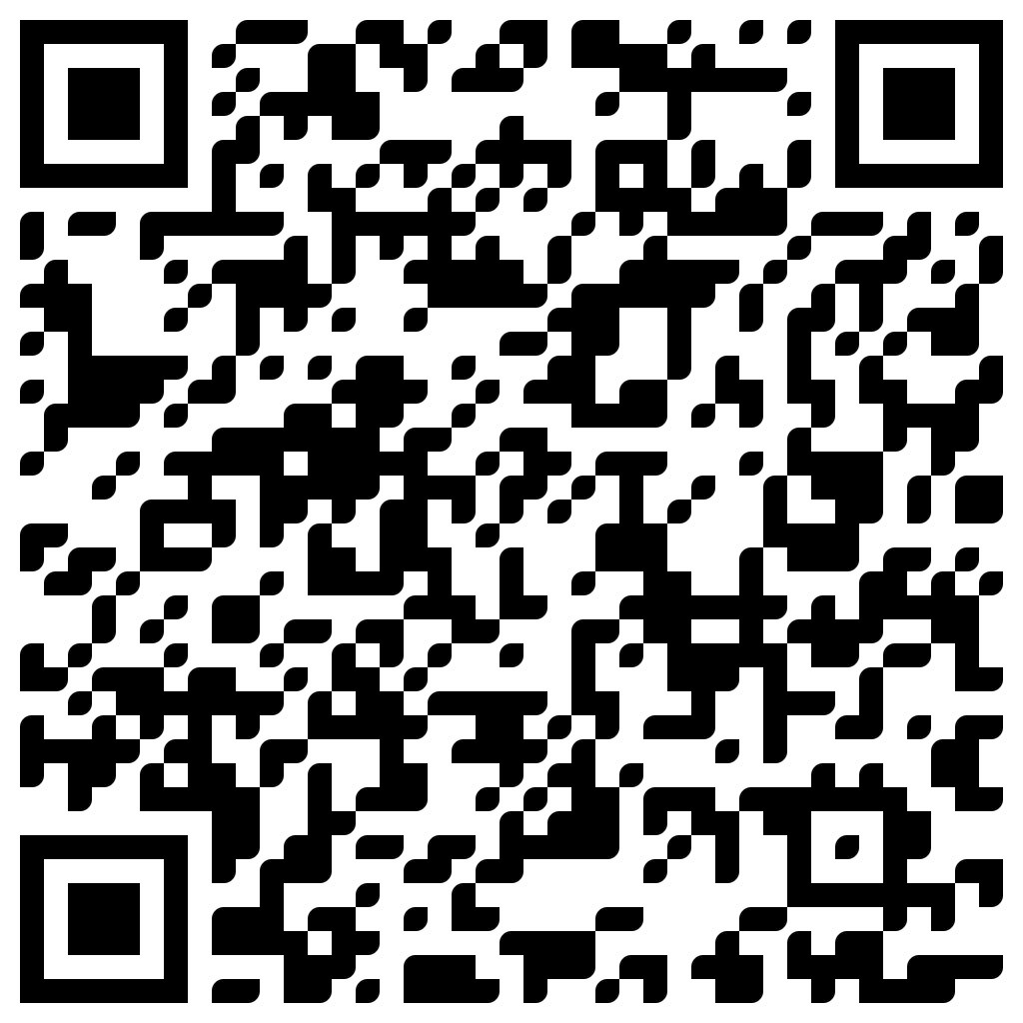
TAKE THE SURVEY
How did I do today? Testimonials or other data welcome!
https://social.stringfestanalytics.com/event-feedback
Notes:
I’m a data analyst give me data on how I did
Testimonials also VERY helpful.

Slide 16
FINAL QUESTIONS?
Thanks for joining!
A recap email with recording, survey and more will be coming…
The recording stays up for seven days.
I appreciate your reviews & referrals.
Notes:
Any questions on descriptive statistics?

