Slide 1
✓ You WILL rock your capstone

Slide 2

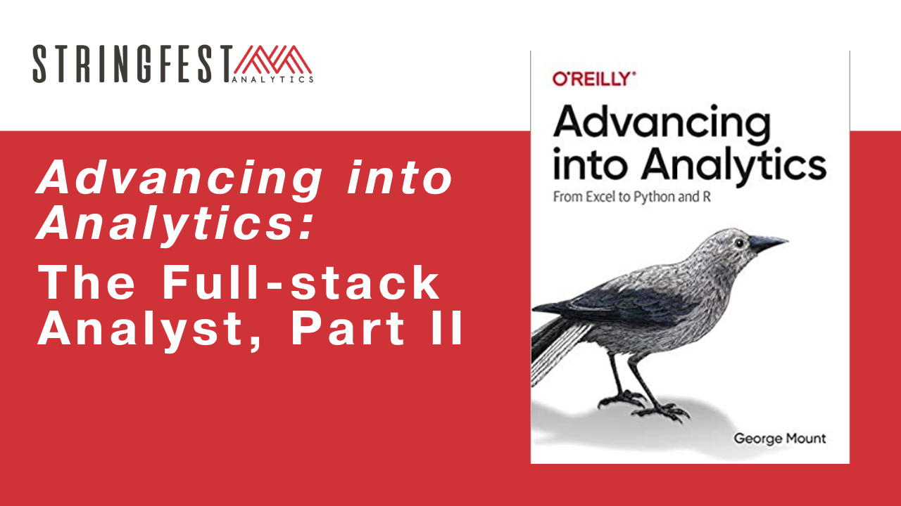
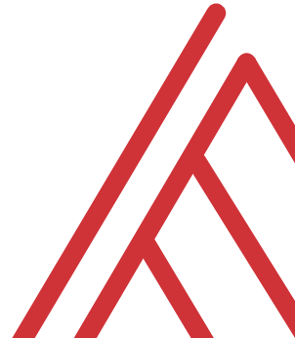
Advancing into Analytics: Analytics Systems

Slide 3
Learning objectives
Presentations
Python functions for Excel
Python and R for Power BI
Departure

Slide 4
Presentations

Slide 5
Ground rules
Speakers:
Provide reproducible repo
Stay on time
Stay on topic
Listeners:
Cede the floor
Ask relevant questions
Don’t tune out

Slide 6
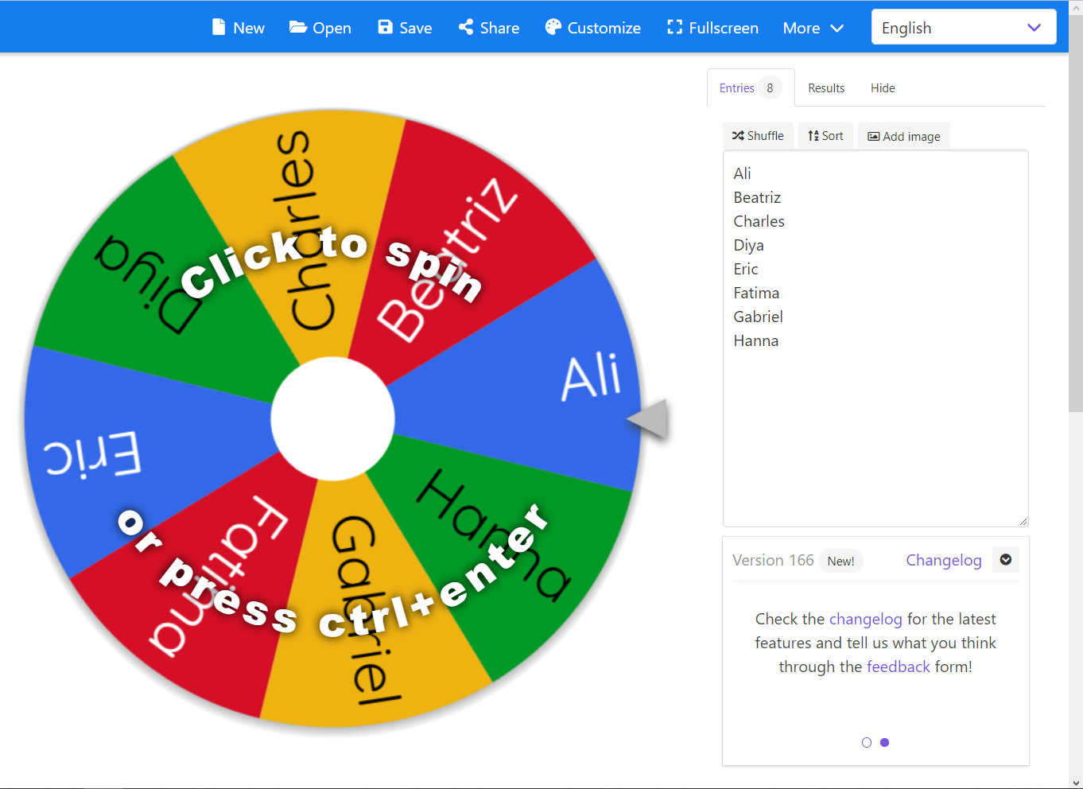
Ready?
https://wheelofnames.com

Slide 7
Python for Excel

Slide 8
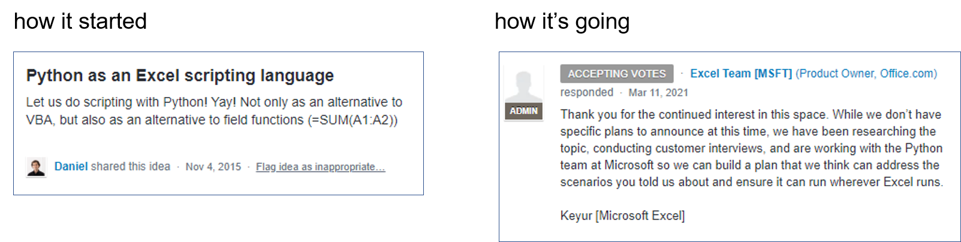
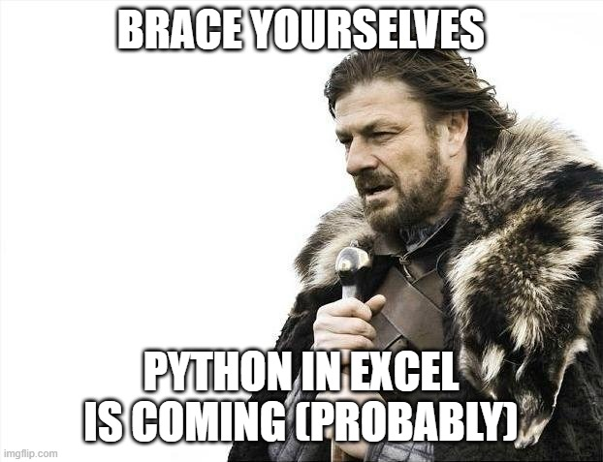
It’s coming, probably…

Slide 9

Why Python in Excel?
Versatility
Package management
Engineering

Slide 10

Demos
Python-Powered Excel with pandas
Good for getting data in and out, analyzing data
But what is missing?
File: pandas-excel.ipynb
Notes:
OK so now you will see R’s equivalent to some of those features you saw with Python. I think that for different reasons Python seems to be taking the lead on Excel automation, but R has some pretty robust features and in some ways are richer than Python’s.

Slide 11
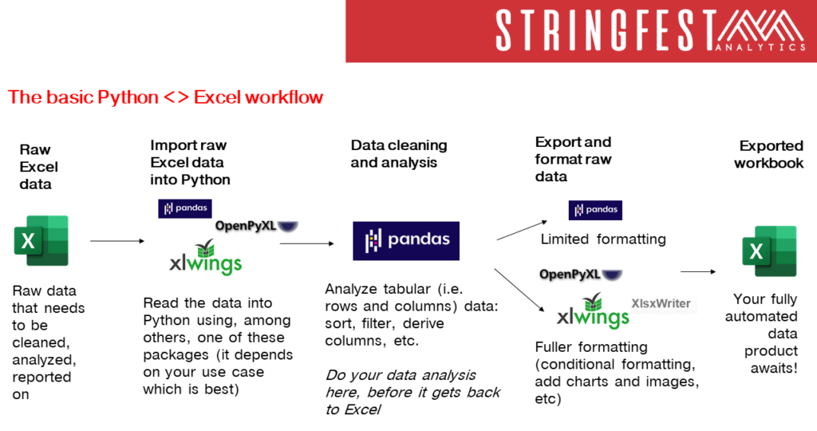

Slide 12
Demos
Python-Powered Excel with xlxswriter
Full-on automation
But what is missing? (It’s in the name)
File: xlsxwriter-excel.ipynb
Notes:
OK so now you will see R’s equivalent to some of those features you saw with Python. I think that for different reasons Python seems to be taking the lead on Excel automation, but R has some pretty robust features and in some ways are richer than Python’s.

Slide 13
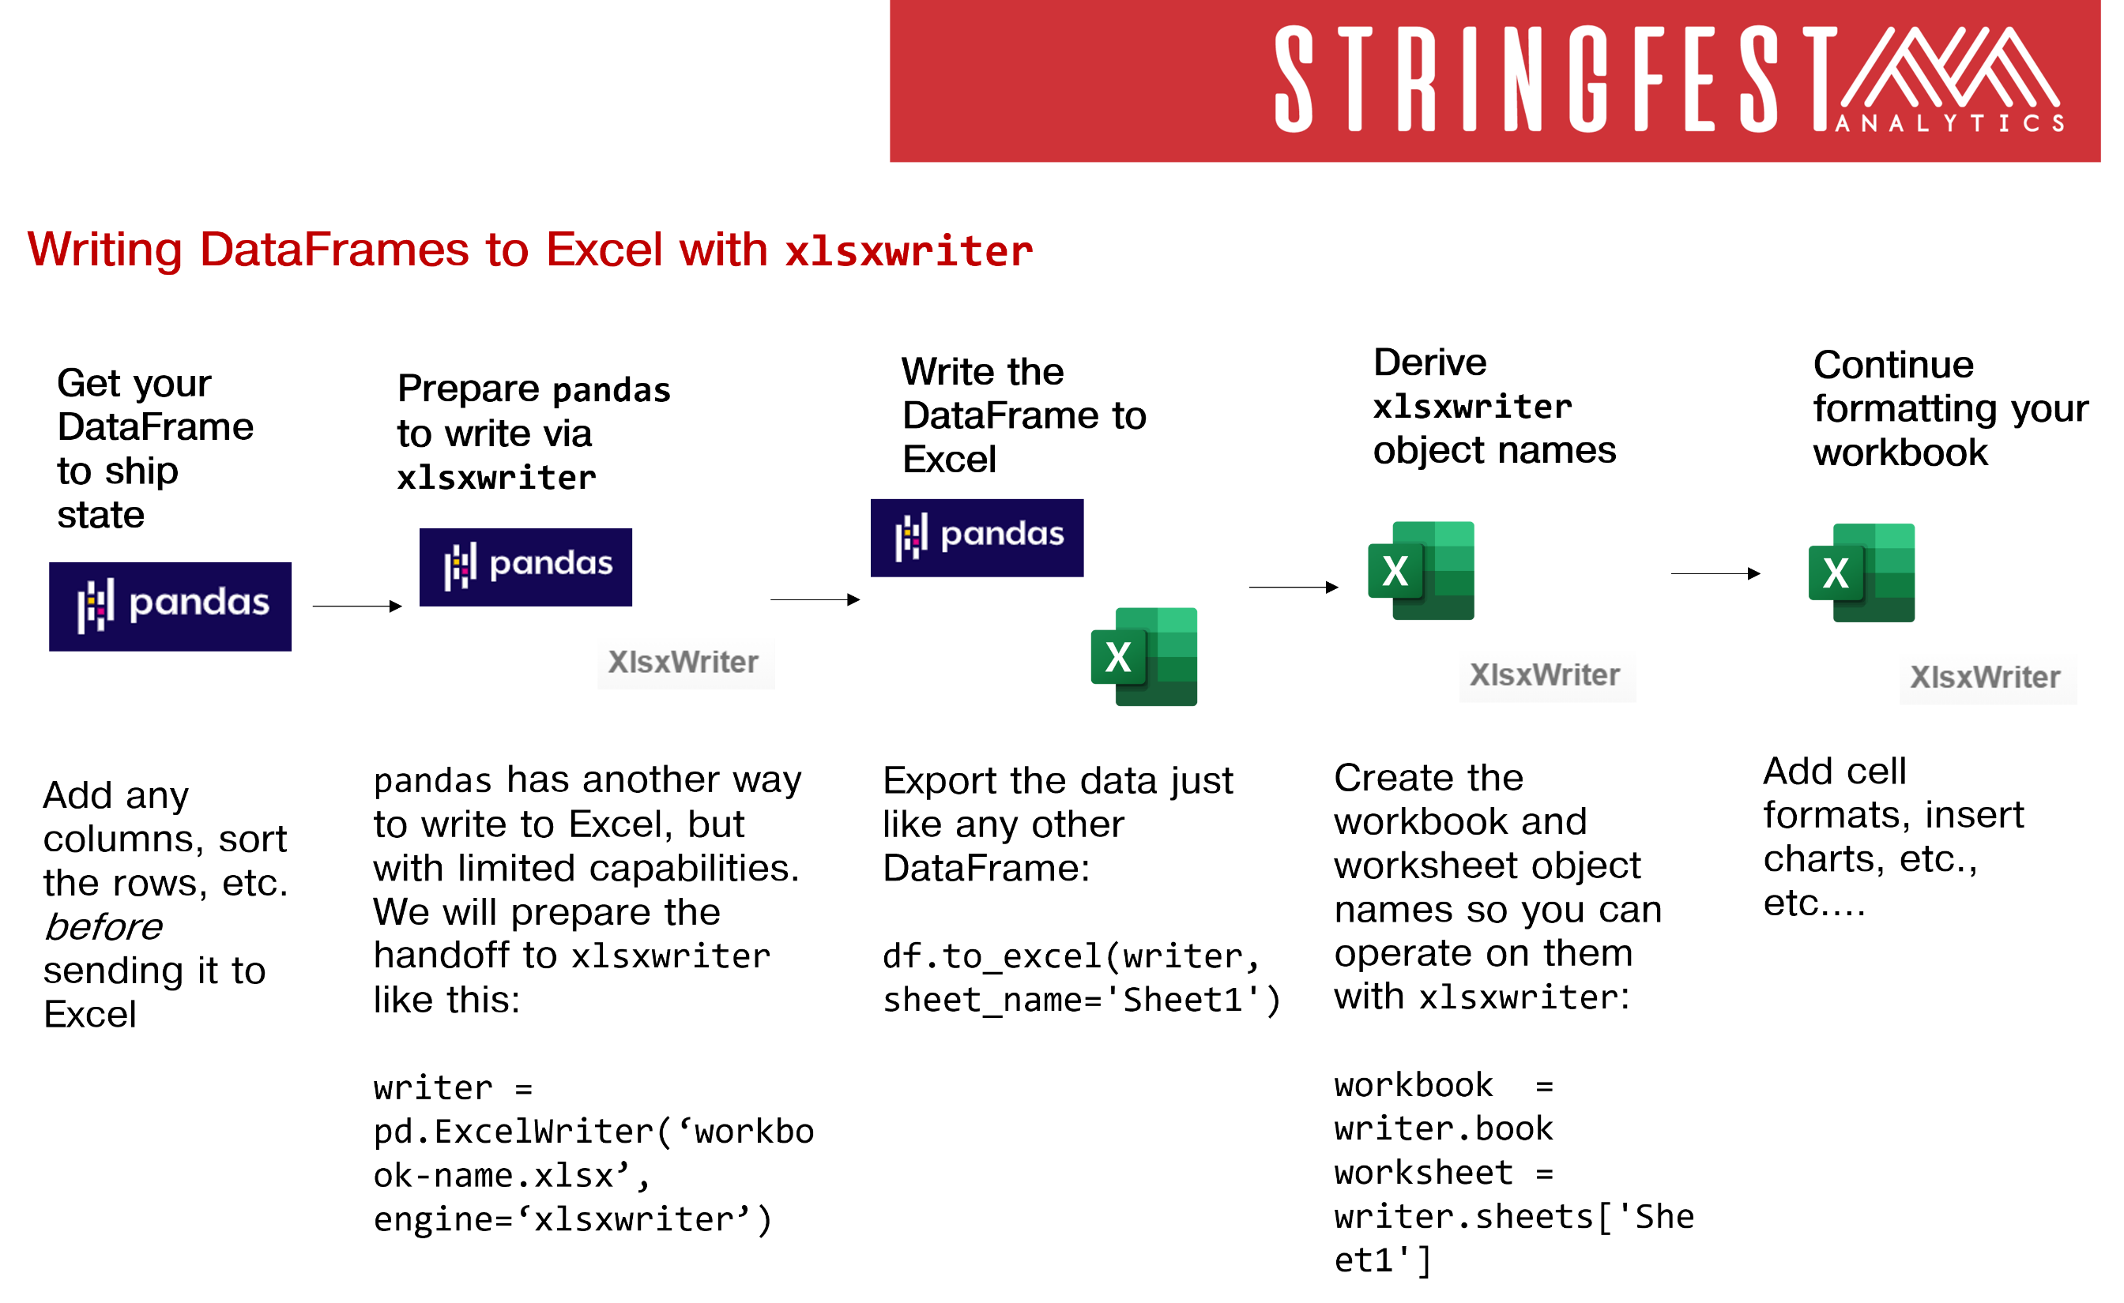

Slide 14
Questions?

Slide 15
Python functions for Excel with xlwings

Slide 16
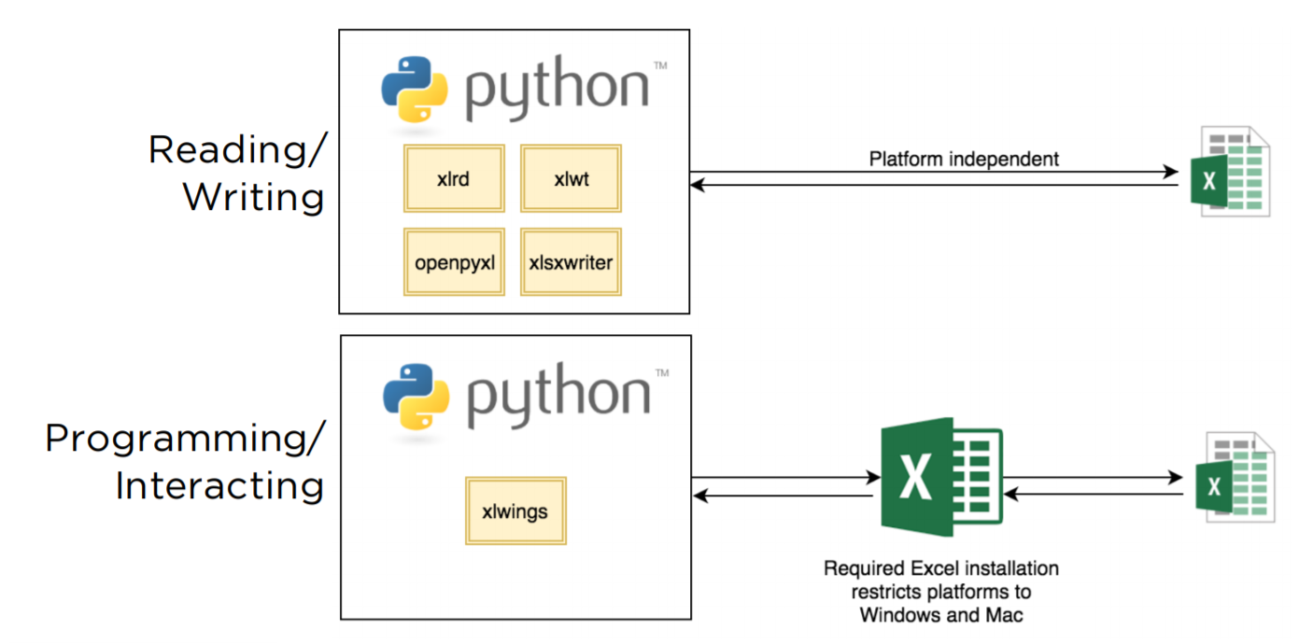
Xl is given wings
Automate Excel reports
Call Python from Excel
Expose workbook as API
Write user-defined functions

Slide 17
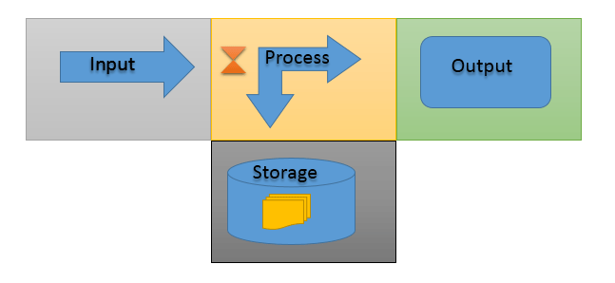
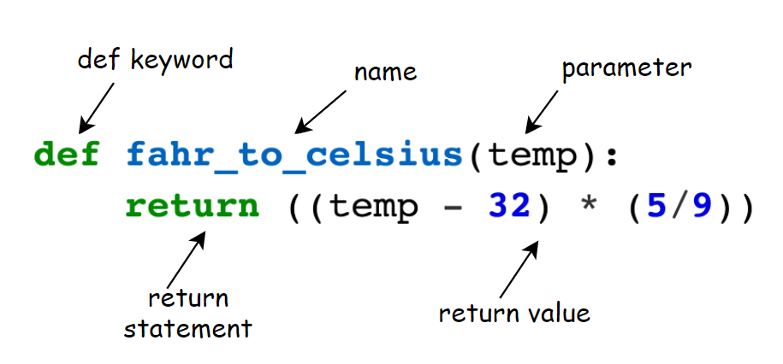
You know functions
https://www.computernetworkingnotes.com/networking-tutorials/basic-functions-of-a-computer-explained.html
https://bham-carpentries.github.io/2018-12-17-bham_python-novice-inflammation/09-func/index.html

Slide 18
Demo
Python functions in Excel – your new macro workbook
From a blank workbook:
Set up xlwings add-in
Define and test Python functions in Excel
Demo notes: docs/xlwings-udfs.docx
Notes:
OK so what we are going to do here is go back to your session or open a new one. Go to the diamonds.r dataset. And let’s actually conduct the analysis that was hinted at earlier.

Slide 19
Next steps

Slide 20
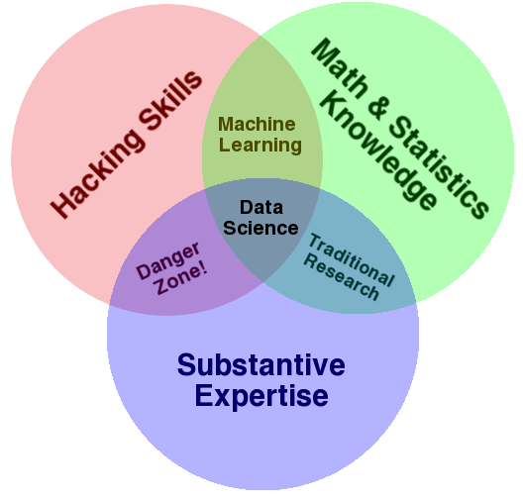
Go forth and data as you please
http://drewconway.com/zia/2013/3/26/the-data-science-venn-diagram

Slide 21
Questions?

Slide 22
THANK YOU
george@stringfestanalytics.com
linkedin.com/in/gjmount
stringfestanalytics.com/contact

Slide 23
Define your own functions…
ABS(number)
SUM(number1,[number2],...)
VLOOKUP (lookup_value, table_array, col_index_num, [range_lookup])
INDEX(array, row_num, [column_num])

Slide 24
Define your own functions…
SUM(number1,[number2],...)
SUM(5, 4, 2)
number1 + number2 + …
5 + 4 + 2
Output
11

Slide 25
Demos
Python-Powered Excel with xlwings
Excel as a Python interface
Create Python UDFs in Excel
Setup needed: docs/xlwings-udfs.docx
Notes:
OK so now you will see R’s equivalent to some of those features you saw with Python. I think that for different reasons Python seems to be taking the lead on Excel automation, but R has some pretty robust features and in some ways are richer than Python’s.

